Slide 1
Principles of Communications: An Introduction
Yanmin Zhu
School of Computers

Slide 2
Physical Layer
Provides the means to transmit bits from sender to receiver,
Defines the mechanical, electrical, and timing interfaces to the network
Involves
  Transmission media ( in various access networks)
  How do we use signals for transferring information, i.e., modulation techniques
Notes:
In this chapter we will look at the lowest layer depicted in the hierarchy of hybrid model introduced last class.

Slide 3

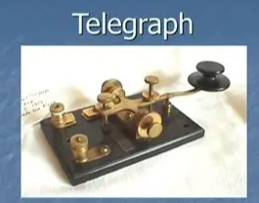
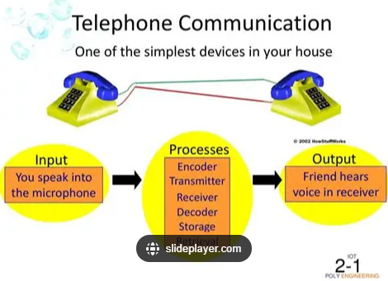

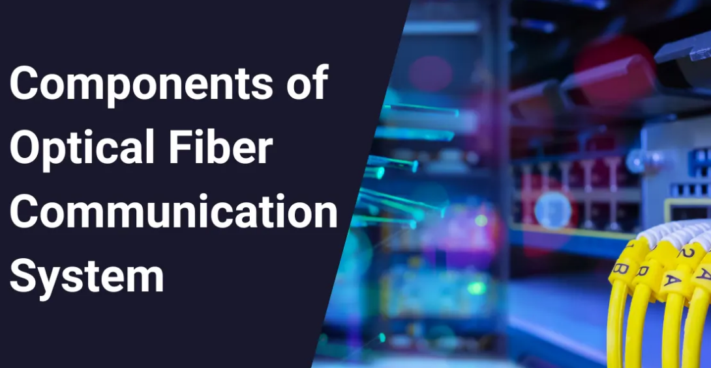

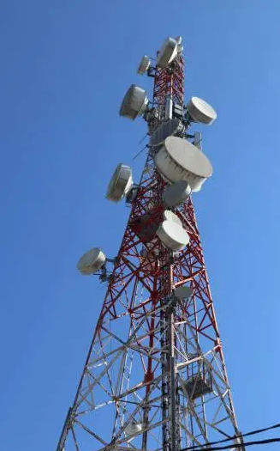

Examples of communications technology
烽火
Telegraph
Telephone
Cell phone
Fiber Cable
Twisted Pair
FM/AM
WiFi

Slide 4
How is the information transmitted
over various kinds of media?

Slide 5
Key concepts and terms
Channel
Baseband, passband
Bandwidth
Modulation, demodulation
Analog signals, digital signals
Analog communication, digital communication
FM, AM, BPSK, QAM128, Manchester coding
Capacity of a channel

Slide 6
Objectives
Basic components of a communication system
Key concepts of communications
Signals and channels (systems)
Key modulation techniques of analog/digital communications
Capacity of a channel

Slide 7
Roadmap
1. Background
2. Signals and channels
3. Analog passband modulations
4. From analog signals to digital signals
5. Digital baseband transmissions
6. Digital passband modulations
7. Capacity of channels

Slide 8
Roadmap
1. Background
2. Signals and channels
3. Analog passband modulations
4. From analog signals to digital signals
5. Digital baseband transmissions
6. Digital passband modulations
7. Capacity of channels

Slide 9


Question
What basic ways do we have for sending information?
Communications: transfer of information

Slide 10
Basic Idea
Information encoding
Information decoding
signals
The sender sends signals, the receiver receive signals
Signals carry information
Notes:
Examples of signals: gestures, signs, symbols, or a language

Slide 11
Questions
Information encoding
Information decoding
signals
Objectives for communications?
What are the major challenges?
What ideas do we have for addressing the challenges?

Slide 12
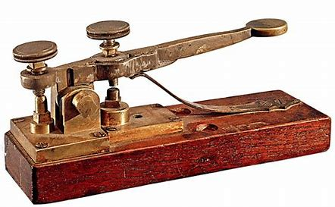
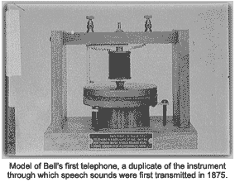
Background
What is communications?
  It is about transfer of information
  It is of significant importance
Information, Message
  Messages (data) convey information, they are conveyed by signals, which can be analog or digital
  Analog signals: voice
  Digital signals: text, image
Samuel Morse, a professor at New York University, developed a form of the telegraph in the 1837 that used an electric current to move an electromagnet attached to a marker that left a written code on a piece of paper. The recipient could then decipher the code.
On March 10th, 1876, when Alexander Graham Bell spoke into the transmitting instrument

Slide 13
Components of a Communication System
noise
source
channel
destination
Information I
Information I’

Slide 14
Setup
over a link directly connecting two devices
Not over multiple links

Slide 15
How do we measure performance of communications?
Notes:
(1) Attenna size lamda/4, (2) multiplexing, (3) spectrum licence, (4) anti-interference.

Slide 16
Performance metrics
Transmission rate: The transmission rate is the volume of data transmitted over a transmission channel within a specified duration of time
Utilization of bandwidth: the transmission rate per bandwidth (b/hz)
Error rate: the percentage of correctly received bits

Slide 17
Roadmap
1. Background
2. Signals and channels
3. Analog passband modulations
4. From analog signals to digital signals
5. Digital baseband transmissions
6. Digital passband modulations
7. Capacity of channels

Slide 18
Signals and Systems
noise
Systems:
Transforming Signals
Signals
source
channel
destination
The study of information transmission systems is inherently concerned with the transmission of signals through systems

Slide 19
There are various types of communication systems.
How do we classify them?
Notes:
(1) Attenna size lamda/4, (2) multiplexing, (3) spectrum licence, (4) anti-interference.

Slide 20
The most important components: signals and channels.
How do we model them, then analyze them?
Why do we need models and analytical methods?
Notes:
生产大炮，要了解物体运动规律，气动特性，才能生产精准的大炮
通信中，我们最关心的事情是什么？ 信号经过信道后，发生改变。为什么发生改变，如何改变的？什么因素最重要？预测经过特定系统后的信号！

Slide 21
Signal and System Analysis
Because of the sophistication of modern communication systems, a great deal of analysis occurs before actual building of the desired system.
Dual time-frequency viewpoint for signal representation, and models for systems
  Frequency-domain representations for signals via the complex exponential Fourier series and the Fourier transform
  System models and techniques for analyzing the effects of such systems on signals
Signal properties: frequency, power spectrum distribution
Channel response: how a channel transforms signals
Notes:
在通信中，“Channel response”通常被翻译为“信道响应”。这是一个描述信道如何影响通过其传输的信号的术语。信道响应可以包括各种因素，如衰减（信号在传输过程中的弱化）、多径效应（信号通过多个路径到达接收器，造成干扰）和噪声等。
信道响应是无线通信系统设计和优化的重要考虑因素，因为它直接影响到信号的质量和可靠性。通过了解和建模信道响应，工程师可以设计出更有效的通信系统，以减少干扰和提高信号质量。

Slide 22
What is a Signal?
Conveying an information by some means, such as gestures, sounds, actions, etc., can be termed as signaling
A signal can be a source of energy which transmits some information
  An electrical impulse or an electromagnetic wave which travels a distance to convey a message, can be termed as a signal in communication systems.
In mathematical terms, a signal is described as a function of time

Slide 23
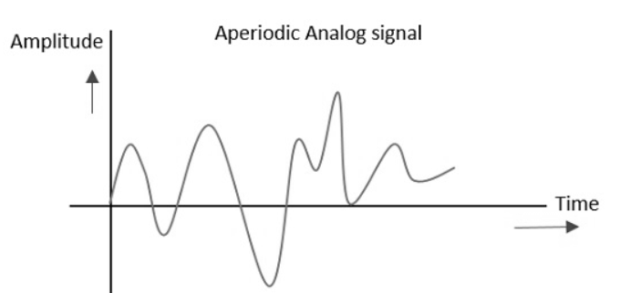
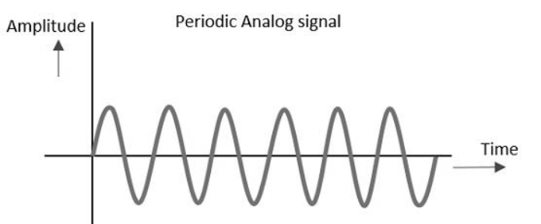
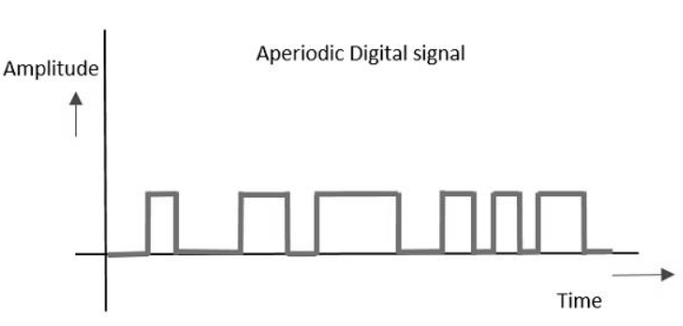
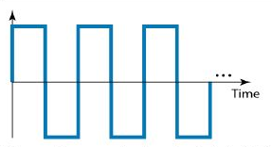
Classification of Signals
Signals
Analog Signals
Digital Signals
Aperiodic
Periodic
Aperiodic
Periodic

Slide 24
Classification of Signals
Signals
Deterministic Signals
Random Signals
The receiver knows in advance the signal to receive
(ideal)
The receiver does not know in advance the signal to receive
(realistic)

Slide 25
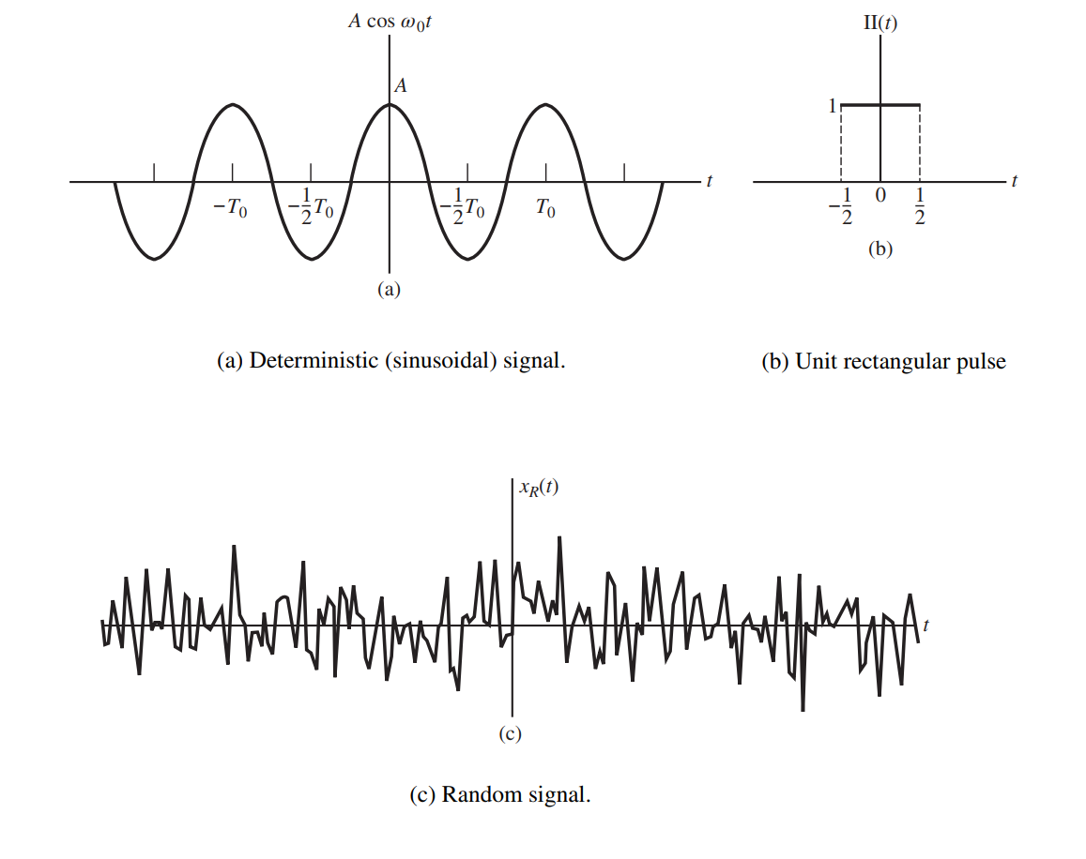
Examples

Slide 26
Modelling a signal in the time domain, is it good enough for analysis?
Dividing combined signals, manipulating signals, predicting signals through a channel?
Notes:
生产大炮，要了解物体运动规律，气动特性，才能生产精准的大炮
通信中，我们最关心的事情是什么？ 信号经过信道后，发生改变。为什么发生改变，如何改变的？什么因素最重要？预测经过特定系统后的信号！

Slide 27
Then how?
No
Notes:
生产大炮，要了解物体运动规律，气动特性，才能生产精准的大炮
通信中，我们最关心的事情是什么？ 信号经过信道后，发生改变。为什么发生改变，如何改变的？什么因素最重要？预测经过特定系统后的信号！

Slide 28
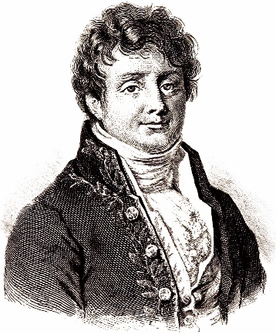
Tool: Fourier Transform
It is important that we know the frequency content of a signal
The mathematical tool that relates the frequency-domain description of the signal to its time-domain description is the Fourier transform.
Two Types of Fourier Analysis
Continuous Fourier transform:
  works with continuous functions in both the time and frequency domains.
Discrete Fourier transform
  works with discrete data in both the time and frequency domains
Joseph Fourier, 1678

Slide 29
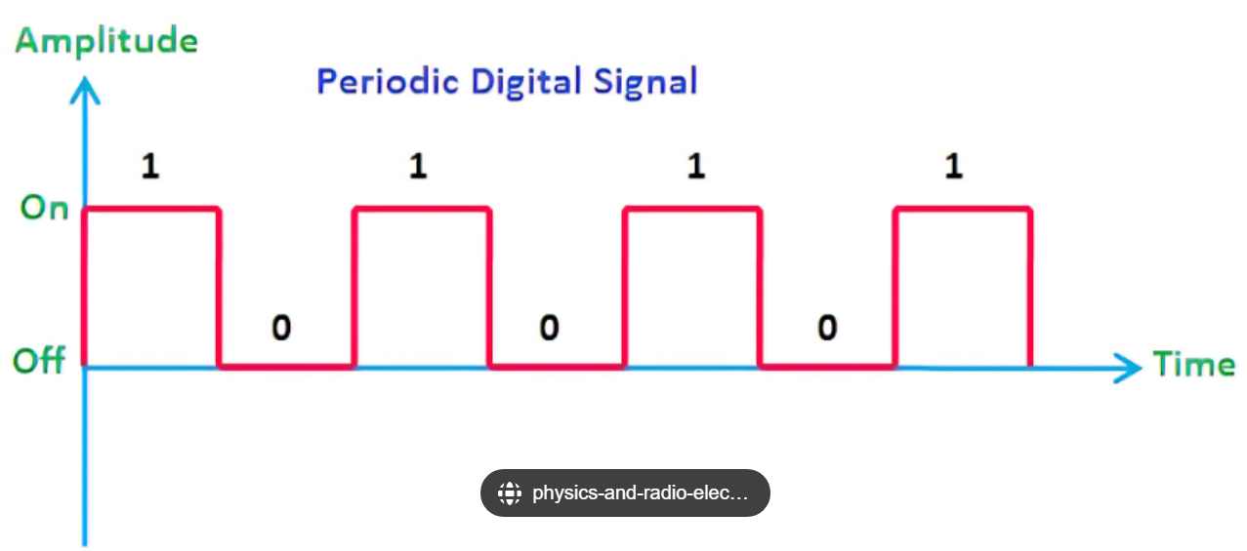
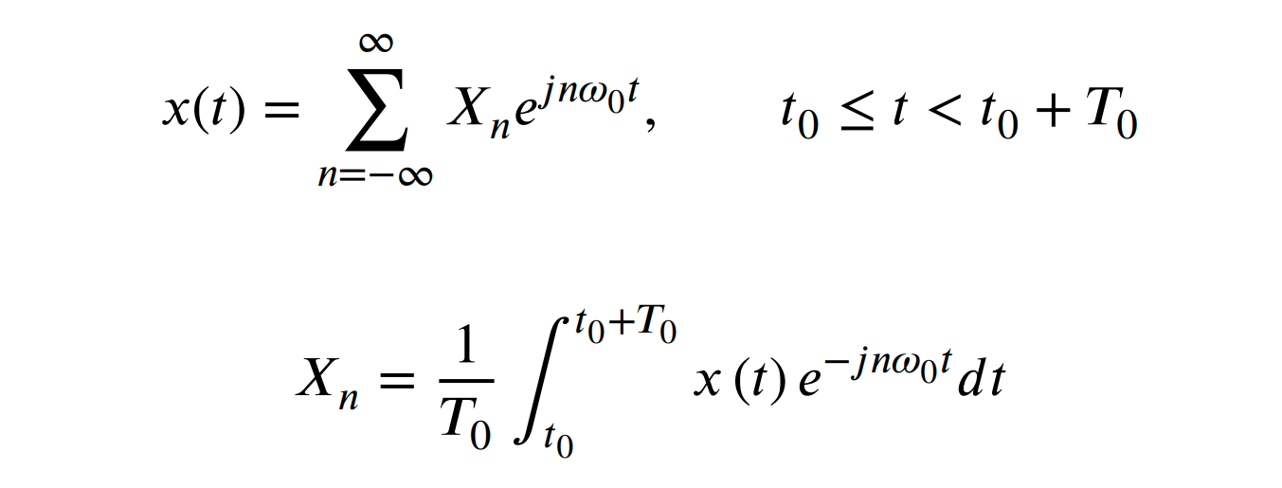
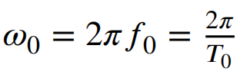

Periodic Signals: Fourier Series
𝑥(𝑡) is periodic with period 𝑇₀
T₀
Euler equation:

Slide 30
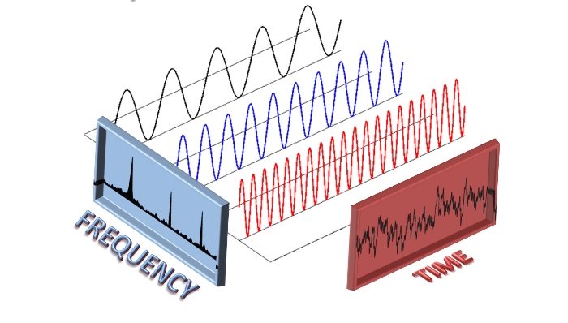
Time and Fruquency Domains
f₀
2f₀
3f₀

Slide 31
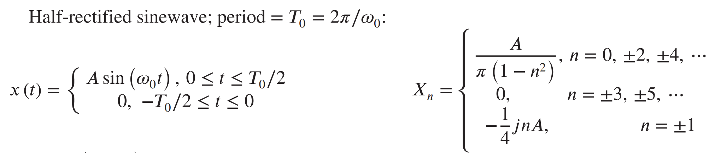
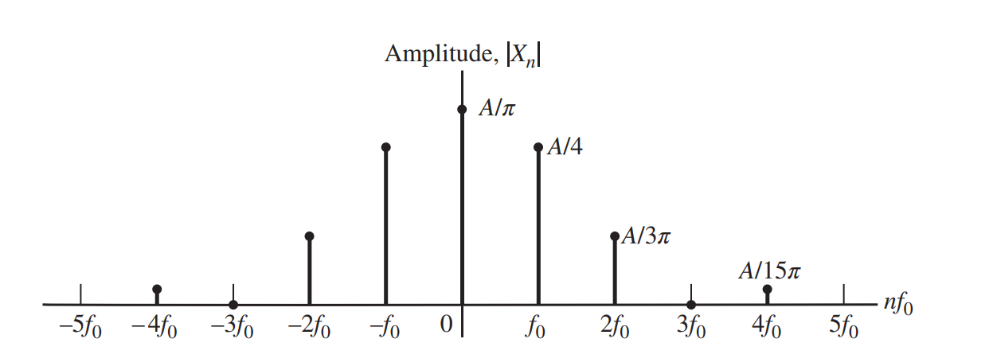
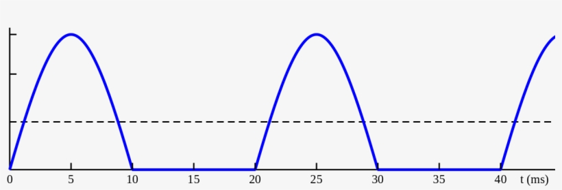
Example: Periodic Signals
Time-domain representation
Frequency-domain representation

Slide 32
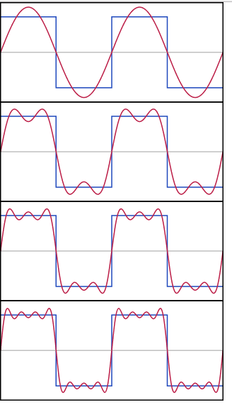
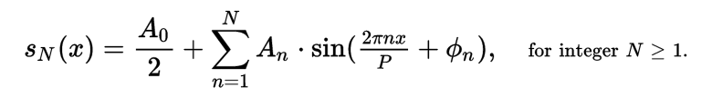
Example
N=1
N=2
N=3
Adding more components
N=4

Slide 33
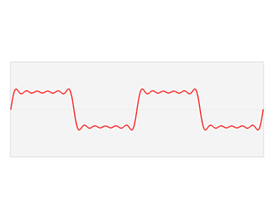
Animation 1

Slide 34
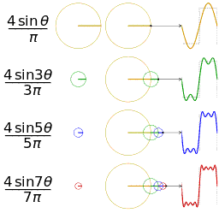
Animation 2

Slide 35
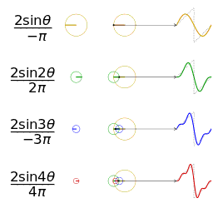
Animation 3

Slide 36
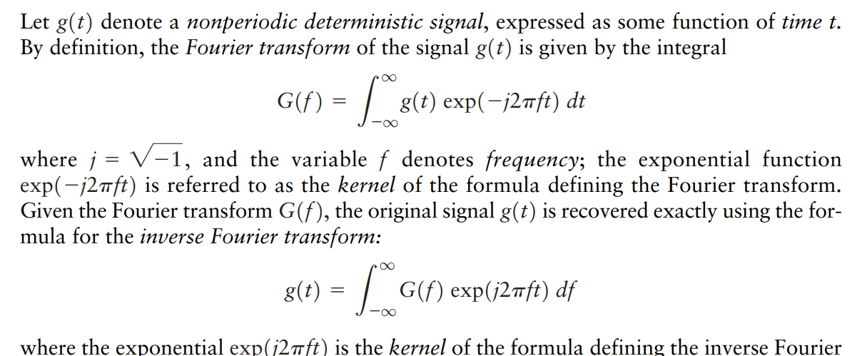
Fourier Transform: Nonperiodic signals

Slide 37
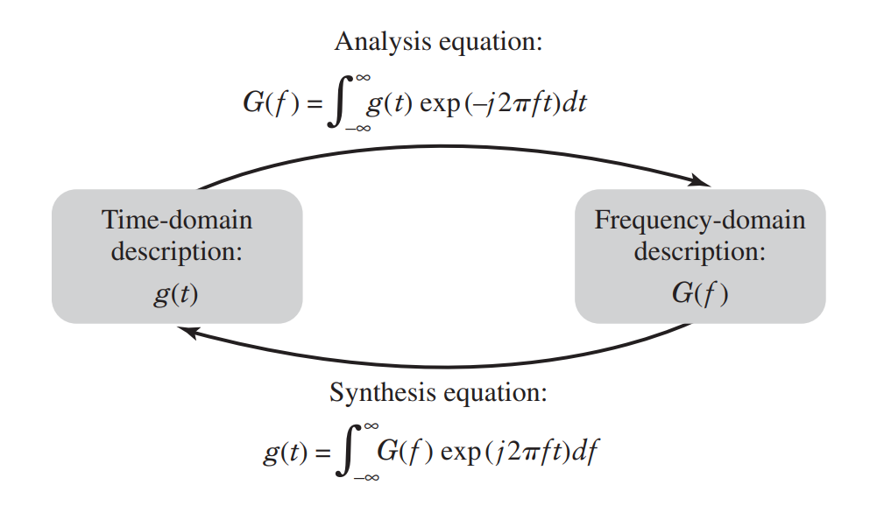
Synthesis equation

Slide 38
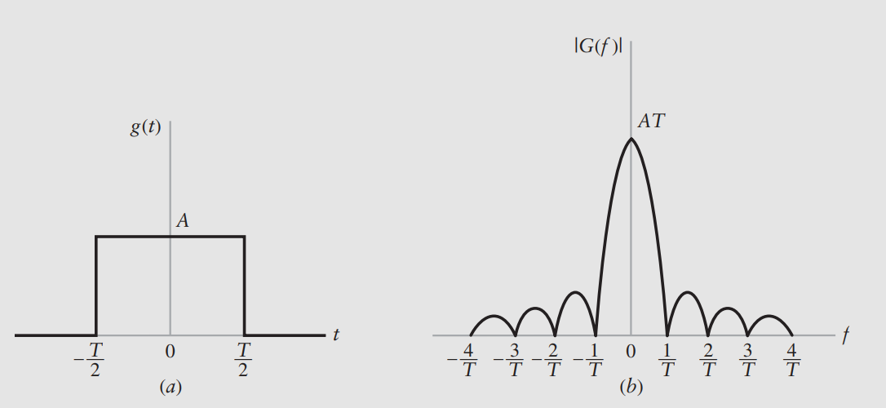
Example: Non-periodic Signals
Time-domain representation
Frequency-domain representation

Slide 39
Why
periodic signals -> discrete frequency,
non-periodic signals ->continuous frequency?
Notes:
生产大炮，要了解物体运动规律，气动特性，才能生产精准的大炮
通信中，我们最关心的事情是什么？ 信号经过信道后，发生改变。为什么发生改变，如何改变的？什么因素最重要？预测经过特定系统后的信号！

Slide 40
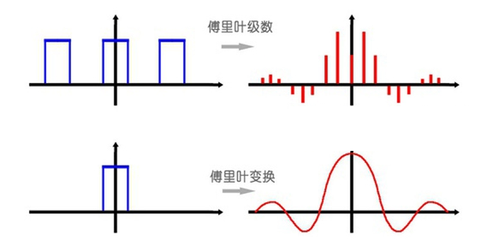
Periodic Signals vs Nonperiodic Signals
Notes:
若函数在时（频）域是连续的，则其像函数在频（时）域是非周期的； 若函数在时（频）域是离散的，则其像函数在频（时）域是周期的。

Slide 41
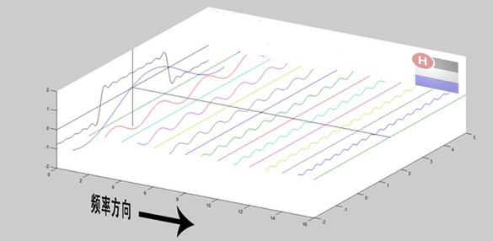
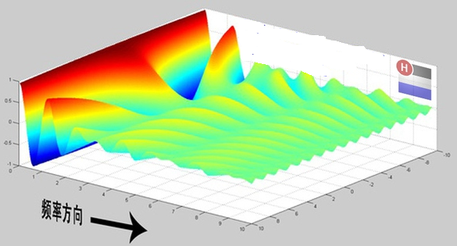
Periodic Signals vs Nonperiodic Signals
Periodic Signals
Nonperiodic Signals

Slide 42
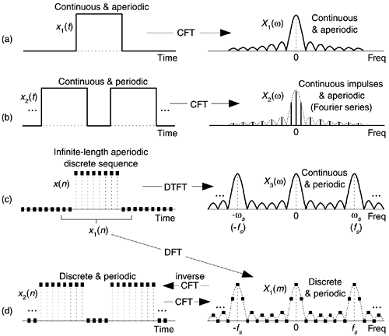
Time Domain vs Frequency Domain
Periodic
Discrete
Nonperiodic
Continuous
Continuous
Nonperiodic
Discrete
Periodic
Time Domain
Frequency Domain

Slide 43
Now
What is the bandwidth of a signal?
Notes:
生产大炮，要了解物体运动规律，气动特性，才能生产精准的大炮
通信中，我们最关心的事情是什么？ 信号经过信道后，发生改变。为什么发生改变，如何改变的？什么因素最重要？预测经过特定系统后的信号！

Slide 44
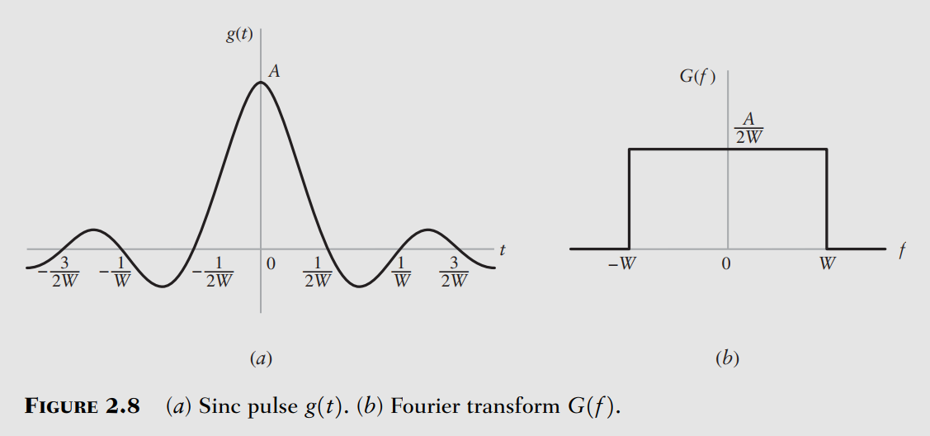
Bandwidth of a Signal
The bandwidth of a signal provides a measure of the extent of the significant spectral content of the signal for positive frequencies
bandwidth

Slide 45
Power of Fourier Analysis?
Notes:
生产大炮，要了解物体运动规律，气动特性，才能生产精准的大炮
通信中，我们最关心的事情是什么？ 信号经过信道后，发生改变。为什么发生改变，如何改变的？什么因素最重要？预测经过特定系统后的信号！

Slide 46




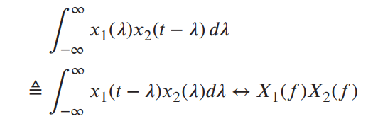
Fourier Transform Theorems
Superposition Theorem
Time-Delay Theorem
Scale-Change Theorem
Modulation Theorem
Convolution Theorem

Slide 47
With the models and Fourier analytical methods,
how do we predict a signal transmitting through a channel?
Notes:
生产大炮，要了解物体运动规律，气动特性，才能生产精准的大炮
通信中，我们最关心的事情是什么？ 信号经过信道后，发生改变。为什么发生改变，如何改变的？什么因素最重要？预测经过特定系统后的信号！

Slide 48

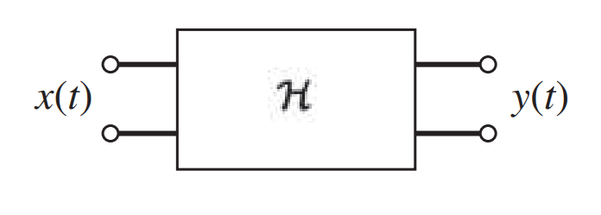
Characterization of Systems and Their Effects on Signals
Input signal
Output signal
?
√
where H [⋅] is the operator that produces the output 𝑦(𝑡) from the input 𝑥(𝑡)

Slide 49
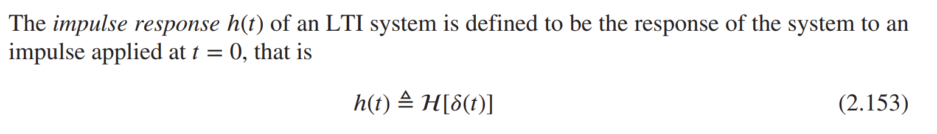
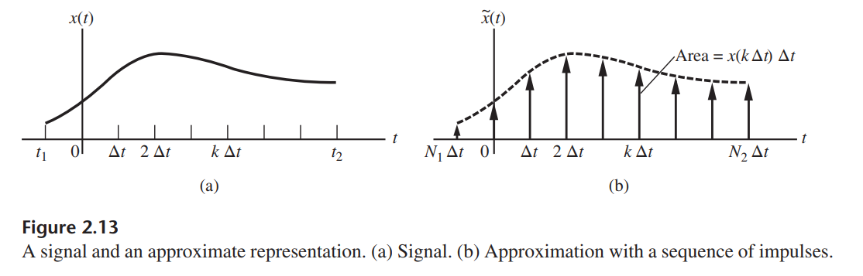
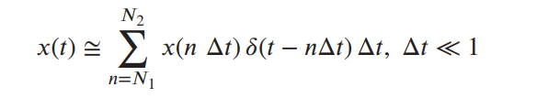
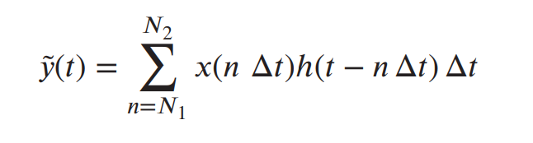
Impulse Response of a System (Channel): h(t)
√
Notes:
LTI系统是线性时不变系统（Linear Time-Invariant System）的缩写。这是一种在系统工程和信号处理中常见的数学模型，用于描述一系列输入和输出之间的关系。
“线性”意味着系统的输出是输入的线性组合，也就是说，如果你将输入信号的振幅改变或者将两个输入信号相加，那么输出信号也会以相应的方式改变。
“时不变”则意味着系统的行为不会随着时间的推移而改变。也就是说，如果你在任何给定的时间点将同样的输入信号输入到系统中，你将得到相同的输出。
LTI系统的一个关键特性是它们可以通过卷积运算来描述输入和输出之间的关系，这在信号处理和通信系统设计中非常有用。此外，这种系统的频率响应可以用来描述系统对不同频率的输入信号的响应，这对于分析和设计滤波器等应用也非常重要。

Slide 50
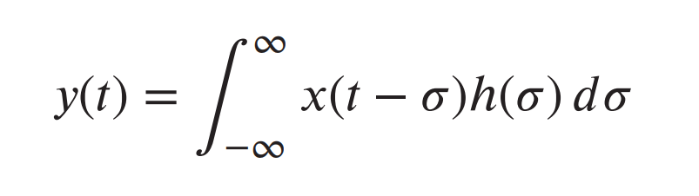
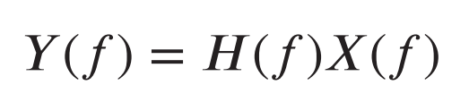
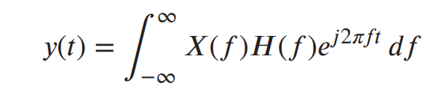
Frequency Response of the Channel: H(f)
Applying the convolution theorem of Fourier transforms
Output
Channel
Signal

Slide 51
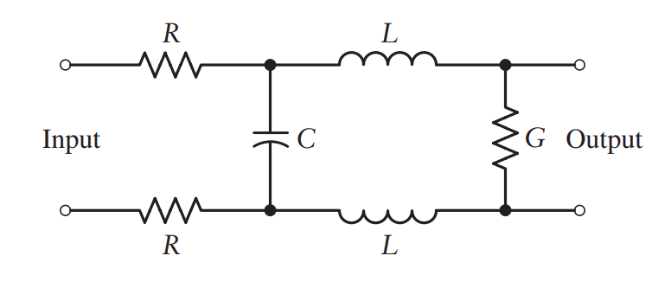
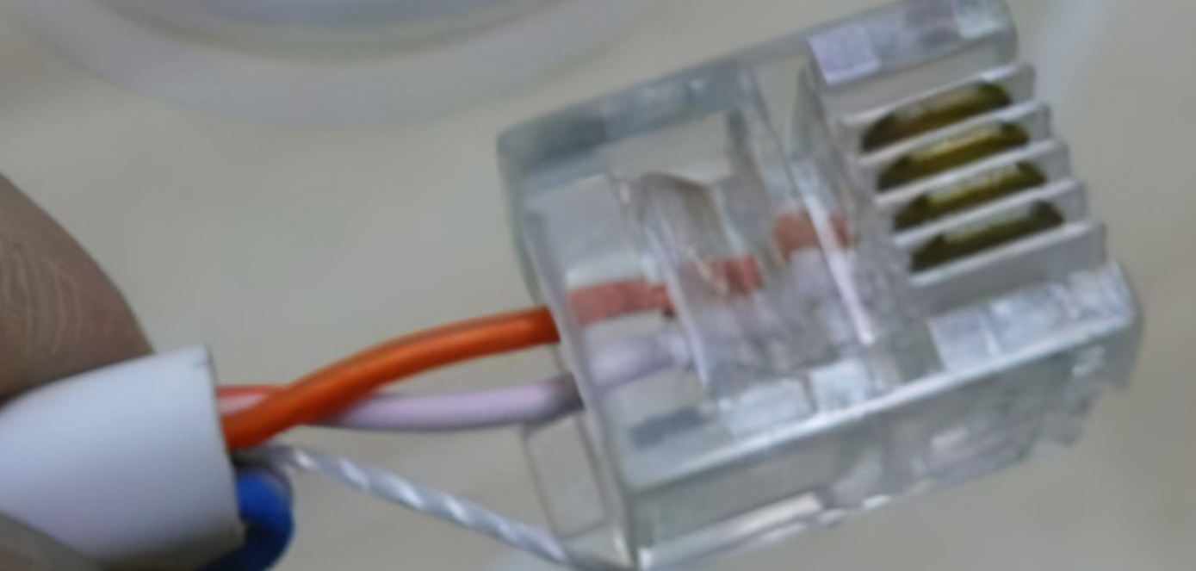
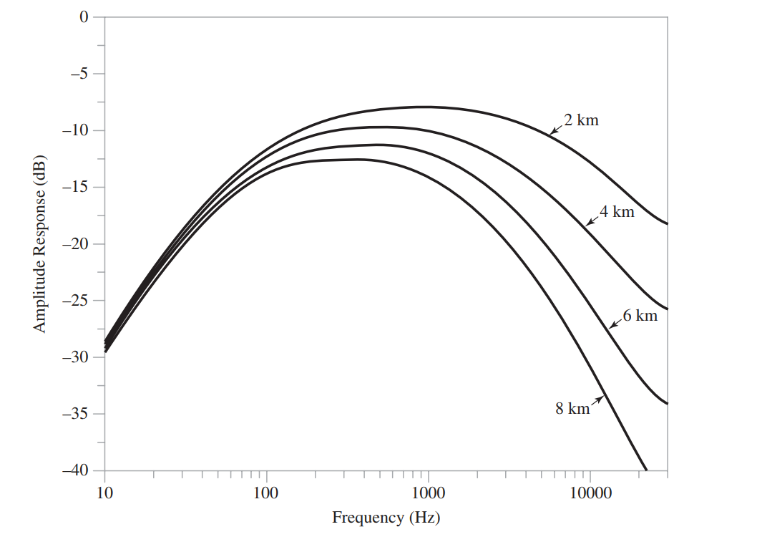
Example: Twisted Pairs for Telephony
H(f)
√
Typical frequency response of a twisted-pair transmission
line of different lengths

Slide 52
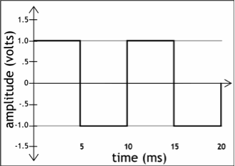
Bandwidth of a Channel
Channel (media)
The range of frequencies transmitted without being strongly attenuated is called the bandwidth.
The bandwidth of a channel is a physical property of the transmission medium
  usually depends on the construction, thickness, and length of the medium.
Notes:
Digital signal transmission can be thought of as being constructed as an infinite number of periodic analog signals.
The quality of transmission is frequency dependent=>not all parts of the digital signal get through the wire as you would expect.
Digital signal transmission is subject to attenuation, distortion, etc. This is partly caused by disallowing high-frequency components to pass
through (bandwidth).
低通滤波器的阶跃响应其上升时间t=1/H，即为带宽的倒数。因为上升时间不可能为0，因此H总是为有限带宽。

Slide 53
Let’s come back on information transmission!
Notes:
(1) Attenna size lamda/4, (2) multiplexing, (3) spectrum licence, (4) anti-interference.

Slide 54
Start with the simple scenario:
continuous-wave signal
transmitting
analog message signal
Notes:
(1) Attenna size lamda/4, (2) multiplexing, (3) spectrum licence, (4) anti-interference.

Slide 55
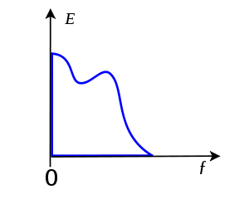
Baseband Signals
Example: Sound wave
A baseband signal is a signal that can include frequencies that are very near zero
Bandwidth definition!
f_{max}
Bandwidth

Slide 56
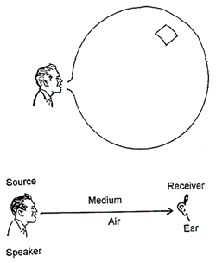
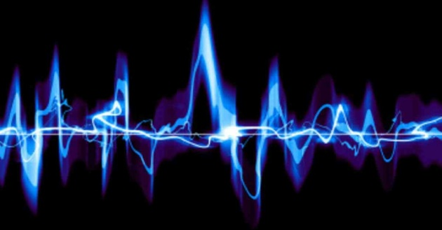
Analog Baseband Transmissions
Analog baseband signals

Slide 57
Channels do not support!
Any problems with
baseband transmissions?
Notes:
(1) Attenna size lamda/4, (2) multiplexing, (3) spectrum license, (4) anti-interference.

Slide 58
Answer: passband transmissions
Then, how?

Slide 59
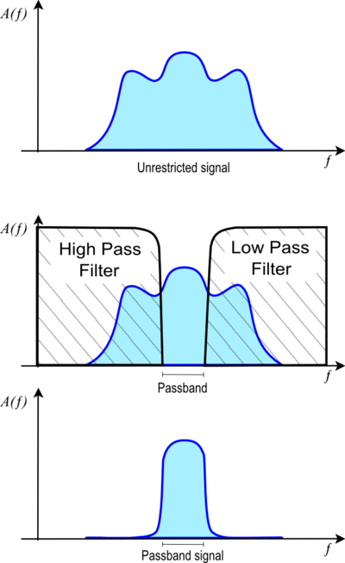
Passband Signal
A passband is the range of frequencies that can pass through a filter without being attenuated.
Bandwidth of a passband signal is the difference between the highest and the lowest
A passband signal is a signal that can pass through a filter

Slide 60
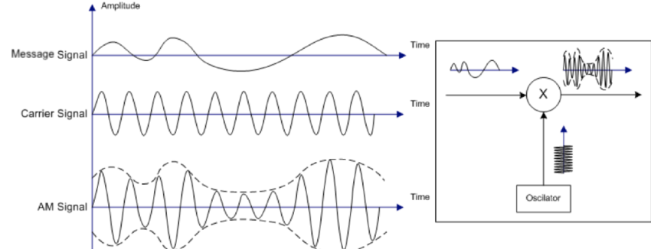

Passband Modulation with Carrier Signal
Modulation: A baseband analog signal is often modulated by a carrier signal to a passband signal in order that it may be transmitted via radio.
Modulation results in shifting the signal up to much higher frequencies (radio frequencies, or RF) than it originally spanned.

Slide 61
Communication System
noise
source
transform
channel
transform
destination
source：analog signals, digital signals
Channel：passband signals, baseband signals
transformation：modulation, multiplexing, encoding

Slide 62
How do we classify
communications technology

Slide 63
Taxonomy of Communication Systems
Continuous-level
Analog Signals
Analog Transmissions
模拟通信
Channel Signals
bearing information
Digital Signals
Digital Transmissions
数字通信
Discrete-level (discrete-valued )

Slide 64
Taxonomy of Communication Systems
Do not use
Baseband Transmissions
基带传输
Channel:
Sinusoidal Carrier Signals
Use
Passband Transmissions
频带传输

Slide 65
Roadmap
1. Background
2. Signals and channels
3. Analog passband modulations
4. From analog signals to digital signals
5. Digital baseband transmissions
6. Digital passband modulations
7. Capacity of channels

Slide 66

Signaling
A continuous tone called sine wave carrier (signaling) is introduced
Three parameters can be modulated to transmit information
amplitude,
frequency,
or phase

Slide 67
With the carrier signal, how do we transmit analog signals?

Slide 68
Three basic forms of analog passband modulation:
(1) amplitude modulation
(2) frequency modulation
(3) phase modulation

Slide 69



Amplitude Modulation (AM)
message signal
Amplitude modulation1 (AM) is formally defined as a process in which the amplitude of the carrier wave is varied about a mean value, linearly with the message signal m(t)
Modulated signal

Slide 70

AM Demodulation: Envelope Detector

Slide 71

Frequency-domain Analysis of AM
Modulation Theorem

Slide 72

AM, PM, vs FM
AM: Amplitude Modulation
PM: Phase Modulation
FM: Frequency Modulation

Slide 73
Countless value points
S
D
0101010101
Given analog information, how do we transmit it with a digital communications system?

Slide 74
Roadmap
1. Background
2. Signals and channels
3. Analog passband modulations
4. From analog signals to digital signals
5. Digital baseband transmissions
6. Digital passband modulations
7. Capacity of channels

Slide 75


Sampling: From Analog to Digital
Key issues
（1） How frequently we take samples?
（2） A sample is a real value!

Slide 76



Sampling Theorem

Slide 77


Frequency Domain Analysis of a Sampling Process
the process of uniformly sampling a continuous time signal of finite energy results in a periodic spectrum with a repetition frequency equal to the sampling rate

Slide 78

Recovering from the Sampled Signal
Original Signal
Sampled Signal
Low-pass Filter

Slide 79

Under-sampled Scenario
走样（Aliasing）

Slide 80

Sampling and Quantization

Slide 81
Given digital signals, how do we transmit them?
Baseband or passband?

Slide 82
Roadmap
1. Background
2. Signals and channels
3. Analog passband modulations
4. From analog signals to digital signals
5. Digital baseband transmissions
6. Digital passband modulations
7. Capacity of channels

Slide 83

Different Line Codes
Ethernet

Slide 84

Real-world Signals
Data sequences formatted with various line codes passed through a channel represented by a second-order lowpass Butterworth filter

Slide 85
Roadmap
1. Background
2. Signals and channels
3. Analog passband modulations
4. From analog signals to digital signals
5. Digital baseband transmissions
6. Digital passband modulations
7. Capacity of channels

Slide 86

Three Types of Modulations

Slide 87

Combinations
Notes:
QPSK: In Fig. 2-25(a), we see dots at 45, 135, 225, and 315 degrees with constant amplitude
Amplitudes and four phases are used, for a total of 16 different combinations. This modulation scheme can be used to transmit 4 bits per symbol. It is called QAM-16 (Quadrature Amplitude Modulation).

Slide 88
Roadmap
1. Background
2. Signals and channels
3. Analog passband modulations
4. Digital baseband transmissions
5. Digital passband modulations
6. From analog signals to digital signals
7. Capacity of channels

Slide 89
Given a physical link, how fast it can transmit information?

Slide 90


Signal Distortion
Channel (media)
A wide band signal will be distorted when transmitted thru relatively narrower band channel
  with the higher harmonics cut off or hold back.
Notes:
Digital signal transmission can be thought of as being constructed as an infinite number of periodic analog signals.
The quality of transmission is frequency dependent=>not all parts of the digital signal get through the wire as you would expect.
Digital signal transmission is subject to attenuation, distortion, etc. This is partly caused by disallowing high-frequency components to pass
through (bandwidth).
低通滤波器的阶跃响应其上升时间t=1/H，即为带宽的倒数。因为上升时间不可能为0，因此H总是为有限带宽。

Slide 91

Impact of Channel Bandwidth
hz
hz
hz
hz
hz

Slide 92
Maximum Data Rate
For the maximum data rate for a finite bandwidth noiseless channel, Nyquist's theorem states:
Maximum data rate=2Hlog₂V (b/s)
  Where H is the Bandwidth and V is the discrete levels of the signal.
Shannon's major result is that the maximum data rate of a noisy channel whose bandwidth is H Hz, and whose signal-to-noise ratio is S/N, is given by
Maximum data rate = Hlog₂(1+S/N)
S/N（dB）= 10log₁₀S/N
Notes:
其中 H为带宽,K为信元有效状态个数 , S/N为信噪比 =10^(dB/10)
香农定理定理促使工程师寻求信号编码的方法以提高信道容量。
香农的结论是应用信息理论推导来的，适用于任何热噪声信道。要想超越这一结论可以被认为是想要发明永动机。一条带宽为3000hz，信噪比位30db的信道，决不能以大于30000b/s的速率传输数据。

Slide 93

Put Together: A Typical Digital Pass-band Tran. System

Slide 94
Source Coding and Channel Coding
Source encoding: to reduce redundancy, such as MPEG-4, Huffman
Channel encoding: error detection and correction. E.g., CRC

Slide 95


Further Reading

Slide 96
Summary
Concepts of analog and digital communications
Fundamentals of signals and systems
Analog baseband transmission
Analog passband modulation
Sampling, quantization, pulse modulation, pulse code modulation
Digital baseband transmission
Digital passband modulations
Channel capacity

Slide 97
Symbol, Baud Rate and Bit Rate
The baud rate is the number of samples/sec made.
Each sample sends one piece of information, that is, one symbol. The baud rate and symbol rate are thus the same.
The modulation technique (e.g., QPSK) determines the number of bits/symbol
The bit rate is the amount of information sent over the channel
  equal to the number of symbols/sec times the number of bits/symbol.
Notes:
码元是承载信息的基本信号单位。比如用脉冲信号表示数据时，一个单位脉冲就是一码元。
一码元的信息量是由码元所能表示的数据有效状态值个数决定的，若一码元有00、01、10、11四个有效状态值，则一码元能携带2bit的信息 。

Slide 98

Modulation Theory

Slide 99

Fourier Analysis

Slide 100

Detection Theory

Slide 101
How do we quantify information?
Notes:
(1) Attenna size lamda/4, (2) multiplexing, (3) spectrum license, (4) anti-interference.

Slide 102

Information Theory
A foundational concept from information is the quantification of the amount of information in things like events, random variables, and distributions.
Information theory is a field of study concerned with quantifying information for communication.
Quantifying information is the foundation of the field of information theory.

Slide 103

Quantifying Information
The intuition behind quantifying information is the idea of measuring how much surprise there is in an event.
Those events that are rare (low probability) are more surprising and therefore have more information than those events that are common (high probability).
  Low Probability Event: High Information (surprising).
  High Probability Event: Low Information (unsurprising).
x_{j} is a particular event

Slide 104

Entropy
The average information associated with the outcomes of an experiment is of interest
The average information associated with a discrete random variable 𝑋 is defined as the entropy 𝐻(𝑋)
Unit: bits when the base is 2

Slide 105

Example: entropy of a binary source

Slide 106


Challenges
(1) Attenuation
(2) Multipath
(3) Doppler Effect
(4) Interference

