Slide 1
Chapter 2:
Application Layer
Yanmin Zhu
School of Computers

Slide 2
Discussions
What is the Application Layer about?
As a developer, what knowledge do you lack?
How do you architect a distributed application?
What services does a network application require from the lower layer?

Slide 3
Chapter 2: Our goals
conceptual, implementation aspects of network application protocols
  transport-layer service models
  client-server paradigm
  peer-to-peer paradigm
learn about protocols by examining popular application-level protocols
  HTTP
  FTP
  SMTP / POP3 / IMAP
  DNS
programming network applications
  socket API

Slide 4
Some network apps
e-mail
web
instant messaging
remote login
P2P file sharing
multi-user network games
streaming stored video clips
social networks
voice over IP
real-time video conferencing
cloud computing
video games

Slide 5
Roadmap
2.1 Principles of network applications
2.2 Web and HTTP
2.3 FTP
2.4 Electronic Mail
2.5 DNS
2.5 P2P applications
2.6 Video Streaming and CDN

Slide 6
Roadmap
2.1 Principles of network applications
2.2 Web and HTTP
2.3 FTP
2.4 Electronic Mail
2.5 DNS
2.5 P2P applications
2.6 Video Streaming and CDN

Slide 7





Creating a network appication
application
transport
network
data link
physical
write programs that
  run on (different) end systems
  communicate over network
  e.g., web server software communicates with browser software
No need to write software for network-core devices
  Network-core devices do not run user applications
  applications on end systems allows for rapid app development, propagation
application
transport
network
data link
physical
application
transport
network
data link
physical

Slide 8
Application architectures
Client-server
  Including data centers / cloud computing
Peer-to-peer (P2P)
Hybrid of client-server and P2P

Slide 9
Client-server architecture
server:
  always-on host
  permanent IP address
  server farms for scaling
clients:
  communicate with server
  may be intermittently connected
  may have dynamic IP addresses
  do not communicate directly with each other
client/server

Slide 10
Pure P2P architecture
no always-on server
arbitrary end systems directly communicate
peers are intermittently connected and change IP addresses
Highly scalable but difficult to manage
peer-peer

Slide 11
Hybrid of client-server and P2P
Skype
  voice-over-IP P2P application
  centralized server: finding address of remote party:
  client-client connection: direct (not through server)
Instant messaging
  chatting between two users is P2P
  centralized service: client presence detection/location
    user registers its IP address with central server when it comes online
    user contacts central server to find IP addresses of buddies

Slide 12
Processes communicating
Process: program running within a host.
within same host, two processes communicate using inter-process communication (defined by OS, e.g., pipe).
processes in different hosts communicate by exchanging messages
Client process: process that initiates communication
Server process: process that waits to be contacted
Note: applications with P2P architectures have client processes & server processes

Slide 13
Sockets
process sends/receives messages to/from its socket
socket analogous to door
  sending process shoves message out door
  sending process relies on transport infrastructure on other side of door which brings message to socket at receiving process
host or
server
host or
server
controlled by
app developer
process
process
socket
socket
TCP with
buffers,
variables
TCP with
buffers,
variables
Internet
controlled
by OS
API: (1) choice of transport protocol; (2) ability to fix a few parameters
Notes:
Shove 挤出 shAf

Slide 14
Addressing processes
to receive messages, process must have identifier
host device has unique 32-bit IP address
Exercise: use ipconfig from command prompt to get your IP address (Windows)
Q: does IP address of host on which process runs suffice for identifying the process?
  A: No, many processes can be running on same
Identifier includes both IP address and port numbers associated with process on host.
Example port numbers:
  HTTP server: 80
  Mail server: 25

Slide 15
App-layer protocol defines
Message syntax:
  what fields in messages & how fields are delineated
Message semantics
  meaning of information in fields
Types of messages exchanged,
  e.g., request, response
Rules for when and how processes send & respond to messages
Public-domain protocols:
  defined in RFCs
  allows for interoperability
  e.g., HTTP, SMTP, BitTorrent
Proprietary protocols:
  e.g., Skype, ppstream

Slide 16
What transport service need?
Data loss
some apps (e.g., audio) can tolerate some loss
other apps (e.g., file transfer, telnet) require 100% reliable data transfer
Throughput
some apps (e.g., multimedia) require minimum amount of throughput to be “effective”
other apps (“elastic apps”) make use of whatever throughput they get
Security
Encryption, data integrity, …
Timing
some apps (e.g., Internet telephony, interactive games) require low delay to be “effective”

Slide 17
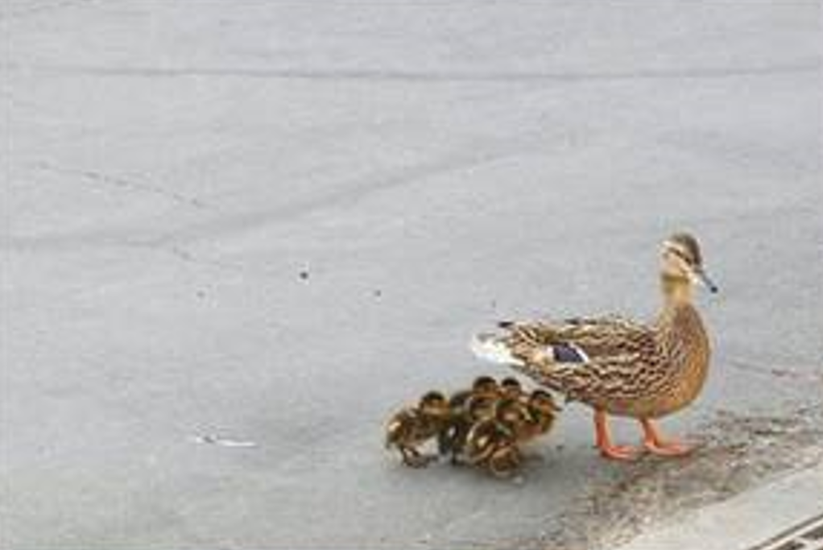
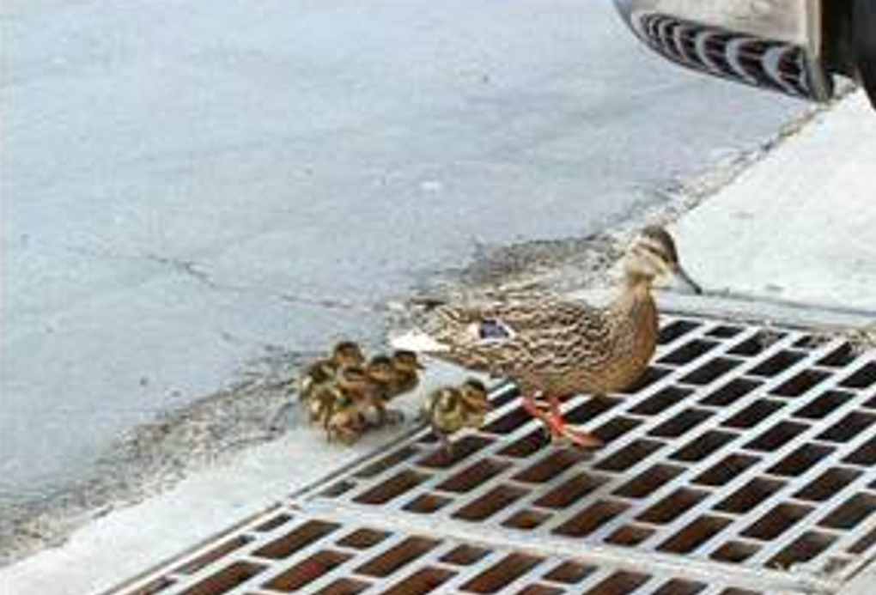
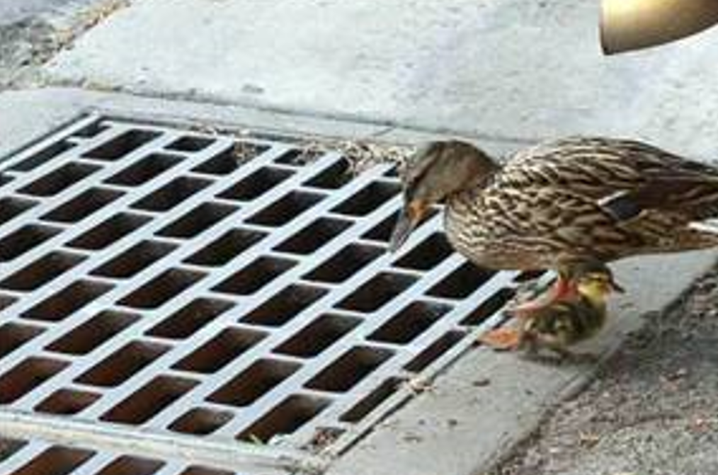
Fun

Slide 18
Transport service requirements
Application
file transfer
e-mail
Web documents
real-time audio/video
stored audio/video
interactive games
instant messaging
Data loss
no loss
no loss
no loss
loss-tolerant
loss-tolerant
loss-tolerant
no loss
Throughput
elastic
elastic
elastic
audio: 5kbps-1Mbps
video:10kbps-5Mbps
same as above
few kbps up
elastic
Time Sensitive
no
no
no
yes, 100’s msec
yes, few secs
yes, 100’s msec
yes and no

Slide 19
Internet transport protocols services
TCP service:
  connection-oriented: setup required between client and server processes
  reliable transport between sending and receiving process
  flow control: sender won’t overwhelm receiver
  congestion control: throttle sender when network overloaded
  does not provide: timing, minimum throughput guarantees, security
UDP service:
  unreliable data transfer between sending and receiving process
  does not provide: connection setup, reliability, flow control, congestion control, timing, throughput guarantee, or security
Q: why bother? Why is there a UDP?
Notes:
['θrɒt(ə)l]

Slide 20
Internet apps vs. transport protocols
Application
layer protocol
SMTP [RFC 2821]
Telnet [RFC 854]
HTTP [RFC 2616]
FTP [RFC 959]
HTTP (eg Youtube),
RTP [RFC 1889]
SIP, RTP, proprietary
(e.g., Skype)
Underlying
transport protocol
TCP
TCP
TCP
TCP
TCP or UDP
typically UDP
Application
e-mail
remote terminal access
Web
file transfer
streaming multimedia
Internet telephony

Slide 21
Roadmap
2.1 Principles of network applications
2.2 Web and HTTP
2.3 FTP
2.4 Electronic Mail
2.5 DNS
2.5 P2P applications
2.6 Video Streaming and CDN

Slide 22
Discussions
What are typical HTTP messages?
HTTP is stateless, how to develop a shopping web application over HTTP?
Why is HTTP widely used for Web apps?

Slide 23

WWW: A Milestone of the Internet!
Before WWW was invented in 1990, what did people do with the Internet?

Slide 24



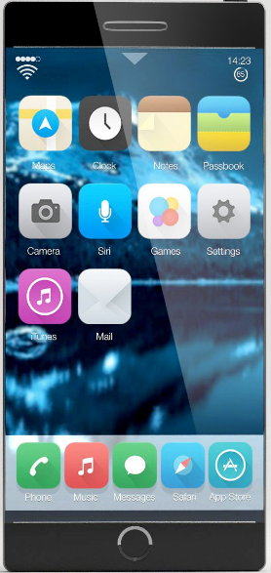
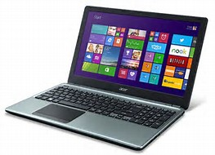
Overview
Apache HTTP Server
Web Server
IBM HTTP Server
Safari
Mozilla Firefox
Google Chrome
Microsoft Edge

Slide 25
Web and HTTP
First some jargon
  Web page consists of objects
  Object can be HTML file, JPEG image, Java applet, audio file,…
  Web page consists of base HTML-file which includes several referenced objects
Each object is addressable by a URL
  Example URL:
www.someschool.edu/someDept/pic.gif
host name
path name

Slide 26
HTTP overview
HTTP: hypertext transfer protocol
Web’s application layer protocol
client/server model
  client: browser that requests, receives, “displays” Web objects
  server: Web server sends objects in response to requests
HTTP request
PC running
Explorer
HTTP response
HTTP request
Server
running
Apache Web
server
HTTP response
Mac running
Navigator

Slide 27
HTTP overview (continued)
Uses TCP:
  client initiates TCP connection (creates socket) to server, port 80
  server accepts TCP connection from client
  HTTP messages (application-layer protocol messages) exchanged between browser (HTTP client) and Web server (HTTP server)
  TCP connection closed
HTTP is “stateless”
server maintains no information about past client requests
aside
Protocols that maintain “state” are complex!
past history (state) must be maintained
if server/client crashes, their views of “state” may be inconsistent, must be reconciled
Notes:
['rek(ə)nsaɪl]
vt. 使一致；使和解；调停，调解；使顺从

Slide 28
HTTP connections
Non-persistent HTTP
At most one object is sent over a TCP connection.
Persistent
HTTP
Multiple objects can be sent over single TCP connection between client and server.

Slide 29
Nonpersistent HTTP
Suppose user enters URL www.someSchool.edu/someDepartment/home.index
(contains text,
references to 10
jpeg images)
1a. HTTP client initiates TCP connection to HTTP server (process) at www.someSchool.edu on port 80
1b. HTTP server at host www.someSchool.edu waiting for TCP connection at port 80. “accepts” connection, notifying client
2. HTTP client sends HTTP request message (containing URL) into TCP connection socket. Message indicates that client wants object someDepartment/home.index
3. HTTP server receives request message, forms response message containing requested object, and sends message into its socket
time

Slide 30
Nonpersistent HTTP (cont.)
4. HTTP server closes TCP connection.
5. HTTP client receives response message containing html file, displays html. Parsing html file, finds 10 referenced jpeg objects
time
6. Steps 1-5 repeated for each of 10 jpeg objects

Slide 31
Non-Persistent HTTP: Response time
Definition of RTT: time for a small packet to travel from client to server and back.
Response time:
one RTT to initiate TCP connection
one RTT for HTTP request and first few bytes of HTTP response to return
file transmission time
total = 2RTT+transmit time
initiate TCP
connection
RTT
request
file
RTT
time to
transmit
file
file
received
time
time

Slide 32
Persistent HTTP
Issues of Nonpersistent HTTP
requires 2 RTTs per object
OS overhead for each TCP connection
browsers often open parallel TCP connections to fetch referenced objects
Persistent HTTP
  server leaves connection open after sending response
  subsequent HTTP messages between same client/server sent over open connection
  client sends requests as soon as it encounters a referenced object
  as little as one RTT for all the referenced objects

Slide 33
HTTP request message
request line
(GET, POST,
HEAD commands)
GET /somedir/page.html HTTP/1.1
Host: www.someschool.edu
User-agent: Mozilla/4.0
Connection: close
Accept-language:fr
(extra carriage return, line feed)
header
lines
Carriage return,
line feed
indicates end
of message
two types of HTTP messages: request, response
HTTP request message:
  ASCII (human-readable format)

Slide 34
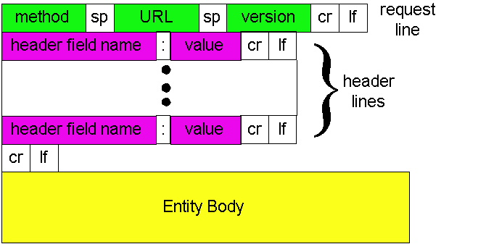
HTTP request message: general format

Slide 35
Uploading form input
Post method:
Uses POST method
Input is uploaded to server in entity body
URL method:
Uses GET method
Input is uploaded in URL field of request line:
Web page often includes form input
www.somesite.com/animalsearch?monkeys&banana

Slide 36
Method types
HTTP/1.0
GET
POST
HEAD
  asks server to leave requested object out of response
HTTP/1.1
GET, POST, HEAD
PUT
  uploads file in entity body to path specified in URL field
DELETE
  deletes file specified in the URL field

Slide 37
HTTP response message
status line
(protocol
status code
status phrase)
HTTP/1.1 200 OK
Connection close
Date: Thu, 06 Aug 1998 12:00:15 GMT
Server: Apache/1.3.0 (Unix)
Last-Modified: Mon, 22 Jun 1998 …...
Content-Length: 6821
Content-Type: text/html
data data data data data ...
header
lines
data, e.g.,
requested
HTML file

Slide 38
HTTP response status codes
In first line in server->client response message. A few sample codes:
200 OK
  request succeeded, requested object later in this message
301 Moved Permanently
  requested object moved, new location specified later in this message (Location:)
400 Bad Request
  request message not understood by server
404 Not Found
  requested document not found on this server
505 HTTP Version Not Supported

Slide 39
Trying out HTTP (client side)
1. Telnet to your favorite Web server:
telnet www.sjtu.edu.cn 80
Opens TCP connection to port 80
(default HTTP server port) at cis.poly.edu.
Anything typed in sent
to port 80 at www.sjtu.edu.cn
2. Type in a GET HTTP request:
GET / HTTP/1.1
Host: www.sjtu.edu.cn
By typing this in (hit carriage
return twice), you send
this minimal (but complete)
GET request to HTTP server
3. Look at response message sent by the HTTP server!
Notes:
Ssh www.cs.sjtu.edu.cn
telnet www.cs.sjtu.edu.cn
GET /~yzhu/index.html HTTP/1.1
Host: www.cs.sjtu.edu.cn

Slide 40
HTTP/2
Key goal: decreased delay in multi-object HTTP requests
HTTP1.1: introduced multiple, pipelined GETs over single TCP connection
server responds in-order (FCFS: first-come-first-served scheduling) to GET requests
with FCFS, small object may have to wait for transmission (head-of-line (HOL) blocking) behind large object(s)
loss recovery (retransmitting lost TCP segments) stalls object transmission
Notes:
t’

Slide 41
HTTP/2
Key goal: decreased delay in multi-object HTTP requests
HTTP/2: [RFC 7540, 2015] increased flexibility at server in sending objects to client:
methods, status codes, most header fields unchanged from HTTP 1.1
transmission order of requested objects based on client-specified object priority (not necessarily FCFS)
push unrequested objects to client
divide objects into frames, schedule frames to mitigate HOL blocking
Notes:
t’

Slide 42

HTTP/2: mitigating HOL blocking
HTTP 1.1: client requests 1 large object (e.g., video file) and 3 smaller objects
server
GET O₄
GET O₃
GET O₂
GET O₁
object data requested
client
O₁
O₂
O₁
O₃
O₂
O₃
O₄
O₄
objects delivered in order requested: O₂, O₃, O₄ wait behind O₁
Notes:
t’

Slide 43
HTTP/2: mitigating HOL blocking
HTTP/2: objects divided into frames, frame transmission interleaved
server
GET O₄
GET O₃
GET O₂
GET O₁
object data requested
client
O₂
O₄
O₃
O₁
O₂
O₃
O₄
O₁
O₂, O₃, O₄ delivered quickly, O₁ slightly delayed
Notes:
shortest job first: decreased average delay!

Slide 44
HTTP/2 to HTTP/3
HTTP/2 over single TCP connection means:
  recovery from packet loss still stalls all object transmissions
  no security over vanilla TCP connection
HTTP/3: adds security, per object error- and congestion-control (more pipelining) over UDP
Notes:
t’

Slide 45
QUIC: Quick UDP Internet Connections
application-layer protocol, on top of UDP
  increase performance of HTTP
  deployed on many Google servers, apps (Chrome, mobile YouTube app)
HTTP/2
HTTP/2 (slimmed)
Application
HTTP/3
TLS
QUIC
Transport
TCP
UDP
Network
IP
IP
HTTP/2 over TCP
HTTP/2 over QUIC over UDP

Slide 46
QUIC: Quick UDP Internet Connections
adopts approaches we’ll study in chapter for connection establishment, error control, congestion control
  error and congestion control: “Readers familiar with TCP’s loss detection and congestion control will find algorithms here that parallel well-known TCP ones.” [from QUIC specification]
  connection establishment: reliability, congestion control, authentication, encryption, state established in one RTT

Slide 47
QUIC: Connection establishment
TCP handshake
(transport layer)
QUIC
1RTT handshake
data
TLS handshake
(security)
data
TCP (reliability, congestion control state) + TLS (authentication, crypto state)
2 serial handshakes
QUIC: reliability, congestion control, authentication, crypto state
1 handshake

Slide 48

QUIC: 0-RTT Connection establishment
TLS session ticket sent by server, cached at client
data
end of first QUIC connection
Client uses last session ticket for encryption, authentication for new connection
0 RTT handshake delay
start of second QUIC connection
data

Slide 49
What a RFC look like?
1 Introduction.............................................7
2 Notational Conventions and Generic Grammar..............13
3 Protocol Parameters.....................................17
4 HTTP Message............................................30
5 Request.................................................34
6 Response................................................38
7 Entity..................................................41
8 Connections.............................................43
9 Method Definitions......................................48
10 Status Code Definitions................................53
11 Access Authentication..................................65
12 Content Negotiation....................................67
13 Caching in HTTP........................................70
14 Header Field Definitions...............................94
15 Security Considerations...............................139
16 Acknowledgments.......................................144
17 References............................................146
18 Authors' Addresses....................................149
19 Appendices............................................150

Slide 50
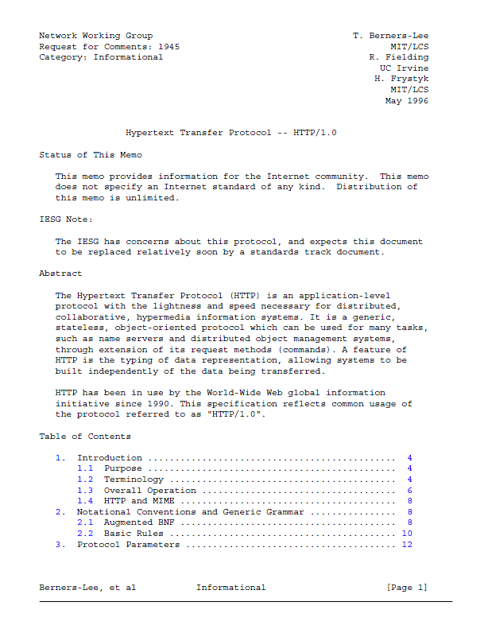
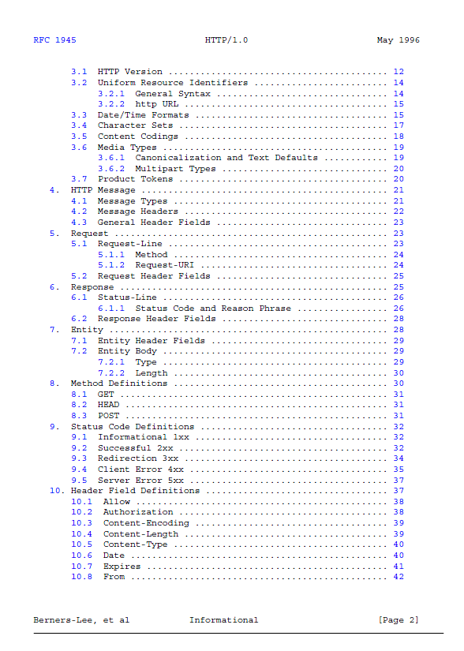
RFC 1945: HTTP/1.0

Slide 51
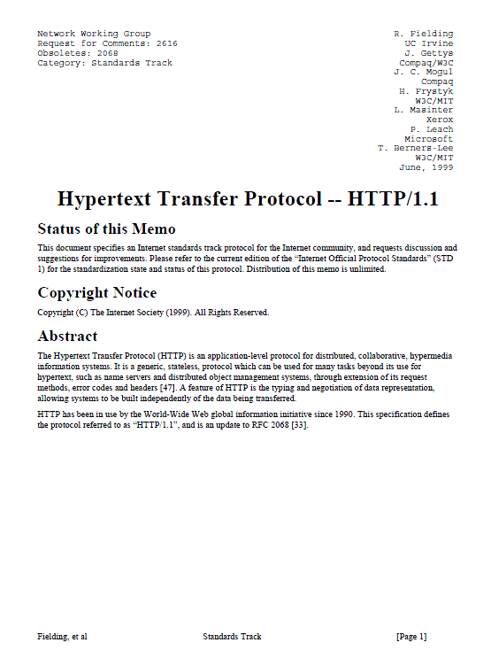
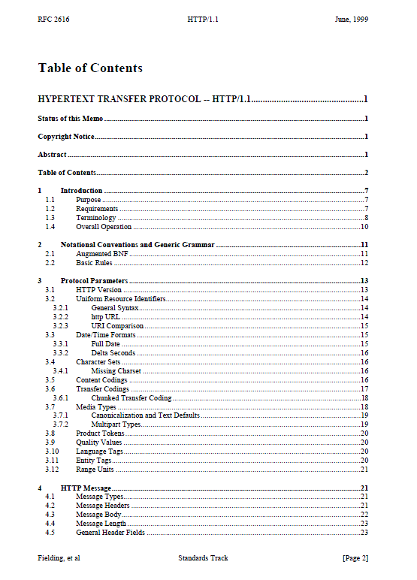
RFC 2068: HTTP/1.1

Slide 52
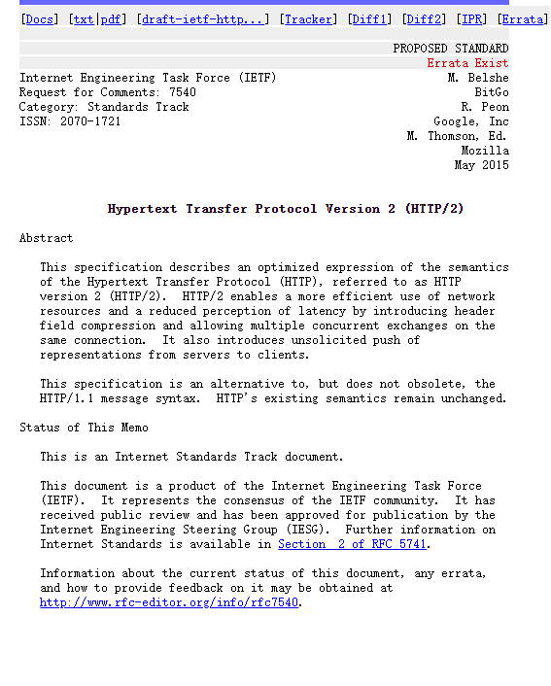
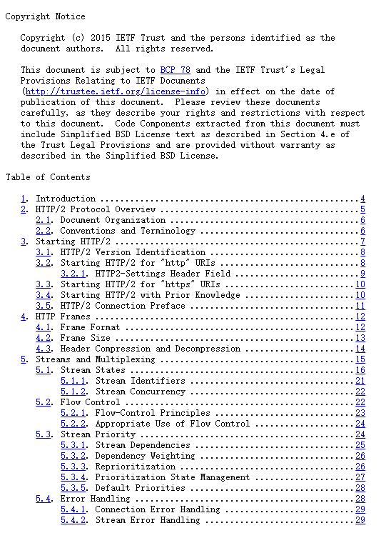
RFC 7540 HTTP/2
Notes:
HTTP/2 is a major revision of the HTTP network protocol, used by the World Wide Web. It was developed by the Internet Engineering Task Force (IETF) and published in 2015. Here are some key features of HTTP/2:
Binary Protocol: Unlike HTTP/1.1, which is text-based, HTTP/2 is binary. This makes it more efficient to parse and less error-prone.
Multiplexing: Multiple requests and responses can be sent simultaneously over a single TCP connection, reducing latency and improving page load times.
Header Compression: HTTP/2 uses HPACK compression to reduce the overhead of HTTP headers, which can be significant in HTTP/1.1.
Server Push: Servers can send resources to the client before they are requested, potentially speeding up page loads.
Stream Prioritization: Clients can assign priority levels to different streams, allowing more important resources to be delivered first.
Overall, HTTP/2 improves performance, efficiency, and speed compared to HTTP/1.1, especially in modern web applications.

Slide 53
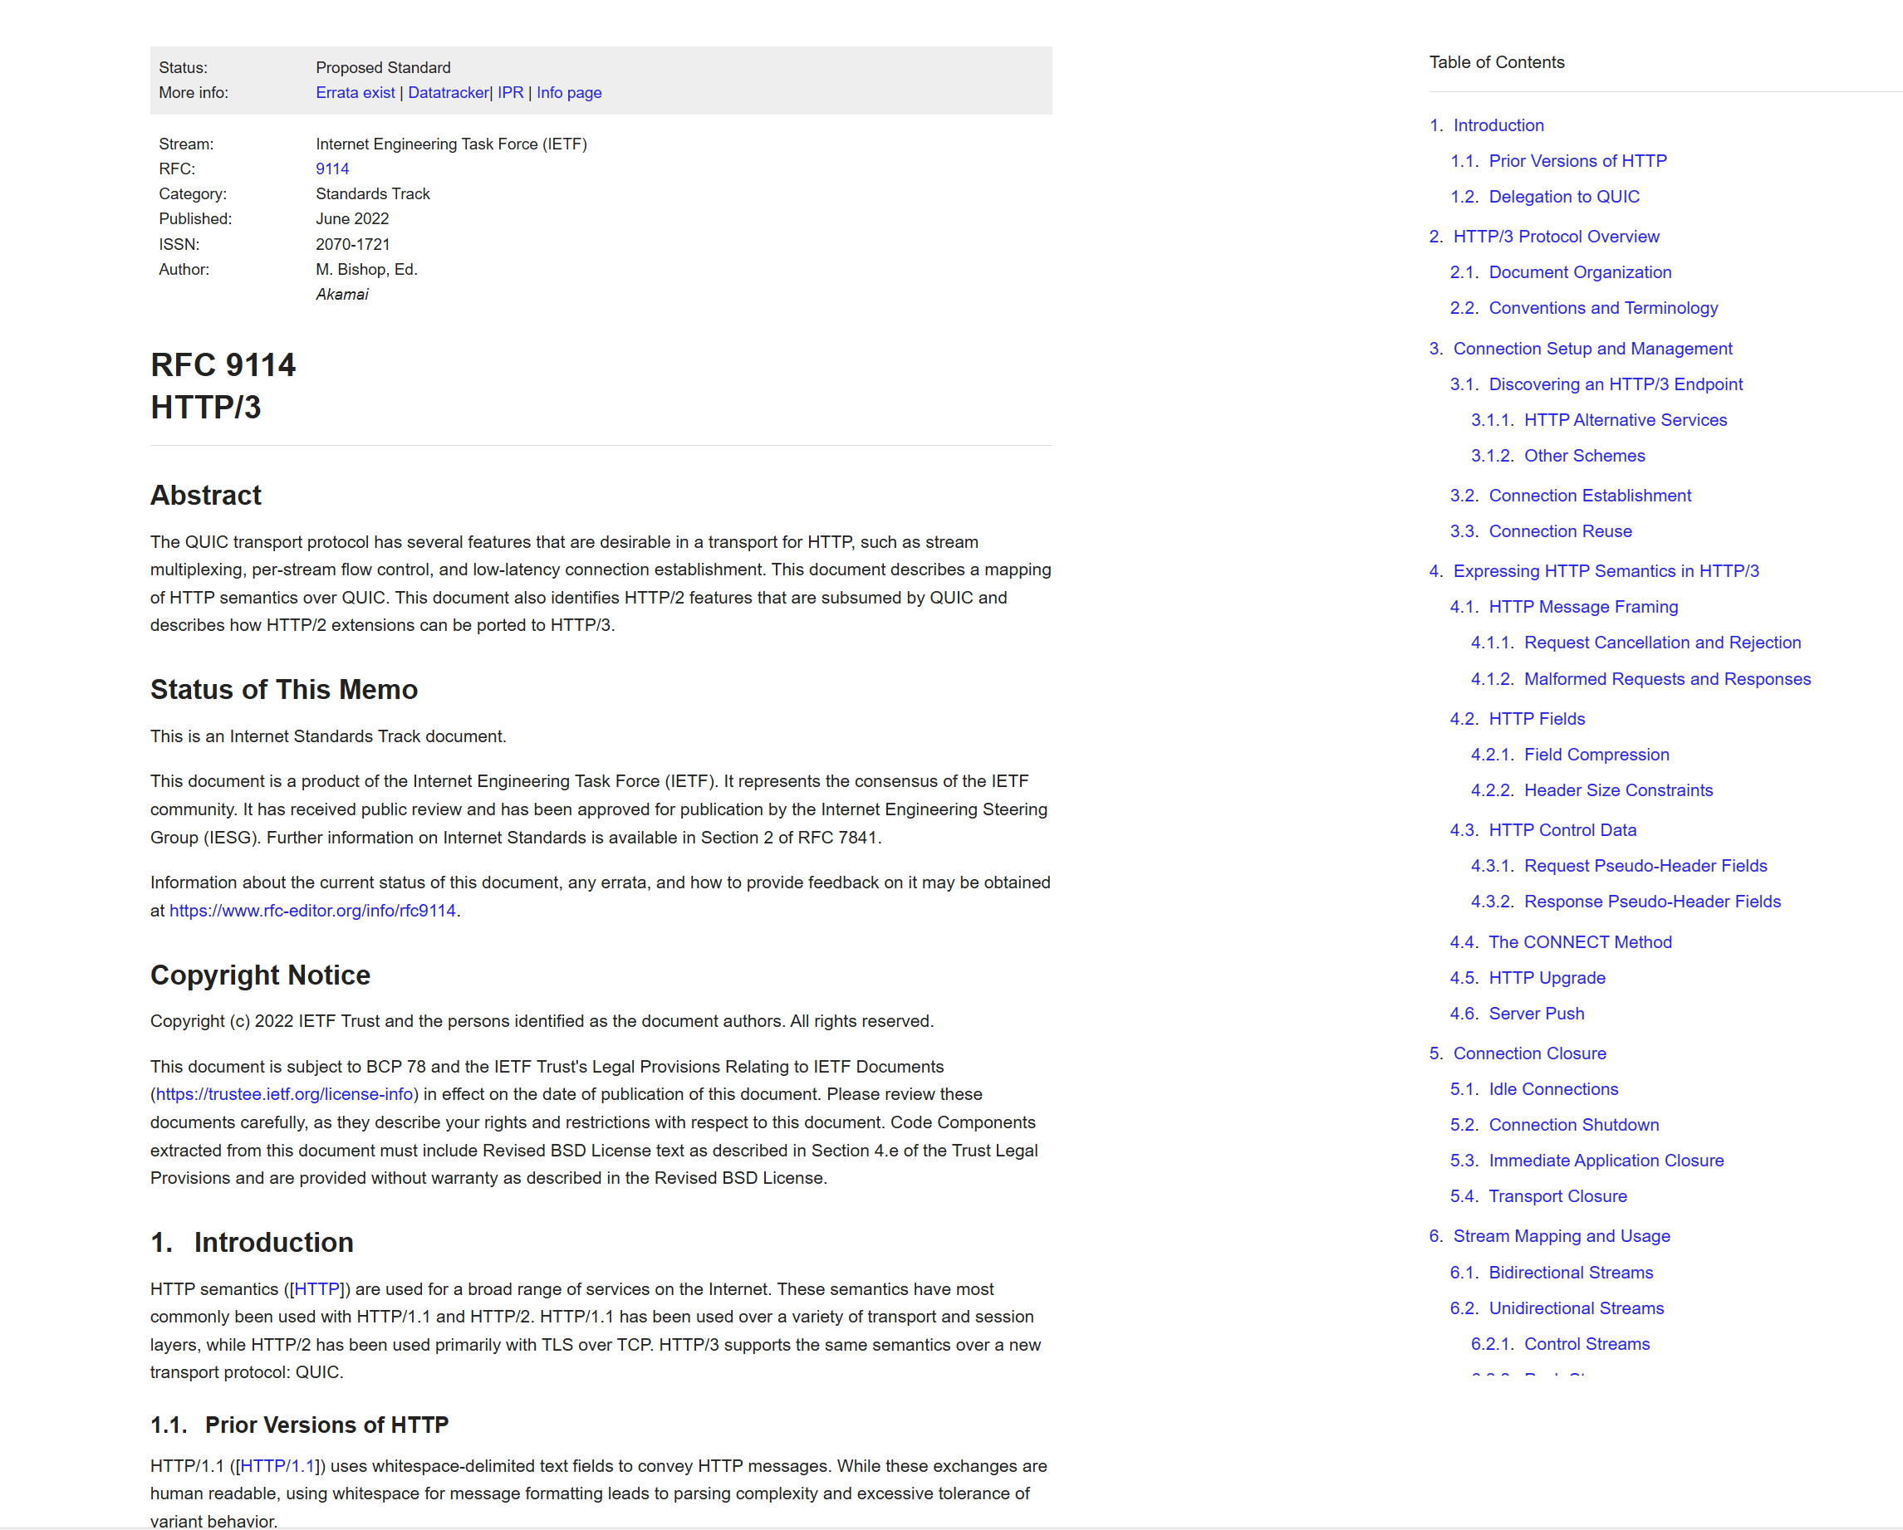
RFC 9114 HTTP/3

Slide 54
Shall we maintain the states of a web client?
Why and how?

Slide 55
User-server state: cookies
Many major Web sites use cookies
Four components:
  1) cookie header line of HTTP response message
  2) cookie header line in HTTP request message
  3) cookie file kept on user’s host, managed by user’s browser
  4) back-end database at Web site
Example:
Susan always access Internet always from PC
visits specific e-commerce site for first time
when initial HTTP requests arrives at site, site creates:
  unique ID
  entry in backend database for ID

Slide 56
Cookies: keeping “state” (cont.)
client
server
ebay 8734
usual http request msg
Amazon server
creates ID
1678 for user
cookie file
usual http response
Set-cookie: 1678
create
entry
ebay 8734
amazon 1678
usual http request msg
cookie: 1678
cookie-
specific
action
access
one week later:
usual http response msg
backend
database
access
ebay 8734
amazon 1678
usual http request msg
cookie: 1678
cookie-
spectific
action
usual http response msg

Slide 57
Cookies (continued)
What cookies can bring:
authorization
shopping carts
recommendations
user session state (Web e-mail)
Cookies and privacy:
cookies permit sites to learn a lot about you
you may supply name and e-mail to sites
How to keep “state”:
protocol endpoints: maintain state at sender/receiver over multiple transactions
cookies: http messages carry state

Slide 58

Web caches (proxy server)
user sets browser: Web accesses via proxy
browser sends all HTTP requests to proxy
  if object in cache: cache returns object
  else proxy requests object from origin server, then returns object to client
origin
server
Proxy
server
HTTP request
HTTP request
client
HTTP response
HTTP response
HTTP request
HTTP response
client
origin
server
Goal: satisfy client request without involving origin server

Slide 59
More about Web caching
proxy acts as both client and server
typically proxy is installed by ISP (university, company, residential ISP)
Why Web caching?
reduce response time for client request
reduce traffic on an institution’s access link.
Internet dense with proxy : enables “poor” content providers to effectively deliver content (but so does P2P file sharing)

Slide 60
Caching example
Assumptions
average object size = 1,000,000 bits
avg. request rate from institution’s browsers to origin servers = 15/sec
delay from institutional router to any origin server and back to router = 2 sec
Consequences
utilization on LAN = 15%
utilization on access link = 100%
total delay = Internet delay + access delay + LAN delay
= 2 sec + minutes + milliseconds
origin
servers
public
Internet
15 Mbps
access link
institutional
network
100 Mbps LAN
institutional
cache

Slide 61
Caching example (cont)
possible solution
increase bandwidth of access link to, say, 100 Mbps
consequence
utilization on LAN = 15%
utilization on access link = 15%
Total delay = Internet delay + access delay + LAN delay
= 2 sec + msecs + msecs
often a costly upgrade
origin
servers
public
Internet
100 Mbps
access link
institutional
network
100 Mbps LAN
institutional
cache

Slide 62
Caching example (cont)
possible solution: install cache
suppose hit rate is 0.4
consequence
40% requests will be satisfied almost immediately
60% requests satisfied by origin server
utilization of access link reduced to 60%, resulting in negligible delays (say 10 msec)
total avg delay = Internet delay + access delay + LAN delay = .6*(2.01) secs + .4*milliseconds < 1.4 secs
origin
servers
public
Internet
15 Mbps
access link
institutional
network
100 Mbps LAN
institutional
cache
Any problem with Web caching?

Slide 63
Conditional GET
proxy
server
Goal: don’t send object if cache has up-to-date cached version
proxy : specify date of cached copy in HTTP request
  If-modified-since: <date>
server: response contains no object if cached copy is up-to-date:
  HTTP/1.0 304 Not Modified
HTTP request msg
If-modified-since: <date>
object
not
modified
HTTP response
HTTP/1.0
304 Not Modified
HTTP request msg
If-modified-since: <date>
object
modified
HTTP response
HTTP/1.0 200 OK
<data>

Slide 64
Already having HTTP, why should we make another protocol for file transfer?
What are typical FTP messages?

Slide 65

FTP: the file transfer protocol
FTP
user
interface
FTP
client
file transfer
FTP
server
user
at host
remote file
system
local file
system
transfer file to/from remote host
client/server model
  client: side that initiates transfer (either to/from remote)
  server: remote host
ftp: RFC 959
ftp server: port 21

Slide 66
FTP: separate control, data connections
FTP client contacts FTP server at port 21, TCP is transport protocol
client authorized over control connection
client browses remote directory by sending commands over control connection.
when server receives file transfer command, server opens 2nd TCP connection (for file) to client
after transferring one file, server closes data connection.
TCP control connection
port 21
FTP
client
TCP data connection
port 20
FTP
server
server opens another TCP data connection to transfer another file.
control connection: “out of band”
FTP server maintains “state”: current directory, earlier authentication

Slide 67
FTP commands, responses
Sample commands:
sent as ASCII text over control channel
USER username
PASS password
LIST return list of file in current directory
RETR filename retrieves (gets) file
STOR filename stores (puts) file onto remote host
Sample return codes
status code and phrase (as in HTTP)
331 Username OK, password required
125 data connection already open; transfer starting
425 Can’t open data connection
452 Error writing file

Slide 68
Roadmap
2.1 Principles of network applications
2.2 Web and HTTP
2.3 FTP
2.4 Electronic Mail
2.5 DNS
2.5 P2P applications
2.6 Video Streaming and CDN

Slide 69
Compared with web and file transfer, what’s unique for emails?
Notes:
用户账号
发出去后，对方不一定马上在线接收

Slide 70
Overview: Electronic Mail
Three major components:
  user agents
  mail servers
  simple mail transfer protocol: SMTP
  User Agent
    a.k.a. “mail reader”
    composing, editing, reading mail messages
    e.g.,Outlook, Firefox, elm, Mozilla Thunderbird
outgoing, incoming messages stored on server
user
agent
mail
server
user
agent
SMTP
mail
server
user
agent
SMTP
SMTP
mail
server
user
agent
user
agent
outgoing
message queue
user
agent
user mailbox

Slide 71
Electronic Mail: mail servers
Mail Servers
  mailbox contains incoming messages for user
  message queue of outgoing (to be sent) mail messages
SMTP protocol [RFC 2821]
between mail servers to send email messages
  client: sending mail to server
  “server”: receiving mail server
user
agent
mail
server
user
agent
SMTP
mail
server
user
agent
SMTP
SMTP
mail
server
user
agent
user
agent
user
agent

Slide 72
Electronic Mail: SMTP
uses TCP to reliably transfer email message from client to server, port 25
direct transfer: sending server to receiving server
three phases of transfer
  1) handshaking (greeting)
  2) transfer of messages
  3) closure
command/response interaction
  commands: ASCII text
  response: status code and phrase
messages must be in 7-bit ASCII

Slide 73

Scenario: Alice sends message to Bob
1) Alice uses UA to compose message and “to” bob@someschool.edu
2) Alice’s UA sends message to her mail server; message placed in message queue
3) Client side of SMTP opens TCP connection with Bob’s mail server
4) SMTP client sends Alice’s message over the TCP connection
5) Bob’s mail server places the message in Bob’s mailbox
6) Bob invokes his user agent to read message
1
mail
server
mail
server
user
agent
user
agent
2
3
6
4
5
SMTP
SMTP
SMTP
How to get the address of bob’s mail server?

Slide 74
Sample SMTP interaction
S: 220 hamburger.edu
C: HELO crepes.fr
S: 250 Hello crepes.fr, pleased to meet you
C: MAIL FROM: <alice@crepes.fr>
S: 250 alice@crepes.fr... Sender ok
C: RCPT TO: <bob@hamburger.edu>
S: 250 bob@hamburger.edu ... Recipient ok
C: DATA
S: 354 Enter mail, end with "." on a line by itself
C: Do you like ketchup?
C: How about pickles?
C: .
S: 250 Message accepted for delivery
C: QUIT
S: 221 hamburger.edu closing connection
Notes:
telnet mail.cs.sjtu.edu 25
HELO cs.sjtu.edu.cn
MAIL FROM: www.cs.sjtu.edu.cn
RCPT TO: <yzhu@sjtu.edu.cn>
DATA
Success on march 6, 2016

Slide 75
Try SMTP interaction for yourself:
telnet servername 25
see 220 reply from server
enter HELO, MAIL FROM, RCPT TO, DATA, QUIT commands
above lets you send email without using email client (reader)

Slide 76
SMTP: final words
SMTP uses persistent connections
SMTP requires message (header & body) to be in 7-bit ASCII
SMTP server uses CRLF.CRLF to determine end of message
Comparison with HTTP:
HTTP: pull
SMTP: push
both have ASCII command/response interaction, status codes
HTTP: each object encapsulated in its own response msg
SMTP: multiple objects sent in multipart msg

Slide 77
Mail message format
SMTP: protocol for exchanging email msgs
RFC 822: standard for text message format:
header lines, e.g.,
  To:
  From:
  Subject:
  different from SMTP commands!
body
  the “message”, ASCII characters only
header
blank
line
body

Slide 78
Mail access protocols
SMTP
SMTP
access
protocol
user
agent
user
agent
sender’s mail
server
receiver’s mail
server
SMTP: delivery/storage to receiver’s server
Mail access protocol: retrieval from server
  1) POP: Post Office Protocol [RFC 1939]
    authorization (agent <-->server) and download
  2) IMAP: Internet Mail Access Protocol [RFC 1730]
    more features (more complex)
    manipulation of stored msgs on server
  3) HTTP: gmail, Hotmail, Yahoo! Mail, etc.

Slide 79
POP3 protocol
S: +OK POP3 server ready
C: user bob
S: +OK
C: pass hungry
S: +OK user successfully logged on
authorization phase
client commands:
  user: declare username
  pass: password
server responses
  +OK
  -ERR
transaction phase, client:
list: list message numbers
retr: retrieve message by number
dele: delete
quit
C: list
S: 1 498
S: 2 912
S: .
C: retr 1
S: <message 1 contents>
S: .
C: dele 1
C: retr 2
S: <message 1 contents>
S: .
C: dele 2
C: quit
S: +OK POP3 server signing off
Notes:
telnet mail.cs.sjtu.edu.cn 80
user yzhu
pass ???
list
retr ??

Slide 80
POP3 (more) and IMAP
More about POP3
IMAP
Previous example uses “download and delete” mode.
Bob cannot re-read e-mail if he changes client
“Download-and-keep”: copies of messages on different clients
POP3 is stateless across sessions
Keep all messages in one place: the server
Allows user to organize messages in folders
IMAP keeps user state across sessions:
  names of folders and mappings between message IDs and folder name

Slide 81
Roadmap
2.1 Principles of network applications
2.2 Web and HTTP
2.3 FTP
2.4 Electronic Mail
2.5 DNS
2.5 P2P applications
2.6 Video Streaming and CDN

Slide 82
DNS: Domain Name System
People: many identifiers:
  ID, passport #
  names
Internet hosts, routers:
  IP address (32 bit) - used for addressing datagrams
  “name”, e.g., ww.yahoo.com - used by humans
Q: how do we map between IP addresses and names?

Slide 83
Is it always necessary to translate names to IPs?
Do you have an approach to mapping names to IP addresses?

Slide 84
Domain Name System:
distributed database
  implemented in hierarchy of many name servers
application-layer protocol
  host, routers, name servers to communicate to resolve names (address/name translation)
note: core Internet function, but implemented as application-layer protocol
  complexity at network’s “edge”

Slide 85

DNS
DNS services
hostname to IP address translation
host aliasing
  Canonical, alias names
mail server aliasing
load distribution
  replicated Web servers: set of IP addresses for one canonical name
Why not centralize DNS?
single point of failure
traffic volume
distant centralized database
maintenance
doesn’t scale!

Slide 86
Distributed, Hierarchical Database
Root DNS Servers
com DNS servers
org DNS servers
edu DNS servers
yahoo.com
DNS servers
pbs.org
DNS servers
poly.edu
DNS servers
umass.edu
DNS servers
amazon.com
DNS servers
Client wants IP for www.amazon.com;
client queries a root server to find com DNS server
client queries com DNS server to get amazon.com DNS server
client queries amazon.com DNS server to get IP address for www.amazon.com

Slide 87
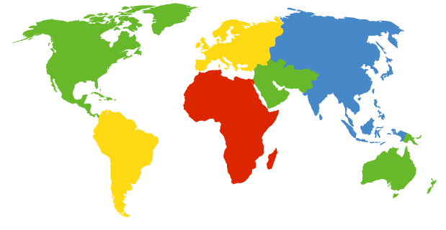
DNS: Root name servers
contacted by local name server that can not resolve name
root name server:
  contacts authoritative name server if name mapping not known
  gets mapping
  returns mapping to local name server
a Verisign, Dulles, VA
c Cogent, Herndon, VA (also LA)
d U Maryland College Park, MD
g US DoD Vienna, VA
h ARL Aberdeen, MD
j Verisign, ( 21 locations)
k RIPE London (also 16 other locations)
i Autonomica, Stockholm (plus 28 other locations)
e NASA Mt View, CA
f Internet Software C. Palo Alto, CA (and 36 other locations)
m WIDE Tokyo (also Seoul, Paris, SF)
13 root name servers worldwide
b USC-ISI Marina del Rey, CA
l ICANN Los Angeles, CA

Slide 88
TLD and Authoritative Servers
Top-level domain (TLD) servers:
  responsible for com, org, net, edu, etc, and all top-level country domains uk, fr, ca, jp.
  Network Solutions maintains servers for com TLD
  Education for edu TLD
Authoritative DNS servers:
  organization’s DNS servers, providing authoritative hostname to IP mappings for organization’s servers (e.g., Web, mail).
  can be maintained by organization or service provider

Slide 89
Local Name Server
does not strictly belong to hierarchy
each ISP (residential ISP, company, university) has one.
  also called “default name server”
when host makes DNS query, query is sent to its local DNS server
  acts as proxy, forwards query into hierarchy

Slide 90
Example
root DNS server
Host at cis.poly.edu wants IP address for gaia.cs.umass.edu
2
3
TLD DNS server
4
5
iterated query:
contacted server replies with name of server to contact
“I don’t know this name, but ask this server”
local DNS server
dns.poly.edu
7
6
1
8
authoritative DNS server
dns.cs.umass.edu
requesting host
cis.poly.edu
gaia.cs.umass.edu
Notes:
迭代的

Slide 91
Example
root DNS server
recursive query:
puts burden of name resolution on contacted name server
heavy load?
2
3
7
6
TLD DNS server
local DNS server
dns.poly.edu
5
4
1
8
authoritative DNS server
dns.cs.umass.edu
requesting host
cis.poly.edu
gaia.cs.umass.edu

Slide 92
DNS: caching and updating records
once (any) name server learns mapping, it caches mapping
  cache entries timeout (disappear) after some time
  TLD servers typically cached in local name servers
    Thus root name servers not often visited
update/notify mechanisms under design by IETF
  RFC 2136
  http://www.ietf.org/html.charters/dnsind-charter.html

Slide 93
DNS records
DNS: distributed db storing resource records (RR)
RR format: (name, value, type, ttl)
Type=A
  name is hostname
  value is IP address
Type=CNAME
  name is alias name for some “canonical” (the real) name
  www.ibm.com is really
  servereast.backup2.ibm.com
  value is canonical name
Type=NS
  name is domain (e.g. foo.com)
  value is hostname of authoritative name server for this domain
(www.ibm.com, servereast.backup2.ibm.com)
Type=MX
  value is name of mailserver associated with name

Slide 94
DNS protocol, messages
query and reply messages, both with same message format
2 bytes
2 bytes
message header
identification: 16 bit # for query, reply to query uses same #
flags:
  query or reply
  recursion desired
  recursion available
  reply is authoritative
identification
flags
# questions
# answer RRs
# authority RRs
# additional RRs
questions (variable # of questions)
answers (variable # of RRs)
authority (variable # of RRs)
additional info (variable # of RRs)

Slide 95
DNS protocol, messages
2 bytes
2 bytes
identification
flags
# questions
# answer RRs
# authority RRs
# additional RRs
name, type fields
for a query
questions (variable # of questions)
RRs in response
to query
answers (variable # of RRs)
records for
authoritative servers
authority (variable # of RRs)
additional “helpful”
info that may be used
additional info (variable # of RRs)

Slide 96
You start a new company (www.ali99.com) (web + mail)
What are the records inserted in to the hierarchy?

Slide 97


Inserting records into DNS
root DNS server
local DNS server
.com top-level DNS server
requesting host
www.ali99.com
authoritative DNS server
dns.ali99.com
www.ali99.com
mail.ali99.com

Slide 98
Inserting records into DNS
register name ali99.com at DNS registrar (e.g., Network Solutions)
  provide names, IP addresses of authoritative name server (primary and secondary)
  registrar inserts two RRs into com TLD server:
  (ali99.com, dns.ali99.com, NS)
  (dns.ali99.com, 212.212.212.1, A)
create authoritative server
  Type A record for www. ali99.com: (www.ali99.com, 212.212.212.100, A)
  Type MX record for ali99.com: (ali99.com, 212.212.212.101, MX)

Slide 99
Roadmap
2.1 Principles of network applications
2.2 Web and HTTP
2.3 FTP
2.4 Electronic Mail
2.5 DNS
2.5 P2P applications
2.6 Video Streaming and CDN

Slide 100
Pure P2P architecture
no always-on server
arbitrary end systems directly communicate
peers are intermittently connected and change IP addresses
Applications:
  File distribution
  Video streaming
peer-peer

Slide 101
What are the advantages of P2P over C/S?

Slide 102
File Distribution: Server-Client vs P2P
Question : How much time to distribute file from one server to N peers?
u_{s}: server upload bandwidth
Server
u_{i}: peer i upload bandwidth
u₁
d₁
u₂
u_{s}
d₂
d_{i}: peer i download bandwidth
File, size F
d_{N}
Network (with
abundant bandwidth)
u_{N}

Slide 103
File distribution time: server-client
Server
server sequentially sends N copies:
  NF/us time
client i takes F/di time to download
F
u₁
d₁
u₂
u_{s}
d₂
d_{N}
Network (with
abundant bandwidth)
u_{N}
Time to distribute F
to N clients using
client/server approach
= d_{cs} = max { NF/u_{s}, F/min(d_{i}) }
i
increases linearly in N
(for large N)

Slide 104
File distribution time: P2P
Server
server must send one copy: F/us time
client i takes F/di time to download
NF bits must be downloaded (aggregate)
F
u₁
d₁
u₂
u_{s}
d₂
d_{N}
Network (with
abundant bandwidth)
u_{N}
fastest possible upload rate: u_{s} + Su_{i}
d_{P2P} = max { F/u_{s}, F/min(d_{i}) , NF/(u_{s} + Su_{i}) }
i

Slide 105
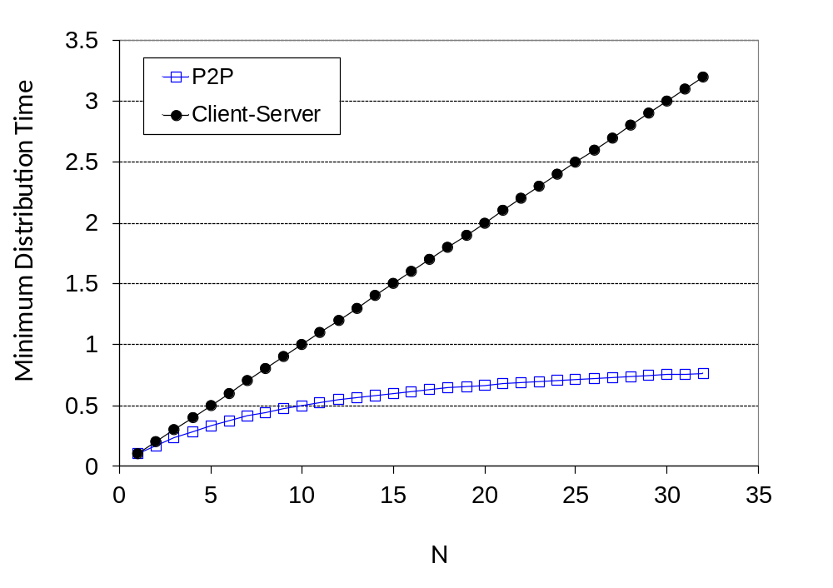
Server-client vs. P2P: example
Client upload rate = u, F/u = 1 hour, u_{s} = 10u, d_{min} ≥ u_{s}

Slide 106
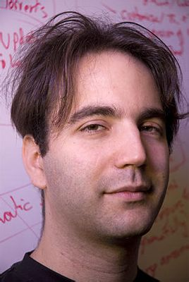
File distribution: BitTorrent
tracker: tracks peers
participating in torrent
torrent: group of
peers exchanging
chunks of a file
obtain list
of peers
trading
chunks
Published on April, 2001
Bram Cohen
peer

Slide 107
Torrent File
A .torrent file is a text file, which consists of two parts
(1) Information about Tracker
(2) Information about the file to be shared
  index of the blocks of the file
  hash value of each block

Slide 108
Overall Architecture
Web Server
Tracker
Web page
with link
to .torrent
.torrent
C
A
Peer
[Seed]
Peer
[Leech]
Downloader
“US”
B
Peer
[Leech]

Slide 109
Overall Architecture
Web Server
Tracker
Web page
with link
to .torrent
Get-announce
C
A
Peer
[Seed]
Peer
[Leech]
Downloader
“US”
B
Peer
[Leech]

Slide 110
Overall Architecture
Web Server
Tracker
Web page
with link
to .torrent
Response-peer list
C
A
Peer
[Seed]
Peer
[Leech]
Downloader
“US”
B
Peer
[Leech]

Slide 111
Overall Architecture
Web Server
Tracker
Web page
with link
to .torrent
Shake-hand
C
A
Peer
[Seed]
Peer
[Leech]
Downloader
“US”
Shake-hand
B
Peer
[Leech]

Slide 112
Overall Architecture
Web Server
Tracker
Web page
with link
to .torrent
pieces
C
A
pieces
Peer
[Seed]
Peer
[Leech]
Downloader
“US”
B
Peer
[Leech]

Slide 113
Overall Architecture
Web Server
Tracker
Web page
with link
to .torrent
pieces
C
A
pieces
Peer
[Seed]
Peer
[Leech]
Downloader
“US”
pieces
B
Peer
[Leech]

Slide 114
Overall Architecture
Web Server
Tracker
Web page
with link
to .torrent
Get-announce
Response-peer list
pieces
C
A
pieces
Peer
[Seed]
Peer
[Leech]
Downloader
“US”
pieces
B
Peer
[Leech]

Slide 115
BitTorrent (1)
file divided into 256KB chunks.
peer joining torrent:
  has no chunks, but will accumulate them over time
  registers with tracker to get list of peers, connects to subset of peers (“neighbors”)
while downloading, peer uploads chunks to other peers.
peers may come and go
once peer has entire file, it may (selfishly) leave or (altruistically) remain

Slide 116
BitTorrent (2)
Sending Chunks: tit-for-tat
Alice sends chunks to four neighbors currently sending her chunks at the highest rate
  re-evaluate top 4 every 10 secs
every 30 secs: randomly select another peer, starts sending chunks
  newly chosen peer may join top 4
Pulling Chunks
at any given time, different peers have different subsets of file chunks
periodically, a peer (Alice) asks each neighbor for list of chunks that they have.
Alice sends requests for her missing chunks
  rarest first

Slide 117
How do we organize peers and files in a distributed way?
Users can search and download files from the p2p network

Slide 118


A Straightforward Solution
Forrest Gump
J
D
C
Forrest Gump
B
I
F
Query
G
H
A

Slide 119
Better solutions?

Slide 120
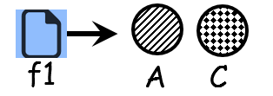
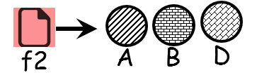
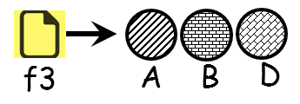
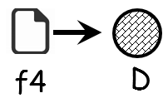
Basic Idea
index
(key, value)
A structure
organizing both peers and index
A
f1
f2
f3
f1
A
C
B
f3
f2
f2
A
B
D
A
f3
A
B
D
C
f1
B
C
f4
D
D
D
f3
f4
f2
Where to get f1?

Slide 121
Simple Database for Storing Index
Key (File name) | Value (IP Address)
The Zookeeper's Wife | 202.120.2.1
Ghost in the Shell | 202.120.1.8, 202.120.100.3
…….
…….
Forrest Gump | 202.112.3.4
The Index, i.e., (key, value) pairs!

Slide 122
Hash Table
More convenient to store and search on numerical representation of key
key = hash(original key)
Original Key (File name) | Numerical Key | Value (IP Address)
The Zookeeper's Wife | 02 | 202.120.2.1
Ghost in the Shell | 05 | 202.120.1.8, 202.120.100.3
…….
…….
Forrest Gump | 02 | 202.112.3.4
The Index, i.e., (key, value) pairs !

Slide 123
Distributed Hash Table (DHT)
Distribute (key, value) pairs over millions of peers
  pairs are evenly distributed over peers
Any peer can query DHT with a key
  DHT returns the value for the key
Each peer only knows about a small number of other peers
(key, value)
(key, value)
(key, value)
A
B
C
D
(key, value)

Slide 124
(key, value)
(key, value)
(key, value)
A
D
(key, value)
B
C
How do you distribute (key, value) pairs over peers?
What are objectives?
Notes:
Continuous playout -> end-to-end throughput
High bandwidth requirements on servers

Slide 125
Chord: Basic Idea
Key-Value Pairs
Peers
Original Key (File name) | Key IDs | Value (IP Address)
The Zookeeper's Wife | 2 | 202.120.5.18
Ghost in the Shellz | 5 | 202.120.1.8, 202.120.100.3
…….
…….
Forrest Gump | 2 | 202.112.3.4
Peer IP | Peer ID
202.120.2.1 | 2
202.120.1.8 | 3
…….
202.120.100.3 | 5
…….
Assignment
(The Zookeeper’s wife, 202.120.5.18)
(Forrest Gump, 202.112.3.4)
(Ghost in the Shellz, 202.120.1.8/202.120.100.3 )
Key hashed to ID space
IP hashed to ID space

Slide 126
Chord: details
rule: assign key-value pair to the peer that has the closest ID.
convention: closest is the immediate successor of the key.
e.g., ID space {0,1,2,3,…,63}
suppose 8 peers: 1,12,13,25,32,40,48,60
  If key = 51, then assigned to peer 60
  If key = 60, then assigned to peer 60
  If key = 61, then assigned to peer 1

Slide 127

















Circular DHT
1
12
60
13
48
25
40
32
“overlay network”

Slide 128
Resolving a query
1
What is the value (IP)
associated with key 53 ?
value
12
60
13
48
O(N) messages
on average to resolve
query, when there
are N peers
25
40
32

Slide 129
Circular DHT with shortcuts
1
value
What is the value (IP) for
key 53
12
60
13
48
25
40
32
each peer keeps track of IP addresses of predecessor, successor, short cuts.
reduced from 6 to 3 messages.
possible to design shortcuts with O(log N) neighbors, O(log N) messages in query

Slide 130
Peer churn
1
3
handling peer churn:
peers may come and go (churn)
each peer knows address of its two successors
each peer periodically pings its
two successors to check aliveness
if immediate successor leaves, choose next successor as new immediate successor
15
4
12
5
10
8
example: peer 5 abruptly leaves

Slide 131
Peer churn
1
3
handling peer churn:
peers may come and go (churn)
each peer knows address of its two successors
each peer periodically pings its
two successors to check aliveness
if immediate successor leaves, choose next successor as new immediate successor
15
4
12
10
8
example: peer 5 abruptly leaves
peer 4 detects peer 5’s departure; makes 8 its immediate successor
4 asks 8 who its immediate successor is; makes 8’s immediate successor its second successor.

Slide 132
Roadmap
2.1 Principles of network applications
2.2 Web and HTTP
2.3 FTP
2.4 Electronic Mail
2.5 DNS
2.5 P2P applications
2.6 Video Streaming and CDN

Slide 133
What are unique characteristics of video streaming applications?
Notes:
Continuous playout -> end-to-end throughput
High bandwidth requirements on servers

Slide 134





Video Streaming and CDNs: context
video traffic: major consumer of Internet bandwidth
  Netflix, YouTube: 37%, 16% of downstream residential ISP traffic
  ~1B YouTube users, ~75M Netflix users
Challenge 1: heterogeneity
  different users have different capabilities (e.g., wired versus mobile; bandwidth rich versus bandwidth poor)
Challenge 2: scale - how to reach ~1B users?
  single mega-video server won’t work (why?)

Slide 135

Multimedia: video
spatial coding example: instead of sending N values of same color (all purple), send only two values: color value (purple) and number of repeated values (N)
video: sequence of images displayed at constant rate
  e.g., 24 images/sec
digital image: array of pixels
  each pixel represented by bits
coding: use redundancy within and between images to decrease # bits used to encode image
  spatial (within image)
  temporal (from one image to next)
……………………..
……………….…….
frame i
temporal coding example: instead of sending complete frame at i+1, send only differences from frame i
frame i+1

Slide 136
Video encoding
spatial coding example: instead of sending N values of same color (all purple), send only two values: color value (purple) and number of repeated values (N)
Coding examples:
MPEG 1 (CD-ROM) 1.5 Mbps
MPEG2 (DVD) 3-6 Mbps
MPEG4 (often used in Internet, < 1 Mbps)
……………………..
……………….…….
frame i
temporal coding example: instead of sending complete frame at i+1, send only differences from frame i
frame i+1

Slide 137


Streaming stored video:
Internet
video server
(stored video)
client
simple scenario:

Slide 138
Challenge 1: heterogeneity
How do we address it?

Slide 139
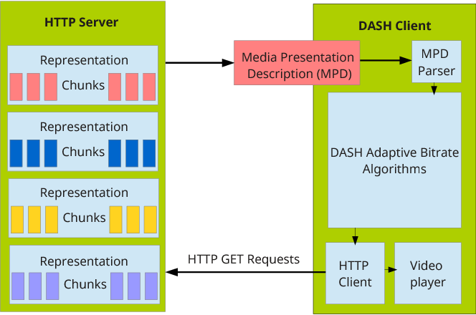
Streaming multimedia: DASH
server:
  divides video file into multiple chunks
  each chunk stored, encoded at different rates
  manifest file: provides URLs for different chunks
client:
  periodically measures server-to-client bandwidth
  consulting manifest, requests one chunk at a time
    chooses maximum coding rate sustainable given current bandwidth
    can choose different coding rates at different points in time (depending on available bandwidth at time)
DASH: Dynamic, Adaptive Streaming over HTTP

Slide 140
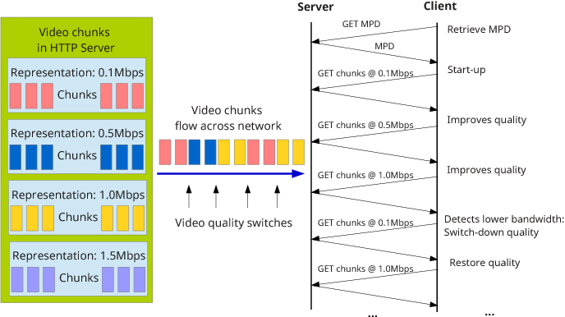
Streaming multimedia: DASH
when to request chunk (so that buffer starvation, or overflow does not occur)
what encoding rate to request (higher quality when more bandwidth available)
where to request chunk (can request from URL server that is “close” to client or has high available bandwidth)
“intelligence” at client: client determines

Slide 141
Challenge 2: Streaming to hundreds of thousands of simultaneous users
How do we address it?

Slide 142
Option 1: Mega-server
Disadvantages
  single point of failure
  point of network congestion
  long path to distant clients
  multiple copies of video sent over outgoing link
this solution doesn’t scale

Slide 143






Option 2: CDN Overview
…
…
Video website
…
manifest file
…
where’s Madmen?
…
…
CDN server
CDN server
CDN server
CDN server
Content Distribution Networks
Notes:
143
Akamai: 100,000+ servers in 1000+ clusters in 1000+ networks in 70+ countries serving trillions of requests a day.
How many people use Netflix?

Slide 144
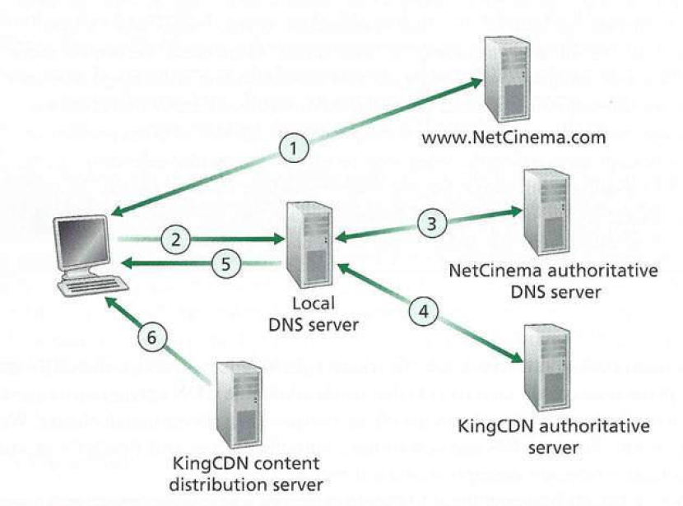


CDN content access: a closer look
CDN Server IP
DNS redirects a user’s request to a CDN server

Slide 145
Return which CDN server to the user?
How do we assign the CDN server that provides best performance to the user
The main idea
Step 1: the CDN learns the IP address of the user
How?
Step 2: Assign the CDN server that is geographically closest to the user host.
How?

Slide 146
Chapter 2: Summary
typical request/reply message exchange:
  client requests info or service
  server responds with data, status code
message formats:
  headers: fields giving info about data
  data: info being communicated
Important themes:
  control vs. data msgs
    in-band, out-of-band
  centralized vs. decentralized
  stateless vs. stateful
  reliable vs. unreliable msg transfer
  “complexity at network edge”

Slide 147
Homeworks
Chapter 01 problems:
  P1, P9, P14, P16, P25
Chapter 02 problems:
  P7, P14, P19, P27, P30
No submission required!

Slide 148
Lab #2
One application layer protocol
  DNS (PDF)

