Slide 1
Chapter 3
Transport Layer
Yanmin Zhu
School of Computers

Slide 2
Discussions
The services provided by and used by the transport layer
Challenges of reliable data transfer and how do we address them?
Congestion happens! How do you handle congestion？What are the objectives of congestion control?

Slide 3
Outline
3.1 Transport-layer services
3.2 Multiplexing and demultiplexing
3.3 Connectionless transport: UDP
3.4 Principles of reliable data transfer
3.5 Connection-oriented transport: TCP
3.6 Principles of congestion control
3.7 TCP congestion control

Slide 4


















Transport services and protocols
application
transport
network
data link
physical
provide logical communication between app processes running on different hosts
transport protocols run in end systems
  send side: breaks app messages into segments, passes to network layer
  rcv side: reassembles segments into messages, passes to app layer
more than one transport protocol available to apps
  Internet: TCP and UDP
logical end-end transport
application
transport
network
data link
physical

Slide 5
Transport vs. network layer
network layer: logical communication between hosts
transport layer: logical communication between processes
  relies on network layer services
  Enhances
Household analogy:
  12 kids sending letters to 12 kids
  processes = kids
  app messages = letters in envelopes
  hosts = houses
  transport protocol = Ann and Bill
  network-layer protocol = postal service

Slide 6
Message, Segment, Datagram
APPLICATION LAYER (Message)
TRANSPORT LAYER (Segment)
NETWORK LAYER (Datagram)
message
datagram
header
tran.
header
app
header
data
segment
datagram

Slide 7





Internet transport-layer protocols
application
transport
network
data link
physical
reliable, in-order delivery (TCP)
  congestion control
  flow control
  connection setup
unreliable, unordered delivery: UDP
  no-frills extension of “best-effort” IP
services not available:
  delay guarantees
  bandwidth guarantees
network
data link
physical
network
data link
physical
logical end-end transport
network
data link
physical
network
data link
physical
network
data link
physical
network
data link
physical
application
transport
network
data link
physical

Slide 8
Outline
3.1 Transport-layer services
3.2 Multiplexing and demultiplexing
3.3 Connectionless transport: UDP
3.4 Principles of reliable data transfer
3.5 Connection-oriented transport: TCP
3.6 Principles of congestion control
3.7 TCP congestion control

Slide 9

Multiplexing/demultiplexing
multiplexing at sender:
demultiplexing at receiver:
use header info to deliver
received segments to correct
socket
handle data from multiple
sockets, add transport header (later used for demultiplexing)
application
application
P1
P2
application
socket
P3
transport
P4
process
transport
network
transport
network
link
network
link
physical
link
physical
physical

Slide 10
TCP/UDP segment format: port #s
32 bits
source port #
dest port #
other header fields
application
data
(payload)
TCP/UDP segment format

Slide 11
Connectionless demultiplexing
What header information is used for demultiplexing at the receiver host?
when host receives UDP segment:
checks destination port # in segment
directs UDP segment to socket with that port #
IP datagrams with same dest. port #, but different source IP addresses and/or source port numbers will be directed to same socket at dest
Notes:
What header information is used for demultiplexing at the receiver host?

Slide 12
Connectionless demux: example
DatagramSocket serverSocket = new DatagramSocket (6428);
DatagramSocket mySocket2 = new DatagramSocket (9157);
DatagramSocket mySocket1 = new DatagramSocket (5775);
application
application
P1
application
P3
P4
transport
transport
network
transport
network
link
network
link
physical
link
physical
physical
source port: 6428
dest port: 9157
source port: ?
dest port: ?
source port: 9157
dest port: 6428
source port: ?
dest port: ?

Slide 13
Connection-oriented demultiplexing
What header information is used for demultiplexing?
TCP socket identified by 4-tuple:
  source IP address
  source port number
  dest IP address
  dest port number
demux: receiver uses all four values to direct segment to appropriate socket
server host may support many simultaneous TCP sockets:
  each socket identified by its own 4-tuple
web servers have different sockets for each connecting client
  non-persistent HTTP will have different socket for each request

Slide 14
Connection-oriented demux: example
3 segments, all destined to IP add: B, dest port: 80 are demultiplexed
application
application
P4
P5
P6
application
P1
P2
P3
transport
transport
network
transport
network
link
network
link
physical
link
physical
physical
server: IP address B
host: IP address A
host: IP address C
source IP,port: B,80
dest IP,port: A,9157
source IP,port: C,5775
dest IP,port: B,80
source IP,port: A,9157
dest IP, port: B,80
source IP,port: C,9157
dest IP,port: B,80

Slide 15
Connection-oriented demux: example
threaded server
application
application
application
P4
P3
P1
P2
transport
transport
network
transport
network
link
network
link
physical
link
physical
physical
server: IP address B
host: IP address A
host: IP address C
source IP, port: B,80
dest IP, port: A,9157
source IP, port: C,5775
dest IP, port: B,80
source IP, port: A,9157
dest IP, port: B,80
source IP, port: C,9157
dest IP, port: B,80

Slide 16
Outline
3.1 Transport-layer services
3.2 Multiplexing and demultiplexing
3.3 Connectionless transport: UDP
3.4 Principles of reliable data transfer
3.5 Connection-oriented transport: TCP
3.6 Principles of congestion control
3.7 TCP congestion control

Slide 17
UDP: User Datagram Protocol [RFC 768]
“no frills,” “bare bones” Internet transport protocol
“best effort” service, UDP segments may be:
  lost
  delivered out of order to app
Why is there a UDP?
no connection establishment (which can add delay)
small segment header
no congestion control: UDP can blast away as fast as desired
simple: no connection state at sender, receiver
Connectionless:
  no handshaking between UDP sender, receiver
  each UDP segment handled independently of others

Slide 18
UDP: more
often used for streaming multimedia apps
  loss tolerant
  rate sensitive
other UDP uses
  DNS
  SNMP
reliable transfer over UDP: add reliability at application layer
  application-specific error recovery!
32 bits
source port #
dest port #
length
checksum
Length, in
bytes of UDP
segment,
including
header
Application
data
(message)
UDP segment format
Notes:
How to compute 16-bit one's complement sum
What that means is:
1. Add the 16-bit values up. Each time a carry-out (17th bit) is
produced, swing that bit around and add it back into the LSb (one's
digit). This is somewhat erroneously referred to as "one's complement
addition."
2. Once all the values are added in this manner, invert all the bits
in the result. A binary value that has all the bits of another binary
value inverted is called its "one's complement," or simply its
"complement."
For example, suppose our header has the following data. I separate the
data into groups of 4 bits only for readability. (I know that headers
are really longer than 8 bytes, but this will demonstrate the
process):
1000 0110 0101 1110
1010 1100 0110 0000
0111 0001 0010 1010
1000 0001 1011 0101
First, we add the 16-bit values 2 at a time:
1000 0110 0101 1110 First 16-bit value
+ 1010 1100 0110 0000 Second 16-bit value
---------------------
1 0011 0010 1011 1110 Produced a carry-out, which gets added
+ /----------------> 1 back into LBb
---------------------
0011 0010 1011 1111
+ 0111 0001 0010 1010 Third 16-bit value
---------------------
0 1010 0011 1110 1001 No carry to swing around (**)
+ 1000 0001 1011 0101 Fourth 16-bit value
---------------------
1 0010 0101 1001 1110 Produced a carry-out, which gets added
+ /----------------> 1 back into LBb
---------------------
0010 0101 1001 1111 Our "one's complement sum"
(**) Note that we could "swing around" the carry-out of 0, but adding
0 back into the LSb has no affect on the sum. (But technically, that's
what the checksum generator does.)
Of course, we'd continue to add the rest of the header data in 16-bit
segments until all data were included.
Then we have to take the one's complement of the sum. We do this by
simply inverting all the bits in the final result from above:
0010 0101 1001 1111 Our "one's complement sum"
1101 1010 0110 0000 The "one's complement"
So the checksum stored in the header would be 1101 1010 0110 0000.
引入 反码和补码（1’s complement and 2’s complement），主要解决计算机只做加法的问题。只做加法，意味着要把减法表达为加法运算。2-1=2+(-1)。
正数的反码：就是正数的2进制表示；负数的反码：第一位是1，表示负数，其他部分为正数二进制的取反。
反码的问题是 0 有两种表达方式
补码解决了反码的问题，0只有一种表达，即0 000
正数的反码：及时正数的二进制表示；负数的补码：第一位是1，表示负数，其他部分为正数二进制的取反，再加1。

Slide 19
UDP checksum
Goal: detect “errors” (e.g., flipped bits) in transmitted segment
Sender:
treat segment contents as sequence of 16-bit integers
checksum: addition of segment contents and then take the 1’s complement of the sum
sender puts checksum value into UDP checksum field
Receiver:
compute checksum of received segment
check if computed checksum equals checksum field value:
  NO - error detected
  YES - no error detected. But maybe errors nonetheless? More later ….

Slide 20
Internet Checksum Example
Note
  When adding numbers, a carryout from the most significant bit needs to be added to the result
Example: add two 16-bit integers
1 1 1 1 0 0 1 1 0 0 1 1 0 0 1 1 0
1 1 1 0 1 0 1 0 1 0 1 0 1 0 1 0 1
1 1 0 1 1 1 0 1 1 1 0 1 1 1 0 1 1
1 1 0 1 1 1 0 1 1 1 0 1 1 1 1 0 0
1 0 1 0 0 0 1 0 0 0 1 0 0 0 0 1 1
wraparound
sum
checksum
Receiver side: checksum + sum of data = 11111….111
Notes:
Kurose and Ross forgot to say anything about wrapping the carry and adding it to low order bit

Slide 21
Real-world practice:
What fields are included for checksum calculation?

Slide 22
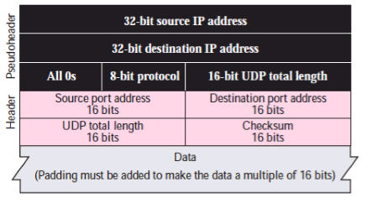
The fields for checksum calculation
three sections:
1) a pseudo header, 2) the UDP header, and 3) the data coming from the application layer.
Notes:
As an example, suppose that we have the bit stream 0110011001100110 0110011001100110 0000111100001111:
This bit stream is divided into segments of 16-bits integers.
So, it looks like this:
0110011001100110 (16-bit integer segment)
0101010101010101
0000111100001111
The sum of first of these 16-bit words is:
0110011001100110
0101010101010101
−−−−−−−−−−−−−−−−−−−−−−−−−−−−−−−−−−−−−−−−−−−−−−−−−−−−−−−−−−−−
1011101110111011
Adding the third word to the above sum gives
1011101110111011
0000111100001111
−−−−−−−−−−−−−−−−−−−−−−−−−−−−−−−−−−−−−−−−−−−−−−−−−−−−−−−−−−
1100101011001010 (sum of all segments)
Now to calculate checksum 1's complement of sum is taken. As I mentioned earlier, 1's complement is achieved by converting all 1s into 0s and all 0s into 1s. So, the checksum at sender side is: 0011010100110101.
Now at the receiver side, again all segments are added .and sum is added with sender's checksum.
If no error than check of receiver would be: 1111111111111111.

Slide 23
Outline
3.1 Transport-layer services
3.2 Multiplexing and demultiplexing
3.3 Connectionless transport: UDP
3.4 Principles of reliable data transfer
3.5 Connection-oriented transport: TCP
3.6 Principles of congestion control
3.7 TCP congestion control

Slide 24
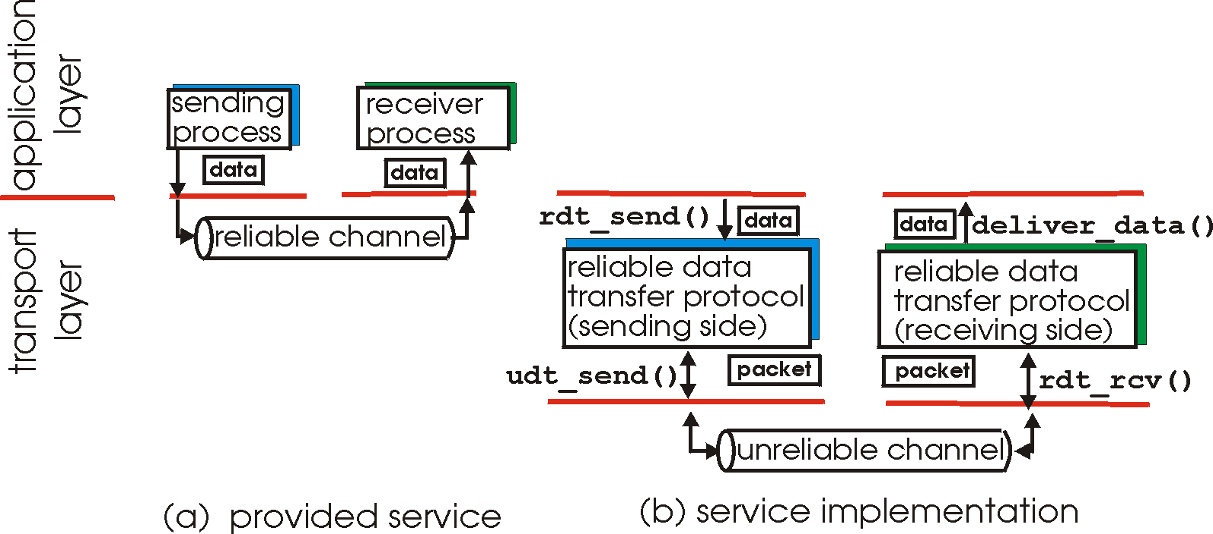
Principles of reliable data transfer
important in app., transport, link layers
one of most important networking topics!
characteristics of unreliable channel will determine complexity of reliable data transfer protocol (rdt)

Slide 25
Principles of reliable data transfer
important in app., transport, link layers
one of most important networking topics!
characteristics of unreliable channel will determine complexity of reliable data transfer protocol (rdt)

Slide 26
Principles of reliable data transfer
important in app., transport, link layers
one of most important networking topics!
characteristics of unreliable channel will determine complexity of reliable data transfer protocol (rdt)

Slide 27
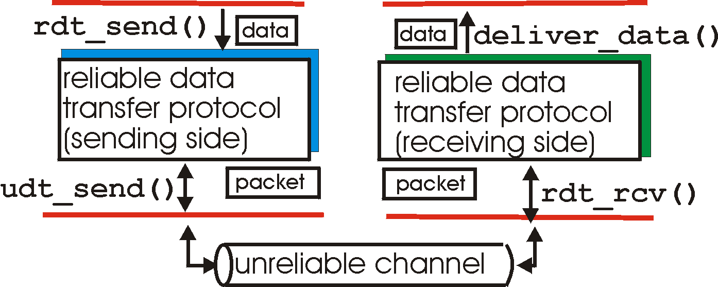
Reliable data transfer: getting started
rdt_send(): called from above, (e.g., by app.). Passed data to
deliver to receiver upper layer
deliver_data(): called by rdt to deliver data to upper
send
side
receive
side
udt_send(): called by rdt,
to transfer packet over
unreliable channel to receiver
rdt_rcv(): called when packet arrives on rcv-side of channel

Slide 28
Reliable data transfer: getting started
We’ll:
incrementally develop sender, receiver sides of reliable data transfer protocol (rdt)
consider only unidirectional data transfer
  but control info will flow on both directions!
use finite state machines (FSM) to specify sender, receiver
event causing state transition
actions taken on state transition
state: when in this “state” next state uniquely determined by next event
state
1
state
2
event
actions

Slide 29
What are the main causes for unreliable data transfer?
Bit error, packet loss, reordering of packets

Slide 30
Roadmap for creating RDT
S
R
Bit error
Assumptions
Packet loss
The channel does not reorder messages!
rdt1.0
No bit error, no loss
rdt2.0
With bit error, no loss
rdt3.0
With bit error and loss
Common simplifying assumption: no reordering of messages

Slide 31
rdt1.0: over a reliable channel
underlying channel perfectly reliable
  no bit errors
  no loss of packets
separate FSMs for sender, receiver:
  sender sends data into underlying channel
  receiver read data from underlying channel
In truth, a reliable channel
Wait for call from above
rdt_send(data)
Wait for call from below
rdt_rcv(packet)
extract (packet,data)
deliver_data(data)
packet = make_pkt(data)
udt_send(packet)
rdt1.0 sender
rdt1.0 receiver

Slide 32
rdt 2.0: Channel with bit error
New assumption:
underlying channel may flip bits in packet
What new problem is created?
Packet Sent
Packet contains bit errors
S
R

Slide 33
Questions
(1) how to detect bit errors?
Solution: Error detection code (EDC)!
The sender encode packets with EDC, and the receiver detects bit errors
(2) how to recover from packets with bit errors?
Solution: feedback (ACK and NAK)!
The receiver informs the sender of the correctness of received packet. When NAK, retransmits!

Slide 34
rdt2.0 FSMs
rdt_rcv(rcvpkt) &&
corrupt(rcvpkt)
rdt_send(data)
snkpkt = make_pkt(data, checksum)
udt_send(sndpkt)
udt_send(NAK)
rdt_rcv(rcvpkt) &&
isNAK(rcvpkt)
Wait for call from above
Wait for ACK or NAK
Wait for call from below
udt_send(sndpkt)
rdt_rcv(rcvpkt) &&
notcorrupt(rcvpkt)
rdt_rcv(rcvpkt) && isACK(rcvpkt)
L
extract(rcvpkt,data)
deliver_data(data)
udt_send(ACK)
rdt2.0 sender
rdt2.0 receiver
Notes:
发送者，2个状态，
1）等待发送
2）等待确认
接受者，1个状态，
等待

Slide 35
rdt2.0: operation with no errors
rdt_send(data)
snkpkt = make_pkt(data, checksum)
udt_send(sndpkt)
rdt_rcv(rcvpkt) &&
isNAK(rcvpkt)
Wait for call from above
Wait for ACK or NAK
rdt_rcv(rcvpkt) &&
corrupt(rcvpkt)
udt_send(sndpkt)
udt_send(NAK)
rdt_rcv(rcvpkt) && isACK(rcvpkt)
L
Wait for call from below
rdt_rcv(rcvpkt) &&
notcorrupt(rcvpkt)
extract(rcvpkt,data)
deliver_data(data)
udt_send(ACK)

Slide 36
rdt2.0: error scenario
rdt_send(data)
snkpkt = make_pkt(data, checksum)
udt_send(sndpkt)
rdt_rcv(rcvpkt) &&
isNAK(rcvpkt)
Wait for call from above
Wait for ACK or NAK
rdt_rcv(rcvpkt) &&
corrupt(rcvpkt)
udt_send(sndpkt)
udt_send(NAK)
rdt_rcv(rcvpkt) && isACK(rcvpkt)
L
Wait for call from below
rdt_rcv(rcvpkt) &&
notcorrupt(rcvpkt)
extract(rcvpkt,data)
deliver_data(data)
udt_send(ACK)

Slide 37
rdt2.0 has a fatal error!
What is wrong?

Slide 38
rdt2.0 has a fatal flaw!
Packet Sent
Packet Received
ACK
Note: with error detection, a corrupted feedback packet results in retransmission
S
R
ACK corrupted
A duplicate or new valid packet?
Packet Retransmitted
What happens if ACK/NAK corrupted?
sender doesn’t know what happened at receiver!
can’t just retransmit: possible duplicate

Slide 39
How do we handle the possible duplication packets received at the receiver?
Notes:
Idea: the sender include a tag saying that this is a retransmission or not, which let the receiver be able to know if it is a duplicate.

Slide 40
Handling duplicates:
#0
#0
Packet Sent
Packet Received
ACK
Note: with error detection, a corrupted feedback packet results in retransmission
S
R
ACK corrupted
A duplicate or new valid packet?
Packet Retransmitted
#0
#0
sender retransmits current pkt if ACK/NAK garbled
sender adds sequence number to each pkt
receiver discards (doesn’t deliver up) duplicate pkt

Slide 41
How many bits for seq. #’
suffice?
Why?

Slide 42
Why 1 bit is sufficient?
#2
#1
#0
time
next
current
S
R
Just distinguish ‘current’ and ‘next’
stop and wait
Sender sends one packet,
then waits for receiver
response

Slide 43
How do we revise the rdt2.0 FSMs for the rdt2.1 sender and receiver, respectively?

Slide 44
Revisit: rdt2.0 FSMs
rdt2.0 sender
rdt2.0 receiver
rdt_rcv(rcvpkt) &&
corrupt(rcvpkt)
rdt_send(data)
snkpkt = make_pkt(data, checksum)
udt_send(sndpkt)
udt_send(NAK)
rdt_rcv(rcvpkt) &&
isNAK(rcvpkt)
Wait for call from above
Wait for ACK or NAK
Wait for call from below
udt_send(sndpkt)
rdt_rcv(rcvpkt) &&
notcorrupt(rcvpkt)
rdt_rcv(rcvpkt) && isACK(rcvpkt)
L
extract(rcvpkt,data)
deliver_data(data)
udt_send(ACK)
Notes:
发送者和接受者，状态都翻倍
发送者：
等待发送0#，等待确认0#
等待发送1#，等待确认1#
接受者：
等待收到0#
等待收到1#

Slide 45
rdt2.1 sender FSM
rdt_send(data)
sndpkt = make_pkt(0, data, checksum)
udt_send(sndpkt)
rdt_rcv(rcvpkt) &&
( corrupt(rcvpkt) ||
isNAK(rcvpkt) )
#0
Wait for call 0 from above
#0
Wait for ACK or NAK 0
udt_send(sndpkt)
rdt_rcv(rcvpkt)
&& notcorrupt(rcvpkt)
&& isACK(rcvpkt)
rdt_rcv(rcvpkt)
&& notcorrupt(rcvpkt)
&& isACK(rcvpkt)
L
L
#1
#1
Wait for ACK or NAK 1
Wait for
call 1 from above
rdt_rcv(rcvpkt) &&
( corrupt(rcvpkt) ||
isNAK(rcvpkt) )
rdt_send(data)
udt_send(sndpkt)
sndpkt = make_pkt(1, data, checksum)
udt_send(sndpkt)
rdt2.1 sender
Notes:
绿色条件：没错
红色条件：出错

Slide 46
rdt2.1 receiver FSM
rdt_rcv(rcvpkt) && notcorrupt(rcvpkt)
&& has_seq0(rcvpkt)
extract(rcvpkt,data)
deliver_data(data)
sndpkt = make_pkt(ACK, chksum)
udt_send(sndpkt)
rdt_rcv(rcvpkt) && corrupt(rcvpkt)
rdt_rcv(rcvpkt) && corrupt(rcvpkt)
sndpkt = make_pkt(NAK, chksum)
udt_send(sndpkt)
sndpkt = make_pkt(NAK, chksum)
udt_send(sndpkt)
Wait for
0 from below
Wait for
1 from below
rdt_rcv(rcvpkt) &&
not corrupt(rcvpkt) &&
has_seq1(rcvpkt)
rdt_rcv(rcvpkt) &&
not corrupt(rcvpkt) &&
has_seq0(rcvpkt)
#0
#1
sndpkt = make_pkt(ACK, chksum)
udt_send(sndpkt)
sndpkt = make_pkt(ACK, chksum)
udt_send(sndpkt)
rdt_rcv(rcvpkt) && notcorrupt(rcvpkt)
&& has_seq1(rcvpkt)
extract(rcvpkt,data)
deliver_data(data)
sndpkt = make_pkt(ACK, chksum)
udt_send(sndpkt)
rdt2.1 receiver
Notes:
绿色条件：没错
红色条件：出错
深褐色条件：重复

Slide 47
rdt2.1: discussion
Sender:
Receiver:
seq # (1bit) added to pkt
must check if received ACK/NAK corrupted
twice as many states
  state must “remember” whether “current” pkt has 0 or 1 seq. #
must check if received packet is duplicate
  state indicates whether 0 or 1 is expected pkt seq #
note: receiver can not know if its last ACK/NAK received OK at sender

Slide 48
rdt2.2: a NAK-free protocol
same functionality as rdt2.1, using ACKs only
instead of NAK, receiver sends ACK for last pkt received OK
  receiver must explicitly include seq # of pkt being ACKed
duplicate ACK at sender results in same action as NAK: retransmit current pkt

Slide 49
How do we revise the rdt2.1 FSMs for the rdt2.2 sender and receiver, respectively?

Slide 50
rdt2.2 Sender FSM
rdt_send(data)
sndpkt = make_pkt(0, data, checksum)
udt_send(sndpkt)
rdt_rcv(rcvpkt) &&
( corrupt(rcvpkt) ||
isACK(rcvpkt,1) )
#0
Wait for call 0 from above
#0
Wait for ACK
0
rdt_rcv(rcvpkt)
&& notcorrupt(rcvpkt)
&& isACK(rcvpkt,1)
udt_send(sndpkt)
rdt_rcv(rcvpkt)
&& notcorrupt(rcvpkt)
&& isACK(rcvpkt,0)
L
#1
#1
Wait for ACK or NAK 1
Wait for
call 1 from above
L
rdt_rcv(rcvpkt) &&
( corrupt(rcvpkt) ||
isACK (rcvpkt, 0) )
rdt_send(data)
udt_send(sndpkt)
sndpkt = make_pkt(1, data, checksum)
udt_send(sndpkt)
rdt2.2 sender

Slide 51
rdt2.2 Receiver FSMs
rdt_rcv(rcvpkt) && notcorrupt(rcvpkt)
&& has_seq0(rcvpkt)
extract(rcvpkt,data)
deliver_data(data)
sndpkt = make_pkt(ACK0, chksum)
udt_send(sndpkt)
rdt_rcv(rcvpkt) &&
(corrupt(rcvpkt) ||
has_seq1(rcvpkt))
rdt_rcv(rcvpkt) &&
(corrupt(rcvpkt) ||
has_seq0(rcvpkt))
Wait for
0 from below
receiver FSM
fragment
Wait for
1 from below
udt_send(sndpkt)
udt_send(sndpkt)
#0
#1
rdt_rcv(rcvpkt) && notcorrupt(rcvpkt)
&& has_seq1(rcvpkt)
extract(rcvpkt,data)
deliver_data(data)
sndpkt = make_pkt(ACK1, chksum)
udt_send(sndpkt)
rdt 2.2 receiver
Notes:
什么时候发生最右边的transition？ Receiver发送了ACK0，但Sender收到一个corrupted pkt，重新发送，Receiver收到数据的时候。

Slide 52
rdt3.0: channels with errors and loss
New assumption:
underlying channel can also lose packets (data or ACKs)
What new problem is created?
Packet Sent
Packet Lost
S
R

Slide 53
Two Problems
(1) The sender cannot receive an ACK for a lost packet?
Solution: introduce a Timer!
Retransmit a packet after the sender waits for a certain amount of time
(2) The timer fires prematurely! The packet is just delayed!
-> A duplicate packet is received as a result of retranmission
Solution: sequence #!
The receiver discards a duplicate packet

Slide 54
How do we revise the rdt2.2 FSMs for the rdt3.0 sender and receiver, respectively?
Notes:
Add a timer!

Slide 55
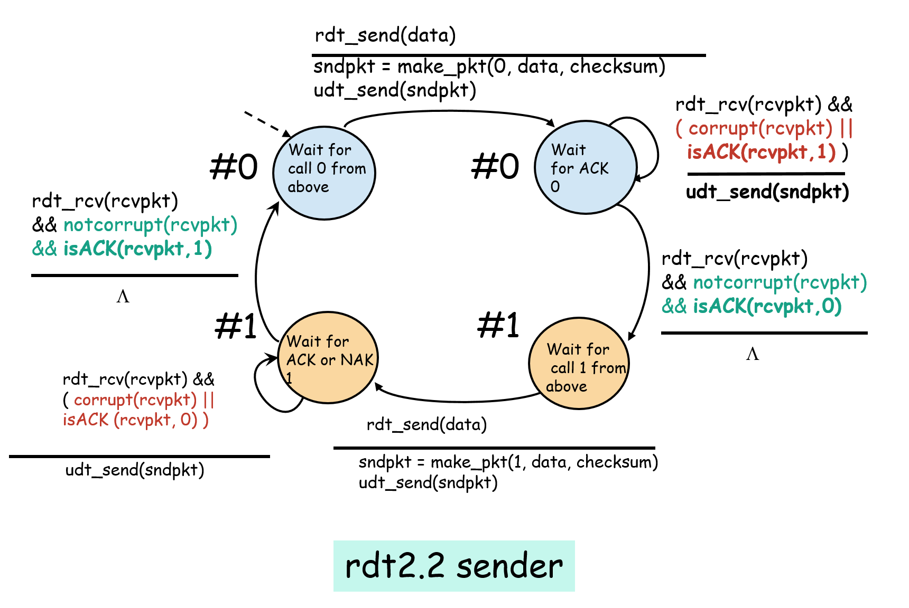
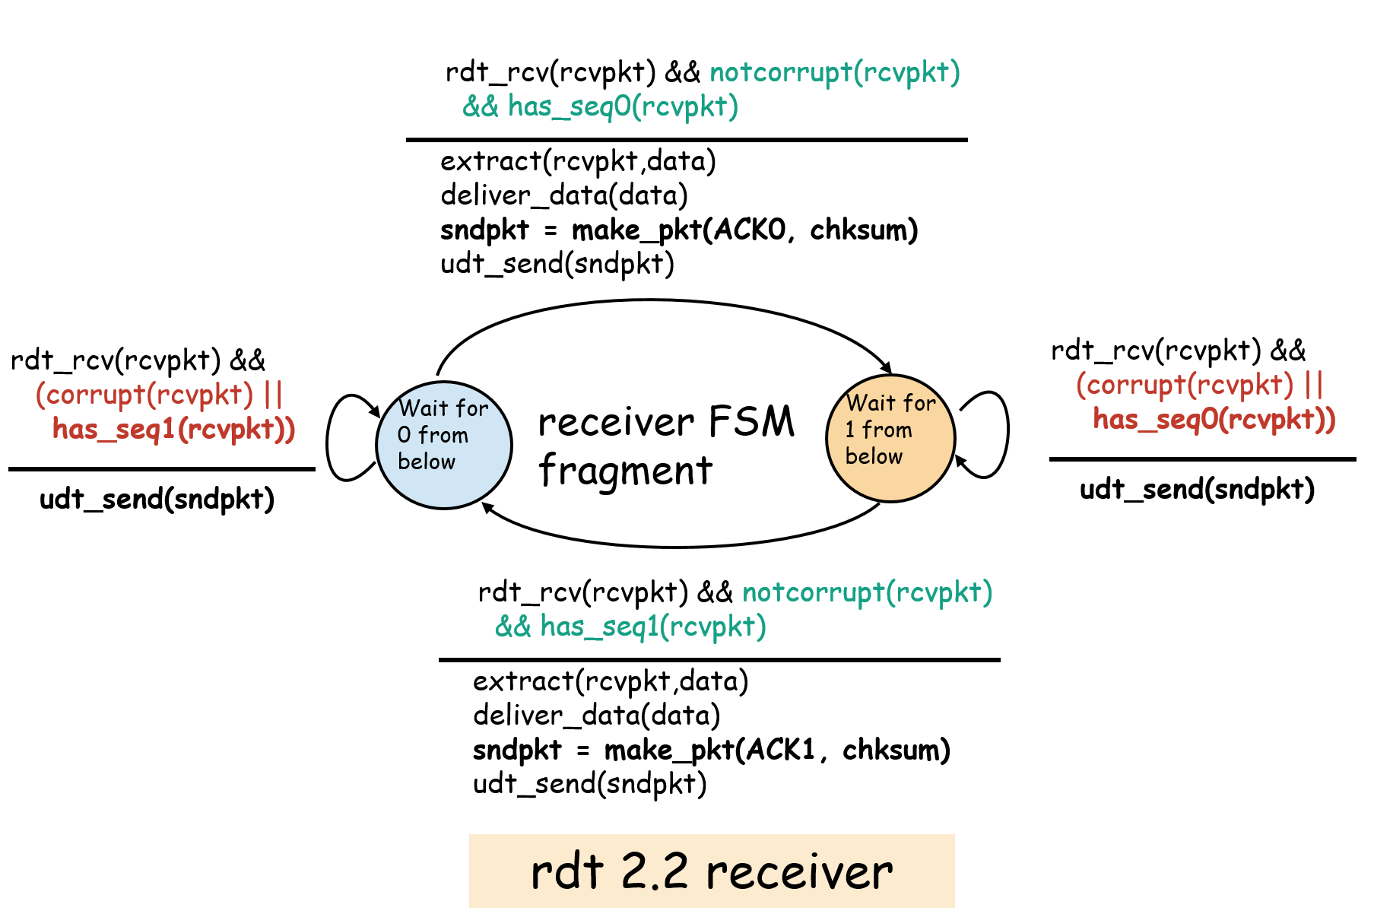
Revisit: rdt2.2 FSMs

Slide 56
FSMs of rdt3.0
rdt_send(data)
rdt_rcv(rcvpkt) &&
( corrupt(rcvpkt) ||
isACK(rcvpkt,1) )
sndpkt = make_pkt(0, data, checksum)
udt_send(sndpkt)
start_timer
rdt_rcv(rcvpkt)
L
L
Wait for
call 0from above
Wait for ACK0
timeout
#0
#0
udt_send(sndpkt)
start_timer
rdt_rcv(rcvpkt)
&& notcorrupt(rcvpkt)
&& isACK(rcvpkt,1)
rdt_rcv(rcvpkt)
&& notcorrupt(rcvpkt)
&& isACK(rcvpkt,0)
stop_timer
stop_timer
Wait for ACK1
#1
#1
Wait for
call 1 from above
timeout
udt_send(sndpkt)
start_timer
rdt_rcv(rcvpkt)
rdt_send(data)
L
rdt_rcv(rcvpkt) &&
( corrupt(rcvpkt) ||
isACK(rcvpkt,0) )
sndpkt = make_pkt(1, data, checksum)
udt_send(sndpkt)
start_timer
L
rdt3.0 sender
rdt3.0 receiver same as 2.2

Slide 57
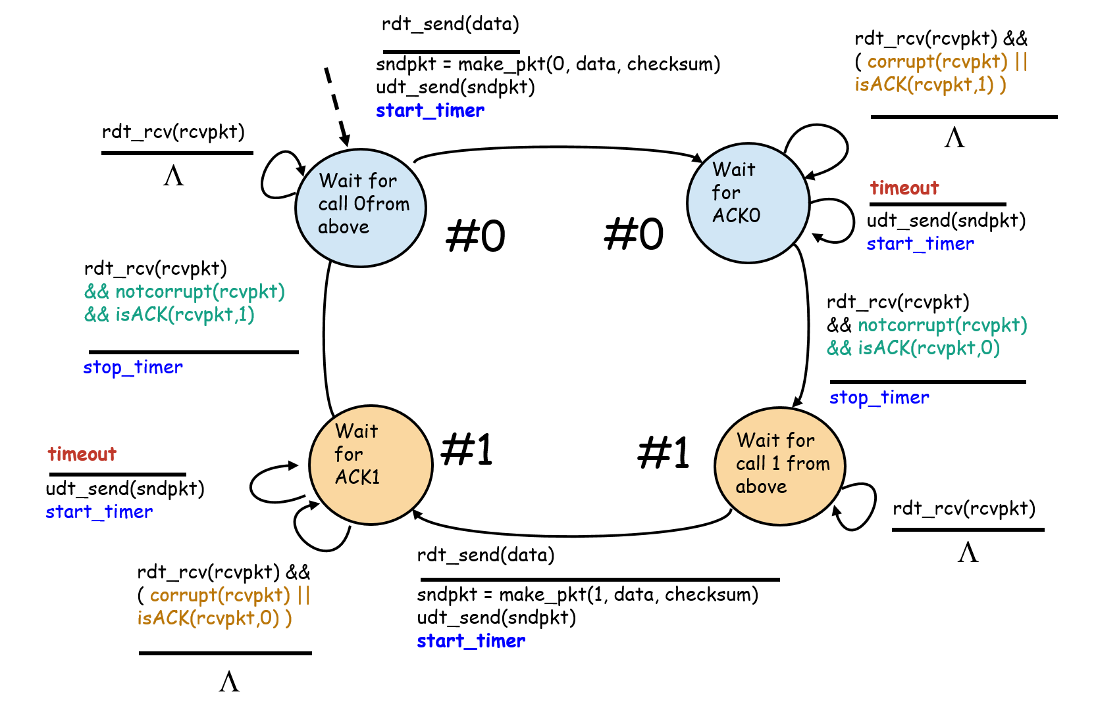
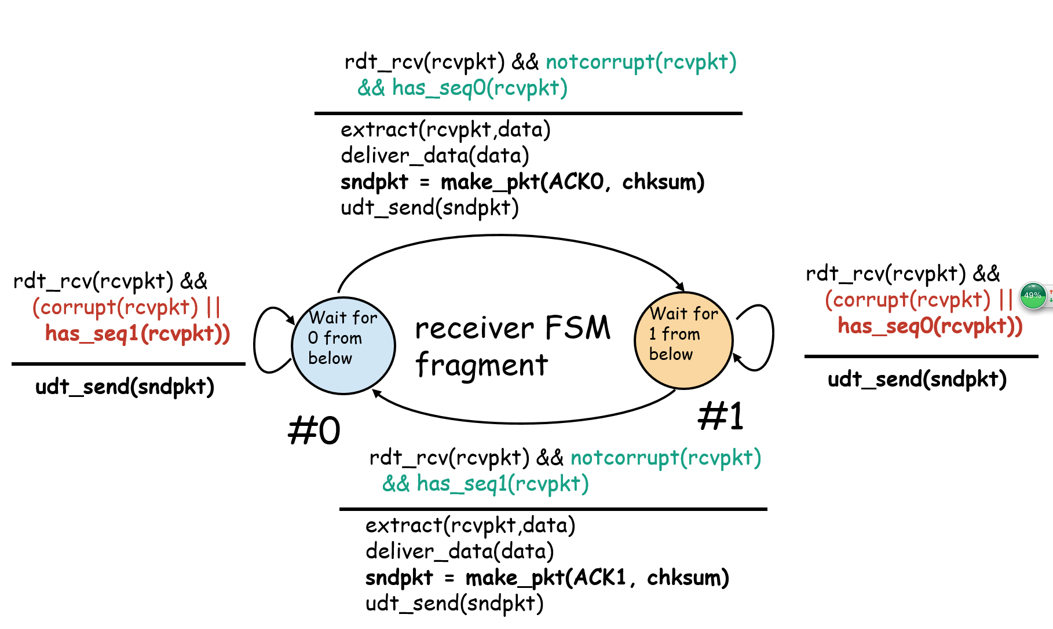
Why such transitions in receiver FSM?
rdt3.0 sender
rdt3.0 receiver
Under what condition this transition happens?
Notes:
Premature timer，packet被Receiver正确接收，Receiver发送ACK(0)，并进入Wait for 1 From below 状态。但是ACK(0)超时到达！
这是 Sender timerout发送，Sender重新发送数据。之后，ACK（0）正确接收，Sender进入 “Wait for call 1 from above”。
Receiver 在 “Wait for 1 from below”状态下，收到序列号为0的数据，重新发送ACK（0）。
这是sender正确接收ACK（0），直接丢弃。

Slide 58

rdt3.0 in action
sender
receiver
sender
receiver
send pkt0
pkt0
send pkt0
pkt0
rcv pkt0
rcv pkt0
ack0
send ack0
ack0
send ack0
rcv ack0
rcv ack0
send pkt1
pkt1
send pkt1
pkt1
rcv pkt1
X
ack1
send ack1
loss
rcv ack1
send pkt0
pkt0
rcv pkt0
timeout
resend pkt1
ack0
send ack0
pkt1
rcv pkt1
ack1
send ack1
rcv ack1
send pkt0
pkt0
rcv pkt0
ack0
send ack0
(a) no loss
(b) packet loss

Slide 59
rdt3.0 in action
sender
receiver
sender
receiver
send pkt0
pkt0
send pkt0
pkt0
rcv pkt0
rcv pkt0
ack0
send ack0
send ack0
rcv ack0
ack0
send pkt1
pkt1
rcv ack0
rcv pkt1
send pkt1
pkt1
send ack1
rcv pkt1
ack1
send ack1
ack1
X
loss
timeout
resend pkt1
pkt1
rcv pkt1
timeout
resend pkt1
rcv ack1
pkt1
rcv pkt1
pkt0
(detect duplicate)
send pkt0
send ack1
ack1
(detect duplicate)
ack1
rcv pkt0
rcv ack1
send ack1
rcv ack1
ack0
send ack0
pkt0
send pkt0
pkt0
send pkt0
rcv pkt0
rcv pkt0
ack0
(detect duplicate)
ack0
send ack0
send ack0
(c) ACK loss
(d) premature timeout/ delayed ACK

Slide 60
What is the main drawback of rdt3.0?

Slide 61



Example
A
B
Propagation delay: 15 ms
Packet size: 8000 bits
1G bps
What is the utilization of the link?
Or what the throughput of the connection between A and B

Slide 62
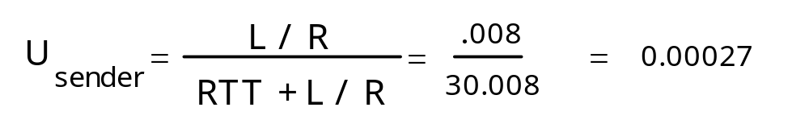
rdt3.0: performance or channel util. issue
sender
receiver
first packet bit transmitted, t = 0
last packet bit transmitted, t = L / R
first packet bit arrives
RTT
last packet bit arrives, send ACK
ACK arrives, send next
packet, t = RTT + L / R
What is the utilization of the channel?

Slide 63
How can we increase the throughput while guaranteeing reliable data transfer?

Slide 64
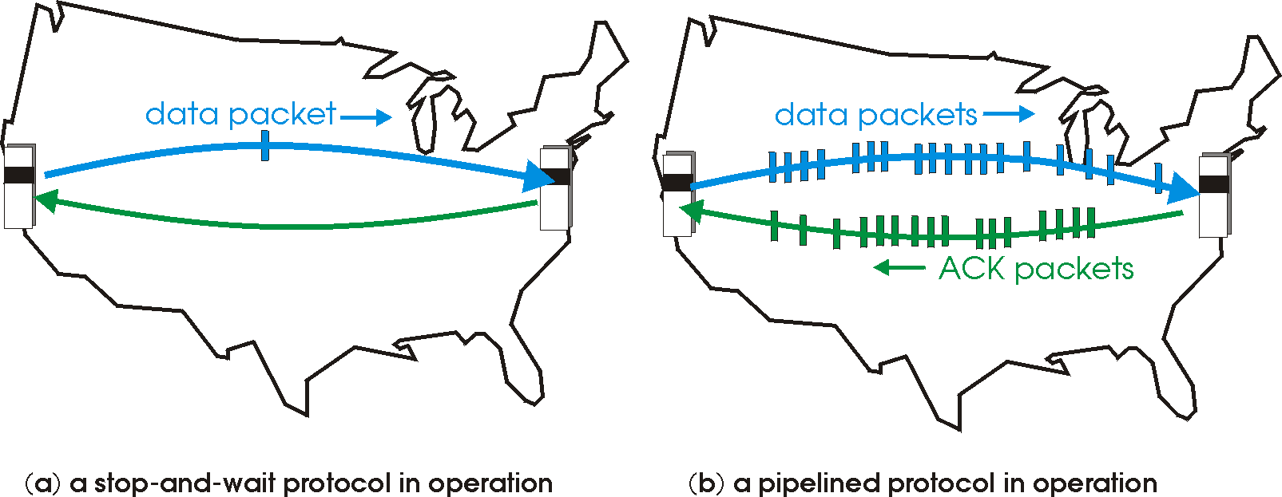
Idea: Pipelining
Pipelining:
sender allows multiple, “in-flight”, yet-to-be-acknowledged pkts

Slide 65
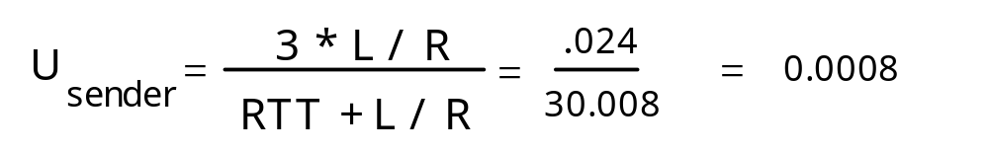
Pipelining: increased utilization
sender
receiver
first packet bit transmitted, t = 0
last bit transmitted, t = L / R
first packet bit arrives
RTT
last packet bit arrives, send ACK
last bit of 2nd packet arrives, send ACK
ACK arrives, send next
packet, t = RTT + L / R
last bit of 3rd packet arrives, send ACK
Increase utilization
by a factor of 3!

Slide 66
What are the new challenges with pipelining?
Notes:
Many packets in flight, not acknowledged.
Out of order arrival! But we need to deliver in order to the upper layer

Slide 67
Two Pipelining Protocols
Go Back N (GBN)
Selective Repeat (SR)

Slide 68


Go-back-N: big picture
Sender
Sender can have up to N unacked packets in pipeline
Receiver only sends cumulative acks
  Doesn’t ack packet if there’s a gap
Sender has one timer for the oldest unacked packet
  If timer expires, retransmit all unacked packets
Can send at most N
(1)
(2)
(3)
(4)
ACK(1)
ACK(1)
ACK(1)
(2)
(3)
(4)
Retransmits
(1) (2) and (3)
(1)
(3)
(4)
Receiver

Slide 69
Go-Back-N
Sender
Receiver
6 | 5 | 4 | 3 | 2 | 1
1 | 2 | 3 | 4 | 5 | 6
Sequence #
Sequence #
1
Packets to be transferred
Buffers

Slide 70
Go-Back-N
Sender
Receiver
6 | 5 | 4 | 3 | 2 | 1
1 | 2 | 3 | 4 | 5 | 6
Sequence #
Sequence #
1
Packets to be transferred
Buffers

Slide 71
Go-Back-N
Sender
Receiver
ACK(1)
6 | 5 | 4 | 3 | 2 | 1
1 | 2 | 3 | 4 | 5 | 6
Sequence #
Sequence #
1
Packets to be transferred
Buffers

Slide 72
Go-Back-N
Sender
Receiver
ACK(1)
6 | 5 | 4 | 3 | 2 | 1
1 | 2 | 3 | 4 | 5 | 6
Sequence #
Sequence #
1
Packets to be transferred
Buffers

Slide 73
Go-Back-N
Sender
Receiver
6 | 5 | 4 | 3 | 2 | 1
1 | 2 | 3 | 4 | 5 | 6
Sequence #
Sequence #
1
Packets to be transferred
Buffers

Slide 74
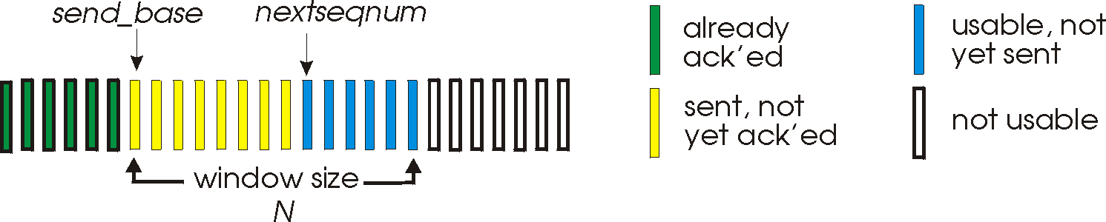


Go-Back-N: more details
Sender
Expected
Expected
not usable
Receiver

Slide 75
GBN: sender extended FSM
rdt_send(data)
if (nextseqnum < base+N) {
sndpkt[nextseqnum] = make_pkt(nextseqnum,data,chksum)
udt_send(sndpkt[nextseqnum])
if (base == nextseqnum)
start_timer
nextseqnum++
}
else
refuse_data(data)
L
base=1
nextseqnum=1
timeout
Wait
start_timer
udt_send(sndpkt[base])
udt_send(sndpkt[base+1])
…
udt_send(sndpkt[nextseqnum-1])
rdt_rcv(rcvpkt)
&& corrupt(rcvpkt)
rdt_rcv(rcvpkt) &&
notcorrupt(rcvpkt)
base = getacknum(rcvpkt)+1
If (base == nextseqnum)
stop_timer
else
start_timer

Slide 76
GBN: receiver extended FSM
default
udt_send(sndpkt)
rdt_rcv(rcvpkt)
&& notcurrupt(rcvpkt)
&& hasseqnum(rcvpkt,expectedseqnum)
L
Wait
extract(rcvpkt,data)
deliver_data(data)
sndpkt = make_pkt(expectedseqnum,ACK,chksum)
udt_send(sndpkt)
expectedseqnum++
expectedseqnum=1
sndpkt =
make_pkt(expectedseqnum,ACK,chksum)
ACK-only: always send ACK for correctly-received pkt with highest in-order seq #
  may generate duplicate ACKs
  need only remember expectedseqnum
out-of-order pkt:
  discard (don’t buffer) -> no receiver buffering!
  Re-ACK pkt with highest in-order seq #

Slide 77
GBN in action
sender window (N=4)
sender
receiver
0 1 2 3 4 5 6 7 8
send pkt0
send pkt1
send pkt2
send pkt3
(wait)
0 1 2 3 4 5 6 7 8
receive pkt0, send ack0
receive pkt1, send ack1
receive pkt3, discard,
(re)send ack1
0 1 2 3 4 5 6 7 8
0 1 2 3 4 5 6 7 8
X
loss
0 1 2 3 4 5 6 7 8
rcv ack0, send pkt4
rcv ack1, send pkt5
0 1 2 3 4 5 6 7 8
receive pkt4, discard,
(re)send ack1
ignore duplicate ACK
receive pkt5, discard,
(re)send ack1
pkt 2 timeout
0 1 2 3 4 5 6 7 8
send pkt2
send pkt3
send pkt4
send pkt5
0 1 2 3 4 5 6 7 8
0 1 2 3 4 5 6 7 8
rcv pkt2, deliver, send ack2
rcv pkt3, deliver, send ack3
rcv pkt4, deliver, send ack4
rcv pkt5, deliver, send ack5
0 1 2 3 4 5 6 7 8

Slide 78
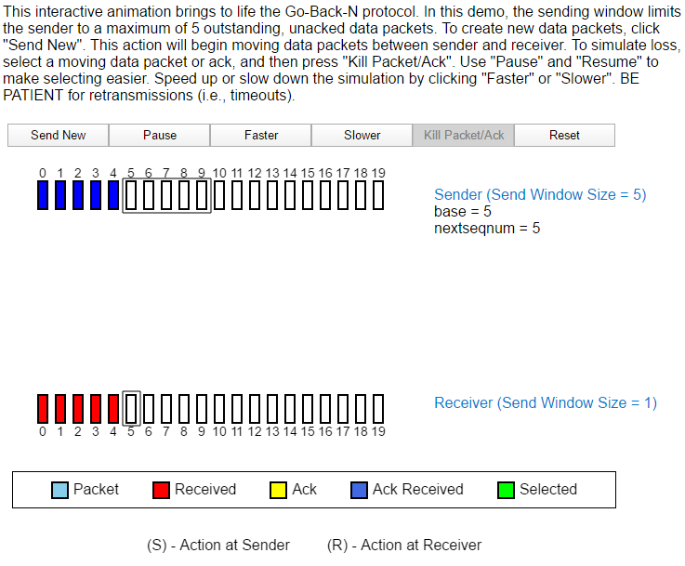
GBN Animation: Animation
Animation:
https://media.pearsoncmg.com/aw/ecs_kurose_compnetwork_7/cw/content/interactiveanimations/go-back-n-protocol/index.html

Slide 79
What are the drawbacks of GBN?
How do we cope with them?

Slide 80
Selective Repeat: Big picture
receiver individually acknowledges all correctly received pkts
  buffers pkts, as needed, for eventual in-order delivery to upper layer
sender only resends pkts for which ACK not received
  sender timer for each unACKed pkt
sender window
  N consecutive seq #’s
  again limits seq #s of sent, unACKed pkts
Sender
Can send at most N
(2)
(1)
(2)
(3)
ACK(1)
ACK(2)
ACK(3)
Retransmit
(2)
timer
PKT(1)
PKT(3)
Receiver

Slide 81
Selective Repeat
Sender
Receiver
6 | 5 | 3 | 4 | 2 | 1
1 | 2 | 3 | 4 | 5 | 6
Sequence #
Sequence #
Packets to be transferred
Buffers

Slide 82
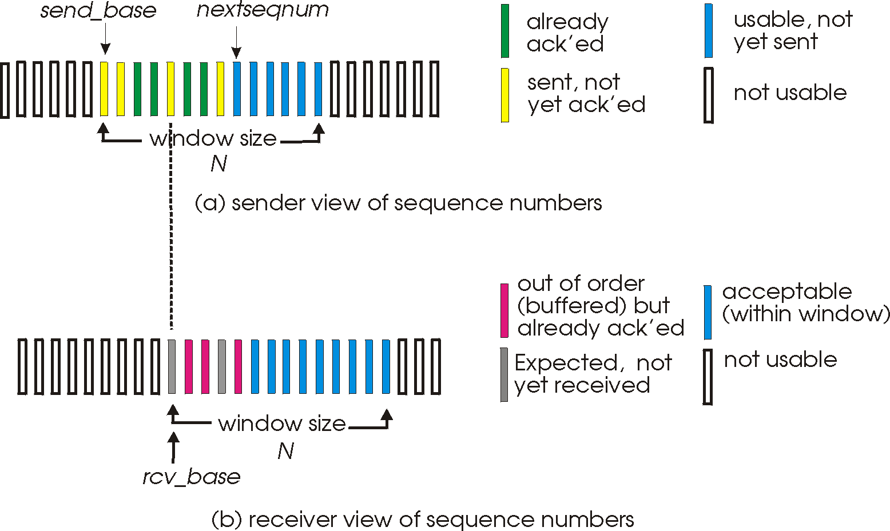
Selective repeat: sender, receiver windows
Sender
Receiver

Slide 83
Selective repeat
Sender
Receiver
data from above :
  if next available seq # in window, send pkt
timeout(n):
  resend pkt n, restart timer
ACK(n) in [sendbase,sendbase+N]:
  mark pkt n as received
  if n smallest unACKed pkt, advance window base to next unACKed seq #
pkt n in [rcvbase, rcvbase+N-1]
  send ACK(n)
  out-of-order: buffer
  in-order: deliver (also deliver buffered, in-order pkts), advance window to next not-yet-received pkt
pkt n in [rcvbase-N,rcvbase-1]
  ACK(n)
otherwise:
  ignore

Slide 84
Selective repeat in action
sender
receiver
sender window (N=4)
0 1 2 3 4 5 6 7 8
send pkt0
send pkt1
send pkt2
send pkt3
(wait)
0 1 2 3 4 5 6 7 8
receive pkt0, send ack0
receive pkt1, send ack1
receive pkt3, buffer,
send ack3
0 1 2 3 4 5 6 7 8
0 1 2 3 4 5 6 7 8
X
loss
0 1 2 3 4 5 6 7 8
rcv ack0, send pkt4
rcv ack1, send pkt5
0 1 2 3 4 5 6 7 8
receive pkt4, buffer,
send ack4
record ack3 arrived
receive pkt5, buffer,
send ack5
pkt 2 timeout
0 1 2 3 4 5 6 7 8
send pkt2
0 1 2 3 4 5 6 7 8
record ack4 arrived
0 1 2 3 4 5 6 7 8
rcv pkt2; deliver pkt2,
pkt3, pkt4, pkt5; send ack2
record ack5 arrived
0 1 2 3 4 5 6 7 8
Q: what happens when ack2 arrives?

Slide 85
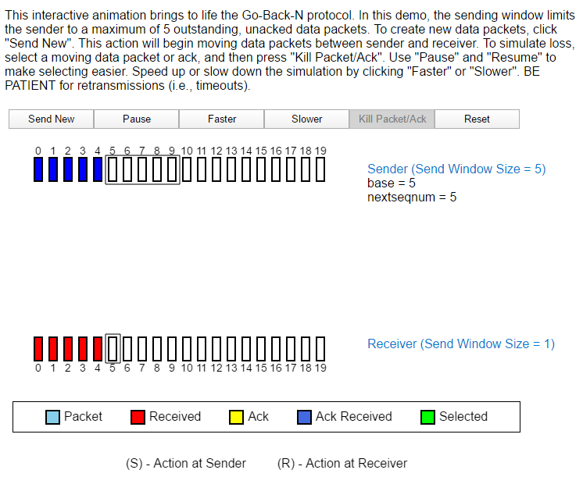
Selective Repeat: Animation
Animation:
https://media.pearsoncmg.com/aw/ecs_kurose_compnetwork_7/cw/content/interactiveanimations/selective-repeat-protocol/index.html
Notes:
http://wps.pearsoned.com/ecs_kurose_compnetw_6/216/55463/14198700.cw/index.html
http://media.pearsoncmg.com/aw/ecs_kurose_compnetwork_6/video_applets/GBNindex.html
解决applet被阻止的解决方法：
把具体的页面网址放到 控制面板 java 中的例外列表中，重新启动浏览器。

Slide 86

Selective repeat: dilemma
0 1 2 3 0 1 2
pkt0
example:
seq #’s: 0, 1, 2, 3
window size=3
0 1 2 3 0 1 2
pkt1
0 1 2 3 0 1 2
receiver window
(after receipt)
0 1 2 3 0 1 2
pkt2
0 1 2 3 0 1 2
sender window
(after receipt)
0 1 2 3 0 1 2
0 1 2 3 0 1 2
pkt3
0 1 2 3 0 1 2
pkt0
will accept packet
with seq number 0
receiver sees no difference in two scenarios!
duplicate data accepted as new in (b)
Q: what relationship between seq # size and window size to avoid problem in (b)?
(a) no problem
receiver can’t see sender side.
receiver behavior identical in both cases!
Something’s (very) wrong!
0 1 2 3 0 1 2
pkt0
0 1 2 3 0 1 2
pkt1
0 1 2 3 0 1 2
0 1 2 3 0 1 2
pkt2
0 1 2 3 0 1 2
X
0 1 2 3 0 1 2
X
timeout
retransmit pkt0
X
0 1 2 3 0 1 2
pkt0
will accept packet
with seq number 0
(b) oops, wrong!
Notes:
两种情况：协议执行一模一样
但是，有一种情况是数据传输错误的

Slide 87
What are drawbacks of SR?
Notes:
Buffer Requirements:
Both the sender and receiver need to maintain buffers to handle out-of-order packets. This requires more memory and can complicate the implementation.
Complexity:
The protocol is more complex to implement than simpler protocols. It requires mechanisms to handle individual acknowledgments and out-of-order delivery.
Acknowledgment Overhead:
Each packet requires an acknowledgment, which can increase overhead, especially if the network has high latency or if the window size is large.
Sequence Number Wrapping:
Since the protocol uses sequence numbers to keep track of packets, there is a possibility of sequence number wrapping if the range is too small relative to the window size. This can lead to ambiguity and errors in packet identification.
Synchronization:
The sender and receiver need to maintain a synchronized view of the window, which can be challenging if there are packet losses or delays.
Retransmission Complexity:
Handling retransmissions efficiently without unnecessary duplication requires careful management of the window and acknowledgment processes.

Slide 88
Outline
3.1 Transport-layer services
3.2 Multiplexing and demultiplexing
3.3 Connectionless transport: UDP
3.4 Principles of reliable data transfer
3.5 Connection-oriented transport: TCP
3.6 Principles of congestion control
3.7 TCP congestion control

Slide 89
TCP: Overview
full duplex data:
  bi-directional data flow in same connection
  MSS: maximum segment size
connection-oriented:
  handshaking (exchange of control msgs) init’s sender, receiver state before data exchange
flow controlled:
  sender will not overwhelm receiver
point-to-point:
  one sender, one receiver
reliable, in-order byte steam:
  no “message boundaries”
pipelined:
  TCP congestion and flow control set window size
send & receive buffers

Slide 90
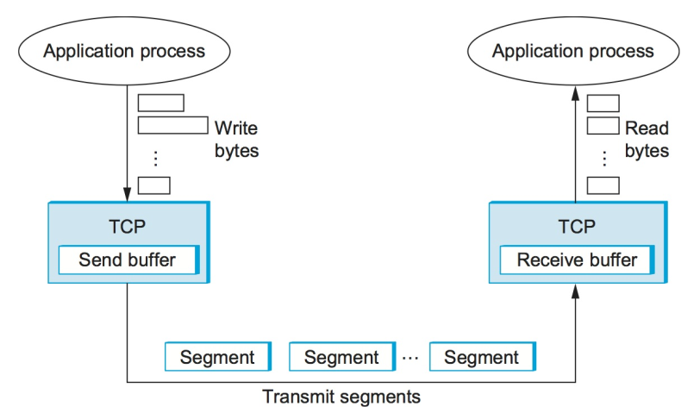
TCP is a byte-oriented protocol
The sender writes bytes into a TCP connection and the receiver
reads bytes out of the TCP connection

Slide 91
3.5 Connection-Oriented Transport: TCP
segment structure
reliable data transfer
flow control
connection management

Slide 92
To realize rdt, what states shall a host maintain?
Connection state, Window, sent #, acked #, timer!

Slide 93
TCP segment structure
32 bits
URG: urgent data
(generally not used)
counting
by bytes
of data
(not segments!)
source port #
dest port #
sequence number
ACK: ACK #
valid
acknowledgement number
PSH: push data now
(generally not used)
head
len
not
used
U
A
P
R
S
F
Receive window
# bytes
rcvr willing
to accept
checksum
Urg data pnter
RST, SYN, FIN:
connection estab
(setup, teardown
commands)
Options (variable length)
application
data
(variable length)
Internet
checksum
(as in UDP)

Slide 94
TCP seq. #’s and ACKs
outgoing segment from sender
source port #
dest port #
Seq. #’s:
  byte stream “number” of first byte in segment’s data
ACKs:
  seq # of next byte expected from other side
  cumulative ACK
Q: how receiver handles out-of-order segments
  A: TCP spec doesn’t say, - up to implementor
sequence number
acknowledgement number
rwnd
checksum
urg pointer
window size
N
  sender sequence number space
sent
ACKed
sent, not-yet ACKed
(“in-flight”)
usable
but not
yet sent
not
usable
incoming segment to sender
source port #
dest port #
sequence number
acknowledgement number
A
rwnd
checksum
urg pointer

Slide 95
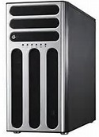
simple telnet scenario
Host A
Server B
User
types
‘C’
Seq=42, ACK=79, data = ‘C’
host ACKs
receipt of
‘C’, echoes
back ‘C’
Seq=79, ACK=43, data = ‘C’
host ACKs
receipt
of echoed
‘C’
Seq=43, ACK=80
Time
Time

Slide 96
TCP Round Trip Time and Timeout
Q: how to set TCP timeout value?
longer than RTT
  but RTT varies
too short: premature timeout
  unnecessary retransmissions
too long: slow reaction to segment loss
S
D
RTT1
RTT2
Time
Time

Slide 97
RTT Estimation – Basic Idea
SampleRTT: measured time from segment transmission until ACK receipt
  ignore retransmissions
SampleRTT will vary, want estimated RTT “smoother”
  average several recent measurements, not just current SampleRTT

Slide 98
RTT Estimation
EstimatedRTT
= (1- α)*EstimatedRTT + α*SampleRTT
Exponential weighted moving average
influence of past sample decreases exponentially fast
typical value: = 0.125

Slide 99
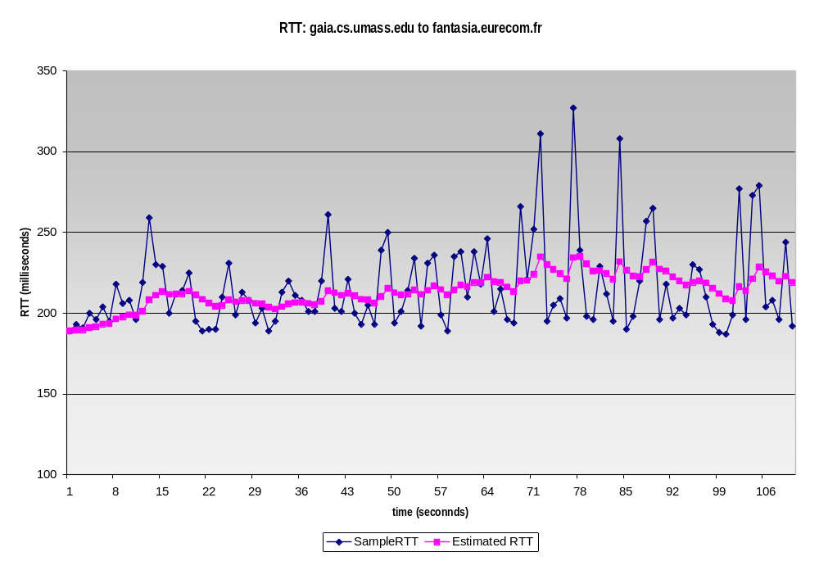
Example RTT estimation:

Slide 100
Setting the timeout
EstimtedRTT plus “safety margin”
  large variation in EstimatedRTT -> larger safety margin
first estimate of how much SampleRTT deviates from EstimatedRTT:
DevRTT = (1-β)*DevRTT +
β*|SampleRTT-EstimatedRTT|
(typically, β = 0.25)
Then set timeout interval:
TimeoutInterval = EstimatedRTT + 4*DevRTT

Slide 101
3.5 Connection-Oriented Transport: TCP
segment structure
reliable data transfer
flow control
connection management

Slide 102
TCP reliable data transfer
TCP creates rdt service on top of IP’s unreliable service
Pipelined segments
Cumulative acks
TCP uses single retransmission timer
Retransmissions are triggered by:
  timeout events
  duplicate acks
Initially consider simplified TCP sender
  ignore duplicate acks
  ignore flow control, congestion control

Slide 103

Sender Illustration
Segment
Segment
Seq #
SendBase
NextSeqNumber

Slide 104
3 Events at Sender
ACK(y)
（1）Called above
（3）ACK
Seq #
SendBase
NextSeqNumber
（2）Timeout

Slide 105
TCP sender event E1: call from above
What actions to take upon event E1?
Create segment with seq #
seq # is byte-stream number of first data byte in segment
start timer if not already running (think of timer as for oldest unacked segment)
  expiration interval: TimeOutInterval

Slide 106
TCP sender event E2: Timeout
What actions to take upon event E2?
retransmit segment that caused timeout
restart timer

Slide 107
TCP sender event E3: Ack received
What actions to take upon event E3?
If acknowledges previously unacked segments
  update what is known to be acked
  start timer if there are outstanding segments
How many cases for the seq # in ACK packet?

Slide 108
TCP sender (simplified)
data received from application above
create segment, seq. #: NextSeqNum
pass segment to IP (i.e., “send”)
NextSeqNum = NextSeqNum + length(data)
if (timer currently not running)
start timer
L
NextSeqNum = InitialSeqNum
SendBase = InitialSeqNum
wait
for
event
timeout
retransmit not-yet-acked segment with smallest seq. #
start timer
ACK received, with ACK field value y
Comment:
SendBase-1: last
cumulatively
ack’ed byte
Example:
SendBase-1 = 71;
y= 73, so the rcvr
wants 73+ ;
y > SendBase, so
that new data is
acked
if (y > SendBase) {
SendBase = y
/* SendBase–1: last cumulatively ACKed byte */
if (there are currently not-yet-acked segments)
start timer
else stop timer
}

Slide 109
TCP: retransmission scenarios
Host A
Host B
Seq=92, 8 bytes data
timeout
ACK=100
X
loss
Seq=92, 8 bytes data
ACK=100
SendBase
= 100
time
lost ACK scenario

Slide 110
TCP: retransmission scenarios
Host A
Host B
Seq=92, 8 bytes data
Seq=100, 20 bytes data
Seq=92 timeout
Sendbase
= 100
ACK=100
ACK=120
premature timeout
Seq=92, 8 bytes data
SendBase
= 120
Seq=92 timeout
ACK=120
SendBase
= 120
time

Slide 111
Cumulative ACK scenario
Host A
Host B
Seq=92, 8 bytes data
timeout
ACK=100
Seq=100, 20 bytes data
X
loss
Cumulative ACK
SendBase
= 120
ACK=120
time

Slide 112
When does the sender send an ACK pkt out?

Slide 113
Scenarios
Expected #
Seq. #
(1)
Expected #
Seq. #
(2)
Expected #
Seq. #
(3)

Slide 114
TCP ACK generation
event at receiver
arrival of in-order segment with
expected seq #. All data up to
expected seq # already ACKed
arrival of in-order segment with
expected seq #. One other
segment has ACK pending
arrival of out-of-order segment
higher-than-expect seq. # .
Gap detected
arrival of segment that
partially or completely fills gap
TCP receiver action
delay ACK transmission. Wait up to
500ms for next segment. If no next \
segment, send ACK
immediately send single cumulative
ACK, ACKing both in-order segments
immediately send duplicate ACK,
indicating seq. # of next expected byte
immediate send ACK, provided that
segment starts at lower end of gap

Slide 115
Fast Retransmit
Idea: duplicate ACKs
Time-out period often relatively long
If sender receives 3 ACKs for the same data, it supposes that segment after ACKed data was lost:
  fast retransmit: resend segment before timer expires
Detect lost segments via duplicate ACKs.
  Sender often sends many segments back-to-back
  If segment is lost, there will likely be many duplicate ACKs.

Slide 116
Host A
Host B
Seq 10, 8 bytes
Seq 19, 5 bytes
X
Ack (18)
Out-of-order seg
Ack (18)
Ack (18)
Out-of-order seg
Seq 19, 5 bytes
timeout
resend 2nd segment
Ack (24)
Retransmission done before timeout occurs!
time
Resending a segment after triple duplicate ACK

Slide 117
Fast retransmit algorithm:
Sender Seq Space
ACK(y)
SendBase
NextSeqNum
event: ACK received, with ACK field value of y
if (y > SendBase) {
SendBase = y
if (there are currently not-yet-acknowledged segments)
start timer
}
else {
increment count of dup ACKs received for y
if (count of dup ACKs received for y = 3) {
resend segment with sequence number y
}

Slide 118
Is 32 bits sequence number space large enough?
Notes:
两种非常不一样的情况（讨论序列号空间大小问题）：（1）空间过小，二发送/接收窗口过大，导致一个重新发送的数据包当初新的数据包接收。（2）空间过小，上一轮的序列号S和下一轮的S，都还在网络中飞，因为带宽很高，发送很快。
两者主要区别，（1）中不假设数据包传输较慢才出错；（2）中加上之前的S传播的相对较慢，这是出错
The wrapping around problem which may lead to wrong data reception
接收端也可能消耗得很快的！

Slide 119
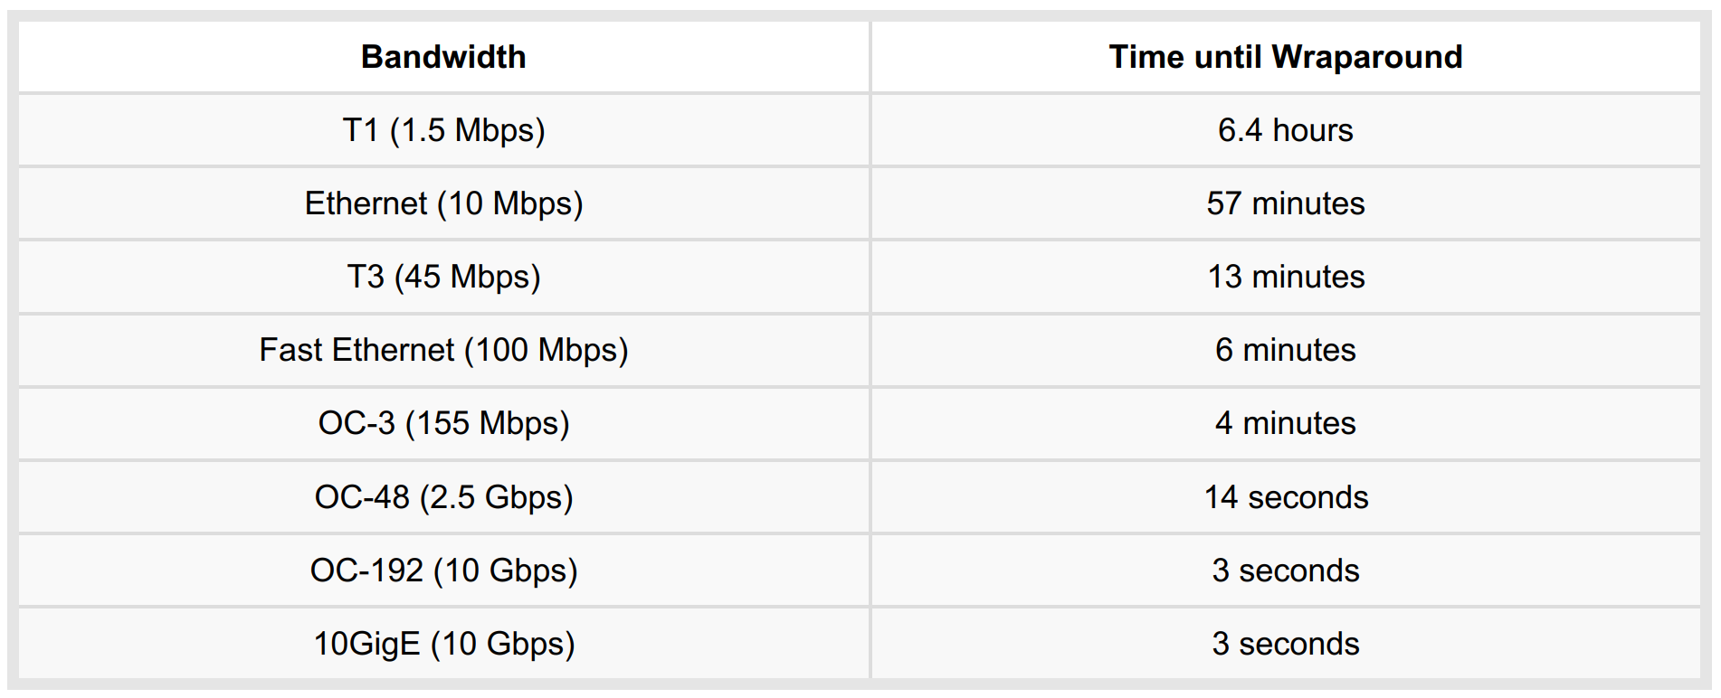
Sequence number space may wrap around
Time Until 32-Bit Sequence Number Space Wraps Around

Slide 120
How do you address this issue?
Notes:
使用options，比如加入时间戳，用于区分两个相同的S。

Slide 121
3.5 Connection-Oriented Transport: TCP
segment structure
reliable data transfer
flow control
connection management

Slide 122
TCP flow control
application
process
application may
remove data from
TCP socket buffers ….
application
TCP socket
receiver buffers
OS
… slower than TCP
receiver is delivering
(sender is sending)
TCP
code
flow control
IP
code
receiver controls sender, so sender won’t overflow receiver’s buffer by transmitting too much, too fast
from sender
receiver protocol stack

Slide 123
How would you make the flow control?

Slide 124
TCP Flow control: how it works
Receiver
to application process
The receiver advertises spare room by including value of rwnd in segments
RcvBuffer
buffered data
rwnd
free buffer space
TCP segment payloads
Sender
receiver-side buffering
The sender limits unACKed data to rwnd: guarantees receive buffer doesn’t overflow!

Slide 125
Is overflow possible?
Unacked packets = NextSeqNum – SendBase <= rwind
window
Seq Space
SendBase
NextSeqNum
rwind=3
rwind=2
rwind=1
rwnd=0
Sender
unack=1
unack=2
unack=1
unack=0
unack=1
unack=0
Beyond this point of time, any inflight packets?
Size=1
Receiver
rwind=3
rwind=2
rwind=1
rwind=0
Notes:
What if ack (rwind=1) lost, will overflow?

Slide 126
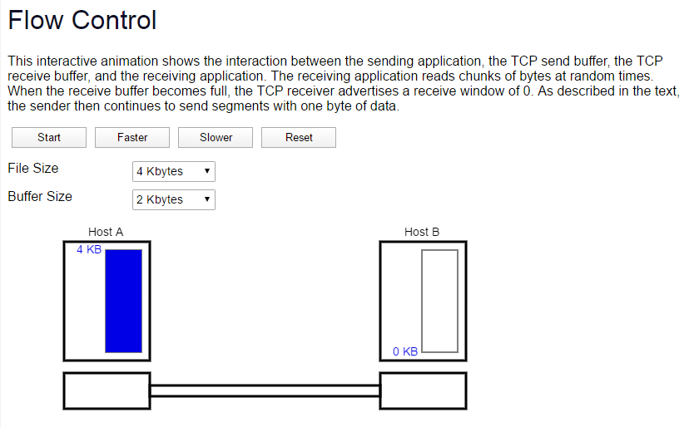
Flow Control: Animation
https://media.pearsoncmg.com/aw/ecs_kurose_compnetwork_7/cw/content/interactiveanimations/flow-control/index.html

Slide 127
Is 16 bits receive window large enough? What is the potential problem?
Notes:
两种非常不一样的情况（讨论序列号空间大小问题）：（1）空间过小，而发送/接收窗口过大，导致一个重新发送的数据包当初新的数据包接收。（2）空间过小，上一轮的序列号S和下一轮的S，都还在网络中飞，因为带宽很高，发送很快。
两者主要区别，（1）中不假设数据包传输较慢才出错；（2）中加上之前的S传播的相对较慢，这是出错
The wrapping around problem which may lead to wrong data reception

Slide 128
Low throughput problem
RTT = 100ms
Bandwidth = 1G bps
Receiver
Sender
Assume the receive buffer is infinite
With TCP, what is the maximum throughput between the sender and the receiver?
= 2¹⁶ bytes/RTT = 5 Mbps

Slide 129
Bandwidth Delay Product
RTT = 100ms
Bandwidth = 1G bps
Receiver
Sender
What is the maximum amount of unacknowledged data?
= bandwidth * delay

Slide 130
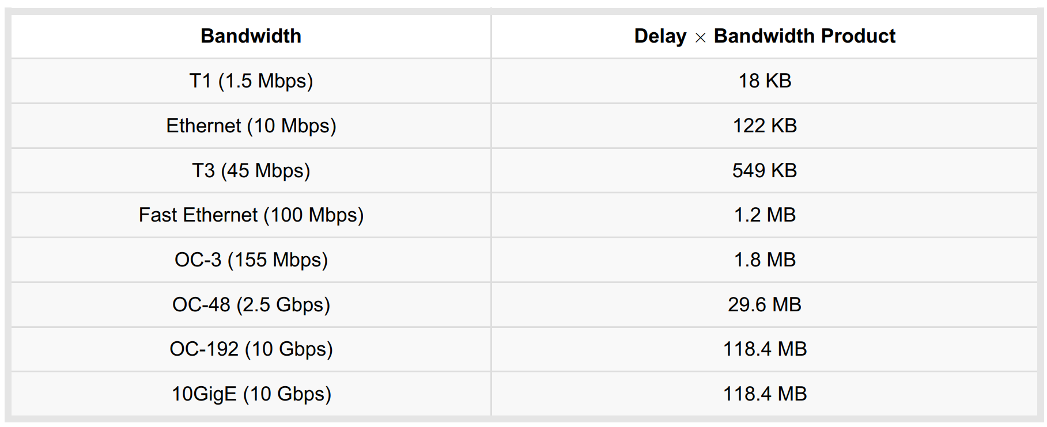
Required Window Size for 100 ms RTT
TCP receive window size = 2¹⁶ bytes = 64 KB
Then, how?

Slide 131
3.5 Connection-Oriented Transport: TCP
segment structure
reliable data transfer
flow control
connection management

Slide 132
Connection Management
before exchanging data, sender/receiver “handshake”:
agree to establish connection (each knowing the other willing to establish connection)
agree on connection parameters
application
application
connection state: ESTAB
connection variables:
  seq # client-to-server
  server-to-client
  rcvBuffer size
  at server, client
connection state: ESTAB
connection Variables:
  seq # client-to-server
  server-to-client
  rcvBuffer size
  at server,client
network
network
Socket clientSocket =
newSocket("hostname","port number");
Socket connectionSocket = welcomeSocket.accept();

Slide 133

Establishing a TCP Connection
connection state: ESTAB
connection variables:
  seq # client-to-server
  server-to-client
  rcvBuffer size
  at server, client
connection state: ESTAB
connection Variables:
  seq # client-to-server
  server-to-client
  rcvBuffer size
  at server,client
Connecting to
202.120.1.100: 80
Listening on
202.120.1.100: 80

Slide 134
Discussion
How do Client and Server
agree on a common state?
Unreliable channel
message
State:
Connection
established!
State:
Connection
established!

Slide 135
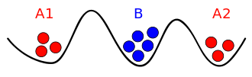
Two Generals Problem
Positions of the armies
Armies A1 and A2 need to communicate but their messengers may be captured by army B.
Consensus to reach:
Yes, we will both attack on 8am.

Slide 136



Agreeing to establish a connection
2-way handshake:
Q: will 2-way handshake always work in network?
variable delays
retransmitted messages (e.g. req_conn(x)) due to message loss
message reordering
Can’t “see” other side
Let’s talk
ESTAB
OK
ESTAB
choose x
req_conn(x)
ESTAB
acc_conn(x)
ESTAB

Slide 137
2-way handshake failure scenarios:
choose x
req_conn(x)
ESTAB
retransmit
req_conn(x)
acc_conn(x)
ESTAB
connection
x completes
client terminates
req_conn(x)
server
forgets x
ESTAB
half open connection!
(no client!)

Slide 138
Three way handshake:
Step 1: client host sends TCP SYN segment to server
  specifies initial seq #
  no data
SYN
SYNACK
Step 2: server host receives SYN, replies with SYNACK segment
  server allocates buffers
  specifies server initial seq. #
Step 3: client receives SYNACK, replies with ACK segment, which may contain data
  Allocate buffers
SYNACK

Slide 139
TCP 3-way handshake
server state
CLOSED
client state
CLOSED
LISTEN
choose init seq num, x
send TCP SYN msg
SYNSENT
SYNbit=1, Seq=x
choose init seq num, y
send TCP SYNACK
msg, acking SYN
SYN RCVD
SYNbit=1, Seq=y
ACKbit=1; ACKnum=x+1
received SYNACK(x)
indicates server is live;
send ACK for SYNACK;
this segment may contain
client-to-server data
ESTAB
ACKbit=1, ACKnum=y+1
received ACK(y)
indicates client is live
ESTAB

Slide 140
3-Way handshake: delayed SYN scenario
server state
CLOSED
client state
CLOSED
LISTEN
choose init seq num, x
send TCP SYN msg
SYNbit=1, Seq=x
SYNSENT
choose init seq num, y
send TCP SYNACK
msg, acking SYN
re-send TCP SYN msg
SYNbit=1, Seq=x
SYN RCVD
Timer out
ESTAB
received SYNACK(x)
indicates server is live;
received ACK(y)
indicates client is live
ESTAB
CLOSED
connection
x completes
LISTEN
SYNbit=1, Seq=y
ACKbit=1; ACKnum=x+1
delayed SYN(x)
send TCP SYNACK
msg, acking SYN
?
SYN RCVD
Wrong SYNACK
Discard it
ACKbit=1, ACKnum=y+1
Notes:
解释 如何解决前面 2-way 出现的问题
ESTAB 状态出现之前，不准结束连接
真的不会出现问题？想想。
答案：不会。 Client在收到 Duplicate SYNACK的时候，他所处的状态不是 SYNSENT，而是 CLOSED 或 LISTEN。

Slide 141
Why does not the initial seq # start from 0?
Notes:
A short previous TCP connection may still have in-flight seq#0 packets, which may be accepted by the following TCP connection receiver.

Slide 142
Possible consequence
Client
SYN, x=0
Server
SYNACK
SYNACK
Seq#:0
Seq#:1
Both sessions use init seq #: 0
Seq#:2
closed
SYN, x=0
SYNACK
A delayed segment of the 1st session wrongly received!
SYNACK
Seq#:0
Seq#:1
wrong

Slide 143
TCP 3-way handshake: FSM
closed
Socket connectionSocket = welcomeSocket.accept();
L
Socket clientSocket =
newSocket("hostname","port number");
SYN(x)
SYNACK(seq=y,ACKnum=x+1)
create new socket for
communication back to client
listen
SYN(seq=x)
SYN
rcvd
SYN
sent
SYNACK(seq=y,ACKnum=x+1)
ACK(ACKnum=y+1)
ESTAB
ACK(ACKnum=y+1)
L

Slide 144
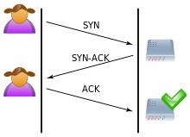
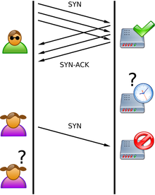
SYN Flooding Attack
A SYN flood is a form of denial-of-service attack in which an attacker sends a succession of SYN requests to a target's system in an attempt to consume enough server resources to make the system unresponsive to legitimate traffic.
The attacker sends several packets but does not send the "ACK" back to the server. The connections are hence half-opened and consuming server resources.
Alice, a legitimate user, tries to connect but the server refuses to open a connection resulting in a denial of service.

Slide 145
Closing a TCP Connection
connection state: ESTAB
connection Variables:
  seq # 26002
  rcvBuffer at client
connection state: ESTAB
connection Variables:
  seq # 15000
  rcvBuffer at server
Communicating on
202.120.10.2: 1150
Communicating on
202.120.1.100: 80

Slide 146
Asymmetric release is problematic
one party just closes down the connection. May result in loss of data:
Host 1
Host 2
Disconnect req.
Resource
released
Data
loss
data
Resource
released
Abrupt disconnection with loss of data.
Notes:
Asymmetric release is the way the telephone system works: when one party hangs up, the connection is broken.
Consider the scenario of Fig. 6-12. After the connection is established, host 1 sends a TPDU that arrives properly at host 2. Then host 1 sends another TPDU. Unfortunately, host 2 issues a DISCONNECT before the second TPDU arrives. The result is that the connection is released and data are lost.
Clearly, a more sophisticated release protocol is needed to avoid data loss. One way is to use symmetric release.

Slide 147
Important!
S
R
Connection-opening is SYMMETRIC
S
Two ways are independent!
R
Connection-closing is ASYMMETRIC

Slide 148
TCP: closing a connection
client, server each closes their side of connection
  send TCP segment with FIN bit = 1
respond to received FIN with ACK
  on receiving FIN, ACK can be combined with own FIN
simultaneous FIN exchanges can be handled

Slide 149
TCP: closing a connection
client state
server state
ESTAB
ESTAB
clientSocket.close()
FIN_WAIT_1
can no longer
send but can
receive data
FINbit=1, seq=x
CLOSE_WAIT
ACKbit=1; ACKnum=x+1
can still
send data
FIN_WAIT_2
wait for server
close
LAST_ACK
FINbit=1, seq=y
TIMED_WAIT
can no longer
send data
ACKbit=1; ACKnum=y+1
timed wait
for 2*max
segment lifetime
CLOSED
CLOSED

Slide 150
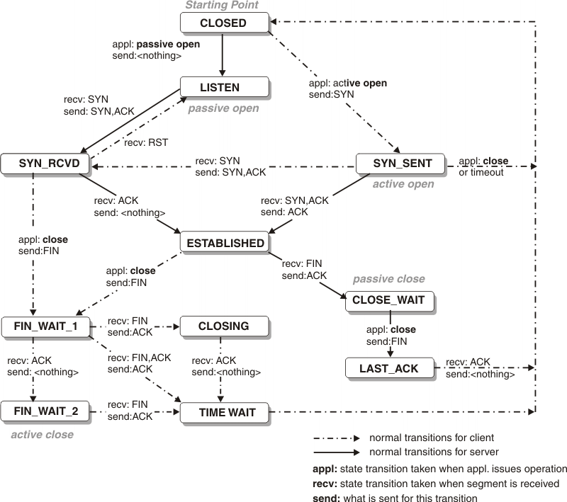
Real TCP state transition diagram
Notes:
TCP connection status - IBM Documentation

Slide 151
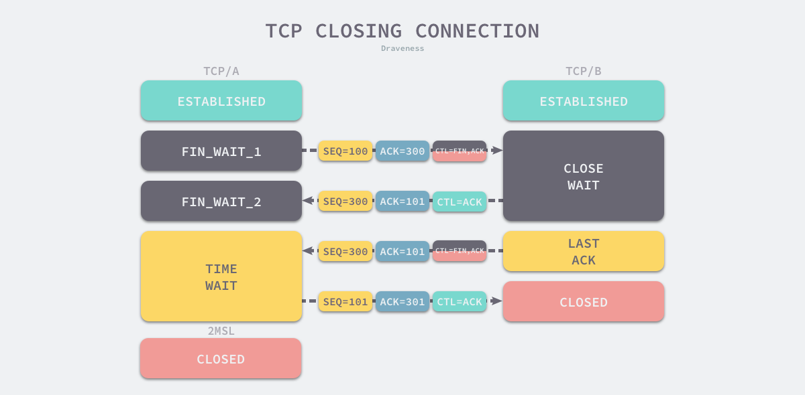
Why Time-Wait?
Notes:
From the above, we can see that TIME_WAIT appears only on the actively disconnected side, while the passively disconnected side goes directly to the CLOSED state, and the client that enters TIME_WAIT needs to wait for 2 MSL before it can actually close the connection. The reason why the TCP protocol requires the TIME_WAIT state is the same as the reason why a client needs to wait for two MSLs before it can directly enter the CLOSED state.
prevent delayed data segments from being received by other TCP connections using the same source address, source port, destination address, and destination port.
guaranteeing that a TCP connection is properly closed remotely, i.e., waiting for the ACK message corresponding to FIN to be received by the party passively closing the connection.
Both of the above reasons are relatively simple, so let’s expand on some of the possible problems behind them.
MSL: just an assumption, 2 minutes

Slide 152
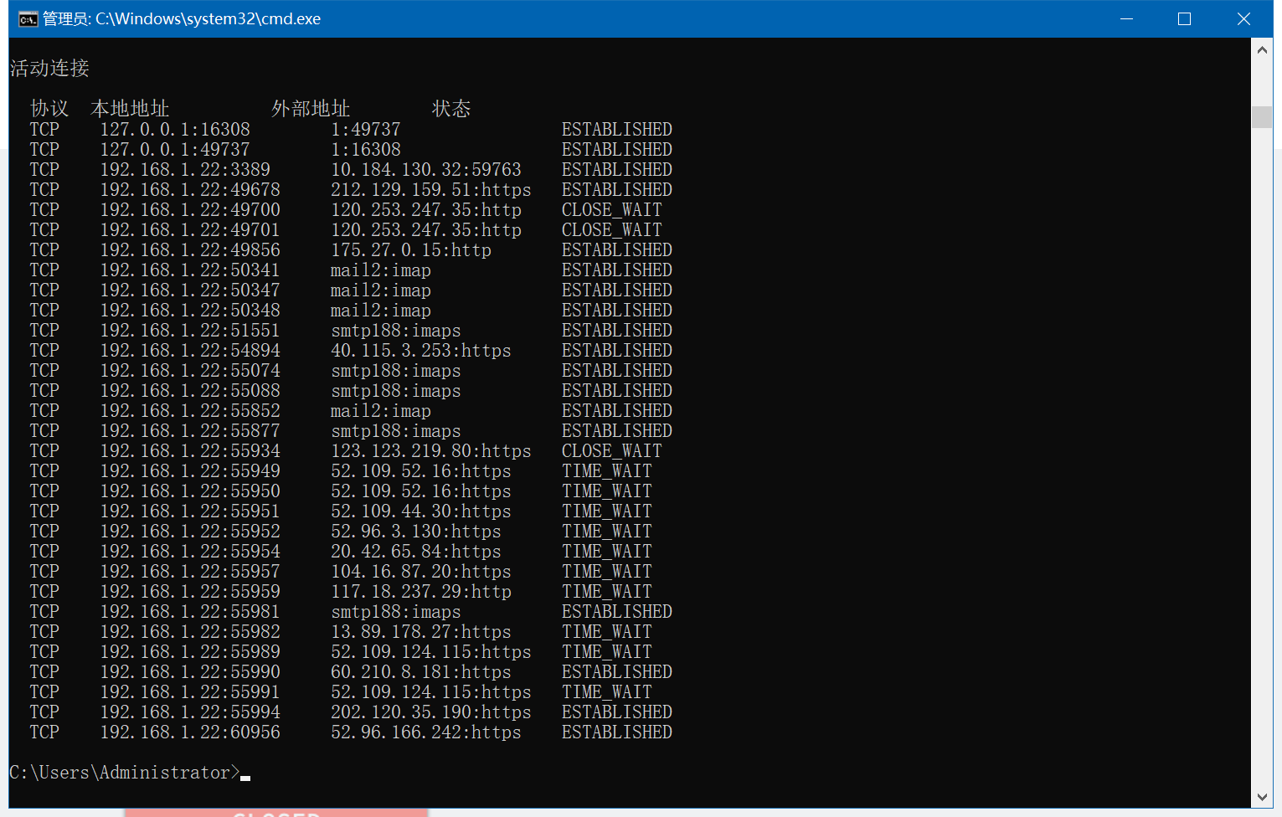
Real TCP Status - Netstat

Slide 153
Outline
3.1 Transport-layer services
3.2 Multiplexing and demultiplexing
3.3 Connectionless transport: UDP
3.4 Principles of reliable data transfer
3.5 Connection-oriented transport: TCP
3.6 Principles of congestion control
3.7 TCP congestion control

Slide 154
Principles of Congestion Control
Congestion:
informally: “too many sources sending too much data too fast for network to handle”
manifestations:
  lost packets (buffer overflow at routers)
  long delays (queueing in router buffers)
different from flow control!

Slide 155
What costs does congestion bring?

Slide 156

Causes/costs of congestion: scenario 1
original data: l_{in}
throughput: l_{out}
two senders, two receivers
one router, infinite buffers
output link capacity: R
no retransmission
Host A
unlimited shared output link buffers
Host B
R/2
λ_{out}
delay
λ_{in}
R/2
l_{in}
R/2
maximum per-connection throughput: R/2
Cost: large delays as arrival rate, l_{in}, approaches capacity

Slide 157
Causes/costs of congestion: scenario 2
one router, finite buffers
sender retransmission of timed-out packet
  application-layer input = application-layer output: λ_{in} = λ_{out}
  transport-layer input includes retransmissions : λ_{in} λ_{in}
‘
l_{in} : original data
l'_{in}: original data, plus retransmitted data
l_{out}
Host A
finite shared output link buffers
Host B

Slide 158
Causes/costs of congestion: scenario 2
idealization: perfect knowledge
sender sends only when router buffers available
R/2
λ_{out}
λ_{in}
R/2
l_{in} : original data
copy
l'_{in}: original data, plus retransmitted data
l_{out}
A
free buffer space!
finite shared output link buffers
Host B

Slide 159

Causes/costs of congestion: scenario 2
Idealization: known loss packets can be lost, dropped at router due to full buffers
sender only resends if packet known to be lost
l_{in} : original data
copy
l'_{in}: original data, plus retransmitted data
l_{out}
A
no buffer space!
Host B

Slide 160
Causes/costs of congestion: scenario 2
Idealization: known loss packets can be lost, dropped at router due to full buffers
sender only resends if packet known to be lost
R/2
when sending at R/2, some packets are retransmissions
λ_{out}
λ_{in}
R/2
l_{in} : original data
l'_{in}: original data, plus retransmitted data
l_{out}
A
free buffer space!
Host B

Slide 161


Causes/costs of congestion: scenario 2
Realistic: duplicates
packets can be lost, dropped at router due to full buffers
sender times out prematurely, sending two copies, both of which are delivered
R/2
when sending at R/2, some packets are retransmissions including duplicated that are delivered!
l_{out}
l_{in}
R/2
l_{in}
copy
l'_{in}
l_{out}
timeout
A
free buffer space!
Host B

Slide 162
Causes/costs of congestion: scenario 2
Realistic: duplicates
packets can be lost, dropped at router due to full buffers
sender times out prematurely, sending two copies, both of which are delivered
R/2
when sending at R/2, some packets are retransmissions including duplicated that are delivered!
l_{out}
l_{in}
R/2
“costs” of congestion:
more work (retrans) for given “goodput”
unneeded retransmissions: link carries multiple copies of pkt
  decreasing goodput

Slide 163
Causes/costs of congestion: scenario 3
Q: what happens as l_{in} and l_{in}’ increase ?
four senders
multihop paths
timeout/retransmit
A: as red l_{in}’ increases, all arriving blue pkts at upper queue are dropped, blue throughput g 0
Host A
l_{in} : original data
l_{out}
Host B
l'_{in}: original data, plus retransmitted data
finite shared output link buffers
Host D
Host C

Slide 164
Causes/costs of congestion: scenario 3
C/2
λ_{out}
λ_{in}’
C/2
another cost of congestion:
when packet dropped, any upstream transmission capacity used for that packet was wasted!

Slide 165
Approaches towards congestion control
Two broad approaches towards congestion control
Network-assisted congestion control:
  routers provide feedback to end systems
  single bit indicating congestion (SNA, DECbit, TCP/IP ECN, ATM)
  explicit rate sender should send at
End-end congestion control:
  no explicit feedback from network
  congestion inferred from end-system observed loss, delay
approach taken by TCP

Slide 166
Case study: ATM ABR congestion control
ABR: available bit rate:
“elastic service”
if sender’s path “underloaded”:
  sender should use available bandwidth
if sender’s path congested:
  sender throttled to minimum guaranteed rate
RM (resource management) cells:
sent by sender, interspersed with data cells
bits in RM cell set by switches (“network-assisted”)
  NI bit: no increase in rate (mild congestion)
  CI bit: congestion indication
RM cells returned to sender by receiver, with bits intact

Slide 167
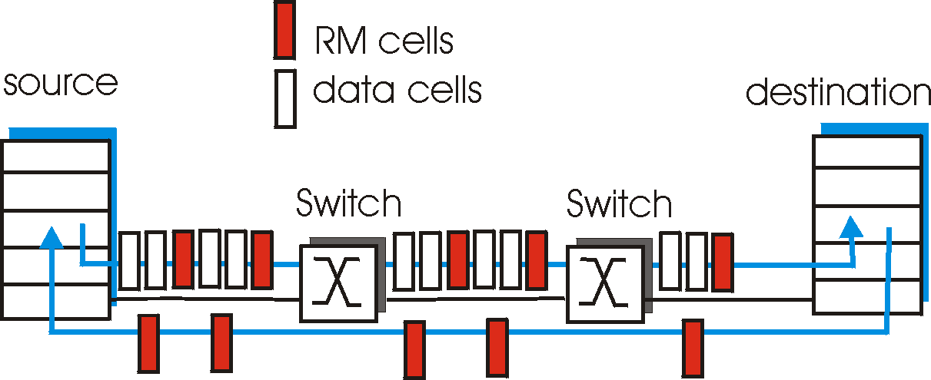
Case study: ATM ABR congestion control
two-byte ER (explicit rate) field in RM cell
  congested switch may lower ER value in cell
  sender’ send rate thus is maximum supportable rate on path
EFCI bit in data cells: set to 1 in congested switch
  if data cell preceding RM cell has EFCI set, sets CI bit in returned RM cell

Slide 168
Outline
3.1 Transport-layer services
3.2 Multiplexing and demultiplexing
3.3 Connectionless transport: UDP
3.4 Principles of reliable data transfer
3.5 Connection-oriented transport: TCP
3.6 Principles of congestion control
3.7 TCP congestion control

Slide 169
What are the design goal of congestion control?
Notes:
Greater throughput while avoiding congestions!

Slide 170
TCP congestion control: Basic Idea
probing for usable bandwidth by gradually increasing transmission rate (window size),
until congestion occurs!

Slide 171
Overview
Dynamically adjust
the transmission rate
  When not congested -> the host increases transmission rate for higher transmission performance
  When congested -> the host decreases the transmission rate for avoiding congestion.

Slide 172
How to detect congestion?
How do we do probing?
Notes:
Greater throughput while avoiding congestions!

Slide 173

How to Control Transmission Rate?
How is the transmission rate controlled?
Note:
Not by applications themselves, but by the transport layer
Internet
Yes.
Through controlling the send window

Slide 174
TCP Congestion Control: details
sender sequence number space
ConWin
last byte ACKed
last byte sent
sent, not-yet ACKed
(“in-flight”)
Sender limits transmission:
LastByteSent-LastByteAcked ≤ cwnd
What is the transmission rate? Roughly
cwnd
rate =
Bytes/sec
RTT

Slide 175
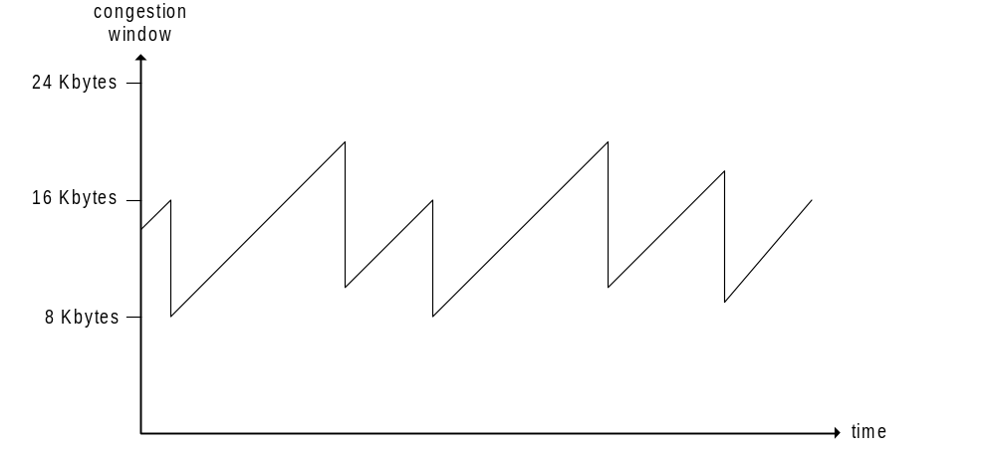
TCP AIMD
Additive Increase Multiplicative Decrease
cwnd: The send window for controlling the rate
additive increase: increase cwnd by 1 MSS every RTT until loss detected
multiplicative decrease: cut cwnd in half after loss
MSS: maximum segment size
probing
for bandwidth
congestion window size
Avoiding congestion

Slide 176
TCP Slow Start
When connection begins, cwnd = 1 MSS
  Example: MSS = 500 bytes & RTT = 200 msec
  initial rate = 20 kbps
available bandwidth may be >> MSS/RTT
desirable to quickly ramp up to respectable rate

Slide 177
TCP Slow Start (more)
When connection begins, increase rate exponentially until first loss event:
  double cwnd every RTT
  done by incrementing cwnd for every ACK received (why it is exponential?)
Summary: initial rate is slow but ramps up exponentially fast
Host A
Host B
one segment
RTT
two segments
four segments
time

Slide 178
Inferring loss of packet
How does sender perceive congestion?
(1) timeout
(2) 3 duplicate acks

Slide 179
TCP: detecting, reacting to loss
loss indicated by timeout:
  cwnd set to 1 MSS;
  window then grows exponentially (as in slow start) to threshold, then grows linearly
TCP Tahoe always sets cwnd to 1 (timeout or 3 duplicate acks)

Slide 180
TCP: detecting, reacting to loss
loss indicated by 3 duplicate ACKs: TCP RENO
  dup ACKs indicate network capable of delivering some segments
  cwnd is cut in half window then grows linearly
3 duplicate ACKS indicate that the connection is delivering data!

Slide 181
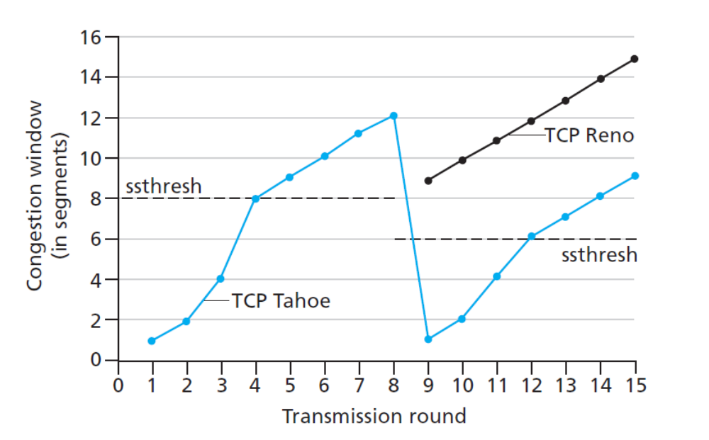
When switching from SS to CA?
Q: when should the exponential increase switch to linear?
A: when cwnd gets to 1/2 of its value before timeout.
Implementation:
variable ssthresh
on loss event, ssthresh is set to 1/2 of cwnd just before loss event

Slide 182
TCP throughput
W
W/2
avg TCP thruput =
3
W
4
RTT
bytes/sec
avg. TCP thruput as function of window size, RTT?
  ignore slow start, assume always data to send
W: window size (measured in bytes) where loss occurs
  avg. window size (# in-flight bytes) is ¾ W
  avg. thruput is 3/4W per RTT

Slide 183
TCP Futures: TCP over long, fat pipes
example: 1500 byte segments, 100ms RTT, want 10 Gbps throughput
requires W = 83,333 in-flight segments
throughput in terms of segment loss probability, L [Mathis 1997]:
  ➜ to achieve 10 Gbps throughput, need a loss rate of L = 2·10⁻¹⁰ – a very small loss rate!
new versions of TCP for high-speed
1.22
.
MSS
TCP throughput =
RTT
L
Notes:
If the bandwidth is very high, the window size is very large. A lost will decrease the window to 1 and it takes long time to recover.

Slide 184
TCP sender congestion control
State | Event | TCP Sender Action | Commentary
Slow Start (SS) | ACK receipt for previously unacked data | cwnd = cwnd + MSS, If (cwnd > Threshold) set state to “Congestion Avoidance” | Resulting in a doubling of cwnd every RTT
Congestion Avoidance (CA) | ACK receipt for previously unacked data | cwnd = cwnd+MSS * (1/cwnd) | Additive increase, resulting in increase of cwnd by 1 MSS every RTT
SS or CA | Loss event detected by triple duplicate ACK | Threshold = cwnd/2, cwnd = Threshold, Set state to “Congestion Avoidance” | Fast recovery, implementing multiplicative decrease. cwnd will not drop below 1 MSS.
SS or CA | Timeout | Threshold = cwnd/2, cwnd = 1 MSS, Set state to “Slow Start” | Enter slow start
SS or CA | Duplicate ACK | Increment duplicate ACK count for segment being acked | cwnd and Threshold not changed

Slide 185

Summary: TCP Congestion Control
New
ACK!
New
ACK!
.
duplicate ACK
new ACK
dupACKcount++
new ACK
cwnd = cwnd + MSS (MSS/cwnd)
dupACKcount = 0
transmit new segment(s), as allowed
cwnd = cwnd+MSS
dupACKcount = 0
transmit new segment(s), as allowed
L
cwnd = 1 MSS
ssthresh = 64 KB
dupACKcount = 0
cwnd > ssthresh
slow
start
L
congestion
avoidance
timeout
ssthresh = cwnd/2
cwnd = 1 MSS
dupACKcount = 0
retransmit missing segment
duplicate ACK
timeout
dupACKcount++
ssthresh = cwnd/2
cwnd = 1 MSS
dupACKcount = 0
retransmit missing segment
timeout
New
ACK!
ssthresh = cwnd/2
cwnd = 1
dupACKcount = 0
retransmit missing segment
New ACK
dupACKcount == 3
cwnd = ssthresh
dupACKcount = 0
dupACKcount == 3
ssthresh= cwnd/2
cwnd = ssthresh + 3
retransmit missing segment
ssthresh= cwnd/2
cwnd = ssthresh + 3
retransmit missing segment
fast
recovery
duplicate ACK
cwnd = cwnd + MSS
transmit new segment(s), as allowed

Slide 186
Is TCP fair to hosts in terms of achieved throughputs?

Slide 187
TCP Fairness
Fairness goal: if K TCP sessions share same bottleneck link of bandwidth R, each should have average rate of R/K
TCP connection 1
TCP
connection 2
bottleneck
router
capacity R

Slide 188
Why is TCP fair?
Two competing sessions:
Additive increase gives slope of 1, as throughout increases
multiplicative decrease decreases throughput proportionally
R
equal bandwidth share
Connection 2 throughput
loss: decrease window by factor of 2
congestion avoidance: additive increase
loss: decrease window by factor of 2
congestion avoidance: additive increase
R
Connection 1 throughput

Slide 189
Fairness (more)
Fairness and UDP
Multimedia apps often do not use TCP
  do not want rate throttled by congestion control
Instead use UDP:
  pump audio/video at constant rate, tolerate packet loss
Research area: TCP friendly
Fairness and parallel TCP connections
nothing prevents app from opening parallel connections between 2 hosts.
Web browsers do this
Example: link of rate R supporting 9 connections;
  new app asks for 1 TCP, gets rate R/10
  new app asks for 11 TCPs, gets R/2 !

Slide 190
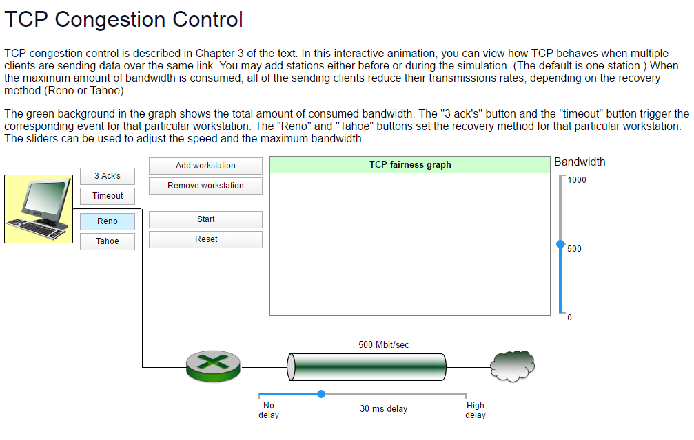
Congestion Control: Animation
https://media.pearsoncmg.com/aw/ecs_kurose_compnetwork_7/cw/content/interactiveanimations/tcp-congestion/index.html

Slide 191
We have covered the fundamentals of the transport layer
Remember: There are many on going developments based on what we covered

Slide 192
Chapter 3: Summary
principles behind transport layer services:
  multiplexing, demultiplexing
  reliable data transfer
  flow control
  congestion control
instantiation and implementation in the Internet
  UDP
  TCP
Next:
leaving the network “edge” (application, transport layers)
into the network “core”

Slide 193
Homework #3
Chapter 3:
  P3, P17, P40, P50

Slide 194
Lab #3
Exploring TCP

Slide 195
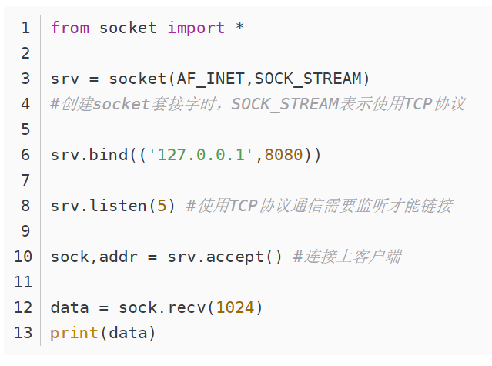
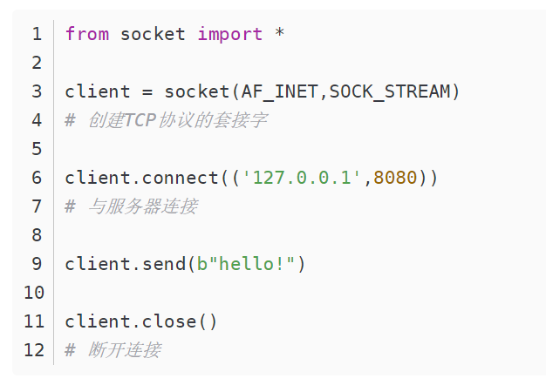
TCP Server and Client

Slide 196
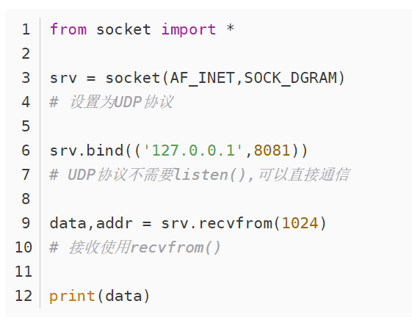
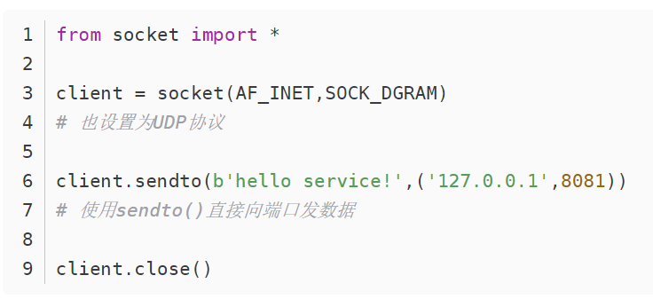
UDP Server and Client

