Slide 1
Chapter 4 Network Layer – Data Plane
Yanmin Zhu
School of Computers

Slide 2
Discussions
The services provided by the network layer? Are they implemented in an end-to-end fashion?
How does a packet be forwarded hop by hop towards the destination host?
What are forwarding entries at routers look like? (one entry for one destination?)
What is software-defined networking? Why is the Internet going SDN?

Slide 3
Outline
4.1 Overview of Network layer
  data plane
  control plane
4.2 What's inside a router
4.3 IP: Internet Protocol
  datagram format
  fragmentation
  IPv4 addressing
  network address translation
  IPv6
4.4 Generalized Forward and SDN
  match
  action
  OpenFlow examples of match-plus-action in action

Slide 4
Chapter 4: network layer
chapter goals:
understand principles behind network layer services, focusing on data plane:
  network layer service models
  forwarding versus routing
  how a router works
  generalized forwarding
instantiation, implementation in the Internet

Slide 5

















Network layer
application
transport
network
data link
physical
transport segment from sending to receiving host
on sending side encapsulates segments into datagrams
on receiving side, delivers segments to transport layer
network layer protocols in every host, router
router examines header fields in all IP datagrams passing through it
network
data link
physical
network
data link
physical
network
data link
physical
network
data link
physical
network
data link
physical
network
data link
physical
network
data link
physical
network
data link
physical
network
data link
physical
application
transport
network
data link
physical
network
data link
physical
network
data link
physical

Slide 6
Two key network-layer functions
network-layer functions:
forwarding: move packets from router's input to appropriate router output
routing: determine route taken by packets from source to destination
  routing algorithms
analogy: taking a trip
forwarding: process of getting through single interchange
routing: process of planning trip from source to destination

Slide 7
Data plane and control plane
Data Plane
Control plane
local, per-router function -> forwarding
determines how datagram arriving on router input port is forwarded to router output port
network-wide logic -> routing
determines how datagram is routed among routers along end-end path from source host to destination host
two control-plane approaches:
  traditional routing algorithms: implemented in routers
  software-defined networking (SDN): implemented in (remote) servers
values in arriving
packet header
0111
1
3
2

Slide 8

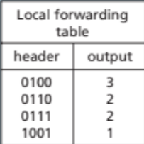
Option 1: Per-router control plane
Individual routing algorithm components in each and every router interact in the control plane
Routing
Algorithm
control
plane
data
plane
values in arriving
packet header
0111
1
3
2

Slide 9
Option 2: Logically central control plane
A distinct (typically remote) controller interacts with local control agents (CAs)
Remote Controller
control
plane
data
plane
CA
CA
CA
CA
CA
values in arriving
packet header
0111
1
3
2

Slide 10
Network service model
Q: What service model for channel transporting datagrams from sender to receiver?
example services for a flow of datagrams:
in-order datagram delivery
guaranteed minimum bandwidth to flow
restrictions on changes in inter-packet spacing
example services for individual datagrams:
guaranteed delivery
guaranteed delivery with less than 40 msec delay

Slide 11
Network layer service models:
Network
Architecture
Internet
ATM
ATM
ATM
ATM
Service
Model
best effort
CBR
VBR
ABR
UBR
Guarantees ?
Congestion
feedback
no (inferred
via loss)
no
congestion
no
congestion
yes
no
Bandwidth
none
constant
rate
guaranteed
rate
guaranteed
minimum
none
Loss
no
yes
yes
no
no
Order
no
yes
yes
yes
yes
Timing
no
yes
yes
no
no

Slide 12
Reflections on best-effort service:
simplicity of mechanism has allowed Internet to be widely deployed adopted
sufficient provisioning of bandwidth allows performance of real-time applications (e.g., interactive voice, video) to be “good enough” for “most of the time”
replicated, application-layer distributed services (datacenters, content distribution networks) connecting close to clients’ networks, allow services to be provided from multiple locations

Slide 13
Outline
4.1 Overview of Network layer
  data plane
  control plane
4.2 What's inside a router
4.3 IP: Internet Protocol
  datagram format
  fragmentation
  IPv4 addressing
  network address translation
  IPv6
4.4 Generalized Forward and SDN
  match
  action
  OpenFlow examples of match-plus-action in action

Slide 14
Router architecture overview
high-level view of generic router architecture:
routing, management
control plane (software)
operates in millisecond
time frame
routing
processor
forwarding data plane (hardware) operates in nanosecond timeframe
high-seed
switching
fabric
router input ports
router output ports

Slide 15
Input port functions
lookup,
forwarding
queueing
line
termination
link
layer
protocol
(receive)
switch
fabric
physical layer:
bit-level reception
data link layer:
e.g., Ethernet
see chapter 5
decentralized switching:
using header field values, lookup output port using forwarding table in input port memory (“match plus action”)
goal: complete input port processing at 'line speed'
queuing: if datagrams arrive faster than forwarding rate into switch fabric

Slide 16
Input port functions
lookup,
forwarding
queueing
line
termination
link
layer
protocol
(receive)
switch
fabric
physical layer:
bit-level reception
decentralized switching:
using header field values, lookup output port using forwarding table in input port memory (“match plus action”)
(1) destination-based forwarding: forward based only on destination IP address (traditional)
(2) generalized forwarding: forward based on any set of header field values
data link layer:
e.g., Ethernet
see chapter 5

Slide 17
Switching fabrics
transfer packet from input buffer to appropriate output buffer
switching rate: rate at which packets can be transfer from inputs to outputs
  often measured as multiple of input/output line rate
  N inputs: switching rate N times line rate desirable
three types of switching fabrics
memory
memory
bus
crossbar

Slide 18
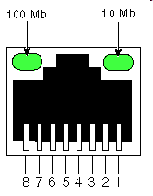
Switching via memory
first generation routers:
traditional computers with switching under direct control of CPU
packet copied to system's memory
speed limited by memory bandwidth (2 bus crossings per datagram)
input
port
(e.g.,
Ethernet)
output
port
(e.g.,
Ethernet)
memory
system bus

Slide 19
Switching via a bus
datagram from input port memory
to output port memory via a shared bus
bus contention: switching speed limited by bus bandwidth
32 Gbps bus, Cisco 5600: sufficient speed for access and enterprise routers
bus

Slide 20
Switching via interconnection network
overcome bus bandwidth limitations
banyan networks, crossbar, other interconnection nets initially developed to connect processors in multiprocessor
advanced design: fragmenting datagram into fixed length cells, switch cells through the fabric.
Cisco 12000: switches 60 Gbps through the interconnection network
crossbar

Slide 21
Input port queuing
fabric slower than input ports combined -> queueing may occur at input queues
  queueing delay and loss due to input buffer overflow!
Head-of-the-Line (HOL) blocking: queued datagram at front of queue prevents others in queue from moving forward
switch
fabric
switch
fabric
output port contention:
only one red datagram can be transferred.
lower red packet is blocked
one packet time later: green packet experiences HOL blocking

Slide 22
Output ports
This slide in HUGELY important!
datagram
buffer
queueing
switch
fabric
link
layer
protocol
(send)
line
termination
buffering required when datagrams arrive from fabric faster than the transmission rate
scheduling discipline chooses among queued datagrams for transmission
Datagram (packets) can be lost due to congestion, lack of buffers
Priority scheduling – who gets best performance

Slide 23
Output port queueing
switch
fabric
switch
fabric
at t, packets more
from input to output
one packet time later
buffering when arrival rate via switch exceeds output line speed
queueing (delay) and loss due to output port buffer overflow!

Slide 24
How do we choose next packet to transmit on the link?
Why different strategies?

Slide 25
Scheduling and discard policy
packet
arrivals
packet
departures
queue
(waiting area)
link
(server)
Scheduling: choose next packet to send on link
  FIFO (first in first out) scheduling: send in order of arrival to queue
Discard policy: if packet arrives to full queue: who to discard?
  tail drop: drop arriving packet
  priority: drop/remove on priority basis
  random: drop/remove randomly

Slide 26
Scheduling policies: priority
high priority queue
(waiting area)
priority scheduling: send highest priority queued packet
multiple classes, with different priorities
  class may depend on marking or other header info, e.g. IP source/dest, port numbers, etc.
  real world example?
arrivals
departures
classify
link
(server)
low priority queue
(waiting area)
2
1
3
4
5
arrivals
packet in service
1
3
2
4
5
departures
1
3
2
4
5

Slide 27
Scheduling policies: still more
Round Robin (RR) scheduling:
multiple classes
cyclically scan class queues, sending one complete packet from each class (if available)
real world example?
2
Class 1
1
3
4
5
arrivals
arrivals
departures
packet in service
1
3
2
4
5
classify
link
(server)
departures
Class 2
1
3
3
4
5

Slide 28
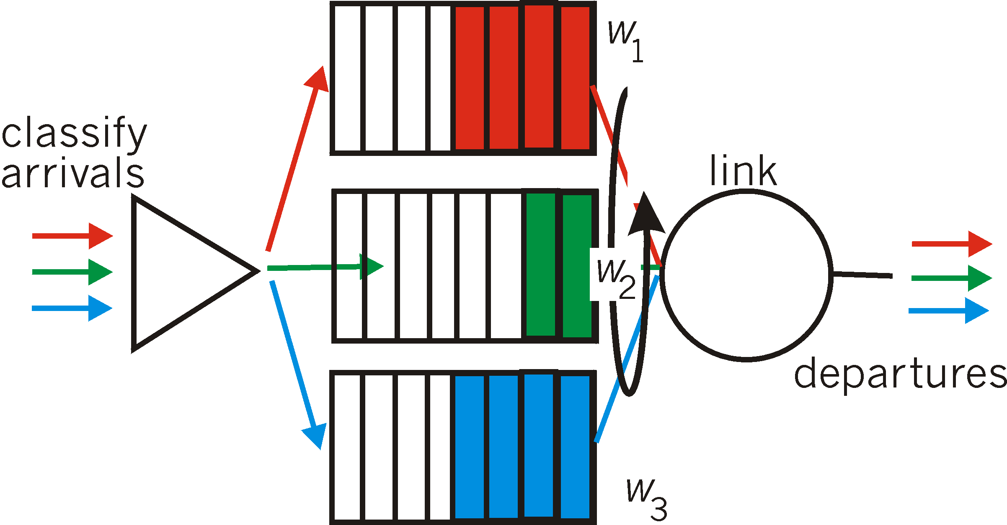
Scheduling policies: still more
Weighted Fair Queuing (WFQ):
generalized Round Robin
each class gets weighted amount of service in each cycle
real-world example?

Slide 29
Outline
4.1 Overview of Network layer
  data plane
  control plane
4.2 What's inside a router
4.3 IP: Internet Protocol
  datagram format
  fragmentation
  IPv4 addressing
  network address translation
  IPv6
4.4 Generalized Forward and SDN
  match
  action
  OpenFlow examples of match-plus-action in action

Slide 30
The Internet network layer
transport layer: TCP, UDP
routing protocols
path selection
RIP, OSPF, BGP
IP protocol
addressing conventions
datagram format
packet handling conventions
network
layer
forwarding
table
ICMP protocol
error reporting
router “signaling”
link layer
physical layer

Slide 31
What essential information shall be included in the IP header?
TCP vs UDP, connectionless or not, UDP header is simple
IP is connectionless. What about IP header?
Notes:
记得 TCP and UDP, UDP头部很简单。IP 是不是也很简单？

Slide 32
IP datagram format
IP protocol version
number
32 bits
total datagram
length (bytes)
header length
(bytes)
head.
len
type of
service
ver
length
for
fragmentation/
reassembly
“type” of data
flgs
fragment
offset
16-bit identifier
max number
remaining hops
(decremented at
each router)
time to
live
upper
layer
header
checksum
32 bit source IP address
upper layer protocol
to deliver payload to
32 bit destination IP address
options (if any)
e.g. timestamp,
record route
taken, specify
list of routers
to visit.
data
(variable length,
typically a TCP
or UDP segment)
how much overhead?
20 bytes of TCP
20 bytes of IP
= 40 bytes + app layer overhead

Slide 33
Why network layer multiplexing and demultiplexing?
How do mul/dem work in IP?

Slide 34
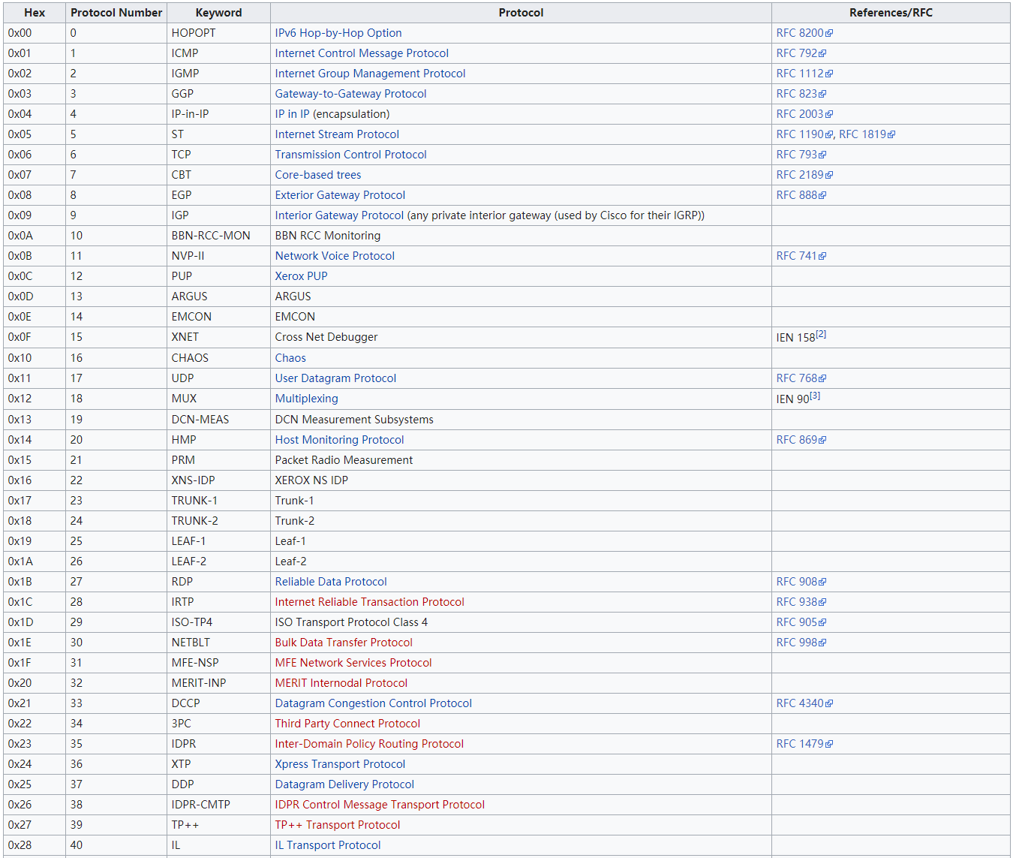
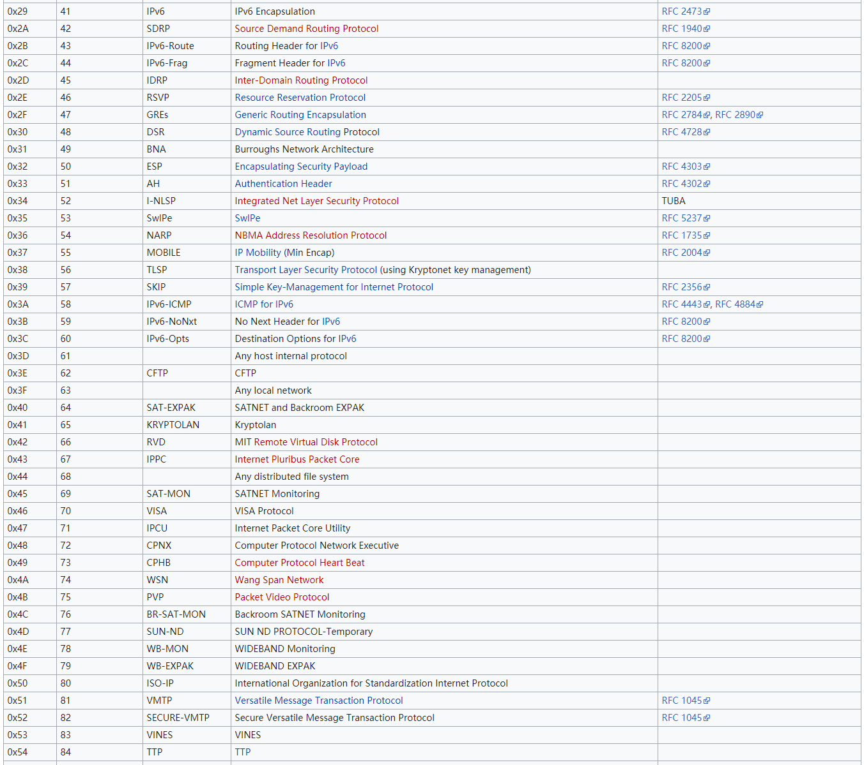
Internet Protocol numbers
Below are the Internet Protocol numbers found in the Protocol field of the IPv4 header and the Next Header field of the IPv6 header

Slide 35
Why IP datagram fragmentation?

Slide 36

Different Maximum Transmission Units
MTU is the maximum transmission unit determined by the link layer technology.
Ethernet frame
PPP frame
MTU = 1024 Bytes
MTU = 512 Bytes
Different link technologies have different MTUs

Slide 37
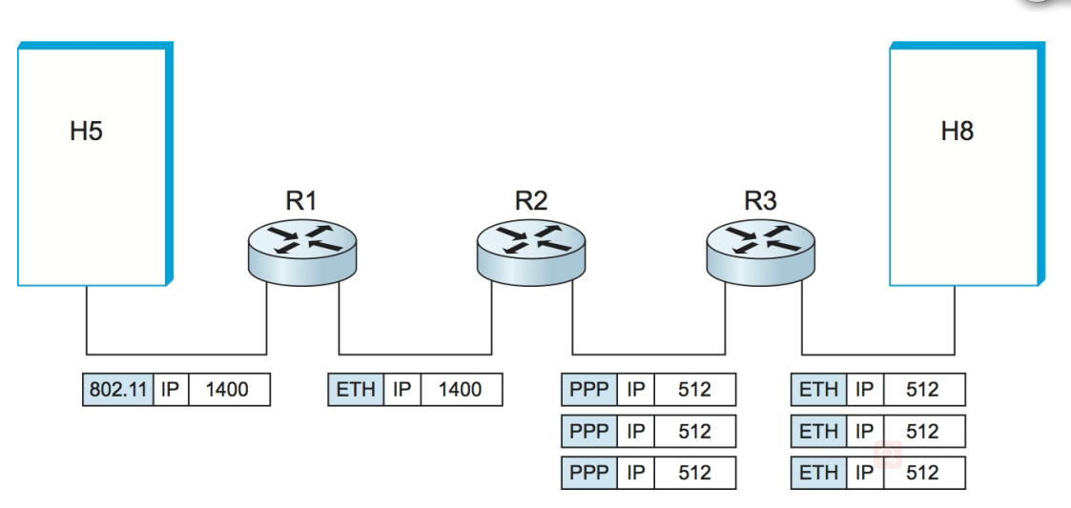
IP fragmentation illustration
Ethernet Link
Ethernet Link
PPP Link
Ethernet Link
large IP datagram divided (“fragmented”) within net, one datagram becomes several datagrams

Slide 38
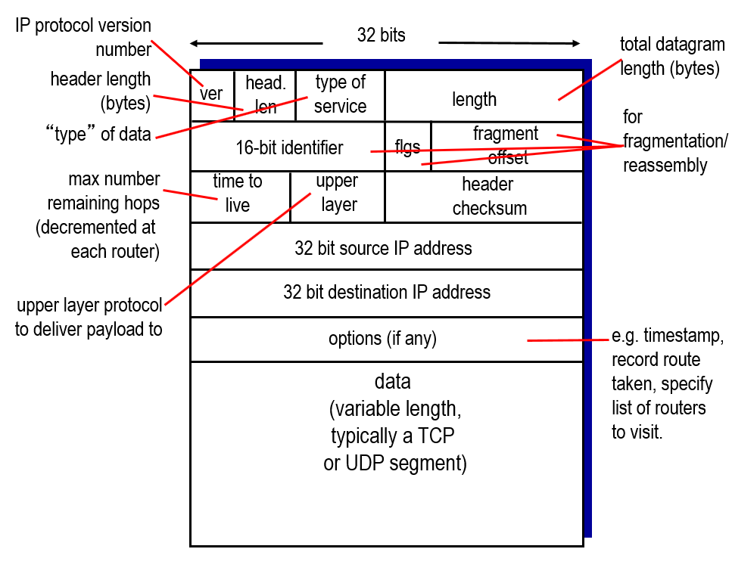
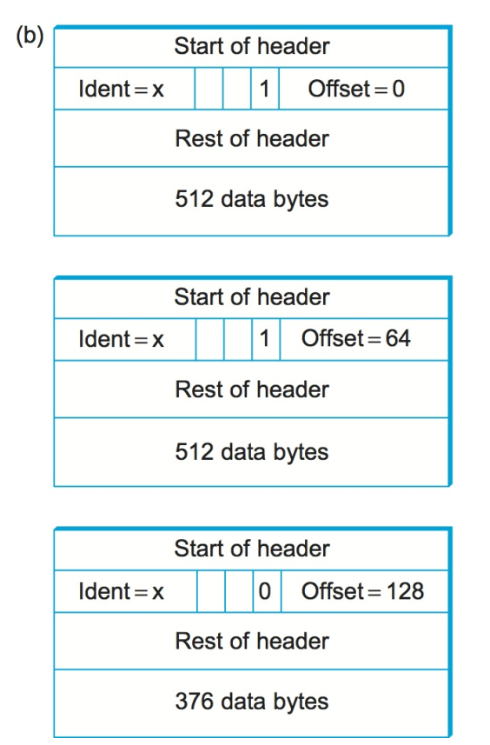
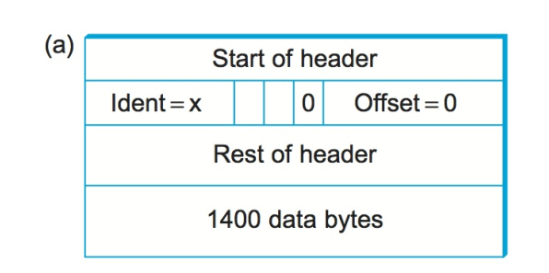
Header fields used in IP fragmentation

Slide 39
IP fragmentation example
example:
4000 byte datagram
MTU = 1500 bytes
length
=4000
ID
=x
fragflag
=0
offset
=0
one large datagram becomes
several smaller datagrams
1480 bytes in
data field
length
=1500
ID
=x
fragflag
=1
offset
=0
=
1480/8
length
=1500
ID
=x
fragflag
=1
offset
=185
length
=1040
ID
=x
fragflag
=0
offset
=370
Offset unit is 8 bytes!

Slide 40
Where to resemble IP fragments
…
fragmentation:
in: one large datagram
out: 3 smaller datagrams
reassembly
At the destination host!
…

Slide 41
About addressing at the network layer
How is a host assigned with an IP?
Already with a host address, why network address?
Why subnet mask?
How is forwarding table organized?

Slide 42
IP addressing: overview
IP address is globally unique: 32-bit identifier for host, router interface
IP addresses associated with each interface
interface: connection between host/router and physical link
  router's typically have multiple interfaces
  host typically has one or two interfaces (e.g., wired Ethernet, wireless 802.11)
223.1.1.1 = 11011111 00000001 00000001 00000001
223
1
1
1
223.1.1.1
223.1.2.1
223.1.1.2
223.1.1.4
223.1.2.9
223.1.1.3
223.1.3.27
223.1.2.2
223.1.3.1
223.1.3.2

Slide 43

IP addressing
223.1.1.1
Q: how are interfaces actually connected?
A: we'll learn about that in chapter 5, 6.
223.1.2.1
223.1.1.2
223.1.1.4
223.1.2.9
223.1.1.3
223.1.3.27
223.1.2.2
A: wired Ethernet interfaces connected by Ethernet switches
223.1.3.1
223.1.3.2
For now: don't need to worry about how one interface is connected to another (with no intervening router)
A: wireless WiFi interfaces connected by WiFi base station

Slide 44
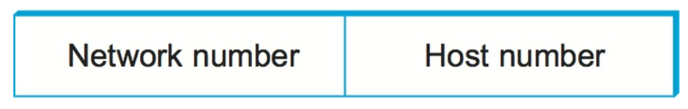
IP Address Format
223.1.1.1 = 11011111 00000001 00000001 00000001
network address
Host address
The original intent of IP addresses was that the network part would uniquely identify exactly one physical network.
Notes:
理论上

Slide 45
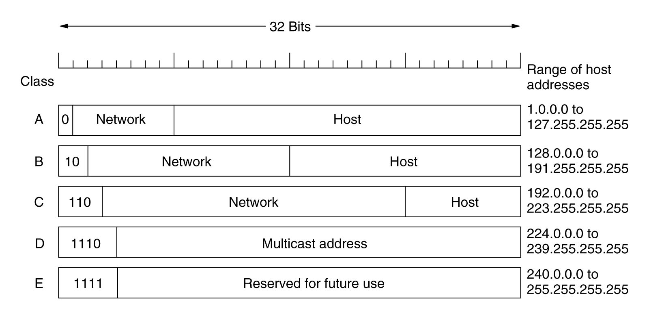
Classful Address

Slide 46
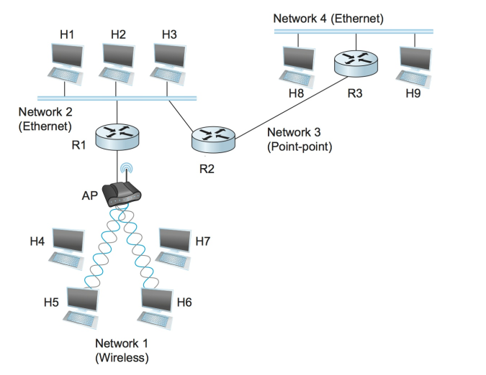
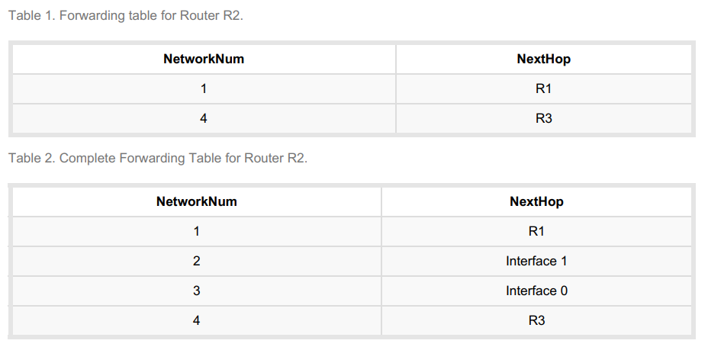
Forwarding Tables with Network Numbers

Slide 47
What problem with classful address?
Assigning one network number per physical network, therefore, uses up the IP address space potentially much faster than we would like. Low efficiency of IP use!
Forwarding table can be huge
Notes:
Assigning many network numbers has another drawback that becomes apparent when you think about routing. Recall
that the amount of state that is stored in a node participating in a routing protocol is proportional to the number of
other nodes, and that routing in an internet consists of building up forwarding tables that tell a router how to reach
different networks. Thus, the more network numbers there are in use, the bigger the forwarding tables get

Slide 48
How do you address the low utilization problem of IP address allocation?

Slide 49
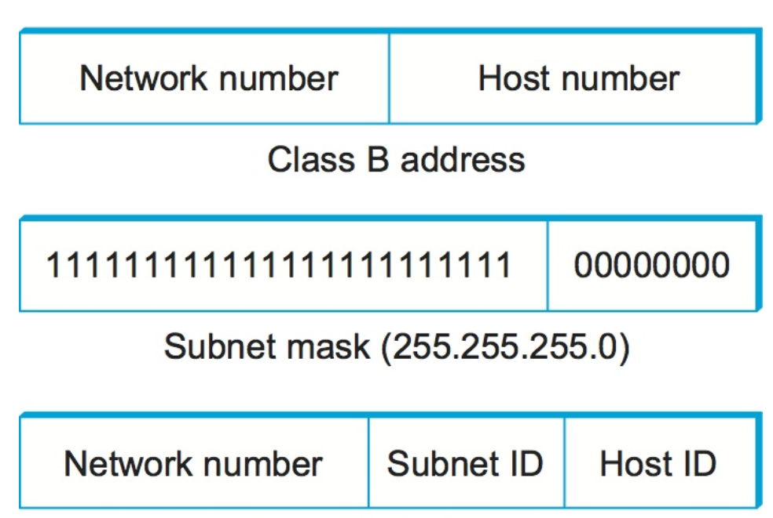
Subnetting
The main approach
Let one network number to be shared by multiple physical networks

Slide 50
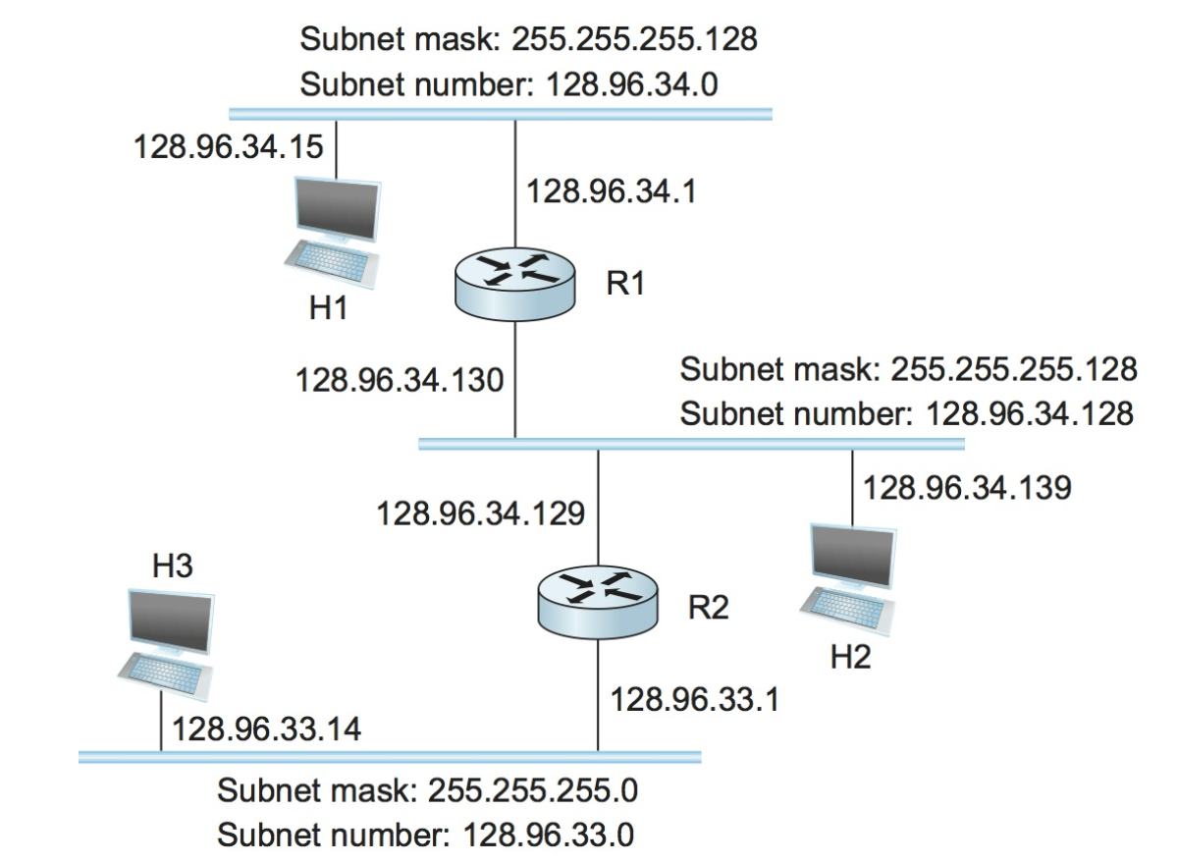
Example of subnets

Slide 51
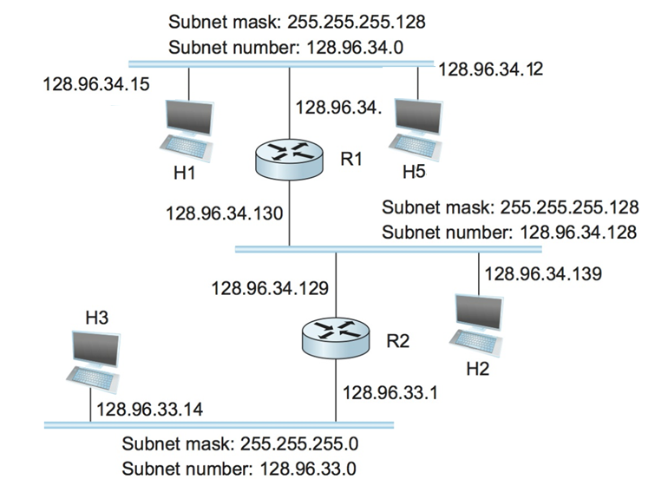
How do we know destination host in same subnet?
When the host wants to send a packet to a destination host, the first thing is to know if that is in the same subnet. How?
to perform a bitwise AND between its own subnet mask and the destination IP address
(1) If on the same subnet, the packet can be delivered directly over the subnet.
(2) If not on the same subnet, the packet needs to be sent to a router to be forwarded to another subnet.
H1, H5, same subnet
H1, H2, diff subnet
Hosts in the same subnet are neighbors

Slide 52
Subnets
223.1.1.2
223.1.1.1
223.1.1.4
How many subnets are there in the network?
223.1.1.3
223.1.9.2
223.1.7.0
223.1.9.1
223.1.7.1
223.1.8.1
223.1.8.0
223.1.2.6
223.1.3.27
223.1.2.1
223.1.2.2
223.1.3.1
223.1.3.2

Slide 53
Subnets
223.1.1.0/24
recipe
to determine the subnets, detach each interface from its host or router, creating islands of isolated networks
each isolated network is called a subnet
223.1.2.0/24
223.1.1.1
223.1.1.2
223.1.2.1
223.1.1.4
223.1.2.9
223.1.2.2
223.1.1.3
223.1.3.27
subnet
223.1.3.1
223.1.3.2
223.1.3.0/24
subnet mask: /24

Slide 54
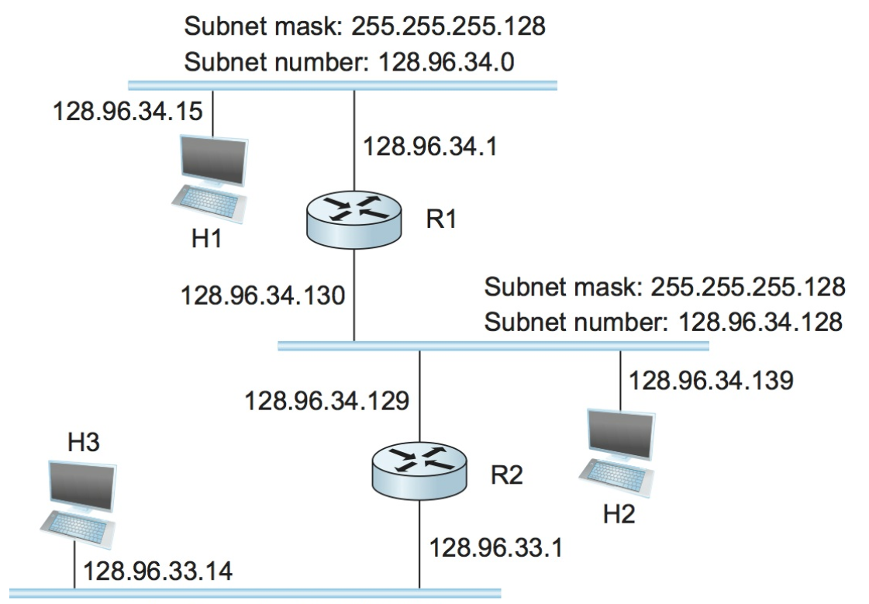
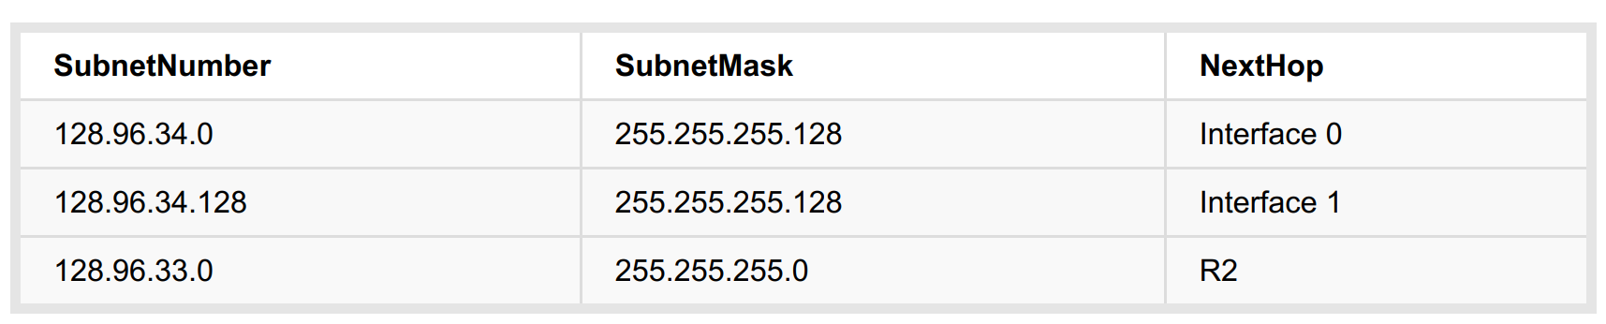
Forwarding tables with subnetting in use
Forwarding Table at R1
Given a packet to H2, how R1 finds the next hop? Forwarding table at R1:

Slide 55
How can you reduce the size of the forwarding table?
Notes:
为什么最长前缀匹配？ 跟 CIDR的IP地址分配是有关系的。

Slide 56
Classless Address: CIDR
CIDR: Classless InterDomain Routing
  Network portion of address of arbitrary length
  address format: a.b.c.d/x, where x is # bits in network portion of address
network
part
host
part
11001000 00010111 00010000 00000000
200.23.16.0/23
The bit length of network part can be arbitrary!

Slide 57
Benefits of using CIDR
It allows routers to do route aggregation (supernetting) so that router entries can be reduced, for more efficient forwarding
192.168.98.0/23 -> O2
192.168.99.0/23 -> O2
192.168.100.0/23 -> O2
192.168.101.0/23 -> O2
192.168.102.0/23 -> O2
192.168.105.0/23 -> O2
192.168.96.0/20 -> O2
route aggregation
Notes:
Supernet vs subnet

Slide 58
Destination-based forwarding
forwarding table
Destination Address Range
11001000 00010111 00010000 00000000
through
11001000 00010111 00010111 11111111
11001000 00010111 00011000 00000000
through
11001000 00010111 00011000 11111111
11001000 00010111 00001000 00000000
through
11001000 00010111 00001111 11111111
otherwise
Link Interface
0
1
2
3

Slide 59
Prefix matching
Destination Address Range
11001000 00010111 00010*** *********
11001000 00010111 00011000 *********
11001000 00010111 00001*** *********
otherwise
Link interface
0
1
2
3
examples:
DA: 11001000 00010111 00010110 10100001
which interface?

Slide 60
Do not divide up nicely
Destination Address Range
11001000 00010111 00010000 00000000
through
11001000 00010111 00010111 11111111
11001000 00010111 00011000 00000000
through
11001000 00010111 00011000 11111111
11001000 00010111 00011001 00000000
through
11001000 00010111 00011111 11111111
otherwise
Link Interface
0
1
2
3
Q: but what happens if ranges don't divide up so nicely?

Slide 61
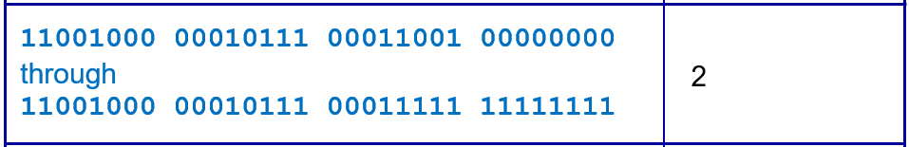
Do not divide up nicely (con't)
Can we use a common prefix to represent this range?
A small range is removed from a regular range (with common prefix)
How do we address this problem?

Slide 62
A Simpler Example (Do not divide nicely)
Destination range | Link interface
X.Y.Z.00000000 Through X.Y.Z.00001111 | 0
X.Y.Z.00010000 Through X.Y.Z.01111111 | 1
otherwise | 2
16 IP addresses
112 IP addresses
How do you make the forwarding table with prefix matching?

Slide 63
Approach 1: Multiple Blocks (common prefixes)
Each block has 16 IP addresses
X.Y.Z.0000~
X.Y.Z. 0001~
X.Y.Z. 0010~
X.Y.Z. 0011~
X.Y.Z. 0100~
X.Y.Z. 0101~
X.Y.Z. 0110~
X.Y.Z. 0111~
PORT 0
PORT 1
Prefix | Port
X.Y.Z.0000* | 0
X.Y.Z.0001* | 1
X.Y.Z.001* | 1
X.Y.Z.01* | 1

Slide 64
Approach 2: Longest Prefix Matching
Each block has 16 IP addresses
X.Y.Z. 0000~
X.Y.Z. 0001~
X.Y.Z. 0010~
X.Y.Z. 0011~
X.Y.Z. 0100~
X.Y.Z. 0101~
X.Y.Z. 0110~
X.Y.Z. 0111~
PORT 0
PORT 1
Given this dest. IP
Prefix | Port
X.Y.Z.0000* | 0
X.Y.Z.0* | 1
X.Y.Z.00001100
Which to match?
longest prefix matching
when looking for forwarding table entry for given destination address, use longest address prefix that matches destination address.

Slide 65
Hierarchical addressing: route aggregation
Hierarchical addressing allows efficient advertisement of routing information:
Organization 0
200.23.16.0/23
Organization 1
200.23.18.0/23
“Send me anything
with addresses
beginning
200.23.16.0/20”
Organization 2
200.23.20.0/23
.
Fly-By-Night-ISP
.
.
.
.
Internet
Organization 7
.
200.23.30.0/23
ISPs-R-Us
“Send me anything
with addresses
beginning
199.31.0.0/16”

Slide 66
Hierarchical addressing: more specific routes
ISPs-R-Us has a more specific route to Organization 1
Organization 0
200.23.16.0/23
“Send me anything
with addresses
beginning
200.23.16.0/20”
Organization 2
200.23.20.0/23
.
Fly-By-Night-ISP
.
.
.
.
Internet
Organization 7
.
200.23.30.0/23
ISPs-R-Us
“Send me anything
with addresses
beginning 199.31.0.0/16
or 200.23.18.0/23”
Organization 1
200.23.18.0/23

Slide 67
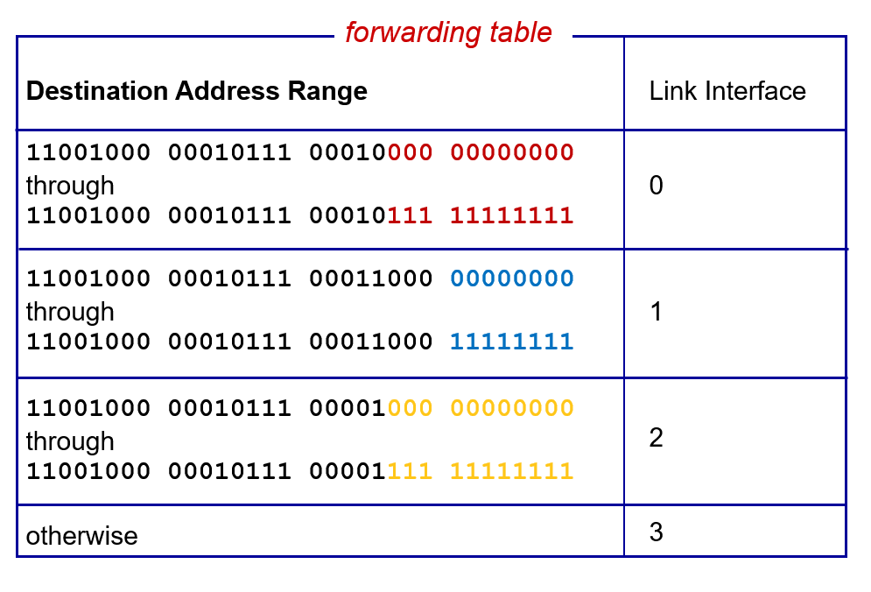
Longest Prefix Matching: An Example
Destination prefix
11001000 00010111 00010*** *********
11001000 00010111 00011000 *********
11001000 00010111 00011*** *********
otherwise
Link interface
0
1
2
3
DA: 11001000 00010111 00011000 10101010
which interface?

Slide 68
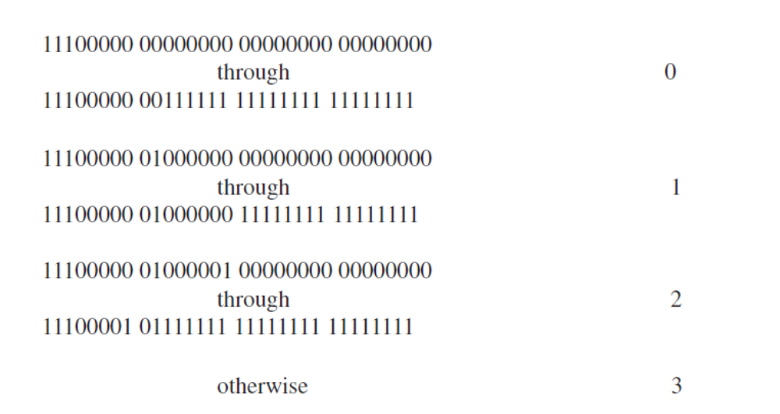
An exercise problem
Small portion left
Provide a forwarding table that has five entries, uses longest prefix matching, and forwards packets to the correct link interfaces.

Slide 69
Visualization
All other ranges
PORT 3
11100000 00000000 00000000 00000000
11100001 11111111 11111111 11111111
1110 000~
1110 0000 00~
1110 0000 01~
1110 0000 10~
1110 0000 11~
1110 0001 00~
1110 0001 01~
1110 0001 10~
1110 0001 11~
PORT 0
PORT 1
PORT 3
PORT 2

Slide 70
Solution (based on LPM)
All other ranges
PORT 3
11100000 00000000 00000000 00000000
11100001 11111111 11111111 11111111
1110 000~
1110 0000 00~
1110 0000 01~
1110 0000 10~
1110 0000 11~
1110 0001 00~
1110 0001 01~
1110 0001 10~
1110 0001 11~
PORT 0
PORT 1
PORT 3
PORT 2

Slide 71
How does a host get IP address?
1) hard-coded by system admin in a file
  Windows: control-panel->network->configuration->tcp/ip->properties
  UNIX: /etc/rc.config
2) DHCP: Dynamic Host Configuration Protocol: dynamically get address from as server
  “plug-and-play”
netsh>
netsh interface>
netsh interface ip>
set address local static 10.0.0.9 255.0.0.0 10.0.0.1 1

Slide 72



DHCP: Dynamic Host Configuration Protocol
Goal: allow host to dynamically obtain its IP address from network server when it joins network
Can renew its lease on address in use
Allows reuse of addresses (only hold address while connected an “on”)
Support for mobile users who want to join network (more shortly)
DHCP
223.1.2.1
A
223.1.1.1
server
223.1.1.2
223.1.1.4
223.1.2.9
B
223.1.2.2
E
223.1.1.3
223.1.3.27
223.1.3.1
223.1.3.2
arriving DHCP
client needs
address in this
network

Slide 73
The new host does not know the IP address of the DHCP server, where to send the request?

Slide 74
DHCP client-server scenario
DHCP server: 223.1.2.5
arriving
client
DHCP discover
DHCP overview:
host broadcasts “DHCP discover” msg
DHCP server responds with “DHCP offer” msg
host requests IP address: “DHCP request” msg
DHCP server sends address: “DHCP ack” msg
src : 0.0.0.0, 68
dest.: 255.255.255.255,67
yiaddr: 0.0.0.0
transaction ID: 654
DHCP offer
src: 223.1.2.5, 67
dest: 255.255.255.255, 68
yiaddrr: 223.1.2.4
transaction ID: 654
Lifetime: 3600 secs
DHCP request
src: 0.0.0.0, 68
dest:: 255.255.255.255, 67
yiaddrr: 223.1.2.4
transaction ID: 655
Lifetime: 3600 secs
time
DHCP ACK
src: 223.1.2.5, 67
dest: 255.255.255.255, 68
yiaddrr: 223.1.2.4
transaction ID: 655
Lifetime: 3600 secs

Slide 75
IP addresses: how to get one?
Q: How does network get subnet part of IP addr?
A: gets allocated portion of its provider ISP's address space
ISP's block 11001000 00010111 00010000 00000000 200.23.16.0/20
Organization 0 11001000 00010111 00010000 00000000 200.23.16.0/23
Organization 1 11001000 00010111 00010010 00000000 200.23.18.0/23
Organization 2 11001000 00010111 00010100 00000000 200.23.20.0/23
... ….. …. ….
Organization 7 11001000 00010111 00011110 00000000 200.23.30.0/23

Slide 76

IP addressing: the last word
Q: Where does an ISP get a block of addresses?
A: ICANN: Internet Corporation for Assigned
Names and Numbers
  allocates addresses
  manages DNS
  assigns domain names, resolves disputes

Slide 77
NAT: Network Address Translation
Running out of IP address
Private IP address
RFC1918 name | IP address range | number of addresses | classful description | largest CIDR block (subnet mask) | host id size
24-bit block | 10.0.0.0 – 10.255.255.255 | 16,777,216 | single class A | 10.0.0.0/8 (255.0.0.0) | 24 bits
20-bit block | 172.16.0.0 – 172.31.255.255 | 1,048,576 | 16 contiguous class B's | 172.16.0.0/12 (255.240.0.0) | 20 bits
16-bit block | 192.168.0.0 – 192.168.255.255 | 65,536 | 256 contiguous class C's | 192.168.0.0/16 (255.255.0.0) | 16 bits

Slide 78
NAT Overview
rest of
Internet
local private network
(e.g., home network)
10.0.0/24
10.0.0.1
10.0.0.4
10.0.0.2
138.76.29.7
10.0.0.3
All datagrams leaving local
network have same single source NAT IP address: 138.76.29.7,
different source port numbers
Datagrams with source or
destination in this network
have 10.0.0/24 address for
source, destination (as usual)

Slide 79
How does NAT work?
Basic idea:
The edge router changes the source IP address of out-going packets and forwards incoming packets to private addresses.
A mapping table is the key!

Slide 80
How NAT router processes packets?
NAT translation table
WAN side addr LAN side addr
1: host 10.0.0.1
sends datagram to
128.119.40.186, 80
2: NAT router
changes datagram
source addr from
10.0.0.1, 3345 to
138.76.29.7, 5001,
updates table
138.76.29.7, 5001 10.0.0.1, 3345
…… ……
S: 10.0.0.1, 3345
D: 128.119.40.186, 80
10.0.0.1
1
2
S: 138.76.29.7, 5001
D: 128.119.40.186, 80
10.0.0.4
10.0.0.2
138.76.29.7
S: 128.119.40.186, 80
D: 10.0.0.1, 3345
4
S: 128.119.40.186, 80
D: 138.76.29.7, 5001
3
4: NAT router
changes datagram
dest addr from
138.76.29.7, 5001 to 10.0.0.1, 3345
10.0.0.3
3: Reply arrives
dest. address:
138.76.29.7, 5001

Slide 81
NAT Router implementation
outgoing datagrams: replace (source IP address, port #) of every outgoing datagram to (NAT IP address, new port #)
  remote clients/servers will respond using (NAT IP address, new port #) as destination addr.
remember (in NAT translation table) every (source IP address, port #) to (NAT IP address, new port #) translation pair
incoming datagrams: replace (NAT IP address, new port #) in dest fields of every incoming datagram with corresponding (source IP address, port #) stored in NAT table

Slide 82
Advantages of NAT
(1) range of addresses not needed from ISP: just one IP address for all devices
(2) can change addresses of devices in local network without notifying outside world
(3) can change ISP without changing addresses of devices in local network
(4) devices inside local net not explicitly addressable, not visible by outside world (a security plus).

Slide 83
NAT is controversial!
Why?

Slide 84
NAT: Network Address Translation
NAT is controversial:
  routers should only process up to layer 3
  violates end-to-end argument
    NAT possibility must be taken into account by app designers, e.g., P2P applications
  address shortage should instead be solved by IPv6
By the way, how many connections are supported?
  16-bit port-number field
  Thus, 60,000 simultaneous connections with a single LAN-side address!

Slide 85
End-to-end principle
Communications protocol operations should be defined to occur at the end-points of a communications system
  or as close as possible to the resource being controlled.
The end-to-end principle is one of the central design principles of the Internet and is implemented in the design of the underlying methods and protocols in the Internet Protocol Suite.
It is also used in other distributed systems.

Slide 86
NAT traversal problem
client wants to connect to server with address 10.0.0.1
  server address 10.0.0.1 local to LAN (client can't use it as destination addr)
  only one externally visible NATted address: 138.76.29.7
Solution 1: statically configure NAT to forward incoming connection requests at given port to server
  e.g., (123.76.29.7, port 2500) always forwarded to 10.0.0.1 port 25000
Client
?
10.0.0.1
10.0.0.4
138.76.29.7
NAT
router

Slide 87
NAT traversal problem
Solution 2: Universal Plug and Play (UPnP) Internet Gateway Device (IGD) Protocol. Allows NATed host to:
  learn public IP address (138.76.29.7)
  add/remove port mappings (with lease times)
  i.e., automate static NAT port map configuration
10.0.0.1
IGD
NAT
router

Slide 88


NAT traversal problem
Solution 3: relaying (used in Skype)
  NATed client establishes connection to relay
  External client connects to relay
  Relay bridges packets between to connections
2. connection to
relay initiated
by client
1. connection to
relay initiated
by NATted host
10.0.0.1
3. relaying
established
Client
138.76.29.7
NAT
router

Slide 89
Outline
4.1 Overview of Network layer
  data plane
  control plane
4.2 What's inside a router
4.3 IP: Internet Protocol
  datagram format
  fragmentation
  IPv4 addressing
  network address translation
  IPv6
4.4 Generalized Forward and SDN
  match
  action
  OpenFlow examples of match-plus-action in action

Slide 90
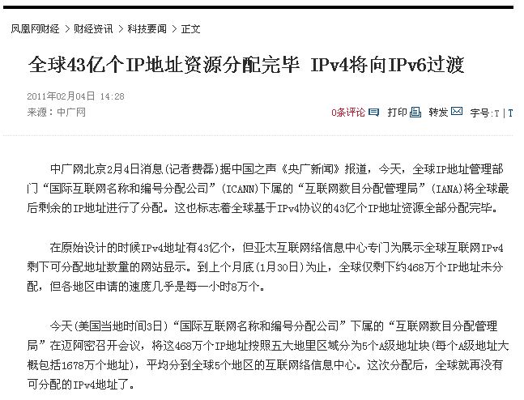


None left!
2011.02.04
Vint Cerf

Slide 91
What are the main motivations for IPv6?

Slide 92
IPv6
Initial motivation:
  32-bit address space soon to be completely allocated.
Additional motivations:
  header format helps speed processing/forwarding
  header changes to facilitate QoS
  IPv6 datagram format:
  fixed-length 40 byte header
  no fragmentation allowed

Slide 93
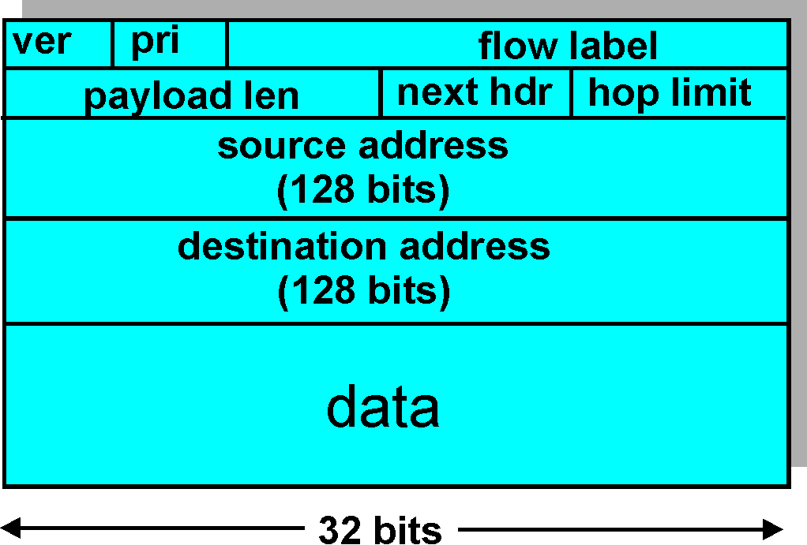
IPv6 Header (Cont)
Priority: identify priority among datagrams in flow
Flow Label: identify datagrams in same “flow.” (concept of “flow” not well defined).
Next header: identify upper layer protocol for data

Slide 94
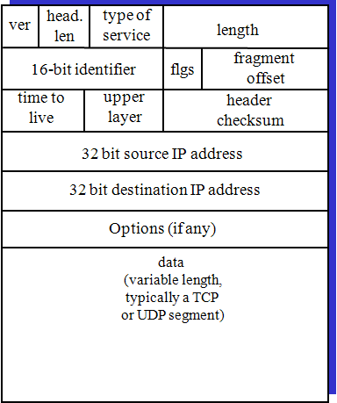
Comparison of IPv4 and IPv6
IPv4: 20-Byte head
IPv6: 40-byte head

Slide 95
Other Changes from IPv4
No fragementation
Checksum: removed entirely to reduce processing time at each hop
Options: allowed, but outside of header, indicated by “Next Header” field
ICMPv6: new version of ICMP
  additional message types, e.g. “Packet Too Big”
  multicast group management functions

Slide 96
Transition from IPv4 to IPv6
not all routers can be upgraded simultaneously
  no “flag days”
  how will network operate with mixed IPv4 and IPv6 routers?
tunneling: IPv6 datagram carried as payload in IPv4 datagram among IPv4 routers
IPv4 header fields
IPv6 header fields
IPv4 payload
IPv4 source, dest addr
IPv6 source dest addr
UDP/TCP payload
IPv6 datagram
IPv4 datagram

Slide 97
Tunneling
A
B
IPv4 tunnel
connecting IPv6 routers
E
F
logical view:
IPv6
IPv6
IPv6
IPv6
A
B
C
D
E
F
physical view:
IPv6
IPv6/IPv4
IPv4
IPv4
IPv6/IPv4
IPv6

Slide 98
Tunneling
A
B
IPv4 tunnel
connecting IPv6 routers
E
F
logical view:
IPv6
IPv6
IPv6
IPv6
A
B
C
D
E
F
physical view:
IPv6
IPv6
IPv4
IPv4
IPv6
IPv6
flow: X
src: A
dest: F
data
src:B
dest: E
src:B
dest: E
flow: X
src: A
dest: F
data
Flow: X
Src: A
Dest: F
data
Flow: X
Src: A
Dest: F
data
A-to-B:
IPv6
B-to-C:
IPv6 inside
IPv4
B-to-C:
IPv6 inside
IPv4
E-to-F:
IPv6

Slide 99
Outline
4.1 Overview of Network layer
  data plane
  control plane
4.2 What's inside a router
4.3 IP: Internet Protocol
  datagram format
  fragmentation
  IPv4 addressing
  network address translation
  IPv6
4.4 Generalized Forward and SDN
  match
  action
  OpenFlow examples of match-plus-action in action

Slide 100
On more abstract level, what does a router perform?

Slide 101
Generalized Forwarding and SDN
Each router contains a flow table that is computed and distributed by a logically centralized routing controller
logically-centralized routing controller
control plane
data plane
local flow table
headers counters actions
1
0100 1101
3
2
values in arriving
packet's header
Notes:
这是一个非常全面和具有挑战性的教学目标设定，旨在培养学生深入理解计算机通信与网络领域的核心概念、技术和方法，并具备分析、设计和创新能力。以下是针对这些目标的建议和指导：
A、知识目标
基础知识掌握：
着重培养学生对计算机通信与网络的核心概念、结构、协议、算法、设备和方法的全面理解，包括各网络层的功能和特点。
强调应用层、传输层、网络层、链路层以及无线与移动网络方面的重要知识点，如HTTP协议、TCP/UDP协议、IP协议、以太网协议、802.11协议等。
前沿技术学习：
引领学生了解计算机通信与网络领域的前沿概念和技术，如软件定义网络、物联网、6G通信、区块链技术等，培养对新技术的敏感性和学习能力。
B、能力目标
网络性能分析与故障诊断：
培养学生分析网络性能、进行故障诊断和网络规划的能力，让他们能够快速有效地应对网络问题。
网络设备设计与物联网系统实现：
帮助学生掌握网络核心设备的设计原理，以及大规模物联网系统的设计和实现能力，培养他们在实际项目中的操作技能。
前沿研究能力：
引导学生进行通信与网络学科前沿的初步研究，培养他们的研究意识和创新能力，让他们能够在学术界和产业界中有所建树。
C、素质目标
国产自主核心技术应用：
鼓励学生利用国产自主核心技术设计和实现复杂网络系统，培养他们对本土技术的认同感和应用能力。
专业志趣与学术创新：
培养学生对通信与网络技术的专业兴趣和学术创新意识，激发他们在学术研究和实践创新方面的热情和动力。
报国志向与行业情怀：
培养学生报国志向和行业情怀，让他们认识到通信与网络技术对国家和社会发展的重要性，激励他们为国家和行业的发展贡献力量。
通过以上目标的培养和实践，学生将能够全面发展自己在计算机通信与网络领域的知识、能力和素质，为未来的职业发展和学术研究奠定坚实基础。
预设提示词
重试
删除
固定
复制
请翻译成英文：
A、知识目标
掌握计算机通信与网络的核心概念、结构、协议、算法、设备和方法，包括网络的基本结构、网络性能的评估和分析方法及网络的参考模型。
在应用层，包括应用层的原理及主要的应用层服务和协议，如万维网及HTTP协议、文件传输及FTP协议、电子邮件协议、域名服务及DNS协议及对等网络协议等。在传输层，包括传输层的基本概念和原理，包括可靠数据传输的原理、网络拥塞管理原理、面向连接的TCP协议及无连接的UDP协议。在网络层，包括虚电路、数据网络的概念和原理、路由器的基本结、IP协议、路由算法、英特网的路由协议。在链路层，包括错误检查及纠正方法、多路访问协议、链路层寻址、以太网协议、链路虚拟化技术等。在无线与移动网络方面，包括802.11协议、无线移动网络接入技术、移动性管理、5G通信及网络等。
还包括计算机通信与网络领域的前沿概念和技术，软件定义网络的概念及原理、物联网理论与技术、6G通信、通感一体技术、网络隐私与安全、区块链技术、网络智能管理与运行等。
B、能力目标
分析网络性能的能力、网络故障诊断能力、复杂场景下网络规划的能力、网络核心设备初步设计能力（包括网络交换机、路由器、软件控制器等）、大规模物联网系统设计和实现的能力、通信与网络学科前沿初步研究的能力。
C、素质目标
通过网络通信领域国产自主核心技术，设计和实现复杂网络系统，培养通信与网络技术的专业志趣和学术创新志向，激发学生的报国志向和行业情怀。
2024/4/9 11:49:25
重试
删除
固定
复制
A. Knowledge Objectives
Master the core concepts, structures, protocols, algorithms, devices, and methods of computer communication and networks, including the basic structure of networks, methods for evaluating and analyzing network performance, and network reference models.
At the application layer, this includes principles of the application layer and major application layer services and protocols such as the World Wide Web and HTTP protocol, file transfer and FTP protocol, email protocols, domain name services and DNS protocol, and peer-to-peer network protocols. At the transport layer, this includes basic concepts and principles of the transport layer, including principles of reliable data transmission, network congestion management, connection-oriented TCP protocol, and connectionless UDP protocol. In the network layer, this includes concepts and principles of virtual circuits, data networks, basic structure of routers, IP protocol, routing algorithms, and Internet routing protocols. At the data link layer, this includes error checking and correction methods, multiple access protocols, data link addressing, Ethernet protocol, and link virtualization technology. In the wireless and mobile network domain, this includes the 802.11 protocol, wireless mobile network access technologies, mobility management, 5G communication and networks, etc.
It also includes cutting-edge concepts and technologies in the field of computer communication and networks, such as the concept and principles of software-defined networks, Internet of Things theories and technologies, 6G communication, integrated sensing technology, network privacy and security, blockchain technology, network intelligent management and operation, etc.
B. Skills Objectives
Ability to analyze network performance, diagnose network faults, plan networks in complex scenarios, preliminary design capabilities of network core devices (including network switches, routers, software controllers, etc.), ability to design and implement large-scale Internet of Things systems, and ability to conduct preliminary research in the field of communication and networks.
C. Quality Objectives
Through the use of domestically developed core technologies in the field of network communication, design and implement complex network systems, cultivate a professional interest and academic innovation orientation in communication and network technology, and inspire students' patriotism and industry sentiments.
2024/4/9 11:49:25
重试
删除
固定
复制
翻译 justification
2024/10/15 09:18:45
重试
删除
固定
复制
"justification" 的中文翻译是“理由”或“正当理由”。
2024/10/15 09:18:45
重试
删除
固定
复制
EXCEL COUNTIF 怎么使用
2024/10/15 11:58:05
重试
删除
固定
复制
在 Excel 中，COUNTIF 函数用于计算茅在指定范围内满足特定条件的单元格数量。以下是 COUNTIF 函数的基本语法：
=COUNTIF(range, criteria) range：要在其中检查条件的单元格范围。
criteria：要应用于范围的条件。
例如，如果要计算在 A 列中等于 "苹果" 的单元格数量，可以使用以下公式：
=COUNTIF(A:A, "苹果") 这将返回 A 列中包含 "苹果" 的单元格数量。您可以根据需要更改范围和条件来满足您的具体需求。
2024/10/15 11:58:05
重试
删除
固定
复制
组态软件
2024/11/7 17:32:26
重试
删除
固定
复制
"组态软件"通常指的是用于创建和管理人机界面（HMI）或监控系统的软件。这些软件通常用于监视和控制工业过程、设备或系统。一些常见的组态软件包括：
Wonderware InTouch：Wonderware InTouch 是一种流行的 HMI/SCADA 软件，用于创建交互式的人机界面并监控工业过程。
Ignition by Inductive Automation：Ignition 是一个全功能的 HMI/SCADA 软件平台，具有强大的数据集成和可视化功能。
WinCC by Siemens：Siemens 的 WinCC 软件是一种广泛使用的 HMI/SCADA 解决方案，适用于各种工业应用。
FactoryTalk View by Rockwell Automation：Rockwell Automation 的 FactoryTalk View 是另一个常用的 HMI 软件，用于创建用户友好的监控界面。
VTScada：VTScada 是一种灵活的 HMI/SCADA 软件，适用于各种规模的应用。
这些软件通常提供用户友好的界面设计工具、实时数据监视、报警管理、数据记录和分析等功能，帮助用户有效地监控和控制工业过程。根据您的具体需求和系统要求，您可以选择适合的组态软件来实现您的监控和控制目标。
2024/11/7 17:32:26
重试
删除
固定
复制
组态软件 的英文是什么
2024/11/7 17:32:50
重试
删除
固定
复制
"组态软件"的英文是 "Configuration Software"。
2024/11/7 17:32:50
重试
删除
固定
复制
When the host wants to send a packet to a destination host, the first thing is to know if that is in the same subnet. How?
2024/11/12 09:04:45
重试
删除
固定
复制
To determine whether a destination host is on the same subnet as the sending host, a host uses a combination of its own IP address, its subnet mask, and the IP address of the destination host. Here's how the process typically works:
Identify IP Addresses and Subnet Mask: The sending host first identifies its own IP address and subnet mask, along with the IP address of the destination host. For example, if the sending host's IP address is 192.168.1.10 with a subnet mask of 255.255.255.0, and the destination IP address is 192.168.1.20, these values are used to determine subnet membership.
Apply the Subnet Mask: The subnet mask is applied to both the sending host's IP address and the destination host's IP address using a bitwise AND operation. This operation helps isolate the network portion of each IP address by clearing the host portion (as defined by the subnet mask).
Bitwise AND Operation:
Sending host IP: 192.168.1.10 = 11000000.10101000.00000001.00001010 (binary)
Subnet Mask: 255.255.255.0 = 11111111.11111111.11111111.00000000 (binary)
Result: 192.168.1.0 = 11000000.10101000.00000001.00000000 (binary)
Destination IP: 192.168.1.20 = 11000000.10101000.00000001.00010100 (binary)
Subnet Mask: 255.255.255.0 = 11111111.11111111.11111111.00000000 (binary)
Result: 192.168.1.0 = 11000000.10101000.00000001.00000000 (binary)
Compare Network Addresses: The results of the bitwise AND operations (network addresses) are compared. If they match, this means both the sending and destination hosts are on the same subnet.
Conclusion: In the example above, both the sending host and the destination host have the network address 192.168.1.0, indicating they are indeed on the same subnet. Therefore, the sending host can send the packet directly to the destination host using the local network.
If the network addresses had been different, this would indicate that the destination host is on a different subnet, and the packet would need to be sent to a gateway or router for delivery to the destination subnet.
2024/11/12 09:04:45
重试
删除
固定
复制
in sdn, what the purpose of the filed of counters in a flow table
2024/11/12 09:21:35
重试
删除
固定
复制
In Software-Defined Networking (SDN), flow tables are used by switches to determine how to process and forward packets based on predefined rules. These flow tables are a core component of SDN controllers, which provide centralized management of network traffic. The field of counters in a flow table serves several important purposes:
Traffic Monitoring: Counters help in monitoring the amount of traffic that matches each flow entry. This includes counting packets and bytes per flow, which can be crucial for network monitoring, performance analysis, and understanding traffic patterns. By analyzing these counters, network operators can gain insights into the utilization and demand on network resources.
Network Management and Planning: The data collected from these counters can be used for proactive network management and capacity planning. Understanding traffic volumes helps in making informed decisions about network expansions, configurations, and optimizations.
Security and Anomaly Detection: Counters can be instrumental in detecting network anomalies and potential security breaches. A sudden increase in traffic in a particular flow could indicate a Distributed Denial of Service (DDoS) attack or other malicious activities. Monitoring these changes allows for timely responses to such threats.
Billing and Accounting: In environments where billing for network usage is necessary (such as in data centers or cloud services), counters provide the necessary data to bill customers based on the volume of data they send and receive. This usage-based billing relies heavily on accurate and detailed traffic measurements.
Quality of Service (QoS) Enforcement: By monitoring the counters, SDN controllers can make decisions to enforce QoS policies. For example, if a particular flow exceeds its allocated bandwidth, the SDN controller can take corrective actions such as rerouting traffic, limiting bandwidth, or prioritizing certain types of traffic.
Statistical Data Gathering: Counters provide statistical data that can be used for various analyses like predicting traffic loads, understanding peak usage times, and optimizing traffic flows to prevent bottlenecks.
Feedback for Adaptive Algorithms: In more advanced SDN setups, counters can provide feedback to adaptive algorithms that dynamically adjust network policies based on current network conditions. This could include dynamic changes to network paths, load balancing decisions, or access control lists.
Overall, the counters in a flow table are essential for the effective management and operation of an SDN environment, providing critical data that influences decision-making processes across the network.

Slide 102
OpenFlow data plane abstraction
flow: defined by header fields
generalized forwarding: simple packet-handling rules
  Pattern: match values in packet header fields
  Actions: for matched packet: drop, forward, modify matched packet or send matched packet to controller
  Priority: disambiguate overlapping patterns
  Counters: #bytes and #packets
Flow table in a router (computed and distributed by controller) define router's match+action rules

Slide 103
OpenFlow Flow table example
* : wildcard
src=1.2.*.*, dest=3.4.5.* → drop
src = *.*.*.*, dest=3.4.*.* → forward(2)
3. src=10.1.2.3, dest=*.*.*.* → send to controller

Slide 104
OpenFlow: Flow Table Entries
Rule
Action
Stats
Packet + byte counters
Forward packet to port(s)
Encapsulate and forward to controller
Drop packet
Send to normal processing pipeline
Modify Fields
Switch
Port
VLAN
ID
MAC
src
MAC
dst
Eth
type
IP
Src
IP
Dst
IP
Prot
TCP
sport
TCP
dport
Link layer
Network layer
Transport layer
Notes:
Now I'll describe the API that tries to meet these goals.
104

Slide 105
OpenFlow abstraction
match+action: unifies different kinds of devices
Router
  match: longest destination IP prefix
  action: forward out a link
Switch
  match: destination MAC address
  action: forward or flood
Firewall
  match: IP addresses and TCP/UDP port numbers
  action: permit or deny
NAT
  match: IP address and port
  action: rewrite address and port

Slide 106
Examples
Destination-based forwarding:
Switch
Port
MAC
src
MAC
dst
Eth
type
VLAN
ID
IP
Src
IP
Dst
IP
Prot
TCP
sport
TCP
dport
Action
*
*
*
*
*
*
51.6.0.8
*
*
*
port6
IP datagrams destined to IP address 51.6.0.8 should be forwarded to router output port 6
Destination-based layer 2 (switch) forwarding:
Switch
Port
MAC
src
MAC
dst
Eth
type
VLAN
ID
IP
Src
IP
Dst
IP
Prot
TCP
sport
TCP
dport
Action
*
22:A7:23:
11:E1:02
*
*
*
*
*
*
*
*
port3
layer 2 frames from MAC address 22:A7:23:11:E1:02 should be forwarded to output port 6

Slide 107
Examples
Firewall:
Switch
Port
MAC
src
MAC
dst
Eth
type
VLAN
ID
IP
Src
IP
Dst
IP
Prot
TCP
sport
TCP
dport
Forward
*
*
*
*
*
*
*
*
*
22
drop
do not forward (block) all datagrams destined to TCP port 22
Switch
Port
MAC
src
MAC
dst
Eth
type
VLAN
ID
IP
Src
IP
Dst
IP
Prot
TCP
sport
TCP
dport
Forward
*
*
*
*
*
128.119.1.1
*
*
*
*
drop
do not forward (block) all datagrams sent by host 128.119.1.1

Slide 108


OpenFlow example
match
action
Example: datagrams from hosts h5 and h6 should be sent to h3 or h4, via s1 and from there to s2
IP Src = 10.3.*.*
IP Dst = 10.2.*.*
forward(3)
Host h6
10.3.0.6
1
s3
controller
2
3
4
Host h5
10.3.0.5
1
s1
s2
1
2
Host h4
10.2.0.4
4
2
4
Host h1
10.1.0.1
3
3
Host h2
10.1.0.2
match
action
match
action
Host h3
10.2.0.3
ingress port = 2
IP Dst = 10.2.0.3
ingress port = 2
IP Dst = 10.2.0.4
forward(3)
ingress port = 1
IP Src = 10.3.*.*
IP Dst = 10.2.*.*
forward(4)
forward(4)

Slide 109
Middleboxes
Middlebox (RFC 3234)
“any intermediary box performing functions apart from normal, standard functions of an IP router on the data path between a source host and destination host”

Slide 110
















Middleboxes everywhere!
Firewalls, IDS: corporate, institutional, service providers, ISPs
national or global ISP
NAT: home, cellular, institutional
Load balancers: corporate, service provider, data center, mobile nets
Application-specific: service providers, institutional, CDN
datacenter
network
Caches: service provider, mobile, CDNs
enterprise
network

Slide 111
Middleboxes
initially: proprietary (closed) hardware solutions
move towards “whitebox” hardware implementing open API
  move away from proprietary hardware solutions
  programmable local actions via match+action
  move towards innovation/differentiation in software
SDN: (logically) centralized control and configuration management often in private/public cloud
network functions virtualization (NFV): programmable services over white box networking, computation, storage

Slide 112
The IP hourglass
HTTP
SMTP
RTP
…
Internet’s “thin waist”:
one network layer protocol: IP
must be implemented by every (billions) of Internet-connected devices
QUIC
DASH
many protocols in physical, link, transport, and application layers
TCP
UDP
IP
Ethernet
…
PPP
PDCP
WiFi
Bluetooth
copper radio fiber

Slide 113
The IP hourglass, at middle age
HTTP
SMTP
RTP
…
QUIC
DASH
Internet’s middle age “love handles”?
middleboxes, operating inside the network
TCP
UDP
caching
NAT
IP
NFV
Firewalls
Ethernet
…
PPP
PDCP
WiFi
Bluetooth
copper radio fiber

