Slide 1
Chapter 5: Network Layer – Control Plane
Yanmin Zhu
School of Computers

Slide 2
Discussions
What is the goal of a routing algorithm?
Is there a routing algorithm for the entire Internet?
How is the forwarding entry for a destination set up?
What is the main idea of implementing SDN?

Slide 3
Chapter 5: chapter goals
understand principles behind network control plane
  traditional routing algorithms
  SDN controllers
  Internet Control Message Protocol (ICMP)
  network management
their instantiation, implementation in the Internet:
  OSPF, BGP, OpenFlow, ODL and ONOS controllers, ICMP, SNMP

Slide 4
Outline
5.1 introduction
5.2 routing protocols
5.3 intra-AS routing in the Internet: OSPF
5.4 routing among the ISPs: BGP
5.5 The SDN control plane
5.6 ICMP
5.7 Network management and SNMP

Slide 5
Network-layer functions
Recall: two network-layer functions:
data plane
forwarding: move packets from router's input to appropriate router output
control plane
routing: determine route taken by packets from source to destination

Slide 6
Two approaches for control plane
Approach 1:
per-router control (traditional)
Approach 2:
logically centralized control (software defined networking)

Slide 7

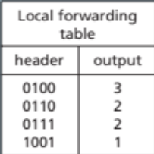
Approach 1: Per-router control plane
Individual routing algorithm components in each and every router interact with each other in control plane to compute forwarding tables
Routing
Algorithm
control
plane
data
plane

Slide 8
Approach 2: Logically central control plane
A distinct (typically remote) controller interacts with local control agents (CAs) in routers to compute forwarding tables
Remote Controller
control
plane
data
plane
CA
CA
CA
CA
CA

Slide 9
Outline
5.1 introduction
5.2 routing protocols
5.3 intra-AS routing in the Internet: OSPF
5.4 routing among the ISPs: BGP
5.5 The SDN control plane
5.6 ICMP
5.7 Network management and SNMP

Slide 10
Goal of routing protocols
To determine “good” paths from sending hosts to receiving host, through network of routers
path: sequence of routers packets will traverse in going from given initial source host to given final destination host
“good”: least “cost”, “fastest”, “least congested”
routing: one of the top networking challenges!

Slide 11
How do you find the best path in a network?

Slide 12
Graph abstraction of the network
5
v
3
w
2
5
u
2
1
z
3
1
2
x
y
1
graph: G = (N,E)
N = set of routers = { u, v, w, x, y, z }
E = set of links ={ (u,v), (u,x), (v,x), (v,w), (x,w), (x,y), (w,y), (w,z), (y,z) }

Slide 13
Graph abstraction: costs
5
c(x,x') = cost of link (x,x')
e.g., c(w,z) = 5
cost could always be 1, or
inversely related to bandwidth,
or inversely related to
congestion
v
3
w
2
5
u
2
1
z
3
1
2
x
y
1
cost of path (x₁, x₂, x₃,…, x_{p}) = c(x₁,x₂) + c(x₂,x₃) + … + c(x_{p-1},x_{p})
key question: what is the least-cost path between u and z ?
routing algorithm: algorithm that finds that least cost path

Slide 14
Routing algorithm classification
Q: global or decentralized information?
Q: static or dynamic?
global: all routers have complete topology, link cost info
  link state algorithms
decentralized: router knows physically-connected neighbors, link costs to neighbors
  iterative process of computation, exchange of info with neighbors
  distance vector algorithms
static:
  routes change slowly over time
dynamic:
  routes change more quickly
  periodic update
  in response to link cost changes

Slide 15
Link-State: Big Picture
Each node measures cost to every neighbor
Each node sends table of neighbors to all nodes
Every node computes routing path
5
3
v
w
5
2
u
2
1
z
3
1
2
x
y
1

Slide 16
A link-state routing algorithm
Dijkstra's algorithm
notations
net topology, link costs known to all nodes
  accomplished via “link state broadcast”
  all nodes have same info
computes least cost paths from one node ('source”) to all other nodes
  gives forwarding table for that node
iterative: after k iterations, know least cost path to k dest.'s
c(x,y): link cost from node x to y; = ∞ if not direct neighbors
D(v): current value of cost of path from source to dest. v
p(v): predecessor node along path from source to v
N': set of nodes whose least cost path definitively known

Slide 17
Dijsktra's algorithm
1 Initialization:
2 N' = {u}
3 for all nodes v
4 if v adjacent to u
5 then D(v) = c(u,v)
6 else D(v) = ∞
7
8 Loop
9 find w not in N' such that D(w) is a minimum
10 add w to N'
11 update D(v) for all v adjacent to w and not in N' :
12 D(v) = min( D(v), D(w) + c(w,v) )
13 /* new cost to v is either old cost to v or known
14 shortest path cost to w plus cost from w to v */
15 until all nodes in N'

Slide 18
Dijkstra's algorithm: example
D(v)
p(v)
D(w)
p(w)
D(x)
p(x)
D(y)
p(y)
D(z)
p(z)
Step
N'
0
u
7,u
3,u
5,u
∞
∞
1
uw
6,w
5,u
11,w
∞
2
uwx
6,w
11,w
14,x
3
uwxv
10,v
14,x
4
uwxvy
12,y
5
uwxvyz
x
9
notes:
construct shortest path tree by tracing predecessor nodes
ties can exist (can be broken arbitrarily)
5
7
4
8
u
3
w
y
z
2
3
7
4
v

Slide 19
Dijkstra's algorithm: another example
Step
0
1
2
3
4
5
N'
u
ux
uxy
uxyv
uxyvw
uxyvwz
D(v),p(v)
2,u
2,u
2,u
D(w),p(w)
5,u
4,x
3,y
3,y
D(x),p(x)
1,u
D(y),p(y)
∞
2,x
D(z),p(z)
∞
∞
4,y
4,y
4,y
5
v
3
w
2
5
u
2
1
z
3
1
2
x
y
1
* Check out the online interactive exercises for more examples: http://gaia.cs.umass.edu/kurose_ross/interactive/

Slide 20
Dijkstra's algorithm: example (2)
resulting shortest-path tree from u:
v
w
u
z
x
y
resulting forwarding table in u:
destination
link
v
(u,v)
x
(u,x)
y
(u,x)
w
(u,x)
z
(u,x)

Slide 21
Link-State is global.
Can a routing algorithm run in a fully distributed fashion, resulting in shortest path?

Slide 22
Distance Vector: Core Idea
Bellman-Ford Equation
d_{x}(y) = min {c(x,v) + d_{v}(y) }
v
where min is taken over all neighbors v of x
10
2
A
3
7
x
B
y
5
1
C

Slide 23
Bellman-Ford example
5
Clearly, d_{v}(z) = 5, d_{x}(z) = 3, d_{w}(z) = 3
v
3
w
2
5
u
z
B-F equation says:
2
1
3
1
2
d_{u}(z) = min { c(u,v) + d_{v}(z),
c(u,x) + d_{x}(z),
c(u,w) + d_{w}(z) }
= min {2 + 5,
1 + 3,
5 + 3} = 4
x
y
1
Node that achieves minimum is next
hop in shortest path ➜ forwarding table

Slide 24
Distance Vector: Big Picture
5
u’s distance vector
3
dest | cost | next hop
v | 2 | v
x | 1 | x
w | inf | -
y | inf | -
z | inf | -
v
w
5
2
u
2
1
z
3
1
2
x
y
1
dest | cost | next hop
u | 2 | U
x | 2 | X
w | 3 | W
y | Inf | -
z | Inf | -
dest | cost | next hop
V
x
w
y
z
dest | cost | next hop
v
x
w
y
z
v’s
x’s
w’s

Slide 25
Distance Vector Algorithm
D_{x}(y) = estimate of least cost from x to y
Node x knows cost to each neighbor v: c(x,v)
Node x maintains distance vector
D_{x} = [D_{x}(y): y є N ]
Node x also maintains its neighbors’ distance vectors
  For each neighbor v, x maintains
  D_{v} = [D_{v}(y): y є N ]

Slide 26
Basic Idea: Distance vector
From time-to-time, each node sends its own distance vector estimate to neighbors
Asynchronous
When a node x receives new DV estimate from neighbor, it updates its own DV using B-F equation:
D_{x}(y) ← min_{v}{c(x,v) + D_{v}(y)} for each node y ∊ N
Under minor, natural conditions, the estimate D_{x}(y) converges to the actual least cost d_{x}(y)

Slide 27
Distance Vector Algorithm
Each node:
Iterative, asynchronous: each local iteration caused by:
local link cost change
DV update message from neighbor
Distributed:
each node notifies neighbors only when its DV changes
  neighbors then notify their neighbors if necessary
wait for (change in local link cost or msg from neighbor)
recompute estimates
if DV to any dest has changed, notify neighbors

Slide 28
D_{x}(y) = min{c(x,y) + D_{y}(y), c(x,z) + D_{z}(y)}
= min{2+0 , 7+1} = 2
D_{x}(z) = min{c(x,y) +
D_{y}(z), c(x,z) + D_{z}(z)}
= min{2+1 , 7+0} = 3
node x table
cost to
cost to
x y z
x y z
x
0 2 7
x
0
2
3
from
y
∞
∞
∞
from
y
2 0 1
z
∞
∞
∞
z
7 1 0
node y table
cost to
x y z
y
2
1
x
∞
∞
z
∞
2 0 1
x
from
y
7
z
∞
∞
∞
node z table
cost to
x y z
x
∞ ∞ ∞
from
y
∞
∞
∞
z
7
1
0
time

Slide 29
D_{x}(y) = min{c(x,y) + D_{y}(y), c(x,z) + D_{z}(y)}
= min{2+0 , 7+1} = 2
D_{x}(z) = min{c(x,y) +
D_{y}(z), c(x,z) + D_{z}(z)}
= min{2+1 , 7+0} = 3
node x table
cost to
cost to
cost to
x y z
x y z
x y z
x
0 2 7
x
0 2 3
x
0 2 3
from
y
∞
∞
∞
from
y
2 0 1
from
y
2 0 1
z
∞
∞
∞
z
7 1 0
z
3 1 0
node y table
cost to
cost to
cost to
x y z
x y z
x y z
y
2
1
x
∞
∞
x
0 2 7
x
0 2 3
z
∞
2 0 1
x
from
y
from
y
2 0 1
from
y
7
2 0 1
z
∞
∞
∞
z
7 1 0
z
3 1 0
node z table
cost to
cost to
cost to
x y z
x y z
x y z
x
∞ ∞ ∞
x
0 2 7
x
0 2 3
from
y
from
y
2 0 1
from
y
2 0 1
∞
∞
∞
z
z
3 1 0
z
3 1 0
7
1
0
time

Slide 30
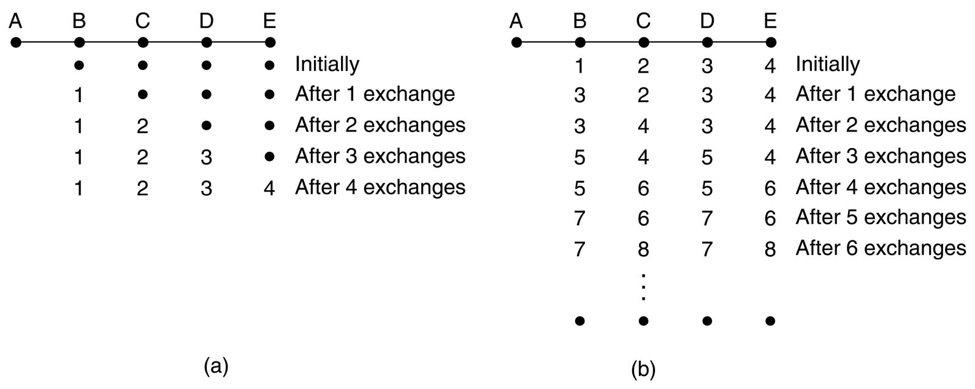
Count-to-infinity problem
Consider all nodes’ distances to A
A new neighbor A is connected to B
A neighbor A is disconnected from B
Good news travel fast
Count-to-infinity problem
Notes:
交换的路径信息量大, 路径信息不一致, 收敛速度慢（坏消息）, 不适合大型网络
Distance vector routing works in theory but has a serious drawback in practice: although it converges to the correct answer, it may do so slowly. In particular, it reacts rapidly to good news, but leisurely to bad news.好消息传播得快，坏消息传播得慢, 无穷计算问题
Suddenly A goes down, or alternatively, the line between A and B is cut, which is effectively the same thing from B's point of view.
At the first packet exchange, B does not hear anything from A. Fortunately, C says: Do not worry; I have a path to A of length 2. Little does B know that C's path runs through B itself. For all B knows, C might have ten lines all with separate paths to A of length 2. As a result, B thinks it can reach A via C, with a path length of 3. D and E do not update their entries for A on the first exchange.
On the second exchange, C notices that each of its neighbors claims to have a path to A of length 3. It picks one of the them at random and makes its new distance to A 4, as shown in the third row of Fig. 5-10(b). Subsequent exchanges produce the history shown in the rest of Fig. 5-10(b).
Gradually, all routers work their way up to infinity, but the number of exchanges required depends on the numerical value used for infinity. For this reason, it is wise to set infinity to the longest path plus 1. The core of the problem is that when X tells Y that it has a path somewhere, Y has no way of knowing whether it itself is on the path.

Slide 31
How do we solve the count-to-infinity problem?

Slide 32

Split Horizon with Poison Reverse
R1 to X: inf.
Split Horizon with Poison Reverse:
Router 1 tells router 2 that the path for X has a metric of infinity.

Slide 33
Comparison of LS and DV algorithms
message complexity
LS: with n nodes, E links, O(nE) msgs sent
DV: exchange between neighbors only
speed of convergence
LS: O(n²) algorithm requires O(nE) msgs
  may have oscillations
DV: convergence time varies
  may be routing loops
  count-to-infinity problem
robustness: what happens if router malfunctions?
LS:
  node can advertise incorrect link cost
  each node computes only its own table
DV:
  DV node can advertise incorrect path cost
  each node's table used by others
    error propagate thru network

Slide 34
The Internet is huge.
Do DV and Link-state work?

Slide 35
Making routing scalable
our routing study thus far - idealized
all routers identical
network is flat
But, not true in practice
scale: with billions of destinations:
can't store all destinations in routing tables!
routing table exchange would swamp links!
administrative autonomy
internet = network of networks
each network admin may want to control routing in its own network

Slide 36
Basic idea of scalable routing
aggregate routers into regions known as “autonomous systems” (AS) (a.k.a. “domains”)
3c
3a
2c
3b
2a
AS3
2b
1c
AS2
1a
1b
1d
AS1

Slide 37
Overview of hierarchical routing
3c
3a
2c
3b
2a
AS3
2b
1c
AS2
1a
1b
1d
AS1
intra-AS routing
inter-AS routing

Slide 38
Intra-AS vs Inter-AS
intra-AS routing
inter-AS routing
routing among hosts, routers in same AS (“network”)
all routers in AS must run same intra-domain protocol
routers in different AS can run different intra-domain routing protocol
gateway router: at “edge” of its own AS, has link(s) to router(s) in other AS'es
routing among AS'es
gateways perform inter-domain routing (as well as intra-domain routing)

Slide 39
Job of inter-AS routing
3c
Given x, how to forward?
3a
3b
AS3
2c
other
networks
1c
2a
other
networks
1a
2b
1b
AS2
x
AS1
1d
suppose router in AS1 receives datagram destined outside of AS1:
router should forward packet to gateway router, but which one?
job of inter-AS routing!
AS1 should learn which dests are reachable through AS2, which through AS3
propagate this reachability info to all routers in AS1

Slide 40
Job of intra-AS routing
Job of intra-AS routing: to determine the path entirely within an AS
also known as interior gateway protocols (IGP)
most common intra-AS routing protocols:
  RIP: Routing Information Protocol
  OSPF: Open Shortest Path First (IS-IS protocol essentially same as OSPF)
  IGRP: Interior Gateway Routing Protocol (Cisco proprietary for decades, until 2016)

Slide 41
How is forwarding table configured?
3c
3a
2c
3b
2a
AS3
2b
1c
AS2
1a
1b
1d
AS1
Intra-AS
Routing
algorithm
Inter-AS
Routing
algorithm
Forwarding
table
by both intra- and inter-AS routing algorithm
  intra-AS sets entries for internal dests (simple!)
  Both inter-AS & intra-AS set entries for external dests (more complicated, how?)

Slide 42
Setting forwarding table at a router
…
x
3c
3a
2c
3b
2a
AS3
2b
1c
AS2
1a
1b
1d
AS1
Given x, which interface to forward?
suppose AS1 learns (via inter-AS protocol) that subnet x reachable via AS3 (gateway 1c) but not via AS2.
inter-AS protocol propagates reachability info to all internal routers.
router 1d determines from intra-AS routing info that its interface I is on the least cost path to 1c.
  installs forwarding table entry (x,I)

Slide 43
Outline
5.1 introduction
5.2 routing protocols
5.3 intra-AS routing in the Internet: OSPF
5.4 routing among the ISPs: BGP
5.5 The SDN control plane
5.6 ICMP
5.7 Network management and SNMP

Slide 44
A concrete and popular example of intra-AS routing
Open Shortest Path First
OSPF

Slide 45
Overview of OSPF
open: publicly available
uses link-state algorithm
  link state packet dissemination
  topology map at each node
  route computation using Dijkstra's algorithm
router floods OSPF link-state advertisements to all other routers in entire AS
  carried in OSPF messages directly over IP (rather than TCP or UDP
  link state: for each attached link
IS-IS routing protocol: nearly identical to OSPF

Slide 46
OSPF advanced features
security: all OSPF messages authenticated (to prevent malicious intrusion)
multiple same-cost paths allowed (only one path in RIP)
for each link, multiple cost metrics for different TOS (e.g., satellite link cost set low for best effort ToS; high for real-time ToS)
integrated uni- and multi-cast support:
  Multicast OSPF (MOSPF) uses same topology data base as OSPF
hierarchical OSPF in large domains.

Slide 47
Hierarchical OSPF
boundary router to other AS
backbone router
backbone
area
border
routers
area 3
internal
routers
area 1
area 2

Slide 48
Hierarchical OSPF
two-level hierarchy: local area, backbone.
  link-state advertisements only in area
  each node has detailed area topology; only know direction (shortest path) to nets in other areas.
area border routers:
  summarize distances to nets in own area
  advertise to other Area Border routers.
backbone routers:
  run OSPF routing limited to backbone.

Slide 49
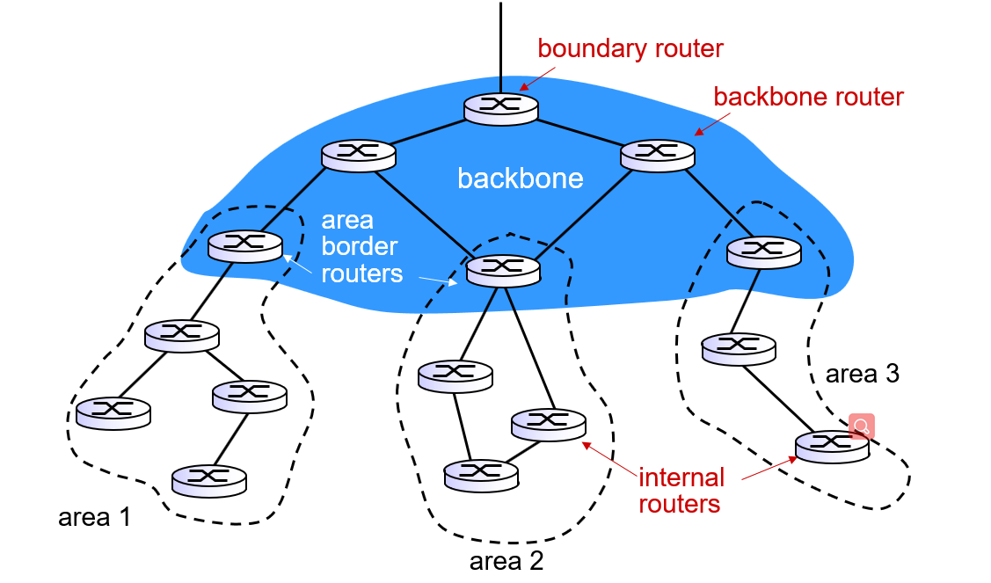
Routing across areas
1A
3A
1B
3B
1D
1C
1E
3C
How does a packet find the routing path from 1E to 3C?
Routers in area 3, given dest 3C, which next hop?
Routers in backbone, given dest 3C, which next hop?
Routers in area 1, given dest 3C, which next hop?

Slide 50
A concrete example of inter-AS routing
Border Gateway Protocol
BGP

Slide 51
Outline
5.1 introduction
5.2 routing protocols
5.3 intra-AS routing in the Internet: OSPF
5.4 routing among the ISPs: BGP
5.5 The SDN control plane
5.6 ICMP
5.7 Network management and SNMP

Slide 52
Overview of BGP
BGP (Border Gateway Protocol): the de facto inter-domain routing protocol
  “glue that holds the Internet together”
BGP provides each AS a means to:
  1: obtain subnet reachability information from neighboring ASes
  2: propagate reachability information to all AS-internal routers.
  3: determine good routes to other networks based on reachability information and policy
BGP allows subnet to advertise its existence to rest of Internet:
“I am here”

Slide 53
eBGP, iBGP connections
2b
2a
2c
1b
3b
2d
1a
1c
3a
3c
AS 2
1d
3d
AS 1
eBGP connectivity
AS 3
iBGP connectivity
1c
gateway routers run both eBGP and iBGP protocols

Slide 54
BGP basics
AS 3
3b
AS 1
1b
3a
3c
1a
1c
AS 2
2b
3d
X
1d
2a
2c
BGP advertisement:
AS3, X
2d
BGP session: two BGP routers exchange BGP messages over TCP connection: advertising paths to different destination network prefixes
  when AS3 gateway router 3a advertises path AS3,X to AS2 gateway router 2c
  AS3 promises to AS2 it will forward datagrams towards X
Notes:
Advertisement的内容是什么？给定网络目标地址的可达性信息

Slide 55
What information should be included in BGP advertisement for a given destination prefix?

Slide 56
Path attributes and BGP routes
advertised prefix includes BGP attributes
  prefix + attributes = “route”
two important attributes:
  AS-PATH: list of ASes through which prefix advertisement has passed
  NEXT-HOP: indicates specific internal-AS router to next-hop AS
Policy-based routing:
  gateway receiving route advertisement uses import policy to accept/decline path (e.g., never route through AS Y).
  AS policy also determines whether to advertise path to other neighboring ASes

Slide 57
BGP path advertisement (One Path Case)
AS3
3b
AS1
1b
3a
3c
1a
1c
AS2
2b
3d
X
1d
AS3,X
AS2,AS3,X
2a
2c
2d
AS2 router 2c receives path advertisement AS3,X (via eBGP) from AS3 router 3a
AS2 router 2c accepts path AS3,X, propagates (via iBGP) to all AS2 routers
AS2 router 2a advertises (via eBGP) path AS2, AS3, X to AS1 router 1c

Slide 58
BGP path advertisement (Tow Paths Case)
AS3
3b
AS1
1b
AS3,X
3a
3c
1a
1c
AS2
2b
3d
X
1d
AS3,X
AS2,AS3,X
2a
2c
2d
gateway router may learn about multiple paths to destination:
AS1 gateway router 1c learns path AS2,AS3,X from 2a
AS1 gateway router 1c learns path AS3,X from 3a

Slide 59
BGP messages
BGP messages exchanged between peers over TCP connection
BGP messages:
  OPEN: opens TCP connection to remote BGP peer and authenticates sending BGP peer
  UPDATE: advertises new path (or withdraws old)
  KEEPALIVE: keeps connection alive in absence of UPDATES; also ACKs OPEN request
  NOTIFICATION: reports errors in previous msg; also used to close connection

Slide 60
How forwarding table entries are set?
AS3
3b
AS1
1b
3a
3c
1a
1c
AS2
2b
3d
X
1d
2a
2c
2d
distant prefix X
What is the forwarding entry for X?
It is jointly determined by BGP and OSPF!

Slide 61
Example: forwarding entry at router 1d for X
distant prefix X
AS3
3b
AS1
1b
AS3,X
1
AS3,X
3a
3c
1a
2
1c
local link interfaces
at 1a, 1d
AS2
2b
3d
X
2
1d
1
AS3,X
AS2,AS3,X
2a
2c
physical link
2d
dest
interface
recall: 1a, 1b, 1c learn about dest X via iBGP from 1c: “path to X goes through 1c”
…
…
…
…
X
1
1d: OSPF intra-AS routing: to get to 1c, forward over outgoing local interface 1

Slide 62
Example: forwarding entry at router 1a
distant prefix X
AS3
3b
AS1
1b
1
3a
3c
1a
2
1c
AS2
2b
3d
X
1d
2a
2c
2d
dest
interface
recall: 1a, 1b, 1c learn about dest X via iBGP from 1c: “path to X goes through 1c”
…
…
…
…
X
2
1d: OSPF intra-domain routing: to get to 1c, forward over outgoing local interface 1
1a: OSPF intra-domain routing: to get to 1c, forward over outgoing local interface 2

Slide 63
An internal router may learn about more than one route to destination, then how does it choose?

Slide 64
Hot Potato Routing
AS3
3b
AS1
1b
3a
3c
1a
1c
AS2
2b
3d
X
1d
112
152
AS3,X
AS1,AS3,X
2a
263
2c
201
OSPF link weights
2d
Router 2d learns (via iBGP) it can route to X via 2a or 2c
hot potato routing: choose local gateway that has least intra-domain cost (e.g., 2d chooses 2a, even though more AS hops to X): don't worry about inter-domain cost!

Slide 65
Background for inter-AS routing policy
legend:
provider
B
network
X
W
A
customer
C
network:
Y
A,B,C are provider networks
X,W,Y are customer (of provider networks)
X is dual-homed: attached to two network
How do AS B and C send BGP advertisement?

Slide 66
BGP: achieving policy via advertisements
legend:
provider
B
network
X
W
A
customer
C
network:
Y
Suppose an ISP only wants to route traffic to/from its customer networks (does not want to carry transit traffic between other ISPs)
A advertises path Aw to B and to C
B chooses not to advertise BAw to C:
  B gets no revenue for routing CBAw, since none of C, A, w are B's customers
  C does not learn about CBAw path
C will route CAw (not using B) to get to w

Slide 67
Why Intra-, Inter-AS routing?
policy:
inter-AS: admin wants control over how its traffic routed, who routes through its net.
intra-AS: single admin, so no policy decisions needed
scale:
hierarchical routing saves table size, reduced update traffic
performance:
intra-AS: can focus on performance
inter-AS: policy may dominate over performance

Slide 68
Outline
5.1 introduction
5.2 routing protocols
5.3 intra-AS routing in the Internet: OSPF
5.4 routing among the ISPs: BGP
5.5 The SDN control plane
5.6 ICMP
5.7 Network management and SNMP

Slide 69
What are the main problems with Internet’s Control Plane?

Slide 70
Problems with per-router approach
Internet network layer: historically has been implemented via distributed, per-router approach
The problems with this approach
  monolithic router contains switching hardware, runs proprietary implementation of Internet standard protocols (IP, RIP, IS-IS, OSPF, BGP) in proprietary router OS (e.g., Cisco IOS)
  different “middleboxes” for different network layer functions: firewalls, load balancers, NAT boxes, etc.
~2005: renewed interest in rethinking network control plane
Notes:
Monolithic：adj. 整体的；巨石的，庞大的；完全统一的

Slide 71
Recall: per-router control plane
Individual routing algorithm components in each and every router interact with each other in control plane to compute forwarding tables
Routing
Algorithm
control
plane
data
plane

Slide 72
Recall: logically centralized control plane
A distinct (typically remote) controller interacts with local control agents (CAs) in routers to compute forwarding tables
Remote Controller
control
plane
data
plane
CA
CA
CA
CA
CA

Slide 73
Why logically centralized control?
easier network management: avoid router misconfigurations, greater flexibility of traffic flows
table-based forwarding allows “programming” routers
  centralized “programming” easier: compute tables centrally and distribute
  distributed “programming more difficult: compute tables as result of distributed algorithm (protocol) implemented in each and every router
open (non-proprietary) implementation of control plane

Slide 74
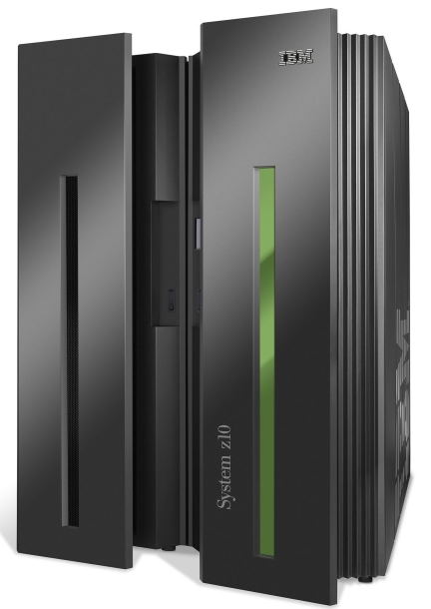
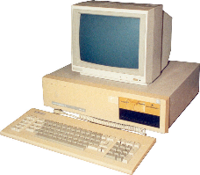
Analogy: mainframe to PC evolution*
App
App
App
App
App
App
App
App
App
App
App
Specialized
Applications
Open Interface
Specialized
Operating
System
Windows
(OS)
Linux
Mac
OS
or
or
Specialized
Hardware
Open Interface
Microprocessor
Vertically integrated
Closed, proprietary
Slow innovation
Small industry
Horizontal
Open interfaces
Rapid innovation
Huge industry
* Slide courtesy: N. McKeown

Slide 75
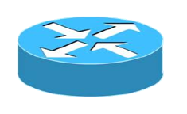

Traffic engineering: difficult (Case 1)
5
v
3
w
2
v
w
5
u
2
1
z
3
z
1
2
x
y
x
1
y
Q: what if w wants to route blue and red traffic differently?
A: can't do it (with destination based forwarding, and LS, DV routing)
Notes:
Note: implicit assumption here: destination based forwarding

Slide 76
Traffic engineering: difficult (Case 2)
5
3
v
w
5
2
u
2
1
z
3
1
2
x
y
1
Q: what if network operator wants to split u-to-z traffic along uvwz and uxyz (load balancing)?
A: can't do it (or need a new routing algorithm)
Notes:
Note: implicit assumption here: destination based forwarding

Slide 77
How do you implement software-defined networking?

Slide 78
Overview of SDN
4. programmable control applications
…
3. control plane functions external to data-plane switches
routing
access control
load
balance
Remote Controller
control
plane
data
plane
CA
2. control, data plane separation
CA
CA
CA
CA
1: generalized“ flow-based” forwarding (e.g., OpenFlow)

Slide 79
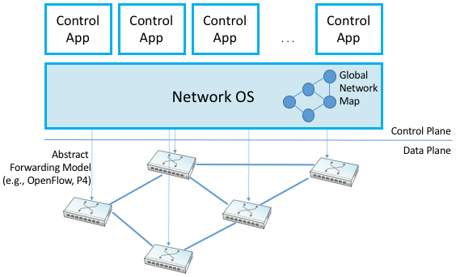
Overview of SDN

Slide 80
SDN perspective: data plane switches
network-control applications
…
Data plane switches
routing
access
control
load
balance
fast, simple, commodity switches implementing generalized data-plane forwarding in hardware
switch flow table computed, installed by controller
API for table-based switch control (e.g., OpenFlow)
  defines what is controllable and what is not
protocol for communicating with controller (e.g., OpenFlow)
control
plane
northbound API
SDN Controller
(network operating system)
southbound API
data
plane
SDN-controlled switches

Slide 81
SDN perspective: SDN controller
network-control applications
SDN controller
(or network OS):
…
routing
access
control
load
balance
maintain network state information
interacts with network control applications “above” via northbound API
interacts with network switches “below” via southbound API
implemented as distributed system for performance, scalability, fault-tolerance, robustness
control
plane
northbound API
SDN Controller
(network operating system)
southbound API
data
plane
SDN-controlled switches

Slide 82
SDN perspective: control applications
network-control applications
…
routing
Network-Control Applications
access
control
load
balance
control
plane
“brains” of control: implement control functions using lower-level services, API provided by SND controller
unbundled: can be provided by 3rd party: distinct from routing vendor, or SDN controller
northbound API
SDN Controller
(network operating system)
southbound API
data
plane
SDN-controlled switches

Slide 83
Components of SDN controller
routing
access
control
load
balance
Interface layer to network control apps: abstractions API
Interface, abstractions for network control apps
…
network graph
RESTful
API
intent
Network-wide state management layer:
state of networks links, switches, services: a distributed database
…
statistics
flow tables
SDN
controller
Network-wide distributed, robust state management
…
Link-state info
host info
switch info
…
Communication layer: communicate between SDN controller and controlled switches
OpenFlow
SNMP
Communication to/from controlled devices

Slide 84

OpenFlow protocol
operates between controller, switch
TCP used to exchange messages
  optional encryption
three classes of OpenFlow messages:
  controller-to-switch
  asynchronous (switch to controller)
  symmetric (misc)
OpenFlow Controller

Slide 85
Controller-to-switch messages
Key controller-to-switch messages
configure: controller queries/sets switch configuration parameters
modify-state: add, delete, modify flow entries in the OpenFlow tables
packet-out: controller can send this packet out of specific switch port
features: controller queries switch features, switch replies
OpenFlow Controller
Fortunately, network operators don't program switches by creating/sending OpenFlow messages directly. Instead use higher-level abstraction at controller

Slide 86
Switch-to-controller messages
Key switch-to-controller messages
flow-removed: flow table entry deleted at switch
packet-in: transfer packet (and its control) to controller.
port status: inform controller of a change on a port.
OpenFlow Controller

Slide 87
SDN: control/data plane interaction
Dijkstra's link-state
Routing
1
S1, experiencing link failure using OpenFlow port status message to notify controller
4
5
…
network graph
RESTful
API
intent
3
…
2
SDN controller receives OpenFlow message, updates link status info
statistics
flow tables
…
Link-state info
host info
switch info
2
3
Dijkstra's routing algorithm application has previously registered to be called when ever link status changes. It is called.
…
OpenFlow
SNMP
6
1
4
Dijkstra's routing algorithm access network graph info, link state info in controller, computes new routes
s2
s1
s4
s3
Link broken, what happen next?

Slide 88
SDN: control/data plane interaction
Dijkstra's link-state
Routing
4
5
…
network graph
RESTful
API
intent
5
link state routing app interacts with flow-table-computation component in SDN controller, which computes new flow tables needed
3
…
statistics
flow tables
…
Link-state info
host info
switch info
2
…
OpenFlow
SNMP
6
Controller uses OpenFlow to install new tables in switches that need updating
6
1
s2
s1
s4
s3

Slide 89

OpenDaylight (ODL) controller
…
Traffic
Engineering
ODL Lithium controller
network apps may be contained within, or be external to SDN controller
Service Abstraction Layer: interconnects internal, external applications and services
REST API
Network service apps
Basic Network Service Functions
topology
manager
switch
manager
stats
manager
Access
Control
forwarding
manager
host
manager
Service Abstraction Layer (SAL)
…
OpenFlow 1.0
SNMP
OVSDB
OpenDaylight（ODL）是Linux基金会负责管理的开源项目，是一款使用JAVA开发的控制器，提供一套基于SDN开发的模块化、可扩展、可升级、支持多协议的控制器框架，目的是推动SDN技术的创新实施和透明化。
Notes:
随着移动设备的不断普及，OTT服务和内容分发的兴起导致服务提供商网络迫切的需要一次网络变革。为了应对日益增长的带宽需求，服务提供商希望网络可以更加敏捷高效，且能从创新型服务和新型业务模式中分一杯羹得到更好的发展，至此SDN的呼声越来越高。而SDN中控制器占重要部分，是兵家必争之地，陆陆续续已经出现了很多SDN控制器，如OpenDaylight、OpenContrail、Ryu、Floodlight、NOX、SPOX等等，其中最受瞩目的莫过于OpenDaylight了。 OpenDaylight是由设备商主导的一个开源控制器，虽然打着开放的旗号，但是OpenDaylight一直排斥基于开放的协议方案，而是想采用折中的方案，即以开放专用接口的方式保留传统设备，采取以退为进的方式维护自己的利益。不可否认地，设备商拥有丰富的设备研发经验， OpenDaylight也确实是一款优秀的控制器，但是在这样的压力下，运营商不得不采取应对措施。于是，运营商推出了开放网络操作系统ONOS。
————————————————
版权声明：本文为CSDN博主「SDNLAB」的原创文章，遵循CC 4.0 BY-SA版权协议，转载请附上原文出处链接及本声明。
原文链接：https://blog.csdn.net/SDNLAB/article/details/41980413

Slide 90
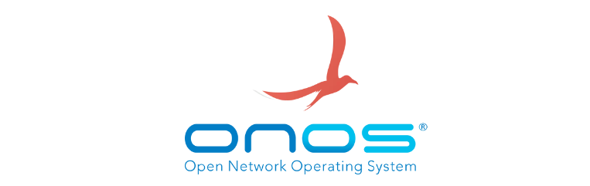
ONOS controller
…
Network
control apps
control apps separate from controller
intent framework: high-level specification of service: what rather than how
considerable emphasis on distributed core: service reliability, replication performance scaling
northbound abstractions,
protocols
REST API
Intent
hosts
paths
flow rules
topology
ONOS
distributed core
devices
links
statistics
device
link
host
flow
packet
southbound abstractions,
protocols
OpenFlow
Netconf
OVSDB
Notes:
运营商更关注 ONOS

Slide 91
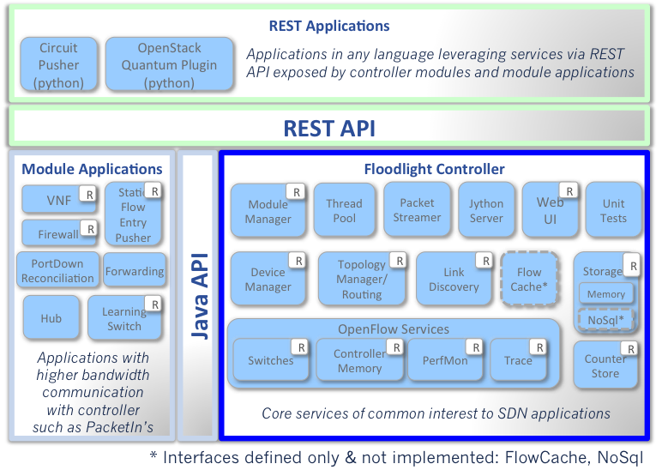

Floodlight
Welcome! Floodlight is a community-developed, open source, Java OpenFlow controller, supporting OpenFlow protocols 1.0 through 1.5.
Notes:
https://floodlight.atlassian.net/wiki/spaces/floodlightcontroller/overview
https://github.com/noxrepo/pox

Slide 92
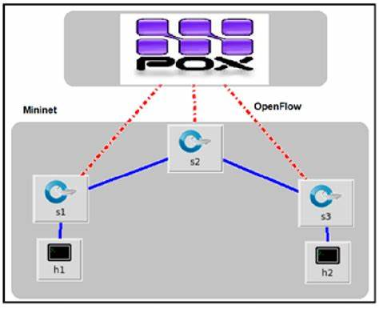
POX SDN Controller

Slide 93
SDN: selected challenges
hardening the control plane: dependable, reliable, performance-scalable, secure distributed system
  robustness to failures: leverage strong theory of reliable distributed system for control plane
  dependability, security
networks, protocols meeting mission-specific requirements
  e.g., real-time, ultra-reliable, ultra-secure
Internet-scaling

Slide 94
Outline
5.1 introduction
5.2 routing protocols
5.3 intra-AS routing in the Internet: OSPF
5.4 routing among the ISPs: BGP
5.5 The SDN control plane
5.6 ICMP
5.7 Network management and SNMP

Slide 95
ICMP: internet control message protocol
used by hosts & routers to communicate network-level information
  error reporting: unreachable host, network, port, protocol
  echo request/reply (used by ping)
network-layer “above” IP:
  ICMP msgs carried in IP datagrams
Type Code description
0 0 echo reply (ping)
3 0 dest. network unreachable
3 1 dest host unreachable
3 2 dest protocol unreachable
3 3 dest port unreachable
3 6 dest network unknown
3 7 dest host unknown
4 0 source quench (congestion
control - not used)
8 0 echo request (ping)
9 0 route advertisement
10 0 router discovery
11 0 TTL expired
12 0 bad IP header

Slide 96

Traceroute and ICMP
source sends series of UDP segments to destination
  first set has TTL =1
  second set has TTL=2, etc.
  unlikely port number
when datagram in nth set arrives to nth router:
  router discards datagram and sends source ICMP message (type 11, code 0)
  ICMP message include name of router & IP address
when ICMP message arrives, source records RTTs
stopping criteria:
UDP segment eventually arrives at destination host
destination returns ICMP “port unreachable” message (type 3, code 3)
source stops
3 probes
3 probes
3 probes

Slide 97
Outline
5.1 introduction
5.2 routing protocols
5.3 intra-AS routing in the Internet: OSPF
5.4 routing among the ISPs: BGP
5.5 The SDN control plane
5.6 ICMP
5.7 Network management and SNMP

Slide 98

What is network management?
autonomous systems (aka network): 1000s of interacting hardware/software components
other complex systems requiring monitoring, control:
  jet airplane
  nuclear power plant
  others?
"Network management includes the deployment, integration
and coordination of the hardware, software, and human
elements to monitor, test, poll, configure, analyze, evaluate,
and control the network and element resources to meet the
real-time, operational performance, and Quality of Service
requirements at a reasonable cost."

Slide 99


Infrastructure for network management
definitions:
managing entity
agent
data
managing
entity
managed devices contain managed objects whose data is gathered into a Management Information Base (MIB)
data
managed device
network
management
protocol
agent
data
managed device
agent
data
managed device
agent
data
agent
data
managed device
managed device

Slide 100
SNMP protocol
Two ways to convey MIB info, commands:
managing
entity
managing
entity
request
trap msg
response
agent
data
agent
data
managed device
managed device
request/response mode
trap mode

Slide 101
SNMP protocol: message types
Message type
Function
GetRequest
GetNextRequest
GetBulkRequest
manager-to-agent: “get me data”
(data instance, next data in list, block of data)
InformRequest
manager-to-manager: here's MIB value
SetRequest
manager-to-agent: set MIB value
Response
Agent-to-manager: value, response to Request
Trap
Agent-to-manager: inform manager
of exceptional event

Slide 102
SNMP protocol: message formats
Get/set header
Variables to get/set
PDU
type
(0-3)
Error
Status
(0-5)
Request
ID
Error
Index
Name
Value
Name
Value
….
PDU
type
4
Agent
Addr
Trap
Type
(0-7)
Enterprise
Specific
code
Time
stamp
Name
Value
….
Trap header
Trap info
SNMP PDU
More on network management: see earlier editions of text!

Slide 103
Chapter 5: summary
we've learned a lot!
approaches to network control plane
  per-router control (traditional)
  logically centralized control (software defined networking)
traditional routing algorithms
  implementation in Internet: OSPF, BGP
SDN controllers
  implementation in practice: ODL, ONOS, Floodlight
Internet Control Message Protocol
Network Management
next stop: link layer!

Slide 104
Lab #4
IP: Wireshark_IP
NAT: Wireshark_NAT
ICMP: Wireshark_ICMP

