Slide 1
Chapter 6:
The Link Layer
Yanmin Zhu
School of Computers
Notes:
224.0.0.0〜224.0.0.255:保留地址，用于路由协议或其他下层拓扑发现协议、以及维护管理协议等，例如 224.0.0.1代表本地子网中的所有主机 ，224.0.0.2代表本地子网中的所有路由器， 224.0.0.5代表所有OSPF路由器 ， 224.0.0.9代表所有RIP2路由器 ，224.0.0.12代表DHCP服务器或中继代理，224.0.0.13代表所有支持PIM的路由器等。

Slide 2
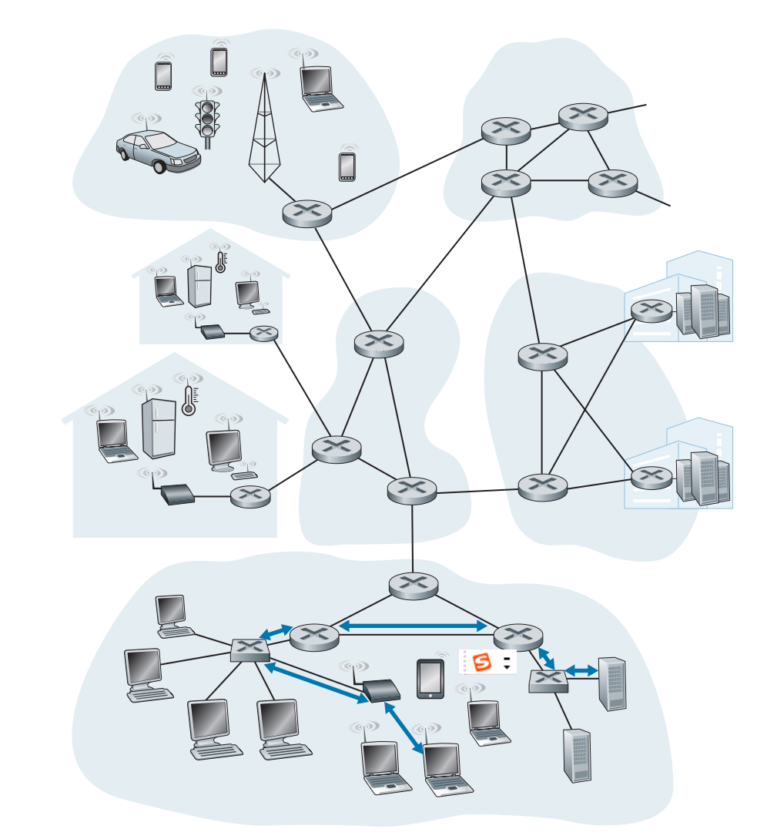
Link-Layer Hops along Host and Server

Slide 3
Discussions
What are the services provided by the link layer?
How do we characterize the capability of an error detection and correction code?
How does the link layer interplay with the network layer?
How do many nodes access a shared broadcast channel?
Notes:
* Application layer, between client/server, assuming TCP/UDP; transport layer, between two processes, assuming network layer services;
These two layers, a communicating party is sure to know the other communicating party (within the known address)
The network layer, between two host, assuming the link layer. It is the job of this layer to find a path from one host to the other host, since the lower layer (i.e., link layer) do not provide such a service. Then, what the service provided by the link layer? Frame delivery between neighboring nodes (host or router) .
What is “neighboring?”
Answer: in a subnet! Link-layer device may be introduced in order to provide such frame delivery service, but these link-layer devices are transparent to the network layer.

Slide 4
The Data Link Layer
Our goals:
understand principles behind data link layer services:
  error detection, correction
  sharing a broadcast channel: multiple access
  link layer addressing
  local area networks: Ethernet, VLANs
instantiation, implementation of various link layer technologies

Slide 5
Chapter 6 Link Layer
6.1 Introduction to the link layer
6.2 Error detection and correction
6.3 Multiple access links and protocols
6.4 Switched local area networks
6.5 Link virtualization: A network as a link layer
6.6 Data center networking

Slide 6
What are the main service provided by the link layer?
data transfer between neighboring network elements

Slide 7

Link Layer: Teminology
Terminology:
hosts and routers are nodes
communication channels that connect adjacent nodes along communication path are links
  wired links
  wireless links
  LANs
layer-2 packet is a frame, encapsulates datagram
data-link layer has responsibility of
transferring datagram from one node
to adjacent node over a link

Slide 8
Link Layer: Context
Datagram transferred by different link protocols over different links, e.g.,
  First link: Ethernet
  Intermediate links: frame relay
  Last link: 802.11
Each link protocol provides different services
  e.g., may or may not provide rdt over link

Slide 9
Link layer services
framing, link access:
  encapsulate datagram into frame, adding header, trailer
  channel access if shared medium
  “MAC” addresses used in frame headers to identify source, dest: different from IP address!
reliable delivery between adjacent nodes
  we learned how to do this already (chapter 3)!
  seldom used on low bit-error link (fiber, some twisted pair)
  wireless links: high error rates

Slide 10
Link layer services (more)
flow control:
  pacing between adjacent sending and receiving nodes
error detection:
  errors caused by signal attenuation, noise.
  receiver detects presence of errors:
    signals sender for retransmission or drops frame
error correction:
  receiver identifies and corrects bit error(s) without resorting to retransmission
half-duplex and full-duplex
  with half duplex, nodes at both ends of link can transmit, but not at same time

Slide 11
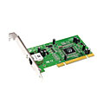
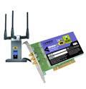

Where is link layer implemented?
in each and every host
link layer implemented in “adaptor” (aka network interface card NIC) or on a chip
  Ethernet card, 802.11 card; Ethernet chipset
  implements link, physical layer
attaches into host’s system buses
combination of hardware, software, firmware
application
transport
network
link
cpu
memory
link
physical
host
bus
(e.g., PCI)
controller
physical
transmission
network adapter
card

Slide 12
Adaptors Communicating
datagram
datagram
controller
controller
sending host
datagram
receiving host
frame
sending side:
encapsulates datagram in frame
adds error checking bits, rdt, flow control, etc.
Coding
receiving side：
looks for errors, rdt, flow control, etc
extracts datagram, passes to upper layer at receiving side
decoding

Slide 13
Link Layer
6.1 Introduction to the link layer
6.2 Error detection and correction
6.3 Multiple access links and protocols
6.4 Switched local area networks
6.5 Link virtualization: A network as a link layer
6.6 Data center networking

Slide 14
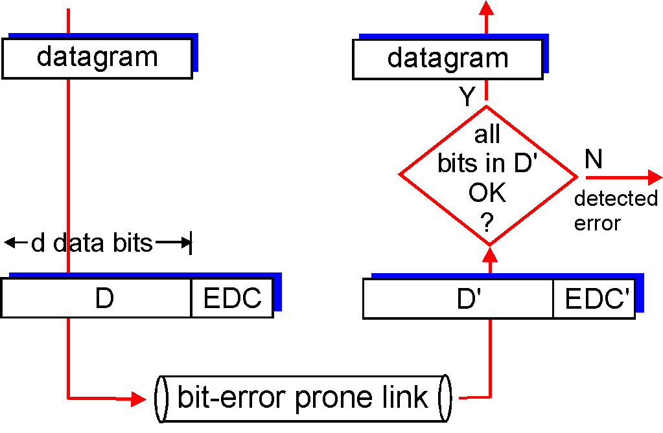
Overview of Error Detection
EDC= Error Detection and Correction bits (redundancy)
D = Data protected by error checking, may include header fields
otherwise
Error detection not 100% reliable!
protocol may miss some errors, but rarely
larger EDC field yields better detection and correction

Slide 15
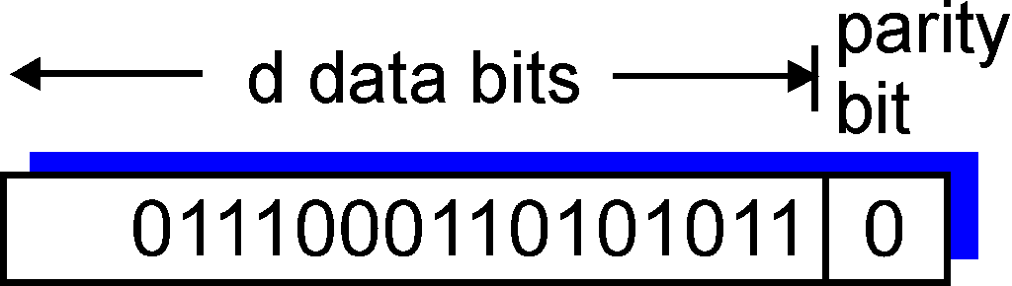
Parity Checking
Single Bit Parity:
Detect single bit errors
Example:

Slide 16
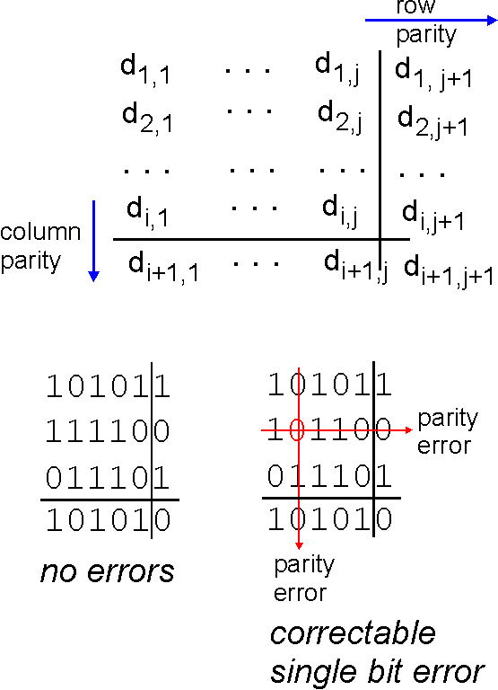
Parity Checking (cont’)
Two Dimensional Bit Parity:
Detect and correct single bit errors
0
0

Slide 17
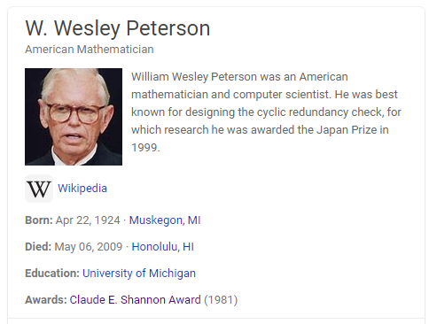
Cyclic Redundancy Check (CRC)
The cyclic redundancy check (CRC) is a technique used to detect errors in digital data. More powerful error-detection coding
This technique was invented by W. Wesley Peterson in 1961
Cyclic redundancy checks are quite simple to implement in hardware and can be easily analyzed mathematically.
Widely used in practice (Ethernet, 802.11 WiFi, ATM, etc.)

Slide 18
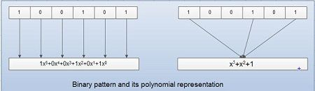
Representing bit stream as a polynomial
Preliminary
Bit stream:
B=b_{n-1}b_{n-2}…b₂b₁b₀
Polynomial:
B(x)=b_{n-1}x^{n-1} + b_{n-2}x^{n-2} + … + b₂x² + b₁x¹ + b₀
Example

Slide 19
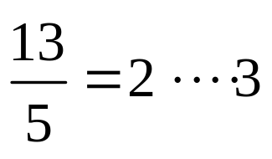
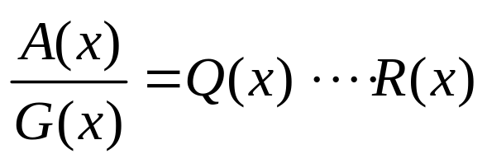
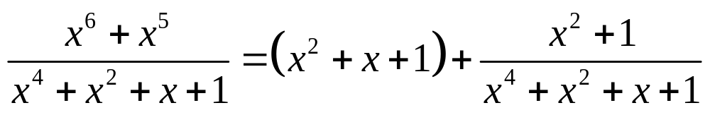
Computing Remainder
Computing remainder
Computing remainder
Example
It is based on binary division!

Slide 20
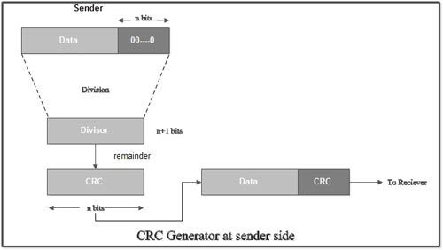
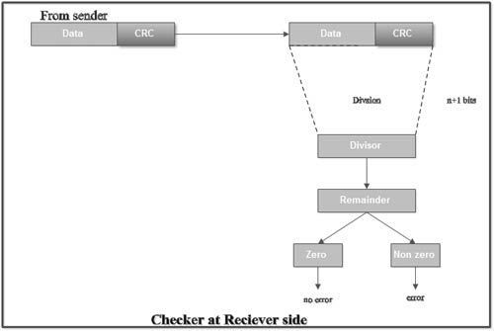
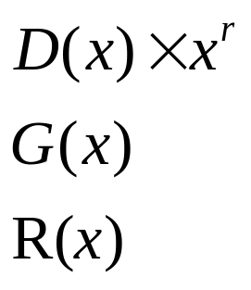
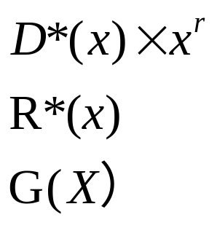
CRC overview
Sender
Receiver

Slide 21
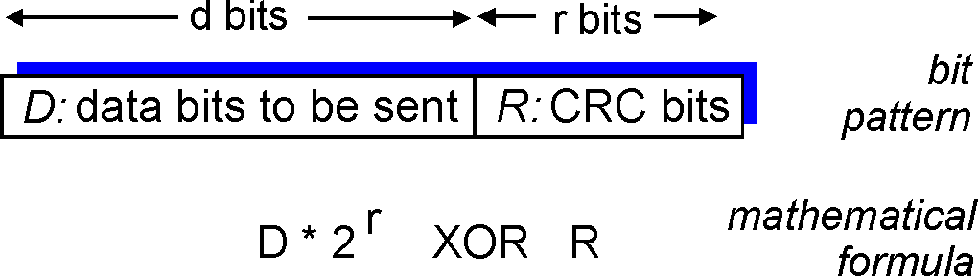
How to compute R(x)?
D^{x}2^{r}
G
R = remainder[ ]

Slide 22
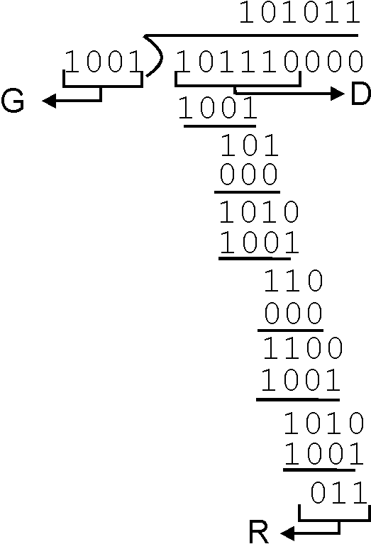
CRC Example
D: 101110
G: 1001
R(x): 011
Data plus redundancy to send
101110011

Slide 23
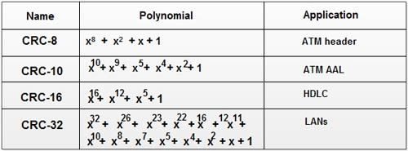
Popular CRC Protocols

Slide 24
Error Detection Performance of CRC
A CRC-n code can detect any error pattern that affects an odd number of bits.
It can detect all burst errors of length ( n ) or less.
It can detect most larger errors, although the probability of undetected errors increases as the error pattern length exceeds ( n ).

Slide 25
Even parity coding
011
2-bit data:
01
3-repetition coding
000111
How do you characterize the performance of a code for error detection and correction?

Slide 26
Hamming Distance
Definition: hamming distance (HD) is the number of positions at which the corresponding symbols are different
Code 1
Code 2
Valid codeword
Valid codeword
111
000
00
11
011
001
Invalid codeword
101
010
10
01
Invalid codeword
110
100
Hamming distance = 2
Hamming distance = 3

Slide 27
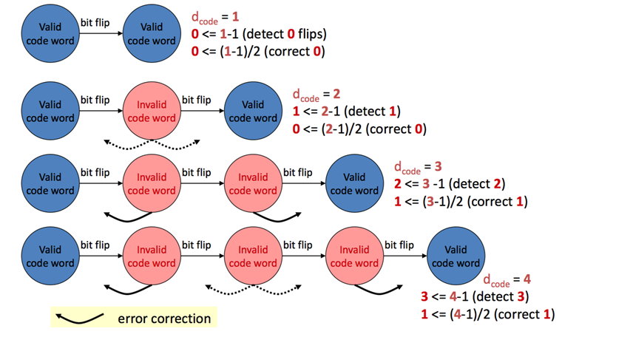
Minimum Hamming distance required

Slide 28
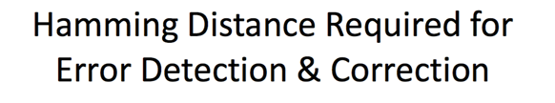
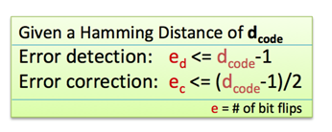
Characterizing Performance of a Code

Slide 29
Link Layer
6.1 Introduction to the link layer
6.2 Error detection and correction
6.3 Multiple access links and protocols
6.4 Switched local area networks
6.5 Link virtualization: A network as a link layer
6.6 Data center networking

Slide 30
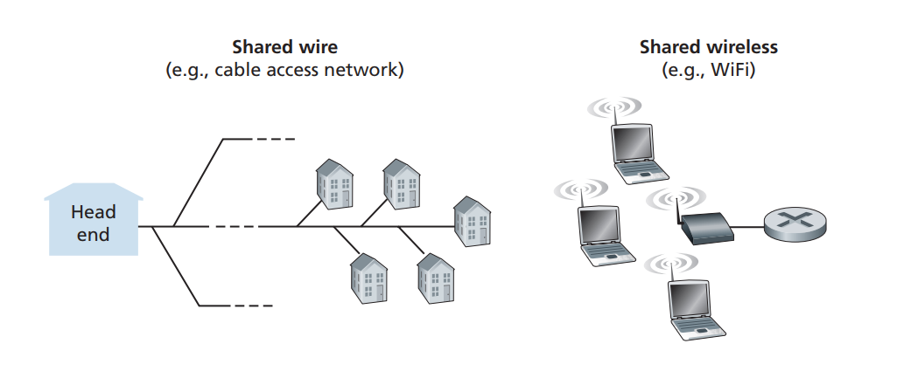
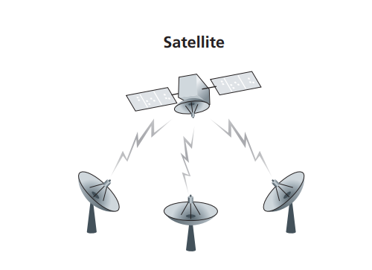

Multiple Access Links and Protocols
Two types of “links”:
Type 1: point-to-point
  PPP for dial-up access
  point-to-point link between Ethernet switch and host
Type 2: broadcast (shared wire or medium)
  old-fashioned Ethernet
  Upstream TV Cable
  802.11 wireless LAN
humans at a
cocktail party
(shared air, acoustical)

Slide 31
Multiple access to a shared link
Node 1
Node 2
Node 3
Node N
Shared link
Link capacity = R pbs

Slide 32
Multiple Access Protocols
Model:
  (1) single shared broadcast channel
  (2) two or more simultaneous transmissions by nodes: interference
    collision if node receives two or more signals at the same time
multiple access protocol (MAC)
An algorithm that determines how nodes share channel, i.e., determine when node can transmit
Assumption: communication about channel sharing must use channel itself!
  no out-of-band channel for coordination

Slide 33
What is an ideal MAC protocol?

Slide 34
Ideal Multiple Access Protocol
1. when one node wants to transmit, it can send at rate R.
2. when M nodes want to transmit, each can send at average rate R/M
3. fully decentralized:
  no special node to coordinate transmissions
  no synchronization of clocks, slots
4. simple

Slide 35
MAC Protocols: a taxonomy
Three broad classes:
Channel Partitioning
  divide channel into smaller “pieces” (time slots, frequency, code)
  allocate piece to node for exclusive use
Random Access
  channel not divided, allow collisions
  “recover” from collisions
“Taking turns”
  nodes take turns
  nodes with more to send can take longer turns
static
dynamic

Slide 36
Channel Partitioning MAC protocols: TDMA
TDMA: time division multiple access
access to channel in "rounds"
each station gets fixed length slot (length = pkt trans time) in each round
unused slots go idle
example: 6-station LAN, 1,3,4 have pkt, slots 2,5,6 idle
6-slot
frame
1
3
4
1
3
4

Slide 37
Channel Partitioning MAC protocols: FDMA
FDMA: frequency division multiple access
channel spectrum divided into frequency bands
each station assigned fixed frequency band
unused transmission time in frequency bands go idle
example: 6-station LAN, 1,3,4 have pkt, frequency bands 2,5,6 idle
time
frequency bands
FDM cable

Slide 38
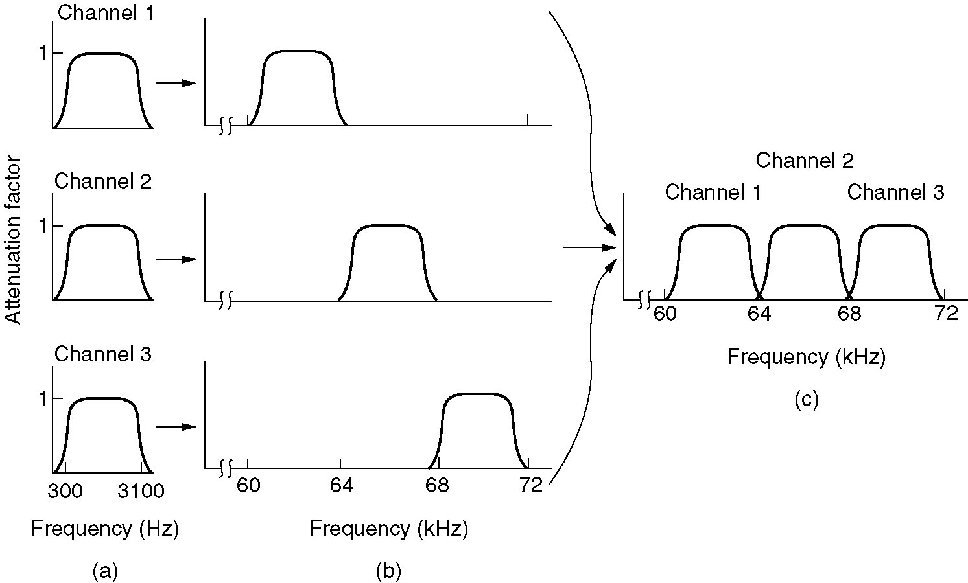
Frequency Division Multiplexing
(a) The original bandwidths.
(b) The bandwidths raised in frequency.
(c) The multiplexed channel.

Slide 39
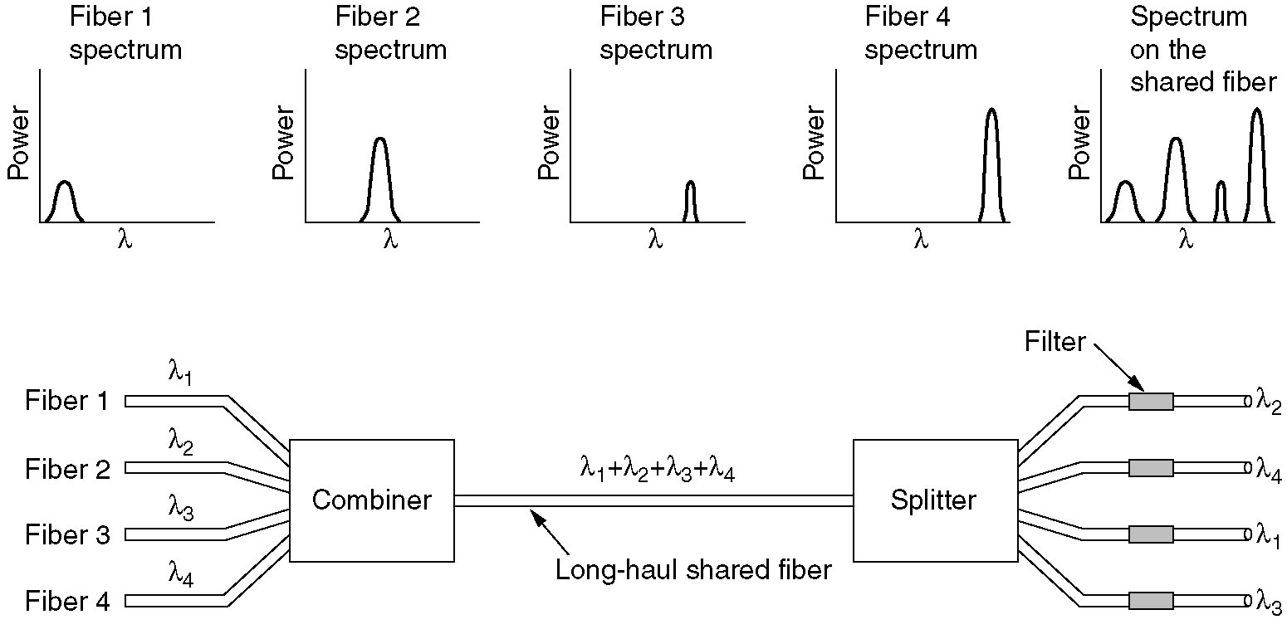
Wavelength Division Multiplexing

Slide 40
What are drawbacks of static channel-partitioning protocols?

Slide 41
How do you overcome the drawbacks?

Slide 42
Basic idea
When a node accesses the link, it uses the whole capacity of the link!
Node 1
Node 2
Node 3
Node N
Shared link
Link capacity = R pbs
The key is to avoid collisions (i.e., nodes transmit at the same time)

Slide 43
Random Access Protocols
Random access MAC protocol specifies:
  how to detect collisions
  how to recover from collisions (e.g., via delayed retransmissions)
Examples of random access MAC protocols:
  ALOHA
  slotted ALOHA
  CSMA, CSMA/CD, CSMA/CA

Slide 44
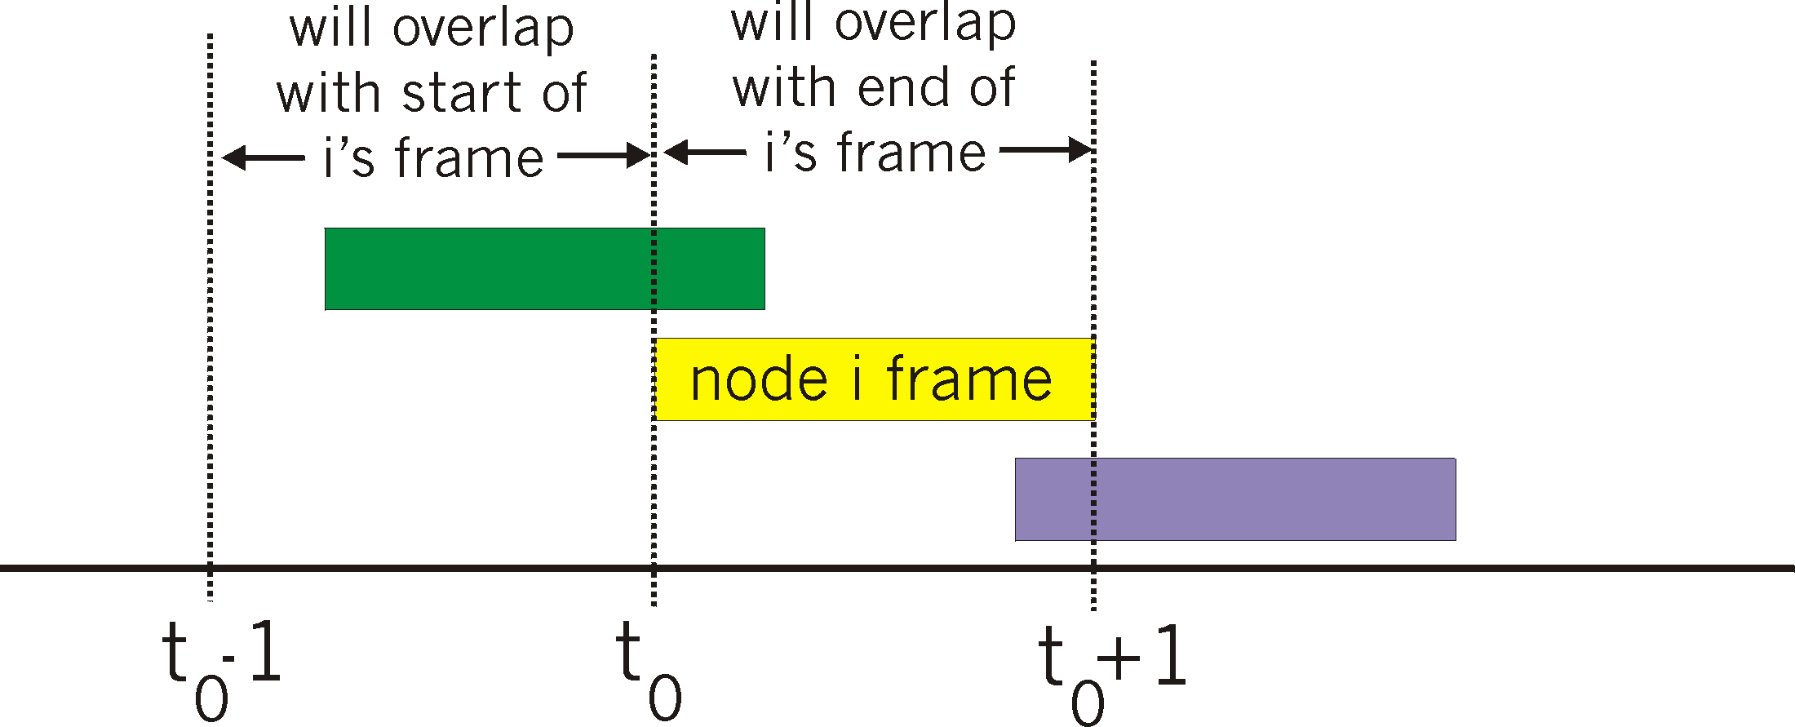
Pure (unslotted) ALOHA
Protocol operations
when frame first arrives, a node transmits immediately
If collision, immediately retransmits with probability p and waits for a frame time with probability 1-p;
Feature: simple, no synchronization

Slide 45
Pure Aloha efficiency
collision happens when:
  frame sent at t₀ collides with other frames sent in [t₀-1,t₀+1]
P(success by given node)
= P(node transmits) . P(no other node transmits in [t₀-1,t₀] . P(no other node transmits in [t₀,t₀+1]
= p . (1-p)^{N-1 .} (1-p)^{N-1}
= p . (1-p)^{2(N-1)}
choosing optimum p and then letting N -> inf...
^{= 1/(2e) = 0.18}
Efficiency : long-run
fraction of successful slots
(many nodes, all with many frames to send)

Slide 46
Slotted ALOHA
node 1
1
1
1
1
node 2
2
2
2
node 3
3
3
3
C
E
C
S
E
C
E
S
S
Protocol operations
when node obtains fresh frame, transmits in next slot
  if no collision: node can send new frame in next slot
  if collision: node retransmits frame in each subsequent slot with prob. p until success

Slide 47
Slotted Aloha efficiency
suppose: N nodes with many frames to send, each transmits in slot with probability p
Given a node, prob that has success in a slot
= p(1-p)^{N-1}
prob that any node has a success
= Np(1-p)^{N-1}
Max efficiency = 1/e = 0.37

Slide 48
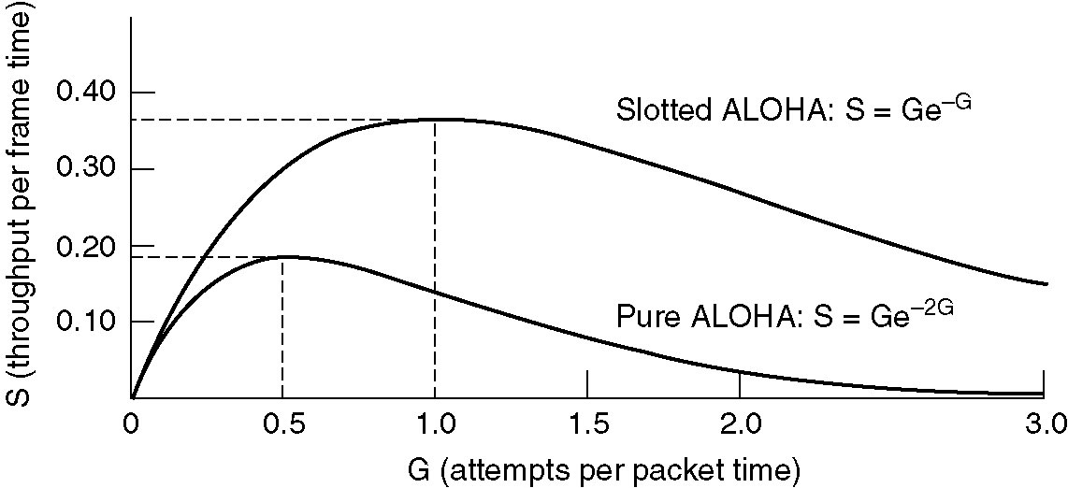
Throughput Comparison
Throughput versus offered traffic for ALOHA systems
Notes:
The relation between the offered traffic and the throughput is shown in Fig. 4-3. The maximum throughput occurs at G = 0.5, with S = 1/2e, which is about 0.184. In other words, the best we can hope for is a channel utilization of 18 percent. This result is not very encouraging, but with everyone transmitting at will, we could hardly have expected a 100 percent success rate.
e = 2.7182818284590

Slide 49
What is the main reason for Aloha’s low efficiency?
Transmissions without considering
transmissions of other nodes!

Slide 50
CSMA (Carrier Sense Multiple Access)
CSMA: listen before transmit
human analogy: don’t interrupt others!
Protocol operations
(1) the adapter senses the channel
if idle, it starts to transmit the frame immediately
if not, it waits until it senses a clear channel and transmits the frame

Slide 51
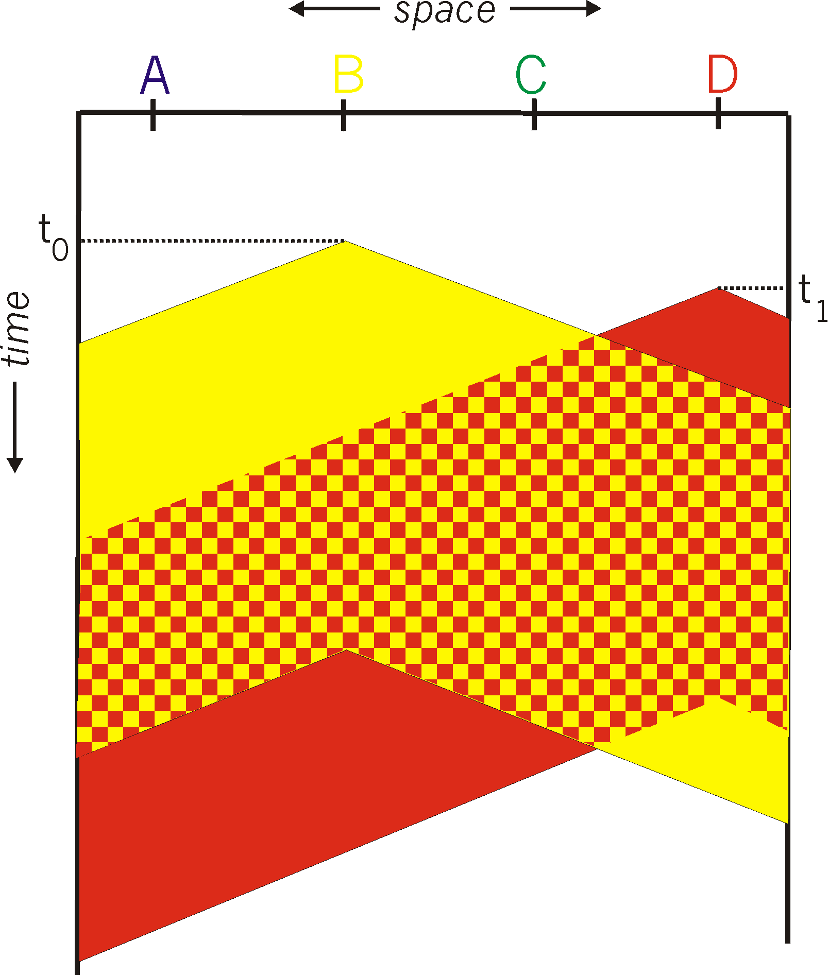
CSMA collisions
spatial layout of nodes
collisions can still occur:
propagation delay means
two nodes may not hear
each other’s transmission
collision:
entire packet transmission
time wasted
note:
role of distance & propagation delay in determining collision probability

Slide 52
CSMA/CD (Collision Detection)
CSMA/CD: carrier sensing, deferral as in CSMA
  collision detection: measure signal strengths, compare transmitted, received signals
  colliding transmissions aborted, reducing channel wastage
Protocol operations
(1) the adapter senses the channel
if idle, it starts to transmit the frame immediately
if not, it waits until it senses a clear channel and transmits the frame
(2) while transmitting, the adapter monitors for collisions
if collision, abort immediately
if not, transmission is successful
(3）after aborting, it waits for a random amount of time (exponential backoff)

Slide 53
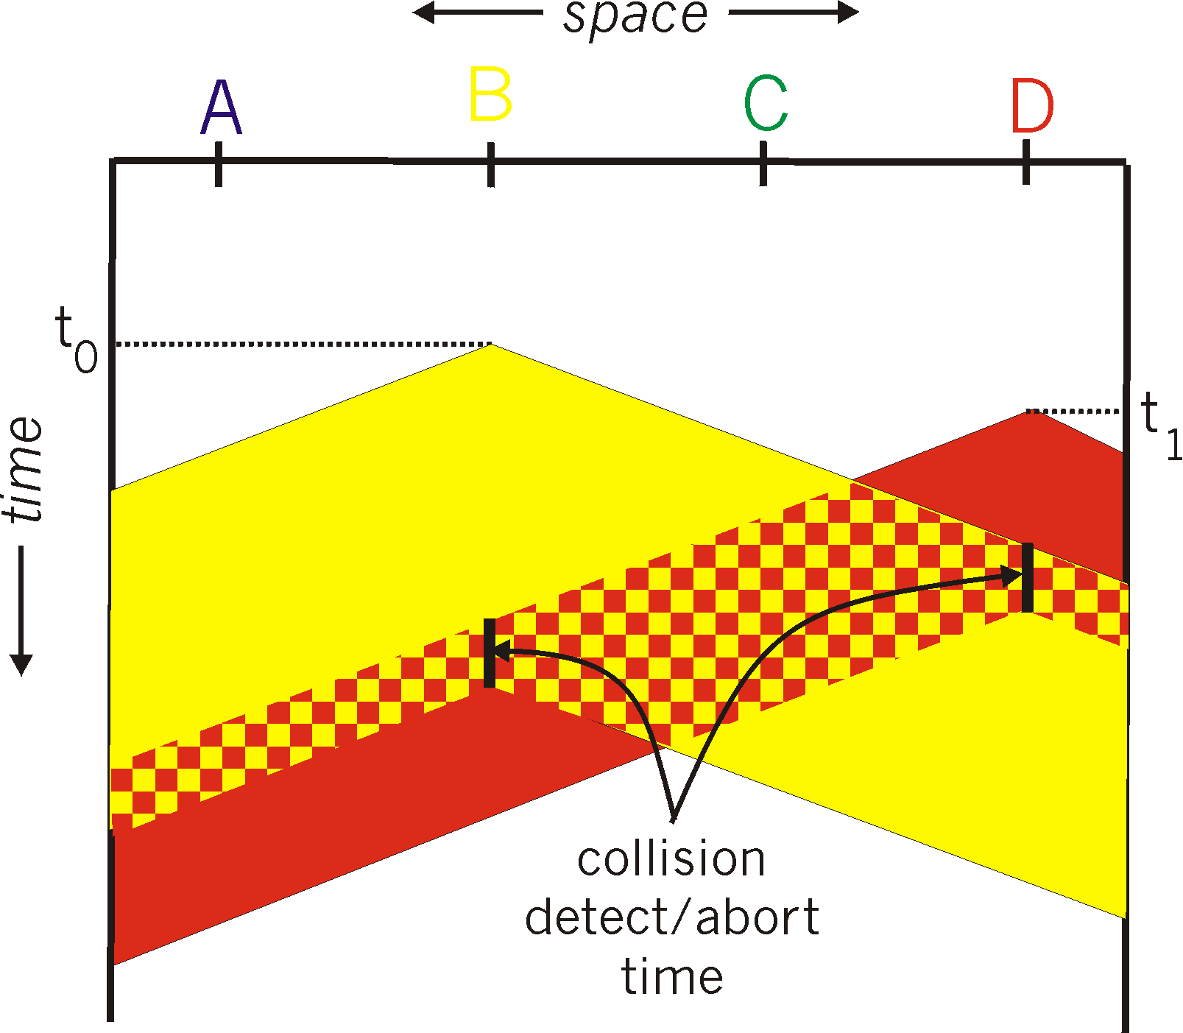
CSMA/CD collision detection

Slide 54
Except static partitioning protocols, can any MAC protocol avoid packet collisions?

Slide 55
“Taking Turns” MAC protocols
(1) channel partitioning MAC protocols:
  share channel efficiently and fairly at high load
  inefficient at low load: delay in channel access, 1/N bandwidth allocated even if only 1 active node!
(2) random access MAC protocols
  efficient at low load: single node can fully utilize channel
  high load: collision overhead
(3) “taking turns” protocols
  look for best of both worlds!

Slide 56

“Taking Turns” MAC protocols
Basic idea of polling
master node “invites” slave nodes to transmit in turn
typically used with “dumb” slave devices
data
poll
master
data
slaves
Concerns:
  polling overhead
  latency
  single point of failure (master)

Slide 57
“Taking Turns” MAC protocols
Basic idea of Token passing:
control token passed from one node to next sequentially.
token message
T
(nothing
to send)
T
Concerns:
  token overhead
  latency
  single point of failure (token)
data

Slide 58
Summary of MAC protocols
(1) channel partitioning, by time, frequency or code
  Time Division, Frequency Division
(2) random access
  ALOHA, S-ALOHA, CSMA, CSMA/CD
  Collision detection: easy in some technologies (wire), hard in others (wireless)
  CSMA/CD used in Ethernet
  CSMA/CA used in 802.11
(3) taking turns
  polling from central site, token passing
  Bluetooth, FDDI, IBM Token Ring

Slide 59
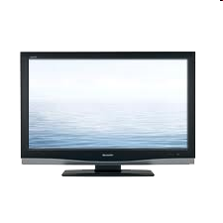



Cable access network
Internet frames, TV channels, control transmitted
downstream at different frequencies
cable headend
…
CMTS
…
splitter
cable
modem
cable modem
termination system
ISP
upstream Internet frames, TV control, transmitted
upstream at different frequencies in time slots
Downstream: multiple 40Mbps downstream (broadcast) channels
  single CMTS transmits into channels （no contention!）
Upstream: multiple 30 Mbps upstream channels
  multiple access （contention!）: all users contend for certain upstream channel time slots (others assigned)

Slide 60

Cable access network (cont’)
cable headend
MAP frame for
Interval [t1, t2]
Downstream channel i
CMTS
Upstream channel j
t₁
t₂
Residences with cable modems
Minislots containing
minislots request frames
Assigned minislots containing cable modem
upstream data frames
DOCSIS: data over cable service interface spec
FDM over upstream, downstream frequency channels
TDM upstream: some slots assigned, some have contention
  downstream MAP frame: assigns upstream slots
  request for upstream slots (and data) transmitted random access (binary backoff) in selected slots

Slide 61
Link Layer
6.1 Introduction to the link layer
6.2 Error detection and correction
6.3 Multiple access links and protocols
6.4 Switched local area networks
6.5 Link virtualization: A network as a link layer
6.6 Data center networking

Slide 62
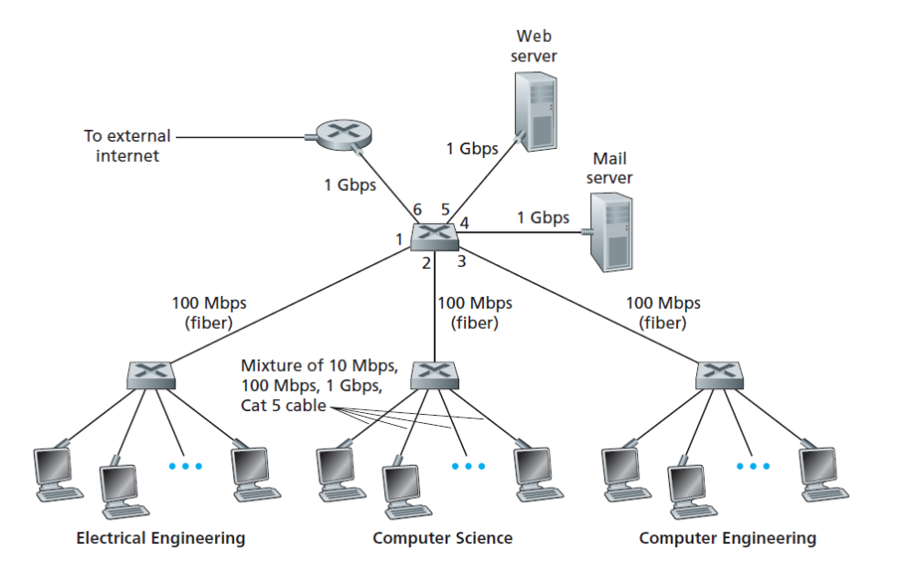
Switched Local area networks
Router
switch
switch
switch
switch

Slide 63
6.4 Switched local area networks
1. Link-layer addressing and ARP
2. Ethernet
3. Link-layer switches
4. Virtual local area networks (VLANs)

Slide 64
MAC Addresses
32-bit IP address:
  network-layer address
  used to get datagram to destination IP subnet
MAC (or LAN or physical or Ethernet) address:
  function: get frame from one interface to another physically-connected interface (same network)
  48 bit MAC address (for most LANs)
    burned in NIC ROM, also sometimes software settable
Permanent, globally unique

Slide 65
LAN Addresses
Each adapter on LAN has unique LAN address
1A-2F-BB-76-09-AD
Broadcast address =
FF-FF-FF-FF-FF-FF
LAN
(wired or
wireless)
= adapter
71-65-F7-2B-08-53
58-23-D7-FA-20-B0
0C-C4-11-6F-E3-98

Slide 66
LAN Address (more)
MAC address allocation administered by IEEE
manufacturer buys portion of MAC address space (to assure uniqueness)
MAC flat address ➜ portability
  can move LAN card from one LAN to another
IP hierarchical address NOT portable
  address depends on IP subnet to which node is attached
analogy:
(a) MAC address: like Social Security Number
(b) IP address: like postal address

Slide 67
Why both MAC and IP address?

Slide 68
Why both MAC and IP address?
(1) The data link layer does not only serve IP protocol, including many others
(2) if adapters use network-layer address, then the adapter needs to be reconfigured every time it moves
(3) if not use MAC add at all, then all received frames should be forwarded to network layer. Great overhead!
Answer: to keep the layers independent

Slide 69
How do MAC address and IP address interact?

Slide 70
MAC Address interacting with IP
137.196.7.78
Note: The sender, A, gets B’s IP via DNS, but does not have B’s MAC!
A
1A-2F-BB-76-09-AD
137.196.7.23
137.196.7.14
LAN
71-65-F7-2B-08-53
58-23-D7-FA-20-B0
0C-C4-11-6F-E3-98
137.196.7.88
B
Question: When sending a packet to B, how does A gets B’s MAC address?

Slide 71
ARP: Address Resolution Protocol
ARP:
Mapping IP address to MAC address
Each IP node (host, router) on LAN has ARP table
ARP table: IP/MAC address mappings for some LAN nodes < IP address; MAC address; TTL>
  TTL (Time To Live): time after which address mapping will be forgotten (typically 20 min)

Slide 72
ARP protocol: Same LAN (network)
A wants to send datagram to B, and B’s MAC address not in A’s ARP table.
A broadcasts ARP query packet, containing B's IP address
  dest MAC address =
  FF-FF-FF-FF-FF-FF
  all machines on LAN receive ARP query
B receives ARP packet, replies to A with its (B's) MAC address
  frame sent to A’s MAC address (unicast)
A caches (saves) IP-to-MAC address pair in its ARP table until information becomes old (times out)
  soft state: information that times out (goes away) unless refreshed
ARP is “plug-and-play”:
  nodes create their ARP tables without intervention from net administrator

Slide 73

Addressing: routing to another LAN
walkthrough: send datagram from A to B via R
  focus on addressing – at IP (datagram) and MAC layer (frame)
  assume A knows B’s IP address
  assume A knows IP address of first hop router, R (how?)
  assume A knows R’s MAC address (how?)
A
B
R
111.111.111.111
222.222.222.222
74-29-9C-E8-FF-55
49-BD-D2-C7-56-2A
222.222.222.220
1A-23-F9-CD-06-9B
111.111.111.112
111.111.111.110
222.222.222.221
CC-49-DE-D0-AB-7D
E6-E9-00-17-BB-4B
88-B2-2F-54-1A-0F

Slide 74
Addressing: routing to another LAN
A creates IP datagram with IP source A, destination B
A creates link-layer frame with R's MAC address as dest, frame contains A-to-B IP datagram
MAC src: 74-29-9C-E8-FF-55
MAC dest: E6-E9-00-17-BB-4B
IP
Eth
Phy
IP src: 111.111.111.111
IP dest: 222.222.222.222
A
B
R
111.111.111.111
222.222.222.222
74-29-9C-E8-FF-55
49-BD-D2-C7-56-2A
222.222.222.220
1A-23-F9-CD-06-9B
111.111.111.112
111.111.111.110
222.222.222.221
CC-49-DE-D0-AB-7D
E6-E9-00-17-BB-4B
88-B2-2F-54-1A-0F

Slide 75
Addressing: routing to another LAN
frame sent from A to R
frame received at R, datagram removed, passed up to IP
MAC src: 74-29-9C-E8-FF-55
MAC dest: E6-E9-00-17-BB-4B
IP src: 111.111.111.111
IP dest: 222.222.222.222
IP
Eth
Phy
IP src: 111.111.111.111
IP dest: 222.222.222.222
IP
Eth
Phy
A
B
R
111.111.111.111
222.222.222.222
74-29-9C-E8-FF-55
49-BD-D2-C7-56-2A
222.222.222.220
1A-23-F9-CD-06-9B
111.111.111.112
111.111.111.110
222.222.222.221
CC-49-DE-D0-AB-7D
E6-E9-00-17-BB-4B
88-B2-2F-54-1A-0F

Slide 76
Addressing: routing to another LAN
R forwards datagram with IP source A, destination B
R creates link-layer frame with B's MAC address as dest, frame contains A-to-B IP datagram
MAC src: 1A-23-F9-CD-06-9B
MAC dest: 49-BD-D2-C7-56-2A
IP
Eth
Phy
IP
Eth
Phy
IP src: 111.111.111.111
IP dest: 222.222.222.222
A
B
R
111.111.111.111
222.222.222.222
74-29-9C-E8-FF-55
49-BD-D2-C7-56-2A
222.222.222.220
1A-23-F9-CD-06-9B
111.111.111.112
111.111.111.110
222.222.222.221
CC-49-DE-D0-AB-7D
E6-E9-00-17-BB-4B
88-B2-2F-54-1A-0F

Slide 77
Addressing: routing to another LAN
R forwards datagram with IP source A, destination B
R creates link-layer frame with B's MAC address as dest, frame contains A-to-B IP datagram
MAC src: 1A-23-F9-CD-06-9B
MAC dest: 49-BD-D2-C7-56-2A
IP
Eth
Phy
IP
Eth
Phy
IP src: 111.111.111.111
IP dest: 222.222.222.222
A
B
R
111.111.111.111
222.222.222.222
74-29-9C-E8-FF-55
49-BD-D2-C7-56-2A
222.222.222.220
1A-23-F9-CD-06-9B
111.111.111.112
111.111.111.110
222.222.222.221
CC-49-DE-D0-AB-7D
E6-E9-00-17-BB-4B
88-B2-2F-54-1A-0F

Slide 78
Addressing: routing to another LAN
R forwards datagram with IP source A, destination B
R creates link-layer frame with B's MAC address as dest, frame contains A-to-B IP datagram
MAC src: 1A-23-F9-CD-06-9B
MAC dest: 49-BD-D2-C7-56-2A
IP src: 111.111.111.111
IP dest: 222.222.222.222
IP
Eth
Phy
A
B
R
111.111.111.111
222.222.222.222
74-29-9C-E8-FF-55
49-BD-D2-C7-56-2A
222.222.222.220
1A-23-F9-CD-06-9B
111.111.111.112
111.111.111.110
222.222.222.221
CC-49-DE-D0-AB-7D
E6-E9-00-17-BB-4B
88-B2-2F-54-1A-0F

Slide 79
6.4 Switched local area networks
1. Link-layer addressing and ARP
2. Ethernet
3. Link-layer switches
4. Virtual local area networks (VLANs)

Slide 80
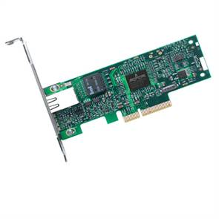
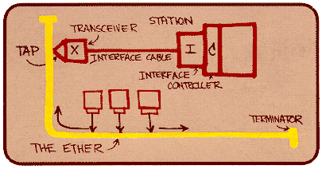

Ethernet
“dominant” wired LAN technology:
cheap $20 for NIC
first widely used LAN technology
simpler, cheaper than token LANs and ATM
kept up with speed race: 10 Mbps – 10 Gbps
Metcalfe’s Ethernet
sketch

Slide 81
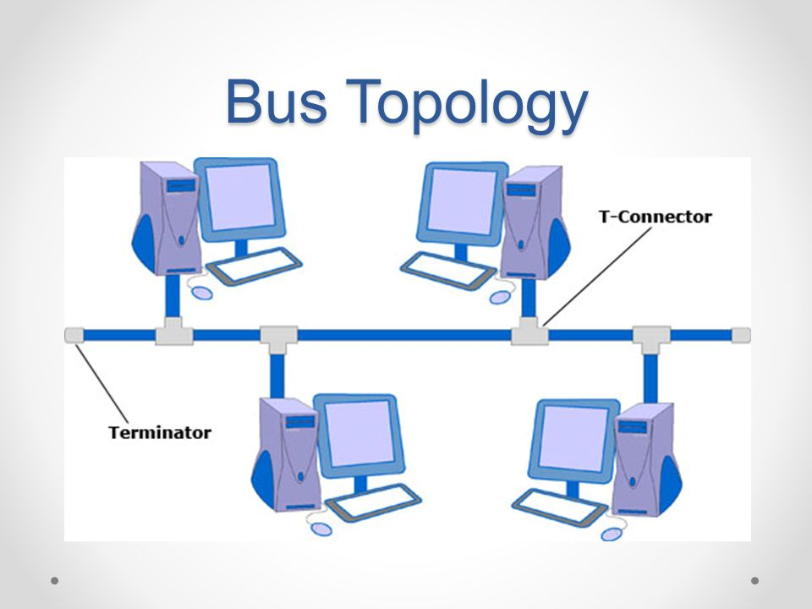
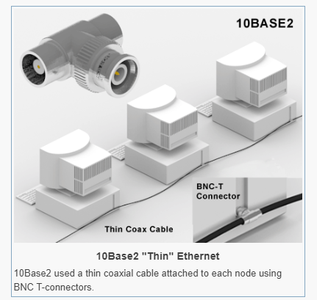
Bus Topology
Old fashioned, Based on Coax (Ethernet 10base2)
Bus topology popular through mid 90s

Slide 82
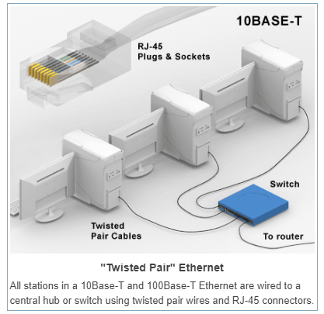
Star topology
switch
star
today: star topology prevails
active switch in center
each “spoke” runs a (separate) Ethernet protocol (nodes do not collide with each other)

Slide 83
Ethernet Services
connectionless:
  No handshaking between sending and receiving NICs
unreliable:
  receiving NIC doesn’t send acks or nacks to sending NIC
  stream of datagrams passed to network layer can have gaps (missing datagrams)
  gaps will be filled if app is using TCP
  otherwise, app will see gaps

Slide 84

Ethernet Frame Structure
Sending adapter encapsulates IP datagram (or other network layer protocol packet) in Ethernet frame
Preamble:
7 bytes with pattern 10101010 followed by one byte with pattern 10101011
used to synchronize receiver, sender clock rates

Slide 85
Ethernet Frame Structure (more)
Addresses: 6 bytes
  if adapter receives frame with matching destination address, or with broadcast address (eg ARP packet), it passes data in frame to network layer protocol
  otherwise, adapter discards frame
Type: indicates higher layer protocol (mostly IP but others possible, e.g., Novell IPX, AppleTalk)
CRC: checked at receiver, if error is detected, frame is dropped
multiplexing

Slide 86
Ethernet MAC: CSMA/CD
Step 1. NIC receives datagram from network layer, creates frame
Step 2. Carrier sensing
  If NIC senses channel idle, starts frame transmission
  If NIC senses channel busy, waits until channel idle, then transmits
Step 3. If NIC transmits entire frame without detecting another transmission, NIC is done with frame !
Step 4. If NIC detects another transmission while transmitting, aborts and sends jam signal

Slide 87
Exponential Backoff
After aborting, NIC enters exponential backoff: after mth collision, NIC chooses K at random from {0,1,2,…,2^{m}-1}.
NIC waits K·512 bit times, returns to Step 2

Slide 88
Why Exponential?
Goal of exponential backoff:
adapt retransmission attempts to estimated current load
When there are a small number of competitors, resolve completion in short time => wait a short time
When there are a larger number of competitors, resolve completion in longer time
When experiencing more collisions, be aware of more competitors

Slide 89
Ethernet’s CSMA/CD (more)
Jam Signal: make sure all other transmitters are aware of collision; 48 bits
Bit time: 0.1 microsec for 10 Mbps Ethernet ;
for K=1023, wait time is about 50 msec
Exponential Backoff example:
first collision: choose K from {0,1}; delay is K· 512 bit transmission times
after second collision: choose K from {0,1,2,3}…
after ten collisions, choose K from {0,1,2,3,4,…,1023}
demo
See/interact with Java
applet on AWL Web site:
highly recommended !

Slide 90
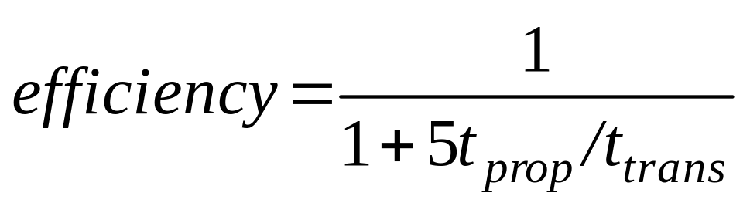
CSMA/CD efficiency
T_{prop} = max prop delay between 2 nodes in LAN
t_{trans} = time to transmit max-size frame
efficiency goes to 1
  as t_{prop} goes to 0
  as t_{trans} goes to infinity
better performance than ALOHA: and simple, cheap, decentralized!

Slide 91
6.4 Switched local area networks
1. Link-layer addressing and ARP
2. Ethernet
3. Link-layer switches
4. Virtual local area networks (VLANs)

Slide 92
How do we physically connect devices in the same subnet?

Slide 93
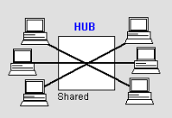
Hubs
Collision domain
Hub
physical-layer (“dumb”) repeaters:
  bits coming in one link go out all other links at same rate
  all nodes connected to hub can collide with one another
  no frame buffering
  no CSMA/CD at hub: host NICs detect collisions

Slide 94
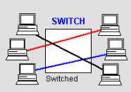
Switch
Collision domain
Collision domain
Switch
link-layer device: smarter than hubs, take active role
  store, forward Ethernet frames
transparent
  hosts are unaware of presence of switches
plug-and-play, self-learning
  switches do not need to be configured

Slide 95
Switch: multiple simultaneous transmissions
A
hosts have dedicated, direct connection to switch
switches buffer packets
Ethernet protocol used on each incoming link, but no collisions; full duplex
  each link is its own collision domain
switching: A-to-A’ and B-to-B’ simultaneously, without collisions
  not possible with dumb hub
C’
B
1
2
6
3
5
4
C
B’
A’
switch with six interfaces
(1,2,3,4,5,6)

Slide 96
Switch Table
A
Q: how does switch know that A’ reachable via interface 4, B’ reachable via interface 5?
A: each switch has a switch table, each entry:
  (MAC address of host, interface to reach host, time stamp)
looks like a routing table!
Q: how are entries created, maintained in switch table?
  something like a routing protocol?
C’
B
1
2
6
3
5
4
C
B’
A’
switch with six interfaces
(1,2,3,4,5,6)

Slide 97
Switch: self-learning
Source: A
Dest: A’
A
A A’
switch learns which hosts can be reached through which interfaces
  when frame received, switch “learns” location of sender: incoming LAN segment
  records sender/location pair in switch table
C’
B
1
2
6
3
5
4
C
B’
A’
MAC addr interface TTL
A
1
60
Switch table
(initially empty)

Slide 98
Switch: frame filtering/forwarding
When frame received:
1. record link associated with sending host
2. index switch table using MAC dest address
3. if entry found for destination
then {
if dest on segment from which frame arrived
then drop the frame
else forward the frame on interface indicated
}
else flood
forward on all but the interface
on which the frame arrived

Slide 99
Self-learning, forwarding: example
Source: A
Dest: A’
frame destination unknown:
A
A A’
flood
C’
B
destination A location known:
1
2
6
3
A A’
A A’
A A’
A A’
A A’
5
4
selective send
C
A’ A
MAC addr interface TTL
B’
A’
A
1
60
A’
4
60
Switch table
(initially empty)

Slide 100
Interconnecting switches
switches can be connected together
S₄
S₁
S₃
A
S₂
F
I
B
C
D
E
G
H
Q: sending from A to G - how does S₁ know to forward frame destined to F via S₄ and S₃?
A: self learning! (works exactly the same as in single-switch case!)

Slide 101
Self-learning multi-switch example
Suppose C sends frame to I, I responds to C
1
S₄
S₁
2
S₃
A
S₂
F
I
B
C
D
E
G
H
Q: show switch tables and packet forwarding in S₁, S₂, S₃, S₄

Slide 102
Institutional network
mail server
to external
network
router
web server
IP subnet

Slide 103
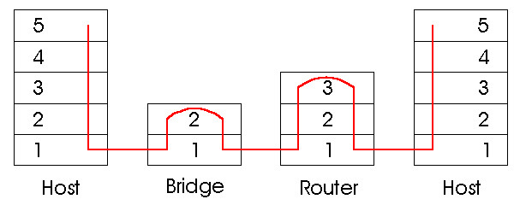
Switches vs. Routers
both store-and-forward devices
  routers: network layer devices (examine network layer headers)
  switches are link layer devices
routers maintain routing tables, implement routing algorithms
switches maintain switch tables, implement filtering, learning algorithms

Slide 104
Switches vs. Routers (2)
Switch |  | Router
Pro | Con | Pro | Con
Plug-and-play | Broadcast storms Topology restricted to spanning tree | No broadcast storms More general topologies | Not plug-and-play

Slide 105
6.4 Switched local area networks
1. Link-layer addressing and ARP
2. Ethernet
3. Link-layer switches
4. Virtual local area networks (VLANs)

Slide 106



VLANs: motivation
Router
switch
switch
switch
switch
Group 3
Group 1
Group 2
What are the problems with a hierarchical LAN connecting different groups?
Lack of traffic isolation among groups
Security/privacy risk
Management of user movement among groups

Slide 107
Basic idea of VLAN
Virtual Local Area Network
switch(es) supporting VLAN capabilities can be configured to define multiple virtual LANS over single physical LAN infrastructure.
Router
VLAN3
Group 3
VLAN1
Group 1
VLAN2
Group 2

Slide 108
Port-based VLAN
switch ports grouped (by switch management software) so that single physical switch ……
1
7
9
15
2
8
10
16
…
…
Electrical Engineering
(VLAN ports 1-8)
Computer Science
(VLAN ports 9-15)
operates as multiple virtual switches
1
7
9
15
2
8
10
16
…
…
Electrical Engineering
(VLAN ports 1-8)
Computer Science
(VLAN ports 9-16)

Slide 109

Port-based VLAN
router
traffic isolation: frames to/from ports 1-8 can only reach ports 1-8
  can also define VLAN based on MAC addresses of endpoints, rather than switch port
1
7
9
15
2
8
10
16
dynamic membership: ports can be dynamically assigned among VLANs
…
…
Electrical Engineering
(VLAN ports 1-8)
Computer Science
(VLAN ports 9-15)
forwarding between VLANS: done via routing (just as with separate switches)
  in practice vendors sell combined switches plus routers

Slide 110
VLANS spanning multiple switches
1
7
9
15
1
3
5
7
2
8
10
16
2
4
6
8
…
…
Electrical Engineering
(VLAN ports 1-8)
Computer Science
(VLAN ports 9-15)
Ports 2,3,5 belong to EE VLAN
Ports 4,6,7,8 belong to CS VLAN
trunk port: carries frames between VLANS defined over multiple physical switches
  frames forwarded within VLAN between switches cannot be vanilla 802.1 frames (must carry VLAN ID info)
  802.1q protocol adds/removed additional header fields for frames forwarded between trunk ports

Slide 111
802.1Q VLAN frame format
type
preamble
dest.
address
source
address
data (payload)
CRC
802.1 frame
type
preamble
dest.
address
source
address
data (payload)
CRC
802.1Q frame
2-byte Tag Protocol Identifier
(value: 81-00)
Recomputed
CRC
Tag Control Information (12 bit VLAN ID field,
3 bit priority field like IP TOS)

Slide 112
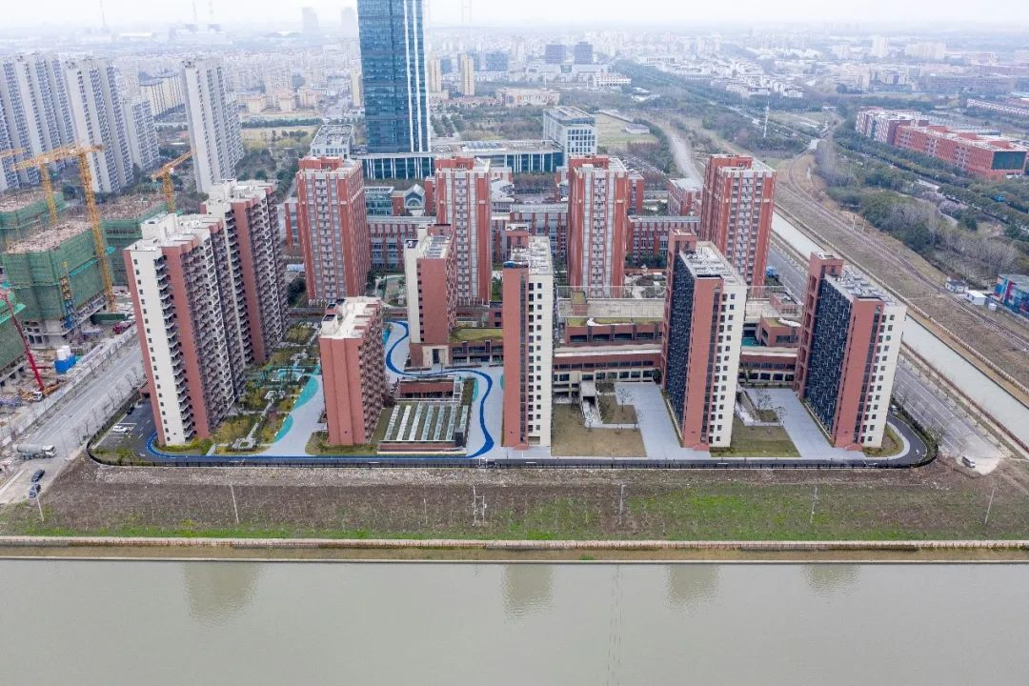
Real Case Study: New North Campus of the University

Slide 113
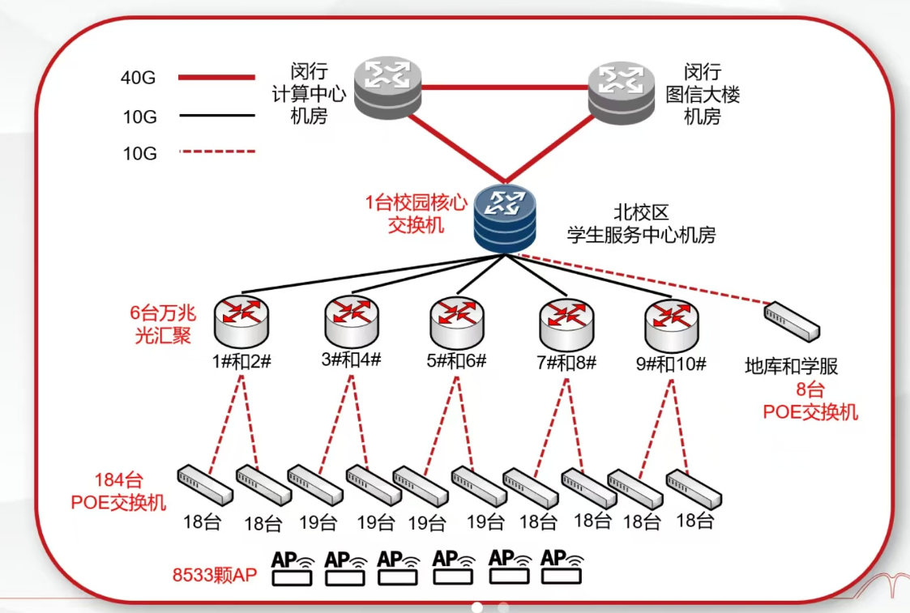
Real Case Study: New North Campus of the University

Slide 114
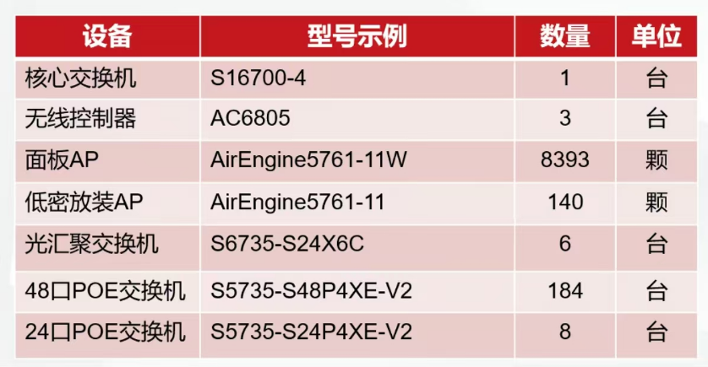
Real Case Study: New North Campus of the University

Slide 115
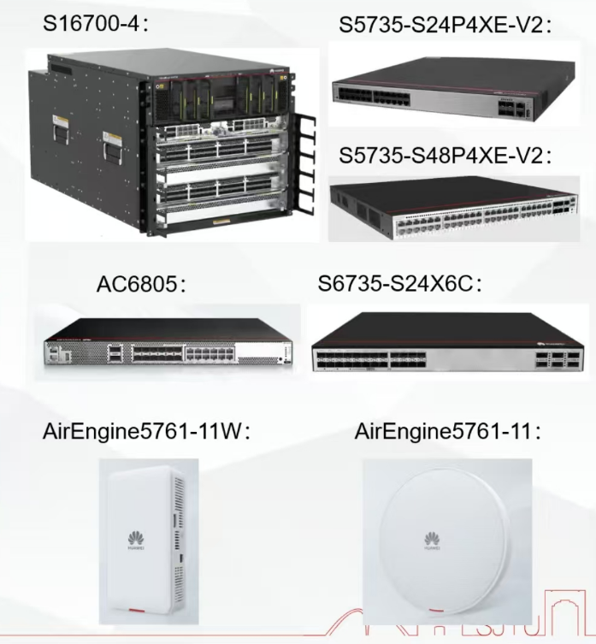
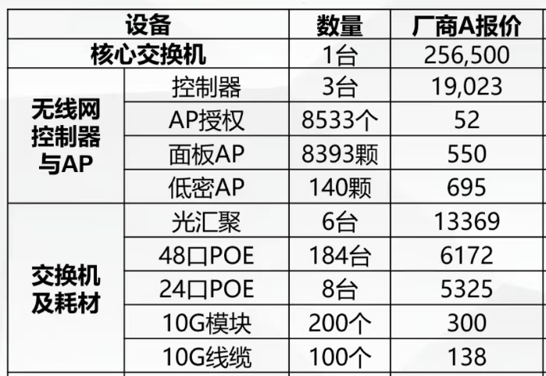
Real Case Study: New North Campus of the University

Slide 116
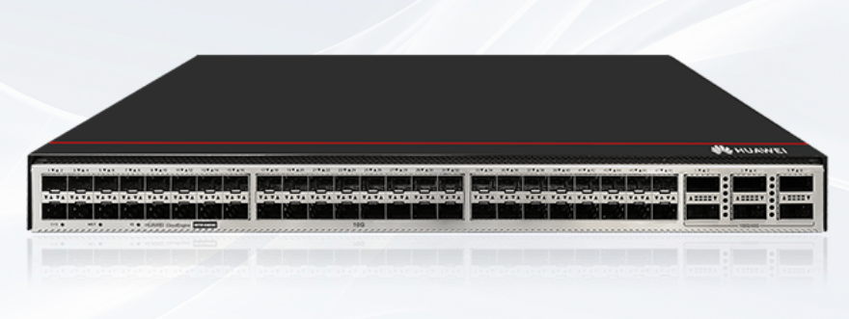
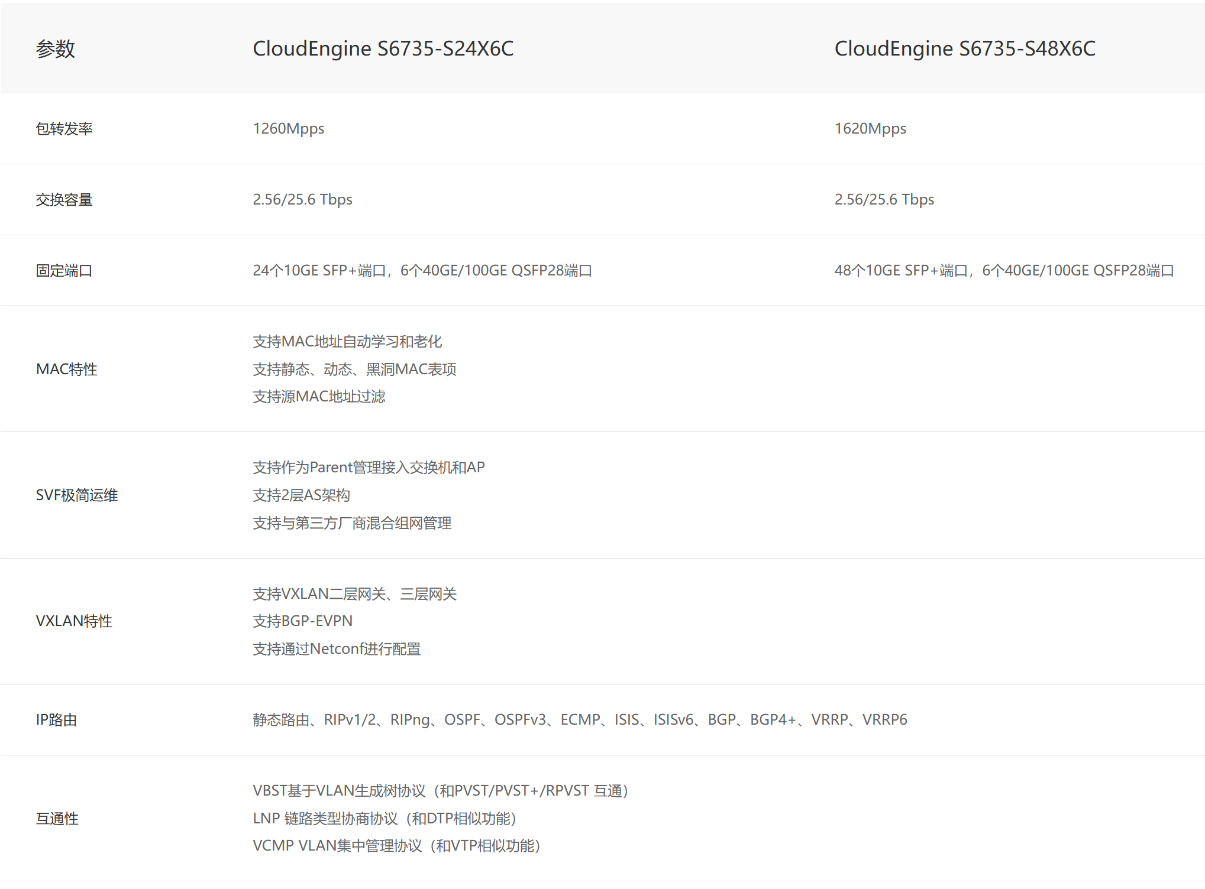
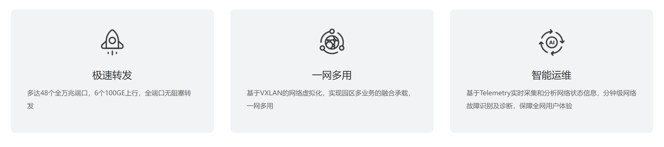
CloudEngine S6735-S系列交换机

Slide 117
Link Layer
6.1 Introduction to the link layer
6.2 Error detection and correction
6.3 Multiple access links and protocols
6.4 Switched local area networks
6.5 Link virtualization: A network as a link layer
6.6 Data center networking

Slide 118
Overview of MPLS
Multiprotocol label switching (MPLS)
MPLS is a packet-switched, virtual-circuit network in its own right
Pedagogical viewpoint
The network layer
The link layer
The Internet viewpoint
A link-layer technology for interconnecting two IP devices

Slide 119
MPLS Example
R6
R7
0
0
1
1
R4
R3
R5
0
0
A
R2
R1
R8
MPLS network
A virtual-circuit network

Slide 120
Multiprotocol label switching (MPLS)
initial goal: high-speed IP forwarding using fixed length label (instead of IP address)
  fast lookup using fixed length identifier (rather than shortest prefix matching)
  borrowing ideas from Virtual Circuit (VC) approach
  but IP datagram still keeps IP address!
PPP or Ethernet
header
IP header
Transport header
MPLS header
label
Exp
S
TTL
20
3
1
5

Slide 121
MPLS forwarding tables
in out out
label label dest interface
10 A 0
in out out
label label dest interface
label-switched router
forward packets to outgoing interface based only on label value (don’t inspect IP address)
MPLS forwarding table distinct from IP forwarding tables
12 D 0
8 A 1
10 6 A 1
12 9 D 0
R6
App
Transport
Network
MPLS
Link
Physical
0
0
D
1
1
App
Transport
Network
MPLS
Link
Physical
R4
R3
R5
0
0
A
in out out
label label dest interface
R2
R1
in out out
label label dest interface
6 - A 0
8 6 A 0

Slide 122
MPLS signaling
modify OSPF, IS-IS link-state flooding protocols to carry info used by MPLS routing,
  e.g., link bandwidth, amount of “reserved” link bandwidth
entry MPLS router uses RSVP-TE signaling protocol to set up MPLS forwarding at downstream routers
R6
RSVP-TE
D
R4
R5
modified
link state
flooding
A

Slide 123
MPLS versus IP paths
flexibility: MPLS forwarding decisions can differ from those of IP： use destination and source addresses to route flows to same destination differently (traffic engineering)
R6
D
R4
R3
R5
A
R2
IP router
IP routing: path to destination determined by destination address alone

Slide 124
MPLS versus IP paths
entry router (R4) can use different MPLS routes to A based, e.g., on source address
R6
D
R4
R3
R5
A
R2
IP routing: path to destination determined by destination address alone
IP-only
router
MPLS routing: path to destination can be based on source and dest. address
  fast reroute: precompute backup routes in case of link failure
MPLS and
IP router

Slide 125
Link Layer
6.1 Introduction to the link layer
6.2 Error detection and correction
6.3 Multiple access links and protocols
6.4 Switched local area networks
6.5 Link virtualization: A network as a link layer
6.6 Data center networking

Slide 126
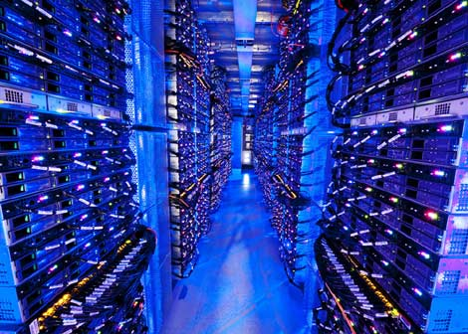
Data center networks
10’s to 100’s of thousands of hosts, often closely coupled, in close proximity:
  e-business (e.g. Amazon)
  content-servers (e.g., YouTube, Akamai, Apple, Microsoft)
  search engines, data mining (e.g., Google)
Inside a 40-ft Microsoft container,
Chicago data center

Slide 127
Typical Architecture
Internet
Two types of traffic
Border router
Access router
Access router
Tier-1 switches
Tier-2 switches
TOR switches
1
2
3
4
5
6
7
8
Server racks

Slide 128
What are the design objectives of a data center network?

Slide 129
Rich interconnection among switches
increased throughput between racks (multiple routing paths possible)
increased reliability via redundancy
Tier-1 switches
Tier-2 switches
TOR switches
Server racks
1
2
3
4
5
6
7
8

Slide 130
Putting all together:

Slide 131
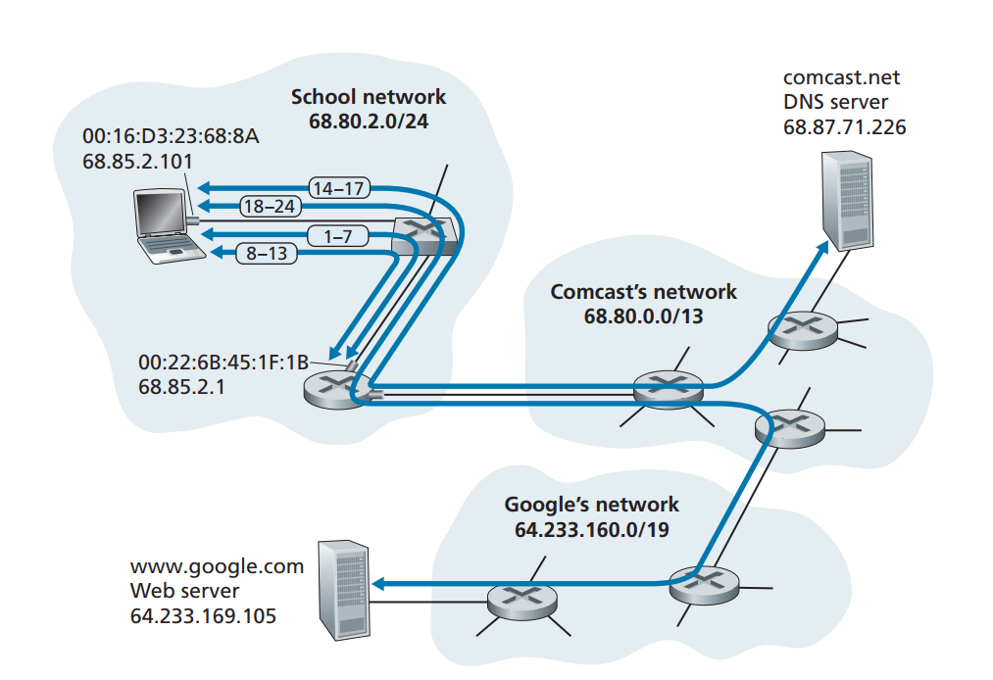
Network Setting
A student, Bob, connects a laptop to his school’s Ethernet switch
He downloads a Web page (say the home page of www.google.com)

Slide 132
Summary
principles behind data link layer services:
  error detection, correction
  sharing a broadcast channel: multiple access
  link layer addressing
instantiation and implementation of various link layer technologies
  Ethernet
  switched LANS

Slide 133
Let’s take a breath
journey down protocol stack complete (including except including PHY communications)
solid understanding of networking principles, practice

Slide 134
Homework #05:
Chapter 6: P5, P10, P13, P21

