Slide 1
Chapter 7:
Wireless and Mobile Networks
Yanmin Zhu
School of Computers

Slide 2
Already finished all layers in the stack, why a separate chapter for wireless and mobile networks?
Key differences: Wireless and mobile

Slide 3
Considering wireless characteristics, what shall be different on link layer, network layer, transport layer and application layer?

Slide 4
Considering mobility, what shall be different on link layer, network layer, transport layer and application layer?

Slide 5
Chapter 7 outline
7.1 Introduction
7.2 Wireless links and network characteristics
7.3 WiFi: 802.11 wireless LANs
7.4 Cellular Internet access
7.5 Mobility management: principles
7.6 Mobile IP
7.7 Handling mobility in cellular networks
7.8 Impact on higher-layer protocols

Slide 6
Chapter 7 outline
7.1 Introduction
7.2 Wireless links and network characteristics
7.3 WiFi: 802.11 wireless LANs
7.4 Cellular Internet access
7.5 Mobility management: principles
7.6 Mobile IP
7.7 Handling mobility in cellular networks
7.8 Impact on higher-layer protocols

Slide 7


Elements of a wireless network
wireless hosts
laptop, PDA, IP phone
run applications
may be stationary (non-mobile) or mobile
  wireless does not always mean mobility
network
infrastructure

Slide 8
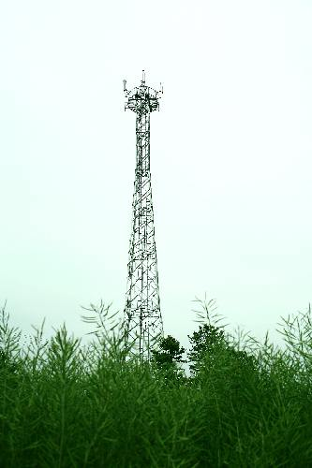
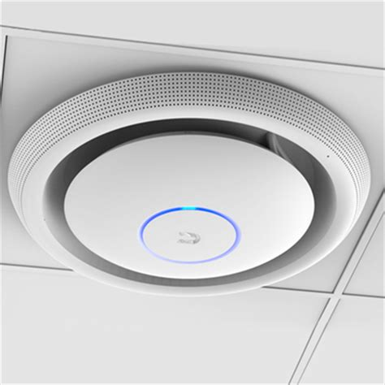
Elements of a wireless network
base station
typically connected to wired network
relay - responsible for sending packets between wired network and wireless host(s) in its “area”
  e.g., cell towers, 802.11 access points
network
infrastructure

Slide 9
Elements of a wireless network
wireless link
typically used to connect mobile(s) to base station
also used as backbone link
multiple access protocol coordinates link access
various data rates, transmission distance
network
infrastructure

Slide 10
Characteristics of wireless standards
1300
802.11 ac
5G
450
802.11n
54
802.11a,g
802.11a,g point-to-point
5-11
802.11b
4G: LTWE WIMAX
4
3G: UMTS/WCDMA-HSPDA, CDMA2000-1xEVDO
Data rate (Mbps)
1
802.15
.384
2.5G: UMTS/WCDMA, CDMA2000
.056
2G: IS-95, CDMA, GSM
Indoor
10-30m
Outdoor
50-200m
Mid-range
outdoor
200m – 4 Km
Long-range
outdoor
5Km – 20 Km

Slide 11
Modes of wireless network
infrastructure mode
base station connects mobiles into wired network
handoff: mobile changes base station providing connection into wired network
network
infrastructure

Slide 12
Modes of wireless network
ad hoc mode
no base stations
nodes can only transmit to other nodes within link coverage
nodes organize themselves into a network: route among themselves

Slide 13
Wireless network taxonomy
single hop
multiple hops
host connects to
base station (WiFi,
WiMAX, cellular)
which connects to
larger Internet
host may have to
relay through several
wireless nodes to
connect to larger
Internet: mesh net
infrastructure
(e.g., APs)
no base station, no
connection to larger
Internet. May have to
relay to reach other
a given wireless node
MANET, VANET
no
infrastructure
no base station, no
connection to larger
Internet (Bluetooth,
ad hoc nets)

Slide 14
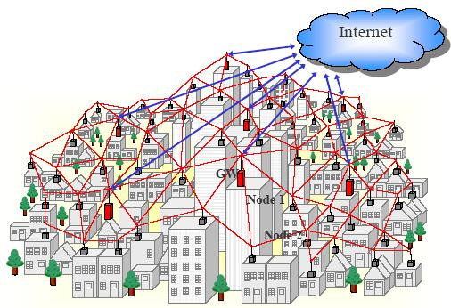
Mesh Networks

Slide 15
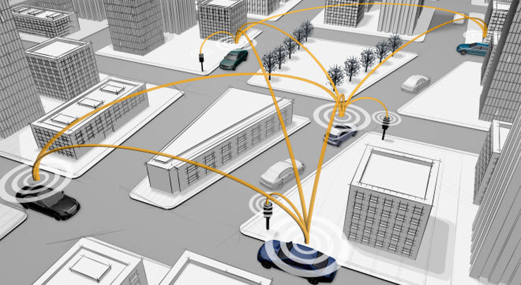
Vehicular Ad Hoc Networks (VANETs)
V2V
I2V
V2I

Slide 16
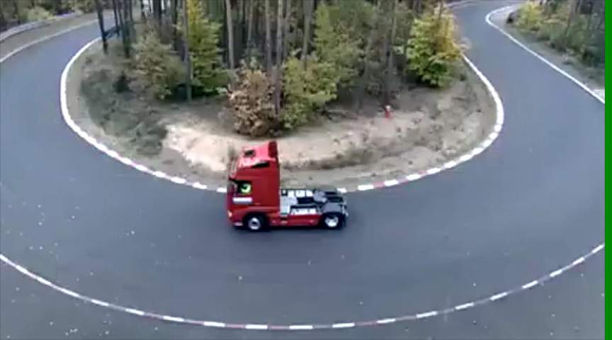
Why VANET?

Slide 17
Chapter 7 outline
7.1 Introduction
7.2 Wireless links and network characteristics
7.3 WiFi: 802.11 wireless LANs
7.4 Cellular Internet access
7.5 Mobility management: principles
7.6 Mobile IP
7.7 Handling mobility in cellular networks
7.8 Impact on higher-layer protocols

Slide 18
What are the main characteristics of wireless links, compared with wired links?

Slide 19
Wireless Link Characteristics (1)
Differences from wired link
  decreased signal strength: radio signal attenuates as it propagates through matter (path loss)
  interference from other sources: standardized wireless network frequencies (e.g., 2.4 GHz) shared by other devices (e.g., phone); devices (motors) interfere as well
  multipath propagation: radio signal reflects off objects ground, arriving ad destination at slightly different times
Thus, these differences make communication across (even a point to point) wireless link much more “difficult”

Slide 20
Wireless Link Characteristics (2)
10⁻¹
SNR: signal-to-noise ratio
  larger SNR – easier to extract signal from noise (a “good thing”)
SNR versus BER tradeoffs
  given physical layer: increase power -> increase SNR->decrease BER
  given SNR: choose physical layer that meets BER requirement, giving highest thruput
    SNR may change with mobility: dynamically adapt physical layer (modulation technique, rate)
10⁻²
10⁻³
BER
10⁻⁴
10⁻⁵
10⁻⁶
10⁻⁷
10
20
30
40
SNR(dB)
QAM256 (8 Mbps)
QAM16 (4 Mbps)
BPSK (1 Mbps)

Slide 21
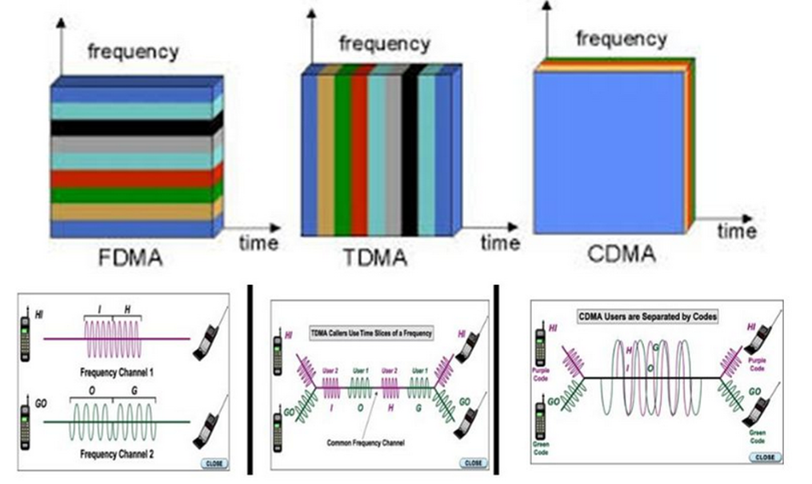
FDMA, TDMA, CDMA

Slide 22
Basic Idea of CDMA
Code Division Multiple Access (CDMA)
unique “code” assigned to each user; i.e., code set partitioning
all users share same frequency, but each user uses own code to encode data
A receiver uses the sender’s code to recover the sent bits
  encoded signal = (original data) X (chipping sequence)
  decoding: inner-product of encoded signal and chipping sequence

Slide 23
CDMA Encode/Decode: One Sender
Z_{i,m}= d_{i}.c_{m}
channel output Z_{i,m}
data
bits
d₀ = 1
1
1
1
1
1
d₁ = -1
1
1
1
-
-
-
-
1
-
-
-
1
-
1
1
1
1
1
sender
1
1
slot 1
channel
output
slot 0
channel
output
1
1
1
1
1
code
1
1
-
-
-
1
-
1
1
1
-
-
-
1
-
1
1
1
slot 1
slot 0
received
input
1
1
1
1
1
1
1
1
d₀ = 1
-
-
-
-
1
-
-
-
1
-
1
1
1
1
1
1
d₁ = -1
receiver
1
slot 1
channel
output
slot 0
channel
output
1
1
1
1
1
code
1
1
-
-
-
1
-
1
1
1
-
-
-
1
-
1
1
1
slot 1
slot 0
M
D_{i} = S Z_{i,m}.c_{m}
m=1
M

Slide 24
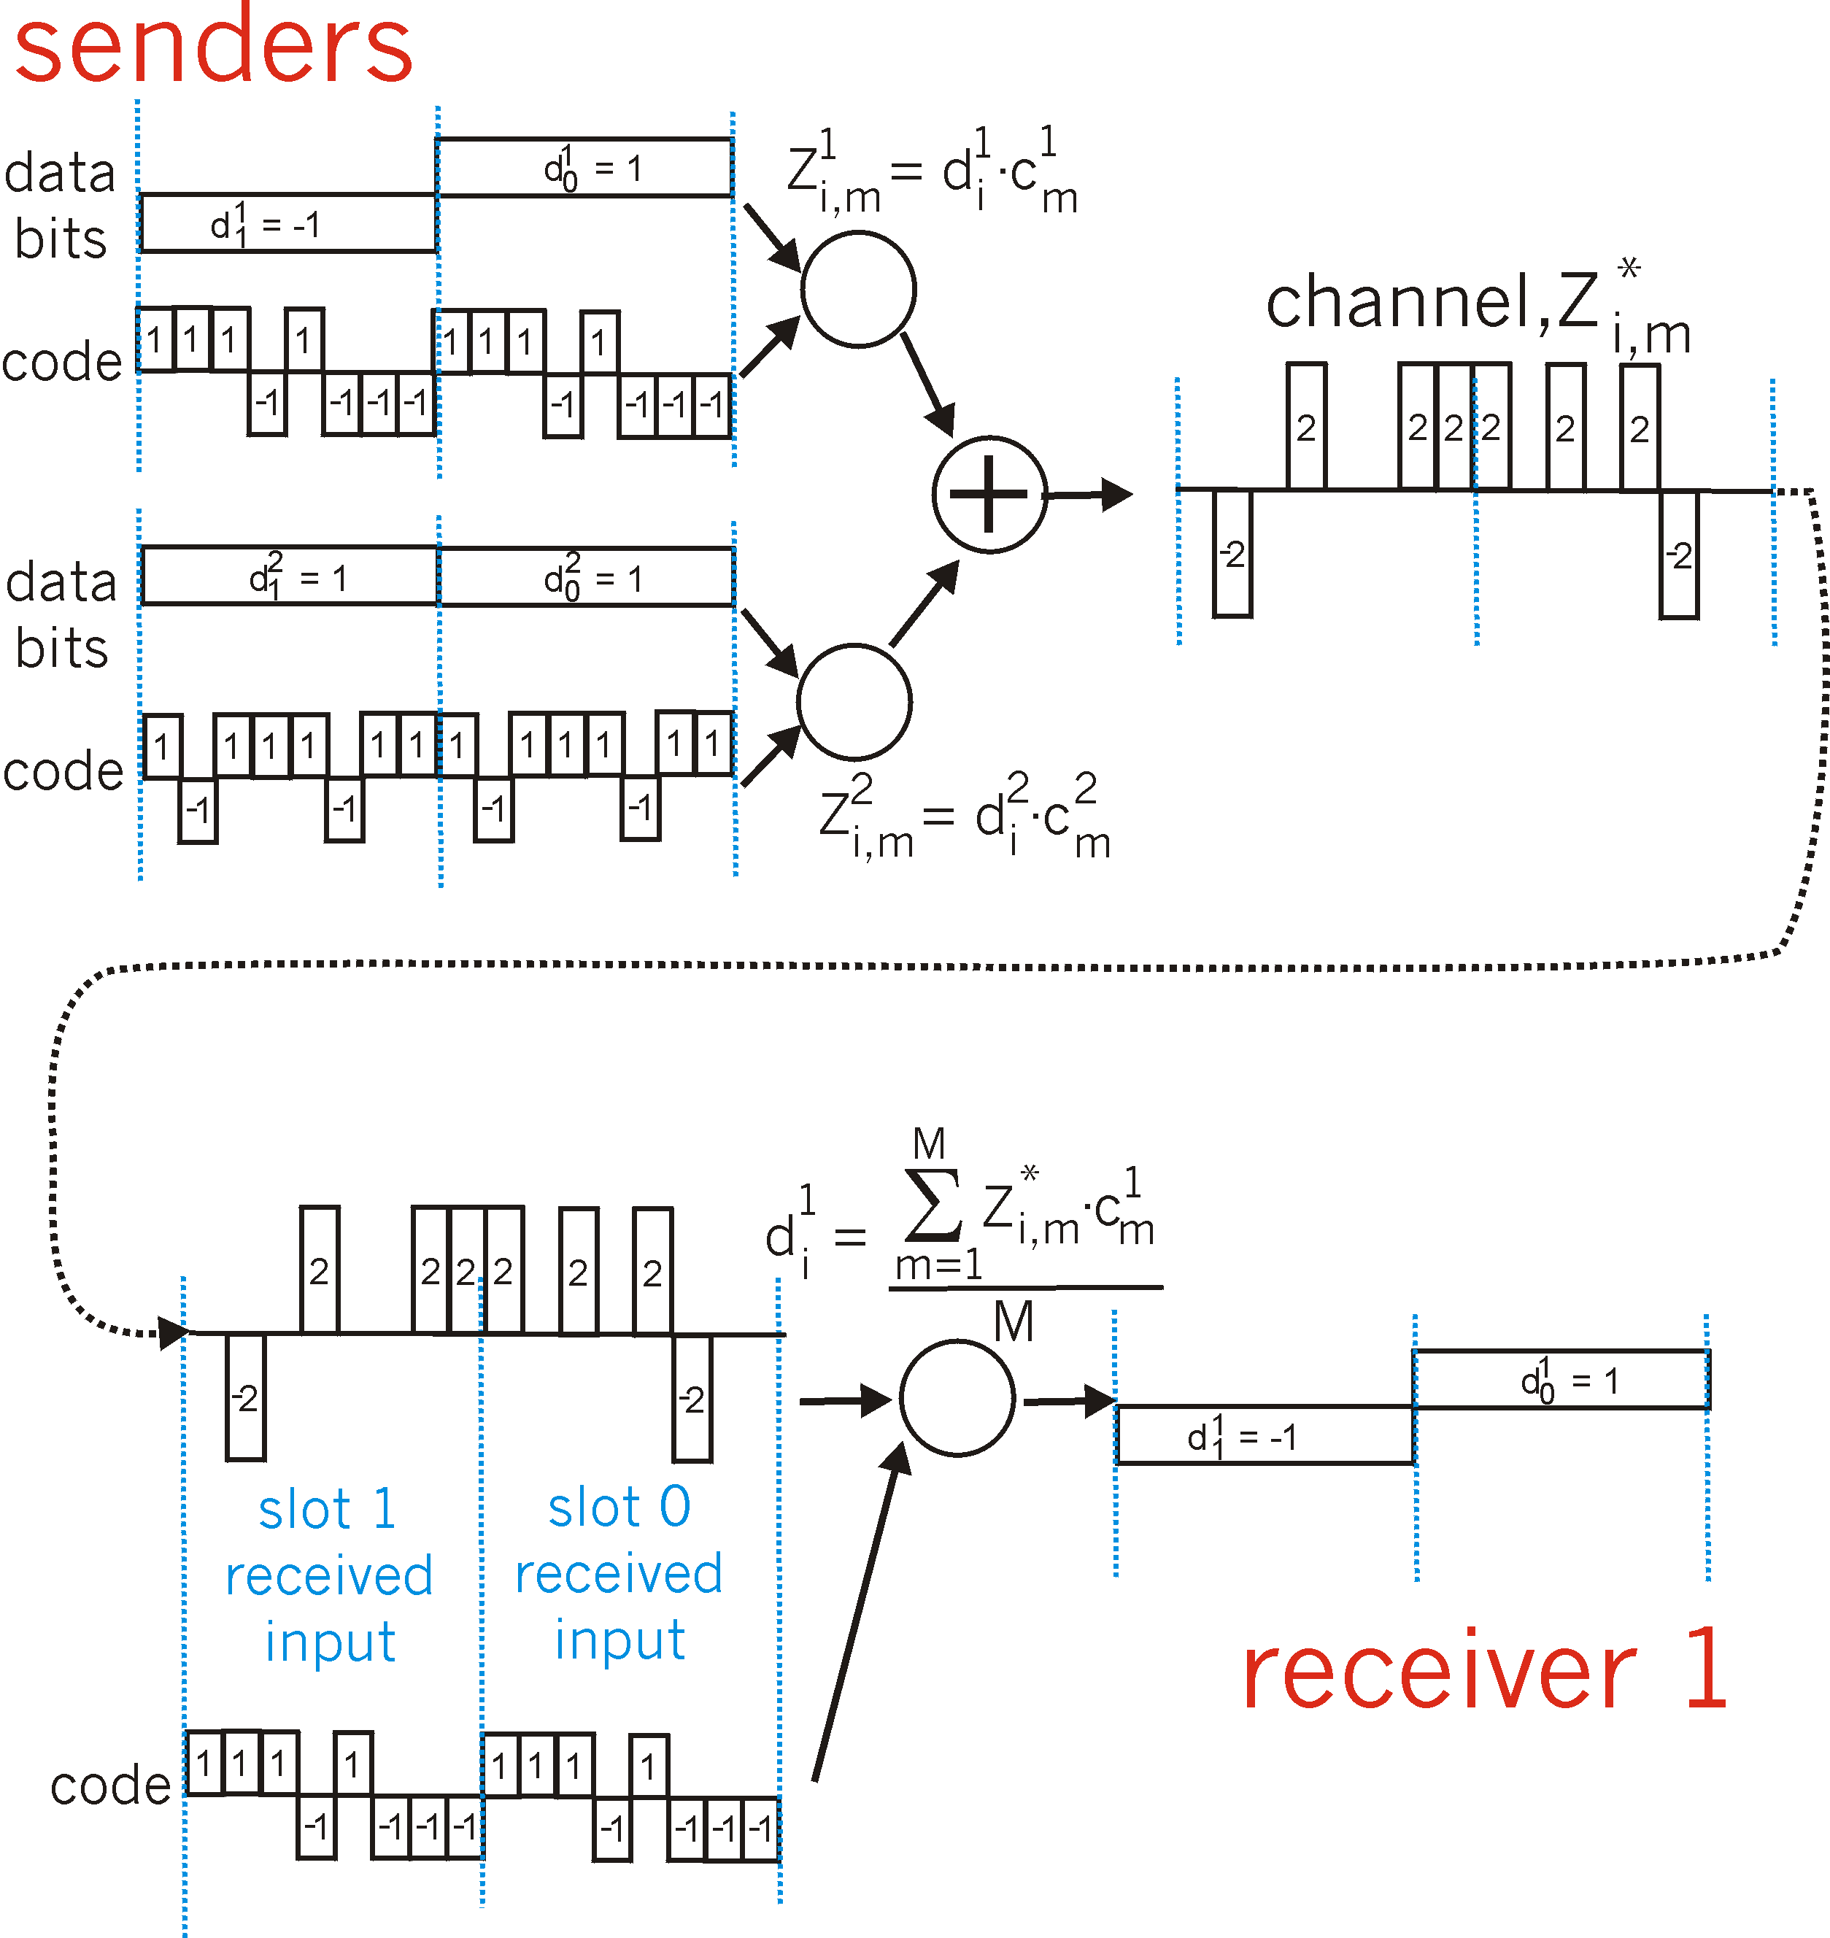
CDMA Encode/Decode: Tow Senders
0
1
A
B
1
1
0
1
Reception from A
Code of A

Slide 25

CDMA
What C transmits?
A
B
E
C
D
SCENARIO 1
SCENARIO 2
SCENARIO 3

Slide 26
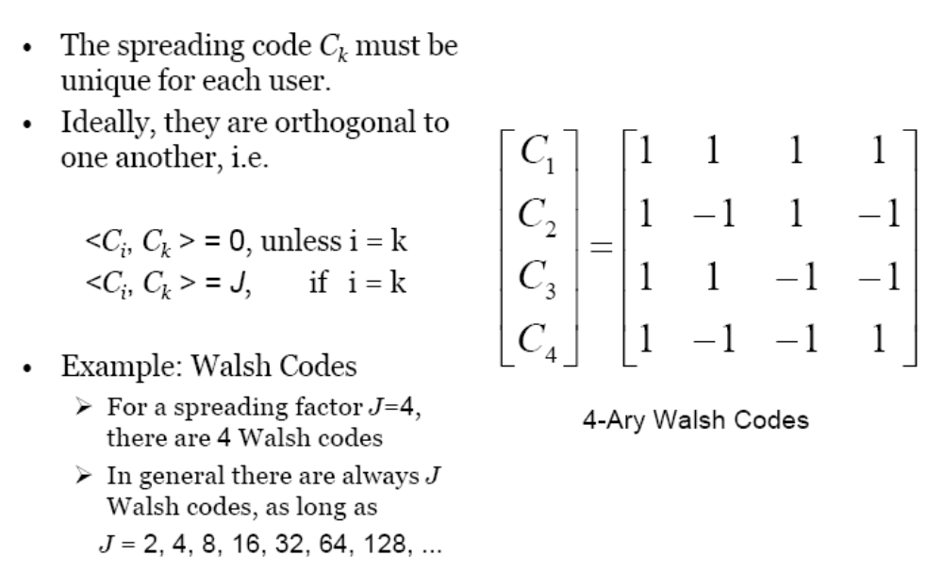
Codes

Slide 27
Who is the inventor of CDMA?

Slide 28
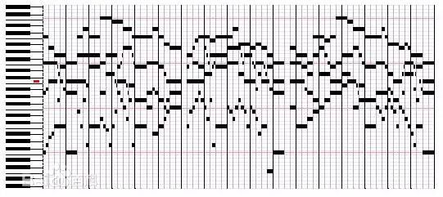

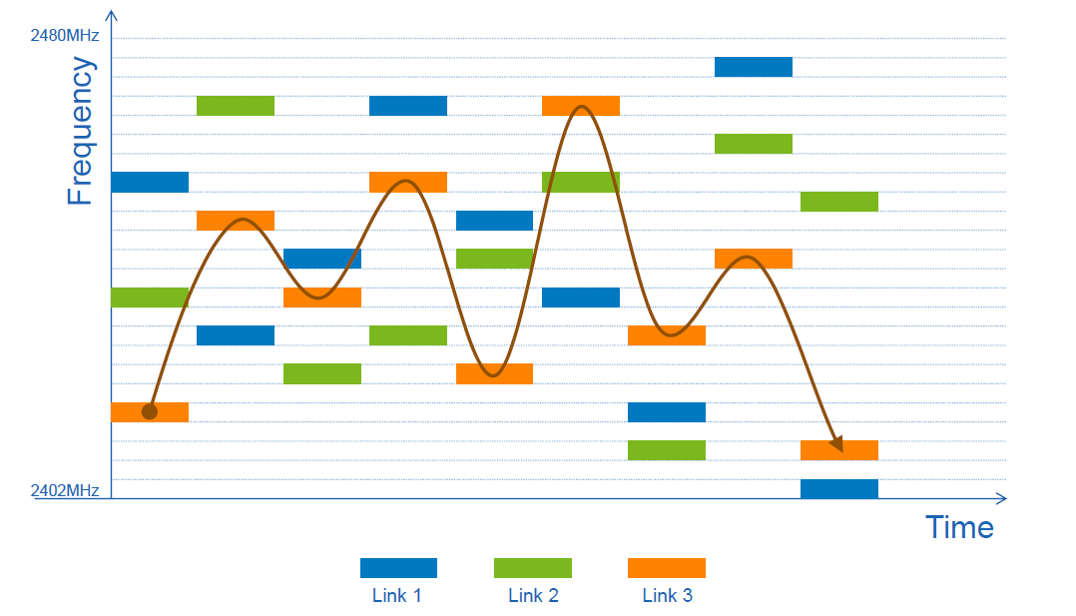
A note on Inventor
Hedy Lamarr
1941, Original for Torpedo
1914/11/9—2000/1/19
1985 QUALCOMM

Slide 29
Chapter 7 outline
7.1 Introduction
7.2 Wireless links and network characteristics
7.3 WiFi: 802.11 wireless LANs
7.4 Cellular Internet access
7.5 Mobility management: principles
7.6 Mobile IP
7.7 Handling mobility in cellular networks
7.8 Impact on higher-layer protocols

Slide 30
WLAN architecture
Wireless host communicates with base station
  base station = access point (AP)
Basic Service Set (BSS) (aka “cell”) in infrastructure mode contains:
  wireless hosts
  access point (AP): base station
  ad hoc mode: hosts only
Internet
switch
or router
AP
BSS 1
AP
BSS 2

Slide 31
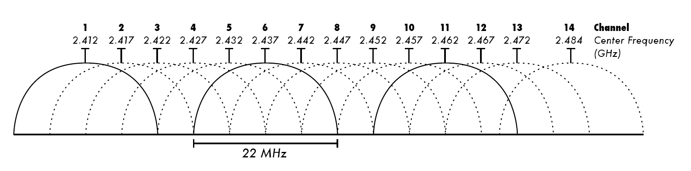
802.11b Channels
802.11b: 2.4GHz-2.485GHz spectrum divided into 11 channels at different frequencies
  AP admin chooses frequency for AP
  interference possible: channel can be same as that chosen by neighboring AP!
Question: what is the maximum throughput if you deploy multiple WiFi APs in a room?

Slide 32
Association before Transmission
Host: must associate with an AP
scans channels, listening for beacon frames containing AP’s name (SSID) and MAC address
selects AP to associate with
may perform authentication
will typically run DHCP to get IP address in AP’s subnet

Slide 33
Two types: passive/active scanning
BBS 1
BBS 2
BBS 1
BBS 2
AP 1
AP 2
AP 1
1
AP 2
1
1
2
2
2
3
3
4
H1
H1
Passive Scanning:
beacon frames sent from APs
association Request frame sent: H1 to selected AP
association Response frame sent: H1 to selected AP
Active Scanning:
Probe Request frame broadcast from H1
Probes response frame sent from APs
Association Request frame sent: H1 to selected AP
Association Response frame sent: H1 to selected AP

Slide 34
Multiple Access for Wireless Channel
AP
H1
H2
H3
CSMA may fail!
Why?

Slide 35
Due to Hidden Terminal Problem!
Comm. Range
A
B
C
A’s signal
strength
C’s signal
strength
A
B
C
space
Collision happen at B
time
A->B
A transmits
time
C->B
C transmits

Slide 36
Multiple access control protocol
AP
BSS
H1
H2
H3
avoid collisions: 2+ nodes transmitting at same time
CSMA - sense before transmitting
  don’t collide with ongoing transmission by other node

Slide 37
CSMA for 802.11
Protocol operations
Sense the channel
  If idle for DIFS, transmit entire frame (no CD), wait for ACK
  If busy
  - select random backoff interval
  - timer counts down while channel idle
  - transmit when timer expires
Wait for ACK
  If ACK received, done
  If no ACK, double contention window and re-select random backoff interval, repeat
sender
receiver
DIFS
data
SIFS
ACK

Slide 38
Why two different space intervals (i.e., DIFS and SIFS)?

Slide 39
WiFi CSMA vs Ethernet
What are the key differences?
(1) WiFi has ACK, since radio links are more error prone
(2) WiFi starts random backoff as soon as it senses a busy channel, why?
No collision detection, so more conservative!
But no collision detection, why?
Difficult to receive while transmitting
Anyway, cannot detect all collisions, due to hidden terminal problem

Slide 40
Idea of Avoiding Collisions
idea: allow sender to “reserve” channel rather than random access of data frames: avoid collisions of long data frames
sender first transmits small request-to-send (RTS) packets to BS using CSMA
  RTSs may still collide with each other (but they’re short)
BS broadcasts clear-to-send (CTS) in response to RTS
CTS heard by all nodes
  sender transmits data frame
  other stations defer transmissions
avoid data frame collisions completely
using small reservation packets!

Slide 41
RTS-CTS exchange
A
B
AP
RTS(A)
RTS(B)
RTS(A)
CTS(A)
CTS(A)
time
reservation collision
DATA (A)
defer
ACK(A)
ACK(A)

Slide 42
A few important design details:
When to decrement the counter, before or after DIFS?
When to freeze the backoff timer?

Slide 43
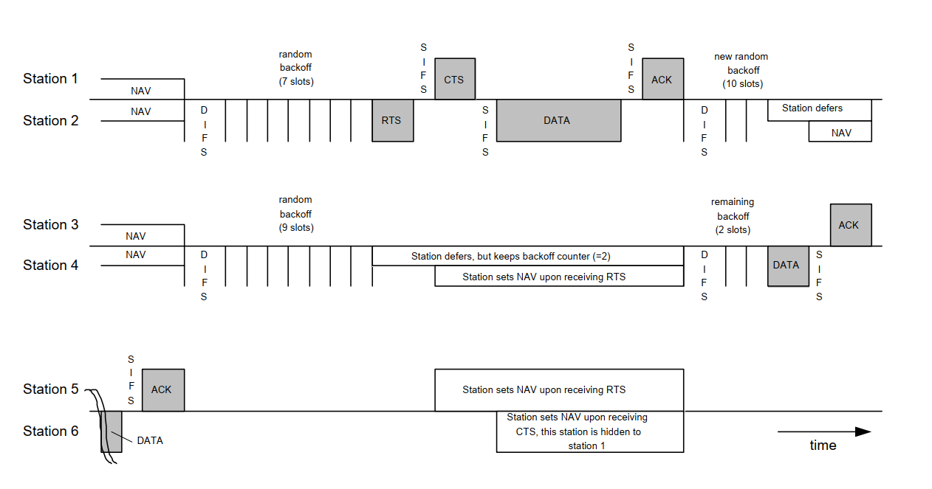
Timing of the 802.11
In this example, station 6 cannot detect the RTS frame of the transmitting station 2, but the CTS frame of station 1.

Slide 44
Two Animations
DEMO1
DEMO2

Slide 45
Three Modes of Service Sets
Mode 1:
Independent Basic Service Set (IBSS)
Independent Basic Service Set (IBSS) allows two or more devices to communicate directly with each other without a need for a central device
H1
H2
H3

Slide 46
Three Modes of Service Sets
Mode 2:
Basic Service Set (BSS)
All mobile devices do not communicate directly, instead through the access point (AP).
BSS
AP
H1
H2
H3

Slide 47
Three Modes of Service Sets
Mode 3:
Extended Service Set (ESS)
ESS is created by connecting multiple Basic Service Set (BSS) via a distribution system
switch
SSID: sameid
SSID: sameid
AP
AP
H3
H4
H1
H2
H5
BSS1
BSS2

Slide 48
802.11: mobility within same subnet
Good, but what about switching?
H1 remains in same IP subnet:
  IP address can remain same
switch: which AP is associated with H1?
  self-learning (Ch. 5): switch will see frame from H1 and “remember” which switch port can be used to reach H1
router
switch
BBS 1
AP 1
AP 2
H1
BBS 2

Slide 49
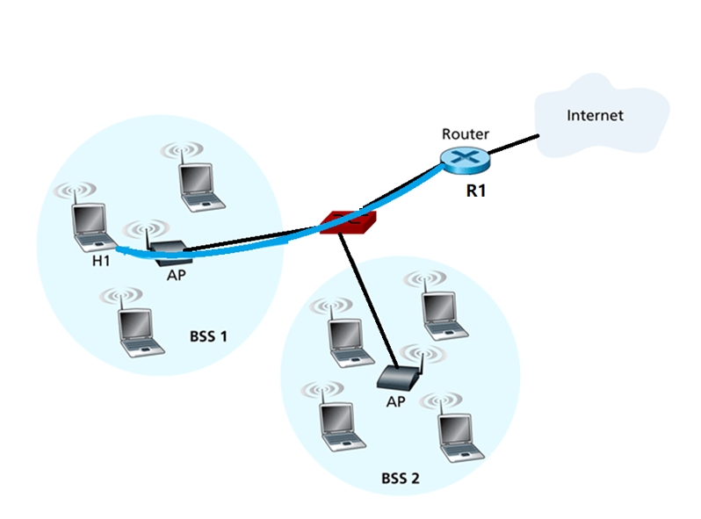

Sending Frames between H1 & A Remote Host
R1 not aware of existence of AP
Remote Host
Can we use Ethernet frame format for WLAN?
Note:
Two link-layer technologies
Notes:
Switch vs AP, switch 没有MAC地址，而AP是有MAC地址的。

Slide 50
802.11 frame: addressing
2
2
6
6
6
2
6
0 - 2312
4
frame
control
duration
address
1
address
2
address
3
seq
control
address
4
payload
CRC
Address 4: used only in ad hoc mode
Address 1: MAC address
of wireless host or AP
to receive this frame
Address 3: MAC address
of router interface to which AP is attached
Address 2: MAC address
of wireless host or AP
transmitting this frame

Slide 51
802.11 frame: addressing
Remote Host
R1 not aware of existence of AP
router
Internet
H1
R1
AP
H1 MAC addr R1 MAC addr
dest. address
source address
802.3 frame
H1 MAC addr AP MAC addr R1 MAC addr
Frame conversion
address 1
address 2
address 3
802.11 frame

Slide 52
802.11 frame: addressing
Remote Host
router
Internet
H1
R1
AP
R1 MAC addr H1 MAC addr
dest. address
source address
802.3 frame
AP MAC addr H1 MAC addr R1 MAC addr
Frame conversion
address 1
address 2
address 3
802.11 frame

Slide 53
What information should be included in 802.11b frame header?

Slide 54
802.11 frame: more
frame seq #
(for RDT)
duration of reserved
transmission time (RTS/CTS)
Byte
6
4
2
2
6
6
6
2
0 - 2312
frame
control
duration
address
1
address
2
address
3
seq
control
address
4
payload
CRC
Bit
2
2
4
1
1
1
1
1
1
1
1
Protocol
version
Type
Subtype
To
AP
From
AP
More
frag
Retry
Power
mgt
More
data
WEP
Rsvd
frame type
(RTS, CTS, ACK, data)

Slide 55
802.11: advanced capabilities
Rate Adaptation
base station, mobile dynamically change transmission rate (physical layer modulation technique) as mobile moves, SNR varies
10⁻¹
10⁻²
10⁻³
QAM256 (8 Mbps)
BER
10⁻⁴
QAM16 (4 Mbps)
BPSK (1 Mbps)
10⁻⁵
operating point
10⁻⁶
10⁻⁷
10
20
30
40
SNR(dB)
1. SNR decreases, BER increase as node moves away from base station
2. When BER becomes too high, switch to lower transmission rate but with lower BER

Slide 56
802.11: advanced capabilities
Power Management
node-to-AP: “I am going to sleep until next beacon frame”
  AP knows not to transmit frames to this node
  node wakes up before next beacon frame
beacon frame: contains list of mobiles with AP-to-mobile frames waiting to be sent
  node will stay awake if AP-to-mobile frames to be sent;
  otherwise sleep again until next beacon frame

Slide 57
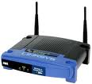

802.11: advanced capabilities
B
A
A
A, B
beacon
beacon
beacon
beacon
The beacon frame contains the list of hosts with pending frames to receive

Slide 58
IEEE 802.11 Wireless LAN
802.11b
  2.4-5 GHz unlicensed spectrum
  up to 11 Mbps
  direct sequence spread spectrum (DSSS) in physical layer
    all hosts use same chipping code
802.11a
  5-6 GHz range
  up to 54 Mbps
802.11g
  2.4-5 GHz range
  up to 54 Mbps
802.11n: multiple antennae
  2.4-5 GHz range
  up to 200 Mbps
  WIFI 5
802.11ax
  2.4-5 GHz range
  Up to 600 Mbps
  WIFI 6
all use CSMA/CA for multiple access
all have base-station and ad-hoc network versions

Slide 59
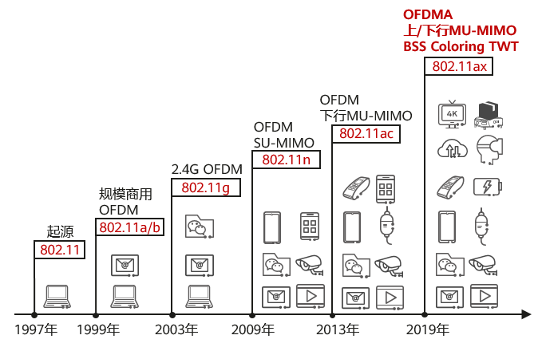
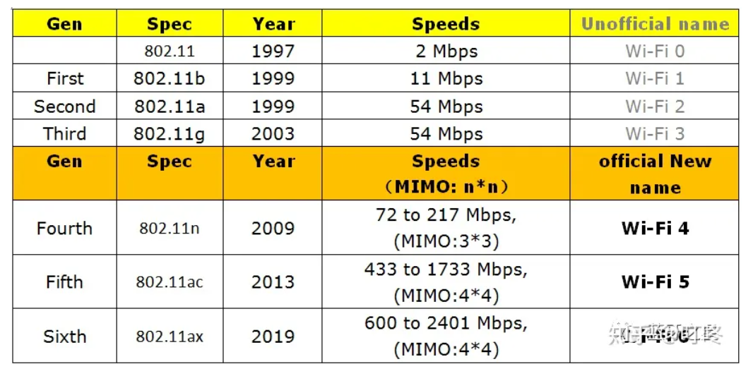
Wi-Fi Standards

Slide 60
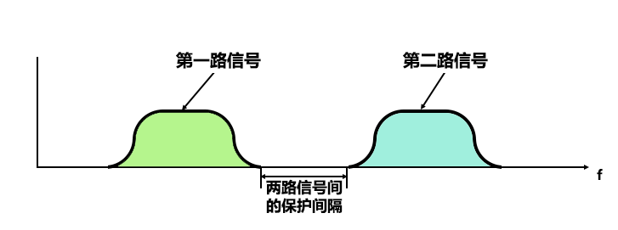
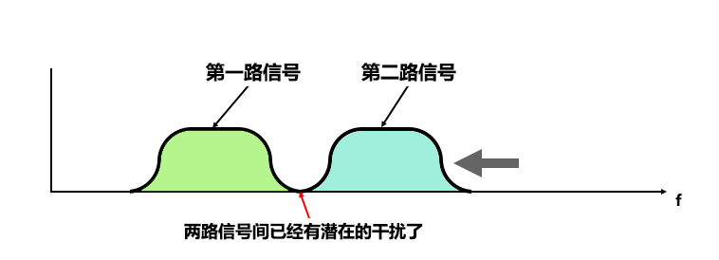
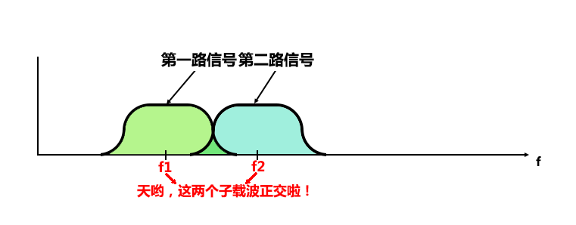
Brief Introduction to OFDM
FDM
OFDM
Physical Layer, to improve efficiency and robustness. Not Link layer tech. MAC still needed!
Notes:
OFDM 主要解决的是物理层的问题，通过频分复用来提高传输效率和抗干扰能力。

Slide 61
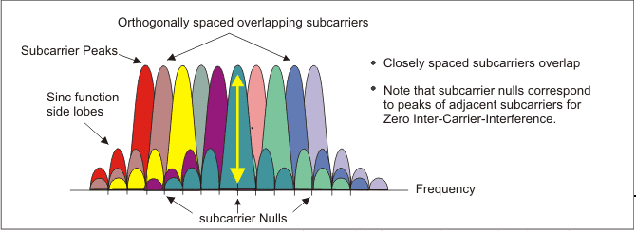
OFDM Signal Frequency Spectra

Slide 62
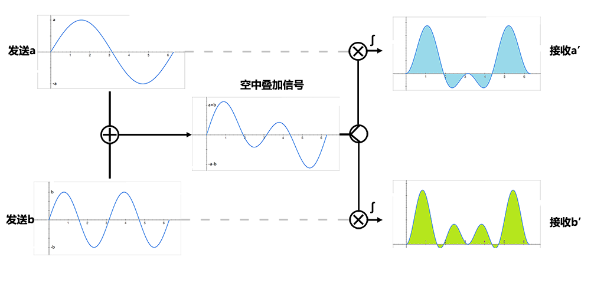
Basic Idea
Carrier 1: sin(t)
Carrier 2: sin(2t)
sin(t)和sin(2t)是正交的，因为sin(t)·sin(2t)在区间[0,2π]上的积分为0

Slide 63
Chapter 7 outline
7.1 Introduction
7.2 Wireless links and network characteristics
7.3 WiFi: 802.11 wireless LANs
7.4 Cellular Internet access
7.5 Mobility management: principles
7.6 Mobile IP
7.7 Handling mobility in cellular networks
7.8 Impact on higher-layer protocols

Slide 64
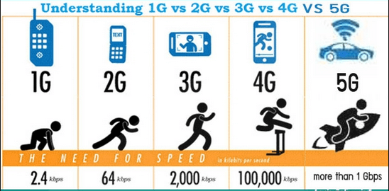
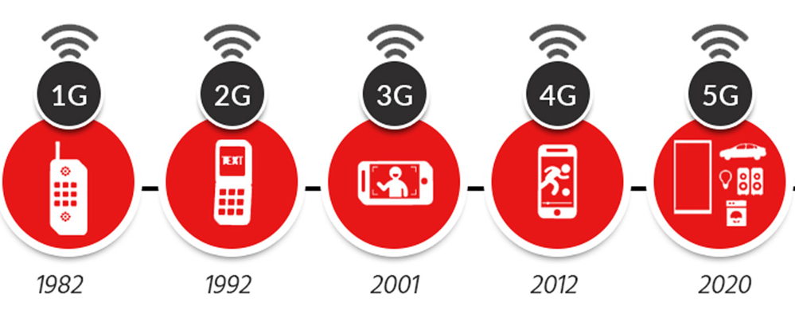
From 1G to 5G

Slide 65
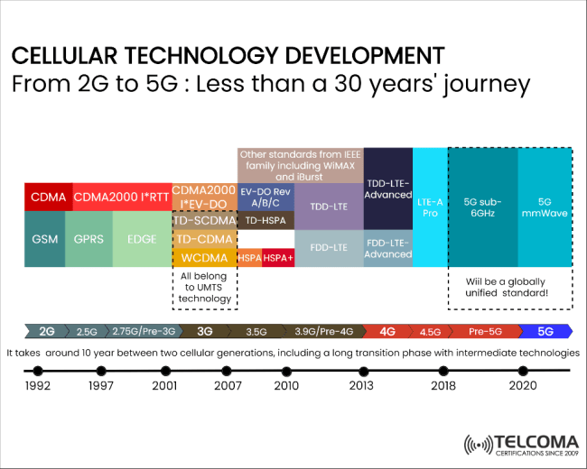
Development of cellular technology
Notes:
IMT 和 3GPP Release 版本的对应关系
IMT-2000
3GPP Release 99 到 Release 5
技术: WCDMA、HSPA（从 Release 5 开始引入 HSDPA）
特点: 这是第三代移动通信技术，支持语音、文本和基础数据服务。
IMT-Advanced
3GPP Release 8 和 Release 10
Release 8: 引入 LTE（Long Term Evolution）
Release 10: 引入 LTE-Advanced
特点: 这是第四代移动通信技术，提供更高的数据速率和更低的延迟。
IMT-2020
3GPP Release 15 和之后的版本
Release 15: 首个 5G NR 标准
Release 16: 进一步完善 5G，包括增强的 URLLC 和 mMTC
特点: 第五代移动通信技术，支持超高速数据传输、超低延迟、大规模设备连接。
关键点
Release 演进: 每个 Release 版本引入新的特性和改进，支持更高效的通信技术。
标准提交: 3GPP 的 Release 版本经过验证后，提交给 ITU 作为 IMT 标准的一部分。
全球一致性: 确保全球网络的互操作性和一致性，促进全球移动通信的发展。
这种对应关系确保了移动通信技术的全球统一性和持续演进。
ITU（国际电信联盟）和 3GPP（第三代合作伙伴计划）之间有着密切的合作关系，但它们的角色和职责有所不同。
ITU（国际电信联盟）
职责: ITU 是联合国的一个专门机构，负责全球电信和无线电频谱的协调和标准化。它制定全球通信标准，管理频谱分配，确保不同国家和地区的技术兼容性。
作用: 提供一个全球框架，确保各国在频谱使用和技术标准上协调一致。
3GPP（第三代合作伙伴计划）
职责: 3GPP 是一个行业组织，专注于移动通信技术标准的制定，如 GSM、UMTS、LTE 和 5G NR。它由多个标准制定机构组成，负责具体技术细节的开发和标准化。
作用: 制定具体的技术标准和规范，推动全球移动通信技术的发展。
关系
合作: 3GPP 制定的技术标准通常会提交给 ITU，后者将这些标准纳入其全球框架中。例如，3GPP 的 LTE 和 5G NR 标准被 ITU 采纳为 IMT（国际移动通信）标准的一部分。
互补性: ITU 提供宏观的政策和频谱管理框架，而 3GPP 负责具体技术的开发和细化，两者共同推动全球移动通信的协调发展。
3GPP2 没有与 3GPP 合并，而是逐渐淡出了主流移动通信标准的制定。3GPP2 主要负责开发 CDMA2000 系列标准，这些标准在北美和部分亚洲市场曾被广泛使用。然而，随着全球移动通信技术向 LTE 和 5G 发展的趋势，3GPP 的标准（如 LTE 和 5G NR）获得了更广泛的采用和支持。
因此，3GPP2 的影响力和市场份额逐渐减少，行业重心转向了 3GPP 制定的标准。许多运营商已经从 CDMA2000 网络迁移到 LTE 和 5G 网络，这也是 3GPP2 标准逐步淡出的原因之一。

Slide 66


Components of cellular network
MSC
connects cells to wired tel. net.
manages call setup (more later!)
handles mobility (more later!)
cell
covers geographical region
base station (BS) analogous to 802.11 AP
mobile users attach to network through BS
air-interface: physical and link layer protocol between mobile and BS
Mobile
Switching
Center
Public telephone
network
Mobile
Switching
Center
wired network

Slide 67
Cellular networks: the first hop
Two techniques for sharing mobile-to-BS radio spectrum
combined FDMA/TDMA: divide spectrum in frequency channels, divide each channel into time slots
CDMA: code division multiple access
time slots
frequency
bands

Slide 68
2G (voice) network architecture
Base station system (BSS)
MSC
BTS
BSC
G
Public
telephone
network
Gateway
MSC
Legend
Base transceiver station (BTS)
Base station controller (BSC)
Mobile Switching Center (MSC)
Mobile subscribers

Slide 69
3G (voice+data) network architecture
radio
network
controller
MSC
G
Public
telephone
network
Gateway
MSC
G
Public
Internet
Key insight: new cellular data
network operates in parallel
(except at edge) with existing
cellular voice network
voice network unchanged in core
data network operates in parallel
SGSN
GGSN
Serving GPRS Support Node (SGSN)
Gateway GPRS Support Node (GGSN)

Slide 70
3G (voice+data) network architecture
MSC
G
Public
telephone
network
Gateway
MSC
radio
network
controller
G
Public
Internet
SGSN
GGSN
radio interface
(WCDMA, HSPA)
radio access network
Universal Terrestrial Radio
Access Network (UTRAN)
core network
General Packet Radio Service
(GPRS) Core Network
public
Internet

Slide 71

4G: differences from 3G
all IP core: IP packets tunneled (through core IP network) from base station to gateway
no separation between voice and data – all traffic carried over IP core to gateway
Mobility
Management
Entity (MME)
Home Subscriber
Server(HSS)
(like HLR+VLR)
Serving
Gateway
(S-GW)
Packet data
network
Gateway
(P-GW)
UE
(user element)
eNodeB
(base station)
HSS
MME
control
G
G
Public
Internet
data
S-GW
P-GW
radio access network
Universal Terrestrial Radio
Access Network (UTRAN)
Evolved Packet Core
(EPC)

Slide 72
3G versus 4G LTE network architecture
MSC
G
Public
telephone
network
3G
radio
network
controller
Gateway
MSC
G
Public
Internet
SGSN
GGSN
4G-LTE
HSS
MME
G
G
Public
Internet
S-GW
P-GW
radio access network
Universal Terrestrial Radio
Access Network (UTRAN)
Evolved Packet Core
(EPC)

Slide 73
Chapter 7 outline
7.1 Introduction
7.2 Wireless links and network characteristics
7.3 WiFi: 802.11 wireless LANs
7.4 Cellular Internet access
7.5 Mobility management: principles
7.6 Mobile IP
7.7 Handling mobility in cellular networks
7.8 Impact on higher-layer protocols

Slide 74
What is mobility?
spectrum of mobility, from the network perspective:
no mobility
high mobility
mobile wireless user,
using same access
point
mobile user, connecting/ disconnecting from network using DHCP.
mobile user, passing through multiple access points while maintaining ongoing connections (like cell phone)
Notes:
Mobility 高还是低，跟要求（demand）有关系！

Slide 75
How do we support mobile Internet access?

Slide 76

Mobility: Vocabulary
home network: permanent “home” of mobile
(e.g., 128.119.40/24)
home agent: entity that will perform mobility functions on behalf of mobile, when mobile is remote
wide area network
Permanent address: address in home network, can always be used to reach mobile
e.g., 128.119.40.186
correspondent

Slide 77
Mobility: more vocabulary
visited network: network in which mobile currently resides (e.g., 79.129.13/24)
Permanent address: remains constant (e.g., 128.119.40.186)
Care-of-address: address in visited network.
(e.g., 79.129.13.2)
wide area network
foreign agent: entity in visited network that performs mobility functions on behalf of mobile.
correspondent: wants to communicate with mobile

Slide 78

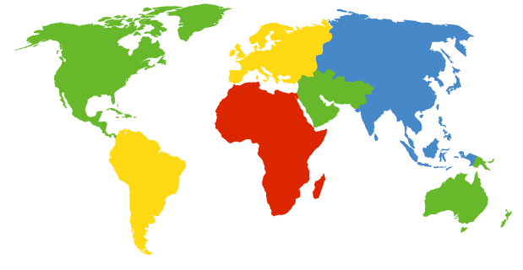

How do you contact a mobile friend?
Consider friend frequently changing addresses, how do you find her?
I wonder where Alice moved to?
search all phone books?
call her parents?
expect her to let you know where he/she is?

Slide 79
Mobility: approaches (1)
Let routing handle it (the network core approach):
routers advertise permanent address of mobile-nodes-in-residence via usual routing table exchange.
routing tables indicate where each mobile located
no changes to end-systems
not
scalable
to millions of
mobiles

Slide 80
Mobility: approaches (2)
let end-systems handle it:
indirect routing:
  communication from correspondent to mobile goes through home agent, then forwarded to remote
direct routing:
  correspondent gets foreign address of mobile, sends directly to mobile

Slide 81
Mobility: registration
visited network
home network
1
2
wide area network
mobile contacts foreign agent on entering visited network
foreign agent contacts home agent home: “this mobile is resident in my network”
Eventually:
Foreign agent knows about mobile
Home agent knows location of mobile

Slide 82
Mobility via Indirect Routing
home agent intercepts packets, forwards to foreign agent
foreign agent receives packets, forwards to mobile
visited
network
home
network
3
wide area network
2
1
correspondent addresses packets using home address of mobile
4
mobile replies directly to correspondent

Slide 83
Indirect Routing
Mobile uses two addresses:
  permanent address: used by correspondent (hence mobile location is transparent to correspondent)
  care-of-address: used by home agent to forward datagrams to mobile
foreign agent functions may be done by mobile itself

Slide 84
Can a mobile move to another network?
suppose mobile user moves to another network
  1) registers with new foreign agent
  2) new foreign agent registers with home agent
  3) home agent update care-of-address for mobile
  4) packets continue to be forwarded to mobile (but with new care-of-address)
mobility, changing foreign networks transparent: ongoing connections can be maintained!

Slide 85
Indirect routing, any problem?
triangle routing problem: correspondent-home-network-mobile
  inefficient when correspondent, mobile are in same network

Slide 86
Mobility via Direct Routing
foreign agent receives packets, forwards to mobile
correspondent forwards to foreign agent
visited
network
home
network
4
wide area network
2
3
correspondent requests, receives foreign address of mobile
1
4
mobile replies directly to correspondent

Slide 87
Mobility via Direct Routing: comments
overcome triangle routing problem
non-transparent to correspondent: correspondent must get care-of-address from home agent
  what if mobile changes visited network?

Slide 88
Any new problem arise?
new
foreign
network
new foreign
agent

Slide 89
Accommodating mobility with direct routing
anchor foreign agent: FA in first visited network
data always routed first to anchor FA
when mobile moves: new FA arranges to have data forwarded from old FA
foreign net visited
at session start
anchor
foreign
agent
wide area network
2
1
4
5
3
new
foreign
network
correspondent
agent
new foreign
agent
correspondent
Correspondent just has the IP address at the beginning (1st take-care-off add)

Slide 90
Chapter 7 outline
7.1 Introduction
7.2 Wireless links and network characteristics
7.3 WiFi: 802.11 wireless LANs
7.4 Cellular Internet access
7.5 Mobility management: principles
7.6 Mobile IP
7.7 Handling mobility in cellular networks
7.8 Impact on higher-layer protocols

Slide 91
Mobile IP
RFC 3344
has many features we’ve seen:
  home agents, foreign agents, foreign-agent registration, care-of-addresses, encapsulation (packet-within-a-packet)
three components to standard:
  indirect routing of datagrams
  agent discovery
  registration with home agent

Slide 92
Mobile IP: indirect routing
foreign-agent-to-mobile packet
packet sent by home agent to foreign agent: a packet within a packet
dest: 128.119.40.186
dest: 79.129.13.2
dest: 128.119.40.186
Permanent address: 128.119.40.186
Care-of address: 79.129.13.2
dest: 128.119.40.186
packet sent by correspondent

Slide 93
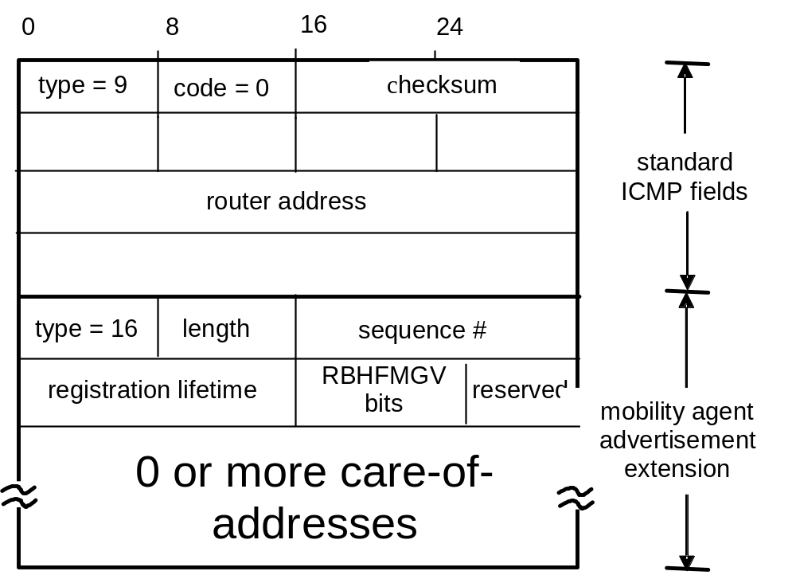
Mobile IP: agent discovery
agent advertisement: foreign/home agents advertise service by broadcasting ICMP messages (typefield = 9)
H,F bits: home and/or foreign agent
R bit: registration required

Slide 94
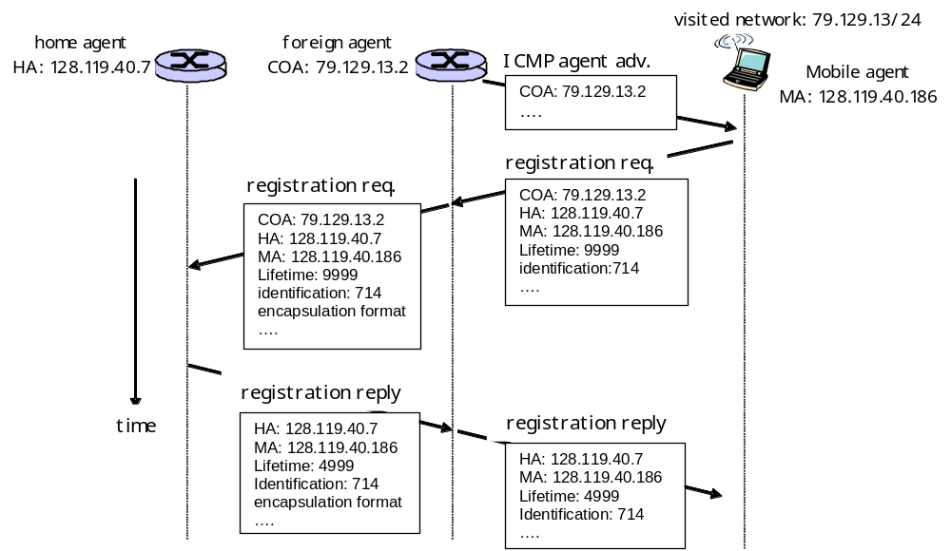
Mobile IP: registration example

Slide 95
Chapter 7 outline
7.1 Introduction
7.2 Wireless links and network characteristics
7.3 WiFi: 802.11 wireless LANs
7.4 Cellular Internet access
7.5 Mobility management: principles
7.6 Mobile IP
7.7 Handling mobility in cellular networks
7.8 Impact on higher-layer protocols

Slide 96

Components of cellular network
recall:
correspondent
wired public telephone
network
MSC
MSC
MSC
MSC
MSC
different cellular networks,
operated by different providers

Slide 97
Handling mobility in cellular networks
home network: network of cellular provider you subscribe to (e.g., Sprint PCS, Verizon)
  home location register (HLR): database in home network containing
    permanent cell phone #,
    profile information (services, preferences, billing),
    information about current location (could be in another network)
visited network: network in which mobile currently resides
  visitor location register (VLR): database with entry for each user currently in network
  could be home network

Slide 98
GSM: indirect routing to mobile
HLR
home
network
2
correspondent
home
Mobile
Switching
Center
home MSC consults HLR,
gets roaming number of
mobile in visited network
1
call routed
to home network
3
Public switched
telephone
network
VLR
Mobile
Switching
Center
4
home MSC sets up 2nd leg of call
to MSC in visited network
mobile
user
MSC in visited network completes
call through base station to mobile
visited
network

Slide 99
GSM: handoff with common MSC
Handoff goal: route call via new base station (without interruption)
reasons for handoff:
  stronger signal to/from new BSS (continuing connectivity, less battery drain)
  load balance: free up channel in current BSS
  GSM doesn’t mandate why to perform handoff (policy), only how (mechanism)
handoff initiated by old BSS
VLR
Mobile
Switching
Center
old
routing
new
routing
old BSS
new BSS

Slide 100
GSM: handoff with common MSC
1. old BSS informs MSC of impending handoff, provides list of 1⁺ new BSSs
2. MSC sets up path (allocates resources) to new BSS
3. new BSS allocates radio channel for use by mobile
4. new BSS signals MSC, old BSS: ready
5. old BSS tells mobile: perform handoff to new BSS
7. mobile, new BSS signal to activate new channel
8. mobile signals via new BSS to MSC: handoff complete. MSC reroutes call
9. MSC-old-BSS resources released
VLR
Mobile
Switching
Center
4
2
1
8
7
3
old BSS
5
6
new BSS

Slide 101
GSM: handoff between MSCs
anchor MSC: first MSC visited during call
  call remains routed through anchor MSC
new MSCs add on to end of MSC chain as mobile moves to new MSC
IS-41 allows optional path minimization step to shorten multi-MSC chain
home network
correspondent
Home MSC
anchor MSC
PSTN
MSC
MSC
MSC
(a) before handoff

Slide 102
GSM: handoff between MSCs
anchor MSC: first MSC visited during call
  call remains routed through anchor MSC
new MSCs add on to end of MSC chain as mobile moves to new MSC
IS-41 allows optional path minimization step to shorten multi-MSC chain
home network
correspondent
Home MSC
anchor MSC
PSTN
MSC
MSC
MSC
(b) after handoff

Slide 103
Mobility: GSM versus Mobile IP
GSM element |  | Comment on GSM element | Mobile IP element
Home system | Network to which mobile user’s permanent phone number belongs |  |  | Home network
Gateway Mobile Switching Center, or “home MSC”. Home Location Register (HLR) | Home MSC: point of contact to obtain routable address of mobile user. HLR: database in home system containing permanent phone number, profile information, current location of mobile user, subscription information |  |  | Home agent
Visited System | Network other than home system where mobile user is currently residing |  |  | Visited network
Visited Mobile services Switching Center. Visitor Location Record (VLR) | Visited MSC: responsible for setting up calls to/from mobile nodes in cells associated with MSC. VLR: temporary database entry in visited system, containing subscription information for each visiting mobile user |  |  | Foreign agent
Mobile Station Roaming Number (MSRN), or “roaming number” | Routable address for telephone call segment between home MSC and visited MSC, visible to neither the mobile nor the correspondent. |  |  | Care-of-address

Slide 104
Chapter 7 outline
7.1 Introduction
7.2 Wireless links and network characteristics
7.3 WiFi: 802.11 wireless LANs
7.4 Cellular Internet access
7.5 Mobility management: principles
7.6 Mobile IP
7.7 Handling mobility in cellular networks
7.8 Impact on higher-layer protocols

Slide 105
What is the impact of wireless links and mobility on high layer protocols?

Slide 106
Wireless, mobility: impact on higher layer protocols
logically, impact should be minimal …
  best effort service model remains unchanged
  TCP and UDP can (and do) run over wireless, mobile
but performance-wise:
  packet loss/delay due to bit-errors (discarded packets, delays for link-layer retransmissions), and handoff
  TCP interprets loss as congestion, will decrease congestion window un-necessarily
  delay impairments for real-time traffic
  limited bandwidth of wireless links

Slide 107
Chapter 7 summary
Wireless
wireless links:
  capacity, distance
  channel impairments
  CDMA
IEEE 802.11 (“Wi-Fi”)
  CSMA/CA reflects wireless channel characteristics
cellular access
  architecture
  standards (e.g., GSM, 3G, 4G LTE)
Mobility
principles: addressing, routing to mobile users
  home, visited networks
  direct, indirect routing
  care-of-addresses
case studies
  mobile IP
  mobility in GSM
impact on higher-layer protocols

