Slide 1
Chapter 8:
Network Security
Yanmin Zhu
School of Computers

Slide 2
What are top cyber attacks?

Slide 3
10 Most Common Types of Cyber Attacks
Malware
Denial-of-Service (DoS) Attacks
Phishing（钓鱼）
Spoofing
Identity-Based Attacks
Code Injection Attacks
Supply Chain Attacks
Insider Threats
DNS Tunneling
IoT-Based Attacks
Notes:
DNS隧道（DNS Tunneling）是一种网络技术，它利用DNS协议来传输非DNS流量，通常用于数据泄露、绕过网络安全设备、或在受限网络中访问互联网。这种技术可以用于合法和非法目的。下面我将介绍如何实现DNS隧道，以及如何防范此类攻击。
DNS隧道的工作原理
DNS隧道利用DNS查询和响应来携带额外的数据。由于DNS请求通常允许通过大多数网络防火墙和过滤器，因此攻击者或用户可以利用这一点来传输数据。
钓鱼攻击（Phishing Attacks）：这是一种常见的基于身份的攻击形式。黑客通常会发送伪装成合法组织（如银行、电子邮件提供商）的电子邮件或信息，诱使受害者点击恶意链接或提供个人信息（如用户名、密码），以获取其身份信息。
Identity-Based Attacks（基于身份的攻击）是指黑客利用受害者的身份信息或者身份验证凭据来实施攻击的一种攻击形式。这种攻击方式通常涉及盗取、伪造或滥用受害者的身份信息，以获取未授权的访问或执行恶意操作。身份盗窃（Identity Theft）：黑客可能通过各种方式获取受害者的个人身份信息，如姓名、地址、社保号码等，然后利用这些信息进行欺诈活动、金融诈骗或其他恶意行为。

Slide 4
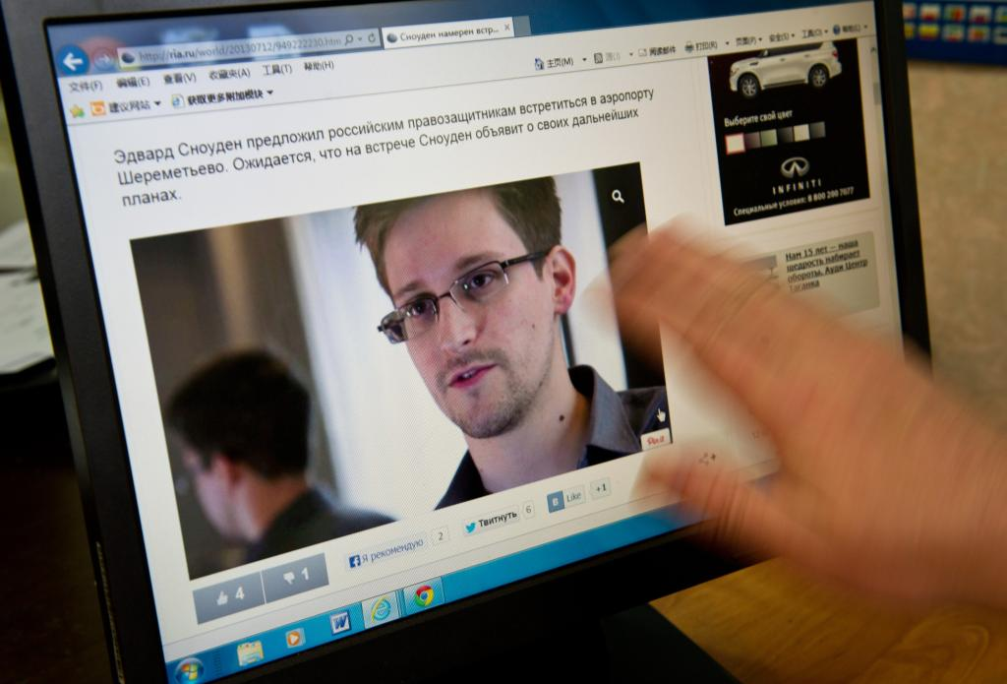
美国“黑客帝国”
2013年，美国前防务承包商雇员爱德华·斯诺登向媒体曝光了美方代号“棱镜”的大规模窃听项目，其对象不仅覆盖美国公民，也包括法国、德国等欧洲国家的政要和民众。前英国《卫报》记者格伦·格林沃尔德在讲述斯诺登事件的《无处藏身》一书中列举了一组数据：美国国家安全局曾在30天内远程窃取970亿封邮件和1240亿条电话数据，其中包括德国的5亿份等

Slide 5
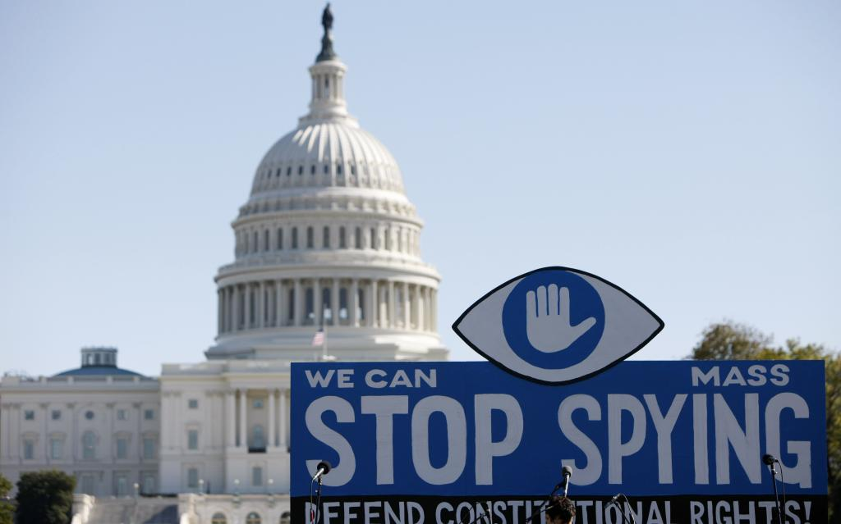
美国“黑客帝国”
2015年“维基揭秘”网站爆料，美国国家安全局曾在希拉克、萨科齐和奥朗德担任法国总统期间对其实施窃听。同年，该网站曝光美方针对日本的大规模窃听项目“目标东京”，对象涉及日本内阁府、经济产业省、财务省、央行等。

Slide 6
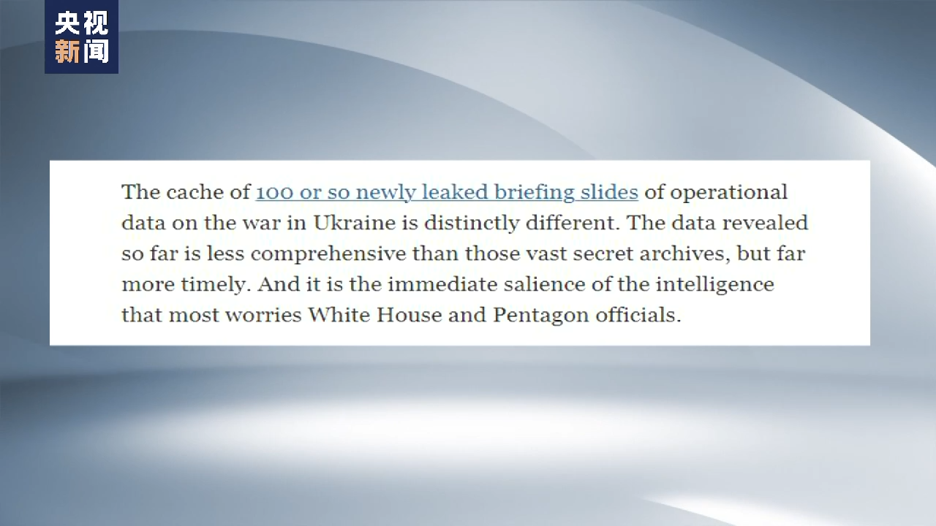
美国“黑客帝国”
美军秘密文件出现在社交媒体上，内容涉及俄乌冲突等各方面情报，还暴露了美方对联合国秘书长古特雷斯以及韩国、以色列、乌克兰等盟友的窃听行动。

Slide 7
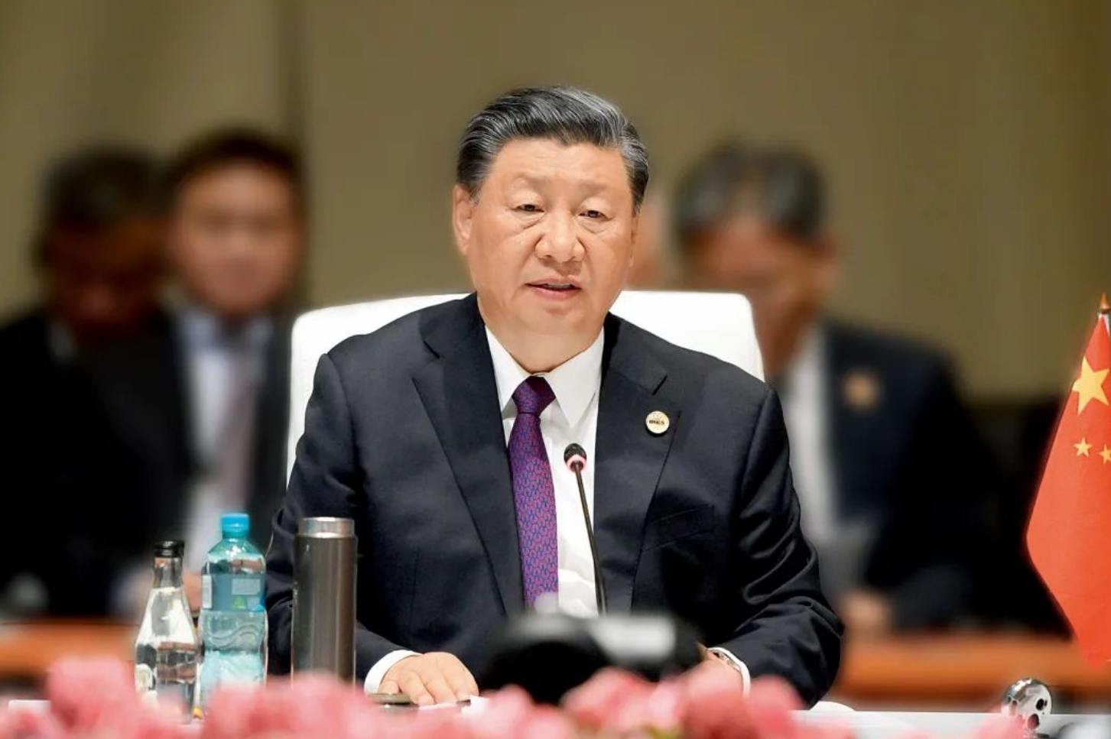
没有网络安全就没有国家安全！
时代大势，新一轮科技革命和产业变革方兴未艾，信息化、数字化正在重新绘制世界权力图谱，每一次重大技术变革都给国家安全带来新的挑战，网络安全已经成为大国博弈的重要领域。
总书记强调：“没有网络安全就没有国家安全。”“网络安全和信息化是一体之两翼、驱动之双轮，必须统一谋划、统一部署、统一推进、统一实施。”

Slide 8
What are the desirable properties of secure communications?
What security risks do you find in layer 5 to layer 1?
What is your own idea for achieving confidentiality, integrity, end-to-end authentication, etc? What is a good cipher?
How do you secure email, TCP and IP?
Notes:
加密 和 消息HASH，是很不同的操作。
加密：确保消息不被他人理解
HASH：确定消息是否被更改过

Slide 9
Chapter 8: Chapter goals:
understand principles of network security:
  cryptography and its many uses beyond "confidentiality"
  authentication
  message integrity
security in practice:
  firewalls and intrusion detection systems
  security in application, transport, network, link layers

Slide 10
Chapter 8 roadmap
8.1 What is network security?
8.2 Principles of cryptography
8.3 Message integrity and digital signature
8.4 End-to-end authentication
8.5 Securing e-mail
8.6 Securing TCP connections: SSL
8.7 Network layer security: IPsec & VPN
8.8 Securing wireless LANs
8.9 Operational security: firewalls and IDS

Slide 11
Chapter 8 roadmap
8.1 What is network security?
8.2 Principles of cryptography
8.3 Message integrity and digital signature
8.4 End-to-end authentication
8.5 Securing e-mail
8.6 Securing TCP connections: SSL
8.7 Network layer security: IPsec & VPN
8.8 Securing wireless LANs
8.9 Operational security: firewalls and IDS

Slide 12
Desirable properties of secure communications
confidentiality: only sender, intended receiver should "understand" message contents
  sender encrypts message
  receiver decrypts message
message integrity: sender, receiver want to ensure message not altered (in transit, or afterwards) without detection
end-to-end authentication: sender, receiver want to confirm identity of each other
operational security: services must be accessible and available to users

Slide 13



Alice, Bob, Trudy
well-known in network security world
Bob, Alice (lovers!) want to communicate "securely"
Alice
Bob
channel
data, control messages
data
secure
sender
secure
receiver
data
Trudy

Slide 14
What can a bad guy do to an ongoing communication?

Slide 15
What do bad guys do?
eavesdrop: intercept messages
actively insert messages into connection
modify messages
delete messages

Slide 16
Possible Attacks
snooping: stealing passwords or information
impersonation: can fake (spoof) source address in packet (or any field in packet)
hijacking: "take over" ongoing connection by removing sender or receiver, inserting himself in place
denial of service: prevent service from being used by others (e.g., by overloading resources)

Slide 17
Who might Bob, Alice be?
well, real-life Bobs and Alices!
Web browser/server for electronic transactions (e.g., on-line purchases)
on-line banking client/server
DNS servers
routers exchanging routing table updates
other examples?

Slide 18
Chapter 8 roadmap
8.1 What is network security?
8.2 Principles of cryptography
8.3 Message integrity and digital signature
8.4 End-to-end authentication
8.5 Securing e-mail
8.6 Securing TCP connections: SSL
8.7 Network layer security: IPsec & VPN
8.8 Securing wireless LANs
8.9 Operational security: firewalls and IDS

Slide 19



The language of cryptography
Alice's
encryption
key
Bob's
decryption
key
K
K
A
B
plaintext
encryption
algorithm
ciphertext
decryption
algorithm
plaintext
m plaintext message
K_{A}(m) ciphertext, encrypted with key K_{A}
m = K_{B}(K_{A}(m))

Slide 20
Getting started: Caesar cipher
Substituting a letter with the letter that is k letters later (e.g., k=3)
e.g.:
Plaintext: bob. i love you. alice
ciphertext: ere, I oryh brx. dolfh
Encryption key: value of k
Only 25 possible keys!

Slide 21
Monoalphabetic cipher
  Idea: substitute one letter for another
abcdefghijklmnopqrstuvwxyz
Substitute
mapping
mnbvcxzasdfghjklpoiuytrewq
e.g.,:
Plaintext: bob. i love you. alice
ciphertext: nkn. s gktc wky. mgsbc
Notes:
单一字母替换方法

Slide 22
How do you break this cipher?
How many possible keys?

Slide 23
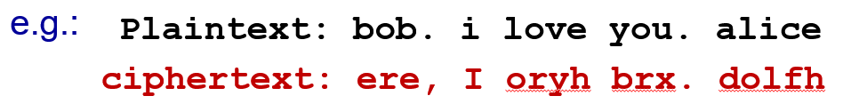
Breaking an encryption scheme
cipher-text only attack: Trudy has ciphertext she can analyze
known-plaintext attack: Trudy knows some of the (plaintext, ciphertext) pairings
  E.g., bob and alice must be in plaintext, then Trudy determines the two pairings (bob, ere) and (alice, dolfh)
chosen-plaintext attack: Trudy is able to choose the plaintext message and obtain its corresponding ciphertext

Slide 24
Frequency analysis attack
Basic idea
Statistical analysis of the plaintext language is useful
e.g., e and t are most occurring letters, (13% and 9%, respectively)
Some letters appear quite often together
e.g., in, it, the

Slide 25
Classification of cryptography systems
K_{A}=K_{B}
symmetric key systems
K_{A}≠K_{B}
public key systems

Slide 26
Symmetric key cryptography
The same key
K
K
S
S
plaintext
message, m
encryption
algorithm
ciphertext
decryption
algorithm
plaintext
K_{s} (m)
m = K_{s}(K_{s}(m))
symmetric key crypto: Bob and Alice share same (symmetric) key: K
e.g., key is knowing substitution pattern in mono alphabetic substitution cipher
Q: how do Bob and Alice agree on key value?

Slide 27
Block cipher: concept
In a block cipher, the message to be encrypted is processed in blocks of k bits (e.g., k=3)
101010101
Being divided into blocks
101
010
101
3 blocks
Encrypting each block
111
110
111

Slide 28
How do we encrypt a block?

Slide 29
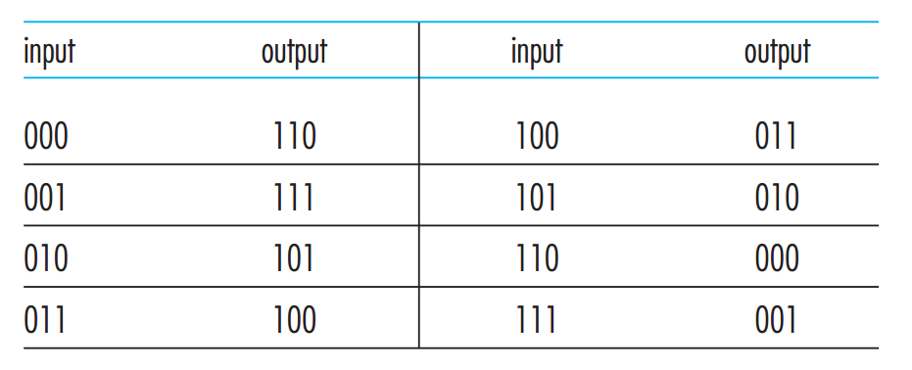
3-bit block cipher
What is a key to this cipher?
Question: How many possible keys?
Notes:
Each of the 8! mappings (a bijection function 双射函数) is a key.

Slide 30
If we use a 64-bit block cipher, what challenge is facing us?
Notes:
Cipher 密码（密码算法）， Key 秘钥

Slide 31
64-bit block cipher
key
Input | output
000…0000 (64 pits) | 000…0101 (64 pits)
…. | ….
…. | ….
…. | ….
…. | ….
…. | ….
111…1111 (64 pits) | 100…1101 (64 pits)
2⁶⁴
^{rows}
This table (or mapping) is required for both encryption and decryption
Although secure (2^64!), it is very difficult to implement!
Notes:
加密， 可能的密码个数： (2^64)!

Slide 32
How does a practical block cipher work?
The basic idea is to use a function that simulates randomly permuted tables (mappings or bijection functions).
Notes:
注意，一种函数 如果能够产生所有64!个表（对应，或双射函数），那就是完美的。否则，这种函数只是近似提供了这种能力，所以用 simulate这个词。

Slide 33
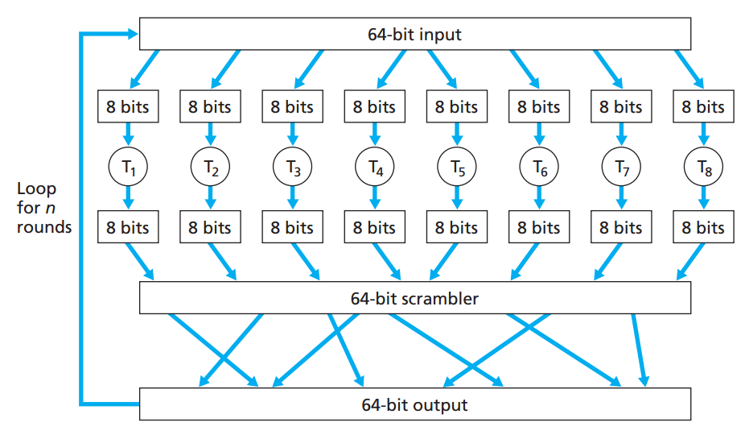
Example of a block cipher using function
Publicly known
A bijection function
(a 64-bit input to a 64-bit output)
Notes:
Why n round? If there is only one round, a given input bit would only affect 8 output bits!

Slide 34
What is the key to the cipher in the previous slide?
The bijection function is the key to the cipher!
More specifically, since the scrambler is publicly known, the secret is only in the 8 Ti's.
Notes:
The bijection function is the key!

Slide 35
Symmetric key crypto: DES
DES: Data Encryption Standard
64-bit plaintext input
56-bit symmetric key
US encryption standard [NIST 1993]

Slide 36
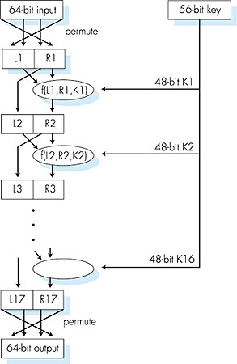
Symmetric key crypto: DES
(publicly known)
DES operation
initial permutation
16 identical "rounds" of function application, each using different 48 bits of key
final permutation
(publicly known)

Slide 37
How secure is DES?
how secure is DES?
  A key has 56 bits, each uniquely controlling 16 internal functions
  There are 2^56 possible keys
  DES Challenge: 56-bit-key-encrypted phrase decrypted (brute force) in less than a day
  no known good analytic attack
making DES more secure:
  3DES: encrypt 3 times with 3 different keys
AES uses 128-bit keys
  If DES can be decrypted in one second, it takes 149 trillion years to crack a 128-bit AES key

Slide 38
Do you see any weakness with block cipher?

Slide 39

Example

Slide 40
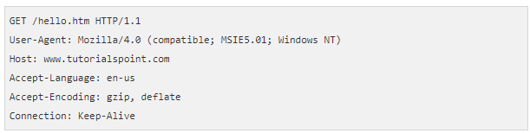
Example
Message 1
index.htm
Message 2
Root of problem: the same blocks produce the same ciphertexts
An attacker may be able to decrypt the entire message if identifying identical ciphertext blocks

Slide 41
How do we overcome this problem?

Slide 42
One solution
m1 and m4 are identical
sender
m1
m2
m3
m4
m5
Messages
⊕
⊕
⊕
⊕
⊕
ri
r1
r2
r3
r4
r5
Random blocks
Also sent
Key: Ks
c1
c2
c3
c4
c5
c1 and c4 are diff.
Key: Ks
m1
m2
m3
m4
m5
receiver
⊕
⊕
⊕
⊕
⊕
r1
r2
r3
r4
r5
ri
⊕
m1
m2
m3
m4
m5

Slide 43
What is the problem with this solution?
The random blocks are also sent.
Random blocks are as many as message blocks
This incurs transmission cost (waste of communication resource)

Slide 44
Cipher-block chaining
sender
m1
m2
m3
m4
m5
Messages
⊕
⊕
⊕
⊕
⊕
Block r1
(Init. Vector)
r1
c1
c2
c3
c4
Also sent
Key Ks
c1
c2
c3
c4
c5
c1 and c4 are diff.
Key Ks
m1
m2
m3
m4
m5
receiver
⊕
⊕
⊕
⊕
⊕
r1
c1
c2
c3
c4
r1, ci
⊕
m1
m2
m3
m4
m5
44

Slide 45
What is the common weakness of all symmetric-key encryption algorithms?
The communication parties must agree on a secret (the symmetric key)! This can be difficult or impossible.
Notes:
Two guys meet in person and agree on the key. What about two communicating hosts, they never meet in person.

Slide 46
Classification of cryptography systems
K_{A}=K_{B}
symmetric key systems
K_{A}≠K_{B}
public key systems

Slide 47
Public key cryptography
This is known to everyone!
+
Bob's public
key
K
B
-
Bob's private
key
K
B
Secret!
plaintext
message, m
encryption
algorithm
ciphertext
decryption
algorithm
plaintext
message, m
+
K (m)
B
-
+
m = K (K (m))
B
B
Alice sends a confidential message to Bob.
Notes:
No need to meet in person to agree on a secret key!

Slide 48


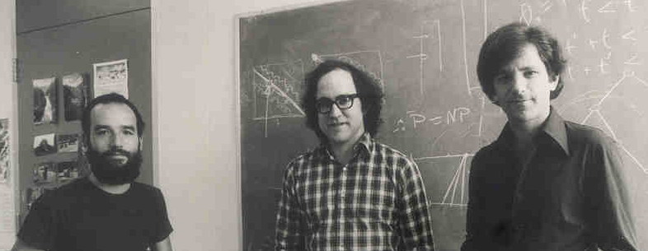

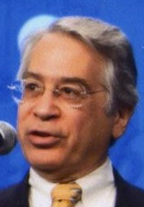
Brief history (Public domain)
1976
Diffie–Hellman key exchange
Whitfield Diffie and Martin Hellman
Exponentiation in a finite field
1977
RSA
Ron Rivest, Adi Shamir and Leonard Adleman
Exponentiation modulo
1980s
Elliptic curve cryptography
Neal Koblitz and Victor Miller
Discrete logarithm

Slide 49
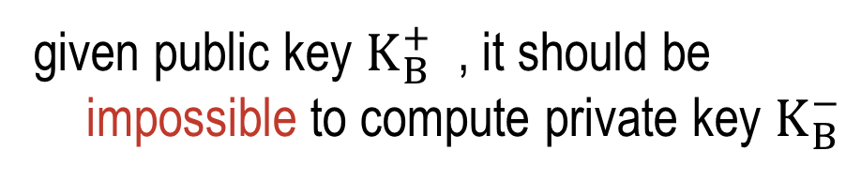


Public key encryption algorithms
Requirements:
1
Need $K_{B}^{+}$(·) and $K_{B}^{−}$(·) such that
$K_{B}^{+}$($K_{B}^{−}$(m) ) = m
2
given public key $K_{B}^{+}$ , it should be impossible to compute private key $K_{B}^{−}$

Slide 50
Prerequisite: modular arithmetic
x mod n = remainder of x when divide by n
facts:
  [(a mod n) + (b mod n)] mod n = (a+b) mod n
  [(a mod n) - (b mod n)] mod n = (a-b) mod n
  [(a mod n) x (b mod n)] mod n = (axb) mod n
thus
(a mod n)^{d} mod n = a^{d} mod n
example: x=14, n=10, d=2:
(x mod n)^{d} mod n = 4² mod 10 = 6
x^{d} = 14² = 196 x^{d} mod 10 = 6

Slide 51
RSA: getting ready
message: just a bit pattern
bit pattern can be uniquely represented by an integer number
thus, encrypting a message is equivalent to encrypting a number
example:
m= 10010001. This message is uniquely represented by the decimal number 145.
to encrypt m, we encrypt the corresponding number, which gives a new number (the ciphertext).

Slide 52
RSA: Creating public/private key pair
1. choose two large prime numbers p, q.
(e.g., 1024 bits each)
2. compute n = pq, z = (p-1)(q-1)
3. choose e (with e<n) that has no common factors
with z (e, z are "relatively prime").
4. choose d such that ed-1 is divisible by z.
(in other words: ed mod z = 1 ).
5. public key is (n,e). private key is (n,d).
+
-
K
K
B
B

Slide 53
Flow of creating a key pair
chosen
Large prime numbers
p
q
- e<n
- e and z are relatively prime
(i.e., no common factors)
n=p*q
n
z
e
z=(p-1)*(q-1)
(e*d) mod z = 1
or
d = (k * z + 1)/e for some k
d
Public key
(n, e)
Private key
(n, d)
Notes:
# Write Python3 code here
from decimal import Decimal
def gcd(a,b):
if b==0:
return a
else:
return gcd(b,a%b)
p = int(input('Enter the value of p = '))
q = int(input('Enter the value of q = '))
no = int(input('Enter the value of text = '))
n = p*q
t = (p-1)*(q-1)
for e in range(2,t):
if gcd(e,t)== 1:
break
for i in range(1,10):
x = 1 + i*t
if x % e == 0:
d = int(x/e)
break
ctt = Decimal(0)
ctt =pow(no,e)
ct = ctt % n
dtt = Decimal(0)
dtt = pow(ct,d)
dt = dtt % n

Slide 54
RSA: encryption, decryption
0. given (n,e) and (n,d) as computed above
1. to encrypt message m (<n), compute
c = m^{e} mod n
2. to decrypt received bit pattern, c, compute
m = c^{d} mod n
magic
happens!
m = (m^{e} mod n) ^{d} mod n
c

Slide 55
RSA example:
Bob chooses p=5, q=7. Then n=35, z=24.
e=5 (so e, z relatively prime).
d=29 (so ed-1 exactly divisible by z).
encrypting 8-bit messages.
m
e
e
bit pattern
m
c = m mod n
encrypt:
0000l000
12
24832
17
d
d
c
c
m = c mod n
decrypt:
17
481968572106750915091411825223071697
12

Slide 56
Why does RSA work?
must show that c^{d} mod n = m
where c = m^{e} mod n
fact: for any x and y:
x^{y} mod n = x^{(y mod z)} mod n
  where n= pq and z = (p-1)(q-1)
c^{d} mod n = (m^{e} mod n)^{d} mod n
= m^{ed} mod n
= m^{(ed mod z)} mod n
= m¹ mod n
= m
ed mod z = 1

Slide 57
RSA: another important property
The following property will be very useful later:
-
+
+
-
K (K (m)) = m
=
K (K (m))
B
B
B
B
use public key first, followed by private key
use private key first, followed by public key
result is the same!

Slide 58
Why
-
+
+
-
K (K (m)) = m
=
K (K (m))
?
B
B
B
B
follows directly from modular arithmetic:
(m^{e} mod n)^{d} mod n = m^{ed} mod n
= m^{de} mod n
= (m^{d} mod n)^{e} mod n

Slide 59
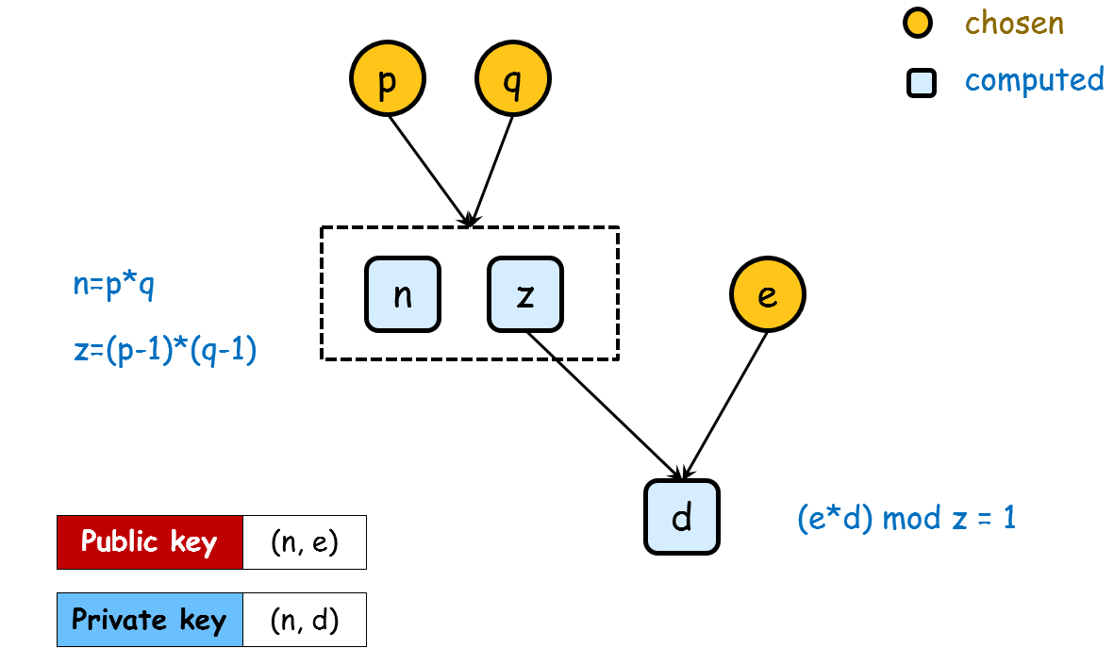
Why is RSA secure?
suppose you know Bob's public key (n,e).
How hard is it to determine d?
?
?
√
?
√
√
?
√
?
  Fact: factoring a big number is hard!

Slide 60
RSA in practice: session keys
exponentiation in RSA is computationally intensive
DES is at least 100 times faster than RSA
use crypto to establish secure connection, then establish second key – symmetric session key – for encrypting data
session key, K_{S}
Bob and Alice use RSA to exchange a symmetric key K_{S}
once both have K_{S}, they use symmetric key cryptography
public key
session key
data comm.

Slide 61
Chapter 8 roadmap
8.1 What is network security?
8.2 Principles of cryptography
8.3 Message integrity and digital signature
8.4 End-to-end authentication
8.5 Securing e-mail
8.6 Securing TCP connections: SSL
8.7 Network layer security: IPsec & VPN
8.8 Securing wireless LANs
8.9 Operational security: firewalls and IDS

Slide 62
How do you ensure message integrity and authenticate the message?

Slide 63
Message integrity and authentication
Alice
Bob
message
Questions: How does bob make sure that
the message was not tampered with on its way to Bob.
the message is from Alice

Slide 64
How do we authenticate a message in the real world?
Example: signed certificate
(1) Can tell if there are changes to the message
(2) The signature, voice pattern or visual pattern is unique to a person
(3) The unique pattern cannot be detached from the message
Notes:
信件或证明文件。 签名（盖章） + 骑缝处签名（盖章）

Slide 65
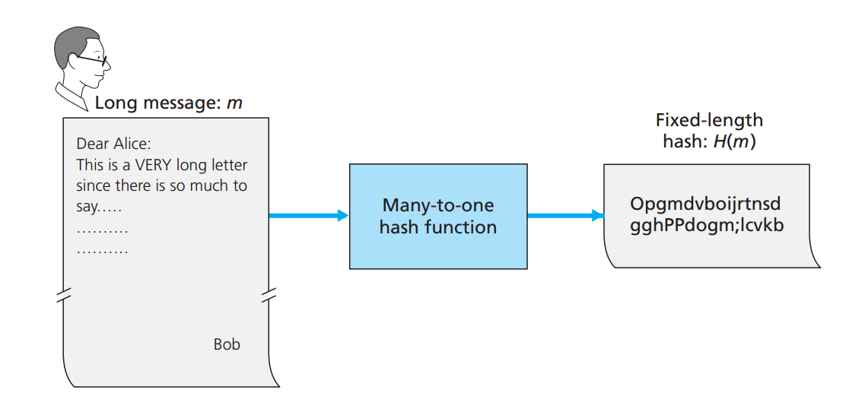
Cryptographic hash functions
A hash function takes an input, m, and computes a fixed-length string H(m)
Notes:
下载软件的时候，网站也提供一个 hash，用于验证下载的程序是否有过更改。

Slide 66
Internet checksum: poor hash function
Internet checksum has some properties of hash function:
produces fixed length digest (16-bit sum) of message
is many-to-one
But given message with given hash value, it is easy to find another message with same hash value:
message
ASCII format
message
ASCII format
I O U 1
0 0 . 9
9 B O B
49 4F 55 31
30 30 2E 39
39 42 D2 42
I O U 9
0 0 . 1
9 B O B
49 4F 55 39
30 30 2E 31
39 42 D2 42
B2 C1 D2 AC
B2 C1 D2 AC
different messages
but identical checksums!
Question: Good hash?

Slide 67
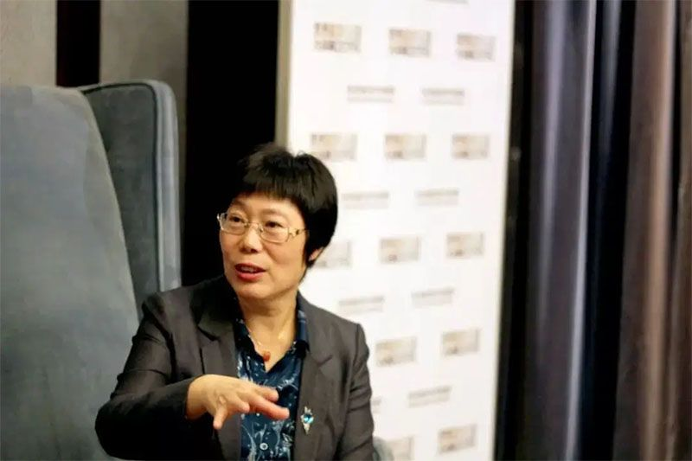
中国人破解MD5
王小云教授的研究成果如下：MD5(M1)=MD5(M2)
即给定消息 M1，能够计算获取 M2，使得 M2 产生的散列值与 M1 产生的散列值相同。

Slide 68
Property of cryptographic hash function
x
H(x)
y
H(x)
Message x
Get a wrong message y
with H(x), get y such that H(y) = H(x)
So, H() must have the following property!
It is computationally infeasible to find any two different messages x and y such that H(x)=H(y)

Slide 69
Hash function algorithms
MD5 hash function widely used (RFC 1321)
  computes 128-bit message digest in 4-step process.
  arbitrary 128-bit string x, appears difficult to construct msg m whose MD5 hash is equal to x
SHA-1 is also used
  US standard [NIST, FIPS PUB 180-1]
  160-bit message digest

Slide 70
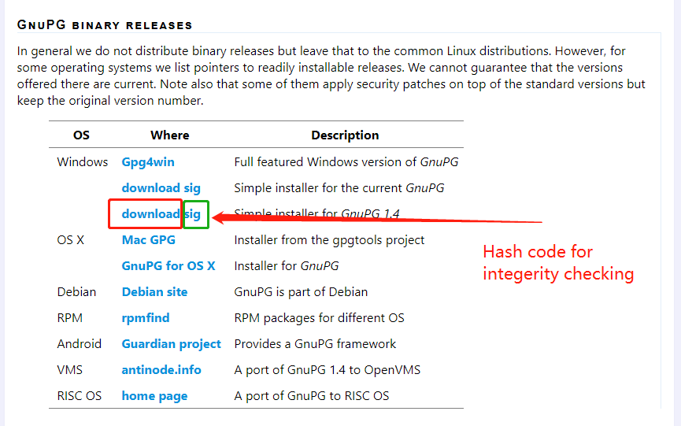
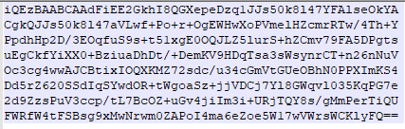
A Real-world use case for integrity

Slide 71
Related techniques
Message authentication code
Digital signature

Slide 72

The first attempt
Message m
compute
compute
Hash H(m)
Hash H(m)
=
compare
Alice
Bob
Internet
m
H(m)
m
h
receive
send

Slide 73
Do you see any problem with this attempt?

Slide 74
Trudy can do the same as Alice does
Message m
compute
compute
Hash H(m)
Hash H(m*)
=
compare
Trudy
Bob
Internet
m*
H(m*)
M*
H(m*)
receive
send

Slide 75
How do we overcome this problem (i.e., cannot be sure that the message is from Alice)?
Make use of something that is unique to the sender and cannot be detached from the message!

Slide 76
The key idea
Secret
101110111
Alice
Bob
Trudy
The secret is unique because it is only known to Alice and Bob.

Slide 77
Message Authentication Code (MAC)
Not transmitted
Message m
Secret S
Secret S
101110111
101110111
compute
compute
Hash H(m+s)
Hash H(m+s)
MAC
=
compare
Alice
Bob
Internet
m
H(m+s)
m
h

Slide 78
Remarks on MAC
It does not provide confidentiality!
A shared symmetric key is used.
It does not support non-repudiation

Slide 79
One issue remained
How do you distribute the shared secret to the communicating parties?

Slide 80
Related techniques
Message authentication code
Digital signature
Make use of the public key!

Slide 81
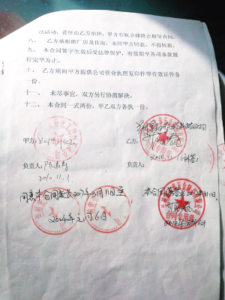
Traditional paper signature
What are the requirements on a paper signature?
Change to the doc can be easily detected
Important!
It is "you" that signed the document
How to verify?
Handwriting pattern is unique
The signer cannot deny having signed this doc?
The signature cannot be detached from the doc and be attached to some other docs
Signature!

Slide 82
How do you create a digital signature?
Bob attaches “digital signature” to the message.
Ensure the messages’ integrity
Authenticate the person signing the message
Cannot be detached and be attached to
Notes:
纸不能切开，但是数据如何不能分开呢？

Slide 83
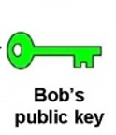
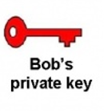
Insights on public key encryption
Bob
1) The private key is unique to the public key
2) The pair of public and private key belongs to Bob

Slide 84
Simple use of public key
Proof of Bob’s identity?
  Method: Bob simply presents his public key or private key to prove his identity
  Fail!
Proof the origin of a message?
  Method: Bob encrypts a message with the private key, and Alice decrypts the message with Bob’s public key
  Fail!

Slide 85
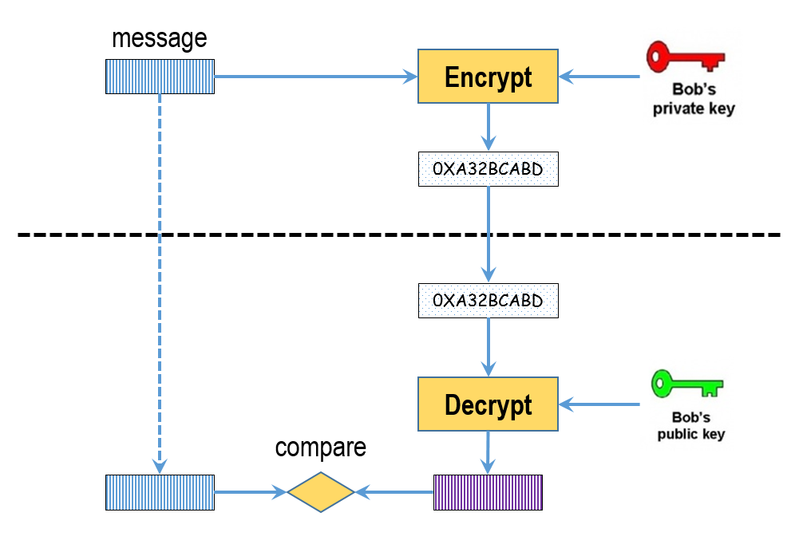
Basic idea: public key for message auth
Bob encrypts it with his private key
Alice decrypts it with Bob’s public key, and compare it to the known message (by sending it from Bob to Alice)
Then, Alice can be sure that the message was from Bob (more precisely, the message is encrypted by the private key.）

Slide 86
There is a clear drawback with this solution?
The message can be huge, and it requires long encryption time.

Slide 87
One clear issue remained
The message itself can be huge!
Encrypting the message with public key is computationally expensive
Solution:
Just encrypt a small digest of the original message
And it is equivalent to encrypting the whole message

Slide 88
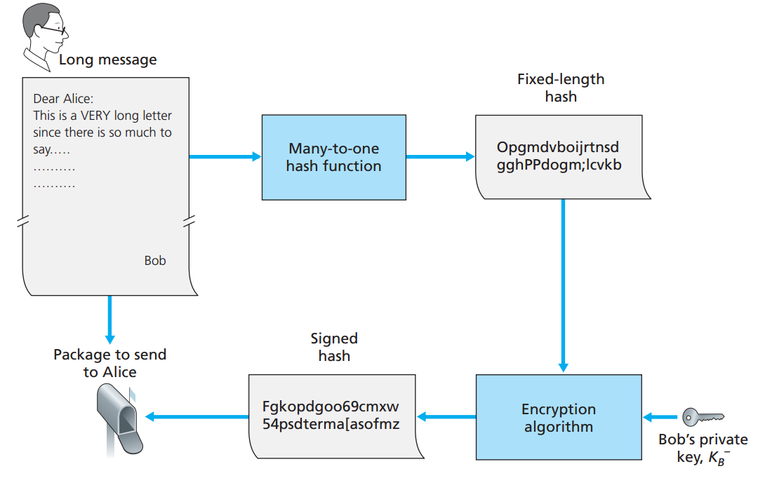
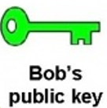
Sending a digitally singed message
Notes:
The message is not known by Alice and Bob in advance.

Slide 89
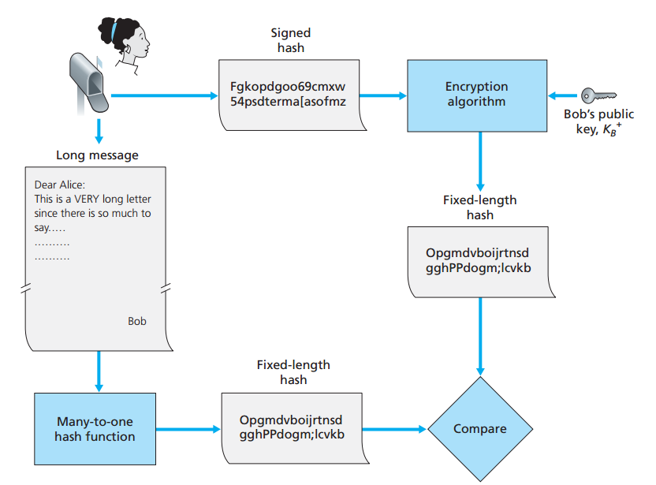
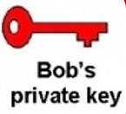
Verifying a digitally signed message
Authenticated
or Not

Slide 90
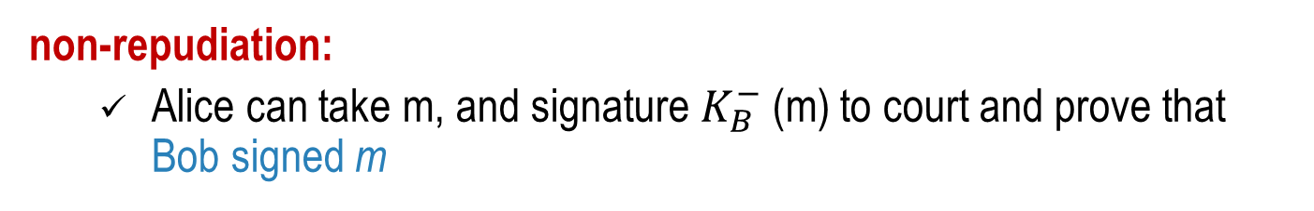
What achieved with digital signatures
Alice thus verifies that:
  Bob signed m, no one else signed m
  Bob signed m, not m’
  No change has been made to the message m
non-repudiation:
  Alice can take m, and signature $K_{B}^{−}$(m) to court and prove that Bob signed m
Because only Bob has access to the private key

Slide 91
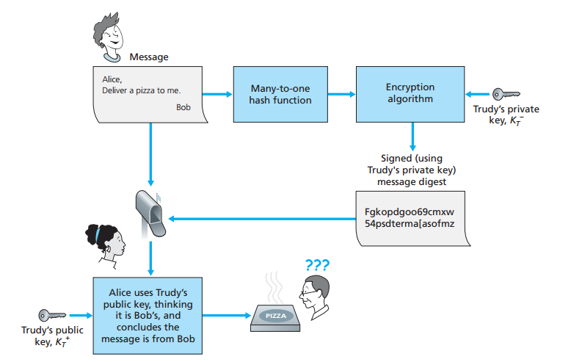
With public key, impersonation possible!
Trudy masquerades as Bob using public key cryptography

Slide 92
Actually, Alice can only be sure the private key (corresponding to the private key) is used to generate hash.
How do we certify that the pair of keys belongs to Bob?
We need an “official” message stating this fact, and the message itself is “digitally signed”
Notes:
如何把 一对公私钥匙与一个身份绑定在一起？
老公和老婆是怎么绑定在一起的？ 结婚证，民政局作证！ 我们看到民政局的章，就认了！

Slide 93


Certification authorities
certification authority (CA): binds a public key to a particular entity, E.
E (person, router) registers its public key with CA.
  E provides "proof of identity" to CA.
  CA creates certificate binding E to its public key.
  certificate containing E's public key digitally signed by CA – CA says "this is E's public key"
Bob's
public
key
+
digital
signature
(encrypt)
+
K
K
B
B
Bob's
identifying information
CA
private
key
certificate for Bob's public key, signed by CA
-
K
CA

Slide 94
Certification authorities
when Alice wants Bob's public key:
  gets Bob's certificate (Bob or elsewhere).
  apply CA's public key to Bob's certificate, get Bob's public key
+
digital
signature
(decrypt)
Bob's
public
key
K
B
+
K
B
CA
public
key
+
Verified!
That CA signed it,
And it is Bob's key.
K
CA

Slide 95
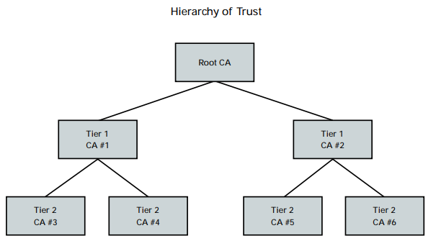
Hierarchy of Trust
Who is certificating the CA?

Slide 96
Chapter 8 roadmap
8.1 What is network security?
8.2 Principles of cryptography
8.3 Message integrity and digital signature
8.4 End-to-end authentication
8.5 Securing e-mail
8.6 Securing TCP connections: SSL
8.7 Network layer security: IPsec & VPN
8.8 Securing wireless LANs
8.9 Operational security: firewalls and IDS

Slide 97
How does one party authenticate the other party over a network?
Is it the same as authenticating a message is from a person (as done in the previous subsec)
For example, you authenticate yourself to an email server.
Notes:
Humans: authenticate by recognizing face, voice, check face against the picture on passport.
We focus on authenticating a live party. E.g., you authenticate yourself to an email server.
本质上，end-to-end authentication 跟 message authentication 是非常类似的，message authentication 没有解决证明对方是不是 live。

Slide 98
Authentication
Goal: Bob wants Alice to "prove" her identity to him
"I am Alice"

Slide 99
Protocol ap1.0:
Alice says "I am Alice"
"I am Alice"
Failure scenario?
in a network,
Bob can not "see" Alice, so Trudy simply declares
herself to be Alice

Slide 100
Protocol ap2.0:
Alice says "I am Alice" in an IP packet containing her source IP address
Failure scenario??
Alice's
IP address
"I am Alice"
Trudy can create
a packet "spoofing"
Alice's address
Alice's IP address is well known!

Slide 101
Protocol ap3.0:
Alice says "I am Alice" and sends her secret password to "prove" it.
Alice's
IP addr
Alice's
password
"I'm Alice"
Alice's
IP addr
OK
Password is a shared secret between Alice and Bob!
Failure scenario??

Slide 102

Protocol ap3.0:
Alice says "I am Alice" and sends her secret password to "prove" it.
playback attack: Trudy records Alice's packet
and later
plays it back to Bob
Another problem: pwd may be stolen
Alice's
IP addr
Alice's
password
"I'm Alice"
Alice's
IP addr
OK
Alice's
IP addr
Alice's
password
"I'm Alice"

Slide 103
Protocol ap3.1:
Alice says "I am Alice" and sends her encrypted secret password to "prove" it.
Alice's
IP addr
encrypted
password
"I'm Alice"
Failure scenario?
Alice's
IP addr
OK
Share a secret symmetric key between Alice and Bob!

Slide 104
Protocol ap3.1:
Alice says "I am Alice" and sends her encrypted secret password to "prove" it.
Alice's
IP addr
encrypted
password
"I'm Alice"
record
and
playback
still works!
Alice's
IP addr
OK
Alice's
IP addr
encrypted
password
"I'm Alice"

Slide 105
What is the root reason of ap3.1's failure?
Cannot distinguish between the original authentication of Alice and the later playback of the original

Slide 106
Protocol ap4.0:
Goal: avoid playback attack
nonce: number (R) used only once-in-a-lifetime
to prove Alice "live", Bob sends Alice nonce, R. Alice must return R, encrypted with shared secret key
"I am Alice"
R
K (R)
Alice is live, and only Alice knows key to encrypt nonce, so it must be Alice!
A-B

Slide 107
What is the drawback of ap4.0?
A shared key is required!

Slide 108
Protocol ap5.0
Basic idea:
use nonce, public key cryptography
"I am Alice"
Bob computes
R
+
-
-
K
(K (R)) = R
K (R)
A
A
A
and knows only Alice could have the private key, that encrypted R such that
"send me your public key"
+
K
A
+
-
K
(K (R)) = R
A
A

Slide 109
Chapter 8 roadmap
8.1 What is network security?
8.2 Principles of cryptography
8.3 Message integrity, authentication
8.4 Securing e-mail
8.5 Securing TCP connections: SSL
8.6 Network layer security: IPsec & VPN
8.7 Securing wireless LANs
8.8 Operational security: firewalls and IDS

Slide 110
Providing Security Services at Layers
Application (e.g., PGP)
Transport (e.g., SSL)
Network (e.g., IPSec)
Link (e.g., securing Wifi)
Physical
Why not just provide security services at the network layer?
(1) It is easy to do it on the application layer
(2) The IPSec only authenticates the IP source. A user cannot use this for user authentication.

Slide 111
Having learned primitives of achieving confidentiality, message integrity, message authentication, end-to-end authentication.
How do we achieve security at different layers?

Slide 112
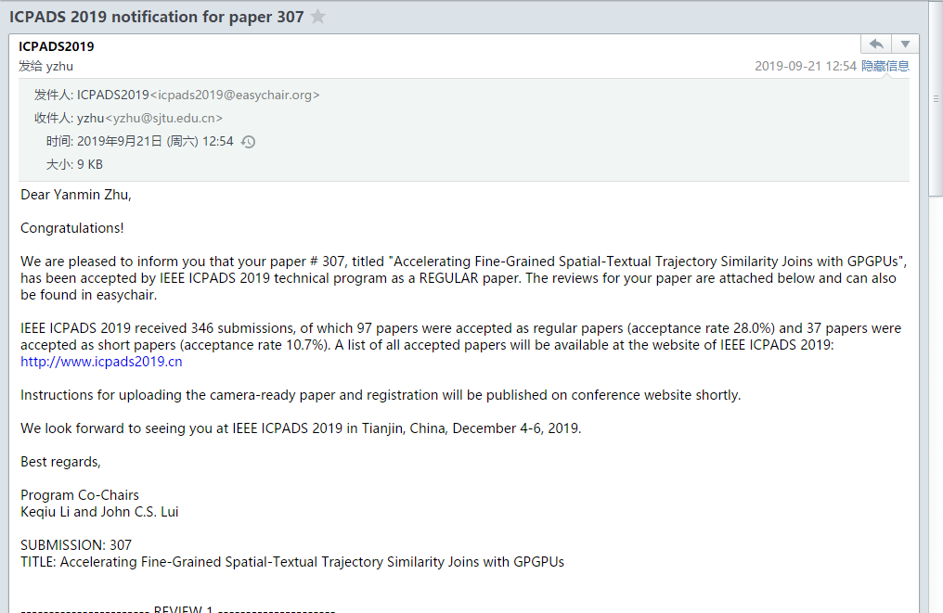


Possible attacks on Email
Message confidentiality
Message integrality
Sender identity
Receiver identity
Alice
Bob
SMTP/HTTP
HTTP/POP3/IMAP
Eve

Slide 113
Desirable security goals for Email
(1) Sender authentication
  It is Alice who is sending the email
(2) Receiver authentication
  Alice wants to make sure that she is sending to the true Bob, not someone else impersonating Bob
(3) Confidentiality
  No one else can read the content of the email
(4) Integrity
  The email was not altered.

Slide 114
First, how do we achieve confidentiality?

Slide 115
Achieving confidentiality (1)
Alice wants to send confidential e-mail, m, to Bob.
K_{S}
symmetric key
.
K_{S}(m )
K_{S}(m )
.
m
K_{S}( )
K_{S}( )
m
+
-
Internet
K_{S}
.
.
+
-
K_{S}
K_{B}( )
+
+
K_{B}( )
K_{B}(K_{S} )
K_{B}(K_{S} )
+
-
Private key (Bob)
K_{B}
Public key (Bob)
K_{B}
Alice:
generates random symmetric private key, K_{S}
encrypts message with K_{S} (for efficiency)
also encrypts K_{S} with Bob's public key
sends both K_{S}(m) and K_{B}(K_{S}) to Bob

Slide 116
Achieving confidentiality (2)
Alice wants to send confidential e-mail, m, to Bob.
K_{S}
symmetric key
.
K_{S}(m )
K_{S}(m )
.
m
K_{S}( )
K_{S}( )
m
+
-
Internet
K_{S}
.
.
+
-
K_{S}
K_{B}( )
+
+
K_{B}( )
K_{B}(K_{S} )
K_{B}(K_{S} )
+
-
Private key (Bob)
K_{B}
Public key (Bob)
K_{B}
Bob:
uses his private key to decrypt and recover K_{S}
uses K_{S} to decrypt K_{S}(m) to recover m
(receiver authentication implied!)

Slide 117
Second, how do we achieve integrity as well as authentication?
Essentially, to utilize digital signature!

Slide 118
Achieving sender auth. + email integrity
Alice wants to provide sender authentication and message integrity
Private key (Alice)
Public key (Alice)
-
+
K_{A}
K_{A}
.
.
-
-
.
-
K_{A}(H(m))
K_{A}(H(m))
+
m
H( )
K_{A}( )
K_{A}( )
H(m )
+
-
compare
Internet
.
m
H( )
H(m )
m
Alice digitally signs message
sends both message (in the clear) and digital signature
Notes:
Just message authentication code

Slide 119
Finally, achieving confidentiality, integrity and authentication?

Slide 120
Achieving all: Process at sender
Alice wants to provide confidentiality, sender authentication, and message integrity.
-
K_{A}
Alice's private key
.
-
.
-
K_{A}(H(m))
m
H( )
K_{A}( )
K_{S}
Symmetric key
.
+
K_{S}( )
m
+
Internet
.
+
K_{S}
K_{B}( )
+
K_{B}(K_{S} )
symmetric key
+
K_{B}
Bob's public key
Alice uses three keys: her private key, Bob's public key, newly created symmetric key

Slide 121
Achieving all: Process at receiver
Alice's public key
+
K_{A}
-
K_{A}(H(m))
.
+
H(m )
K_{A}( )
-
K_{S}(m, K_{A}(H(m)))
.
-
K_{S}( )
-
compare
.
-
H( )
K_{S}
H(m )
.
m
symmetric key
-
K_{B}( )
+
K_{B}(K_{S} )
-
K_{B}
Bob’s private key

Slide 122
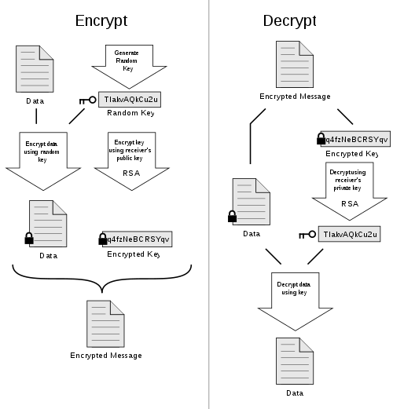
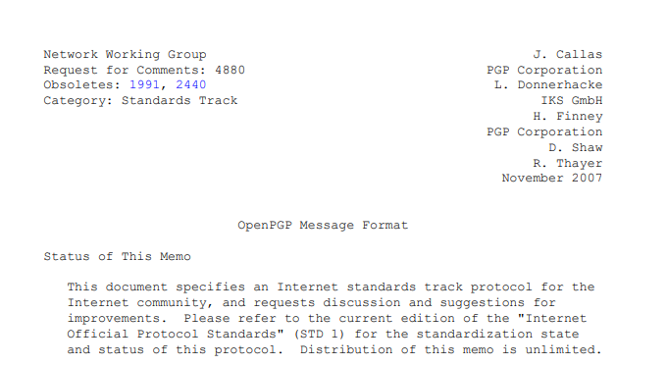
PGP for Email
Pretty Good Privacy (PGP) is an encryption program that provides cryptographic privacy and authentication for e-mails
RFC 4880

Slide 123
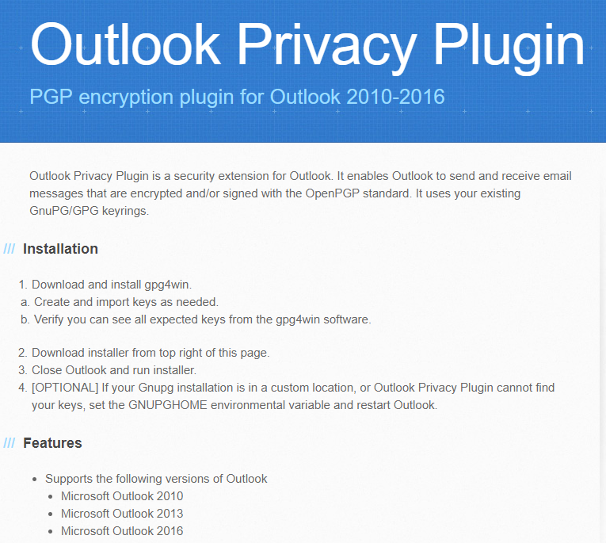
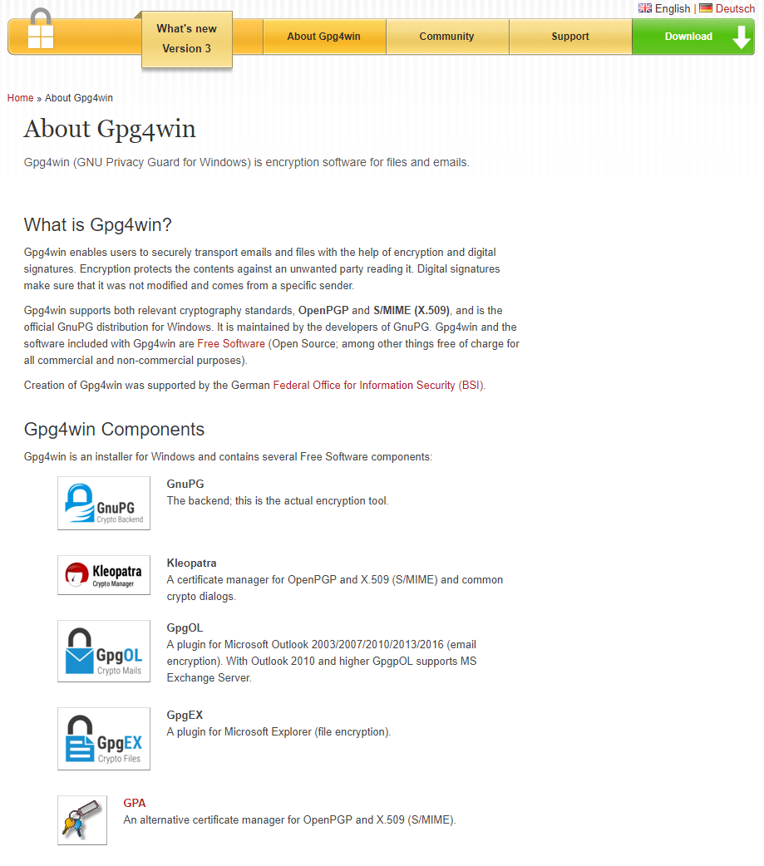
Real-world Use of PGP with Outlook

Slide 124
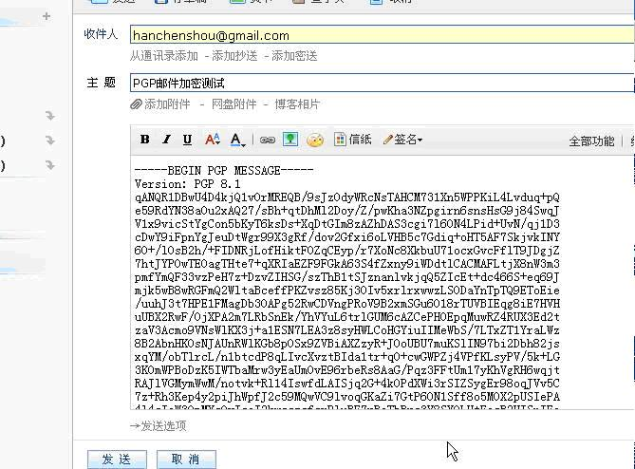
Example

Slide 125
Chapter 8 roadmap
8.1 What is network security?
8.2 Principles of cryptography
8.3 Message integrity, authentication
8.4 Securing e-mail
8.5 Securing TCP connections: SSL
8.6 Network layer security: IPsec & VPN
8.7 Securing wireless LANs
8.8 Operational security: firewalls and IDS

Slide 126
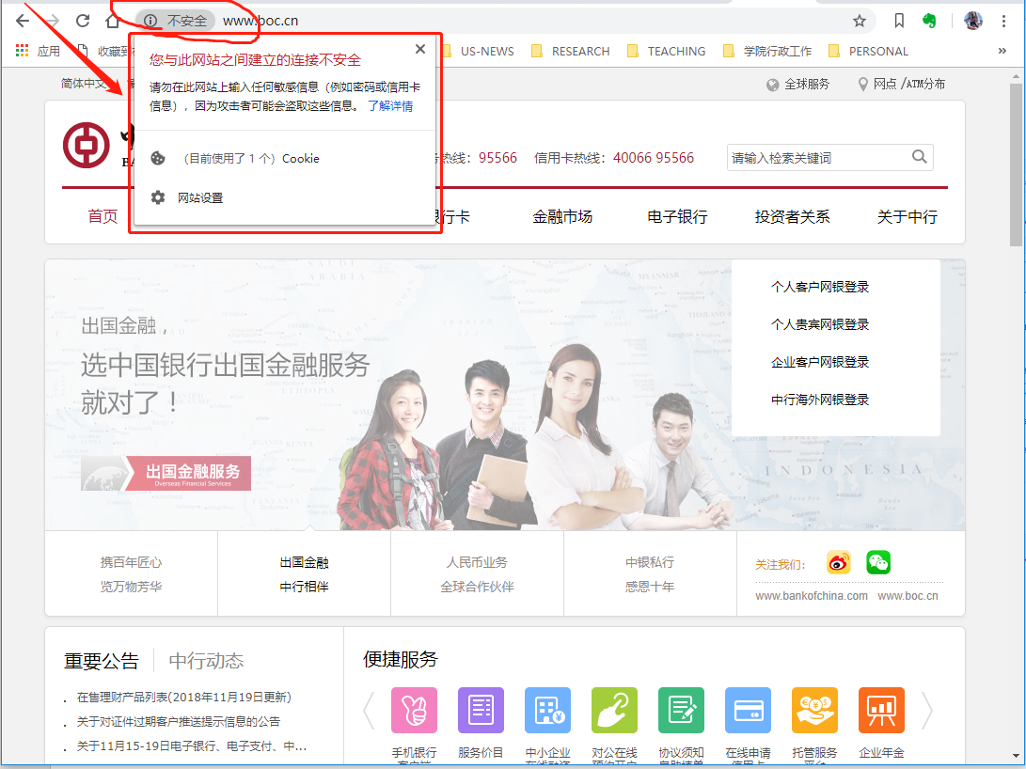
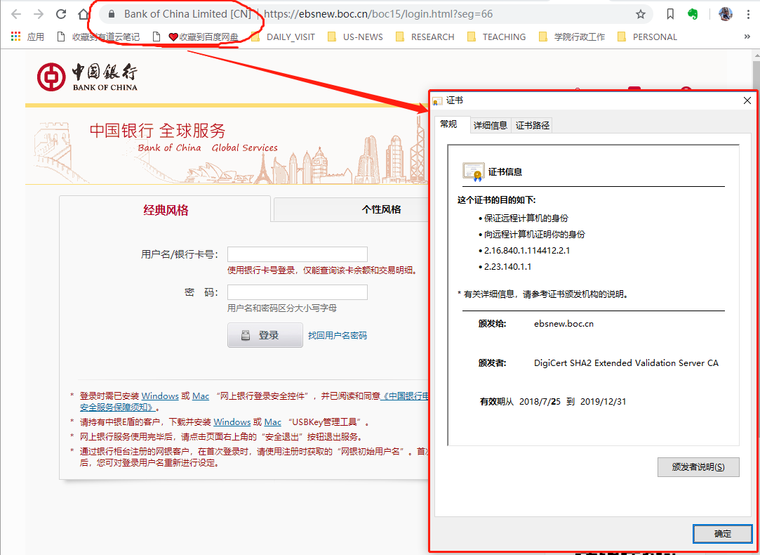
Unsecure Scenarios
Using unsure TCP connection
Data may be intercepted
Using SSL connection
Data are confidential.

Slide 127
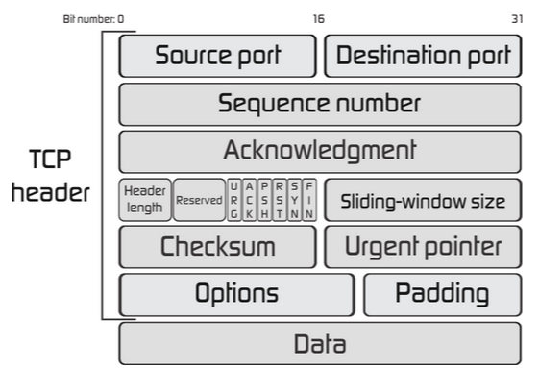
Possible Attacks on TCP
SYN
SYN/ACK
ACK
DATA SETGMENT
Alice
process
Bob
process
routers
routers
Eve

Slide 128
Security Concerns on TCP
You cannot always be sure that the entity with whom you are communicating is really who you think it is.
Network data can be intercepted, so it is possible that it can be read by an unauthorized third party, sometimes known as an attacker.
If an attacker can intercept the data, the attacker may be able to modify the data before sending it on to the receiver.

Slide 129
Desirable security features for TCP
HTTP
HTTP
TCP socket
TCP socket
TCP
IP
Link
Physical
TCP
IP
Link
Physical
(1) Client authentication
(2) Server authentication
(3) Confidentiality
(4) Data integrity

Slide 130
SSL and TCP/IP
HTTP
Application layer
SSL socket
HTTP
SSL sublayer
TCP socket
TCP socket
TCP
IP
Link
Physical
TCP
IP
Link
Physical
TCP API
TCP enhanced with SSL
SSL provides application programming interface (API) to applications
C and Java SSL libraries/classes readily available

Slide 131
SSL: Secure Sockets Layer
widely deployed security protocol
  supported by almost all browsers, web servers
  https
  billions $/year over SSL
mechanisms: [Woo 1994], implementation: Netscape
variation -TLS: transport layer security, RFC 2246
provides
  confidentiality
  integrity
  authentication
original goals:
  Web e-commerce transactions
  encryption (especially credit-card numbers)
  Web-server authentication
  optional client authentication
  minimum hassle in doing business with new merchant
available to all TCP applications
  secure socket interface

Slide 132
Could do something like PGP:
-
K_{A}
.
.
-
-
K_{A}(H(m))
K_{S}
m
H( )
K_{A}( )
.
+
K_{S}( )
m
+
Internet
.
+
K_{S}
K_{B}( )
+
K_{B}(K_{S} )
+
K_{B}
Is this an idea good for securing TCP?

Slide 133
Problems and New Idea
Problem
want to send byte streams & interactive data
New Idea
want set of secret keys for entire connection
want certificate exchange as part of protocol: handshake phase

Slide 134
Almost-SSL: a simple secure channel
Phase 1: handshake: Alice and Bob use their certificates, private keys to authenticate each other and exchange shared secret
Phase 2: key derivation: Alice and Bob use shared secret to derive set of keys
Phase 3: data transfer: data to be transferred is broken up into series of records
Phase 4: connection closure: special messages to securely close connection

Slide 135
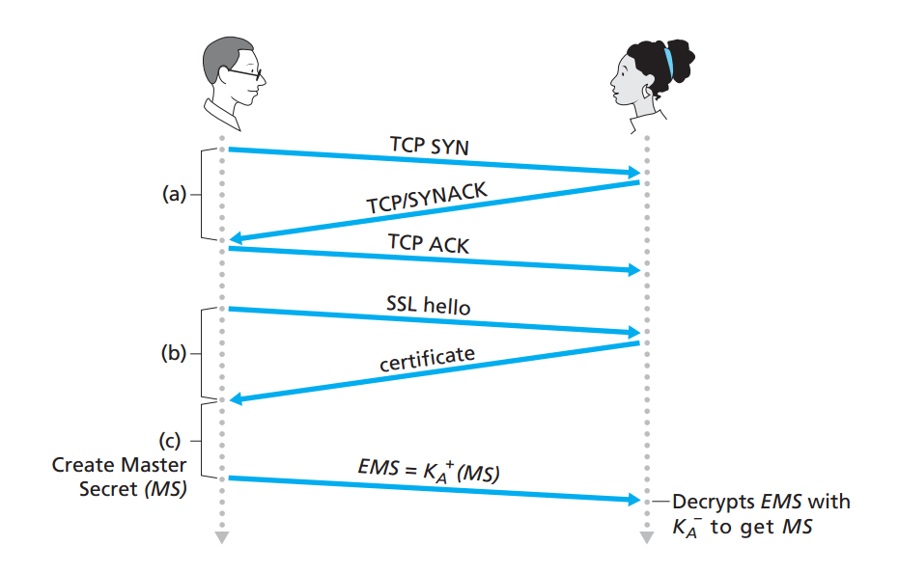
Phase 1: Handshake
(a) Establish TCP
(b) Authentication
(c) Master key
MS: master secret; EMS: encrypted master secret

Slide 136
Phase 2: key derivation
Data
The MS is used as the key
MS: master secret
MS: master secret
Problem: considered bad to use same key for more than one cryptographic operations

Slide 137
Phase 2: key derivation
Idea: use different keys for message authentication code (MAC) and encryption
keys derived from key derivation function (KDF)
  takes master secret and (possibly) some additional random data and creates the keys
Data
MS: master secret
Key 1, Key 2, … Key N

Slide 138
Phase 2: key derivation
K_{C} & M_{C}
Client: C
K_{S} & M_{S}
Server: S
four keys (two directions):
  K_{c} = encryption key for data sent from client to server
  M_{c} = MAC key for data sent from client to server
  K_{s} = encryption key for data sent from server to client
  M_{s} = MAC key for data sent from server to client

Slide 139
Phase 3: data transfer
HTTP
TCP: byte stream
Where to put MAC?
HTTP
SSL socket
SSL socket
SSL sublayer
SSL sublayer
TCP socket
TCP socket
TCP
IP
Link
Physical
TCP: a byte-steam service
TCP
IP
Link
Physical
record #1
record #2
record #3
data
mac
data
mac
data
mac

Slide 140
Phase 3: data records
instead, break stream in series of records
  each record carries a MAC
  receiver can act on each record as it arrives
issue: in record, receiver needs to distinguish MAC from data
  want to use variable-length records
  Solution: add a length field
length
data
MAC

Slide 141
Reordering attack!
data
mac
data
mac
data
mac
TCP
data
mac
TCP
data
mac
TCP
data
mac
Seq#: 0
Seq#: 10
Seq#: 20
Seq#: 10
Seq#: 0
Seq#: 20
TCP
data
mac
TCP
data
mac
TCP
data
mac
Reordered (TCP header not encrypted)
Wrong data received
encrypted
Notes:
注意： data block 的头部hi不包含 序列号信息的。

Slide 142
Solution: sequence numbers
put sequence number into MAC:
  MAC = MAC(M_{x}, sequence #||data)
  note: actually no sequence number field
If the sequence numbers in the TPC segments changed, such changes can be easily detected!
Notes:
MAC 中的是 data block的序列号，不是TCP的直接序列号。不是一个东西。
Data block 头部没有序列号信息，因为不需要，只要放在MAC里面计算就好了，就能检测出是否更改了顺序。

Slide 143
Replay attack!
Attacker could replay all records
8AM
handshake
mac
data
mac
9AM
handshake
mac
data
mac

Slide 144
Solution: Alice and Bob each generates a Nonce
Alice’s Nonce and Bob’s Nonce
Master Key
Four keys (E_{B}, M_{B}, E_{A}, M_{A})
Replayed messages will fail because the attacker cannot generate correct keys (Bob finds integrity check failure)
More details later.
Notes:
More details later.

Slide 145
Truncation Attack
problem: truncation attack:
  attacker forges TCP connection close segment
  one or both sides thinks there is less data than there actually is.
solution: record types, with one type for closure
  type 0 for data; type 1 for closure
MAC = MAC(M_{x}, sequence||type||data)
length
type
data
MAC
Encrypted

Slide 146
Almost-SSL: summary
hello
certificate, nonce
K_{B}⁺(MS) = EMS
type 0, seq 1, data
bob.com
type 0, seq 2, data
type 0, seq 1, data
encrypted
type 0, seq 3, data
type 1, seq 4, SSL close
type 1, seq 2, SSL close

Slide 147
Toy SSL isn't complete
which encryption protocols?
want negotiation?
  allow client and server to support different encryption algorithms
  allow client and server to choose together specific algorithm before data transfer

Slide 148
SSL cipher suite
cipher suite
  public-key algorithm
  symmetric encryption algorithm
  MAC algorithm
SSL supports several cipher suites
negotiation: client, server agree on cipher suite
  client offers choice
  server picks one
common SSL symmetric ciphers
  DES – Data Encryption Standard: block
  3DES – Triple strength: block
  RC2 – Rivest Cipher 2: block
  RC4 – Rivest Cipher 4: stream
SSL Public key encryption
  RSA

Slide 149
Real SSL: handshaking (1)
Purpose
server authentication
negotiation: agree on crypto algorithms
establish keys
client authentication (optional)

Slide 150
Real SSL: handshaking (2)
client sends list of algorithms it supports, along with client nonce
server chooses algorithms from list; sends back: choice + certificate + server nonce
client verifies certificate, extracts server's public key, generates pre_master_secret, encrypts with server's public key, sends to server
client and server independently compute encryption and MAC keys from pre_master_secret and nonces
client sends a MAC of all the handshake messages
server sends a MAC of all the handshake messages

Slide 151
Real SSL: handshaking (3)
last 2 steps protect handshake from tampering
client typically offers range of algorithms, some strong, some weak
man-in-the middle could delete stronger algorithms from list
last 2 steps prevent this
  last two messages are encrypted

Slide 152
Real SSL: handshaking (4)
why two random nonces?
suppose Trudy sniffs all messages between Alice & Bob
next day, Trudy sets up TCP connection with Bob, sends exact same sequence of records
  Bob (Amazon) thinks Alice made two separate orders for the same thing
  solution: Bob sends different random nonces for each connection. This causes encryption keys to be different on the two days
  Trudy's messages will fail Bob's integrity check

Slide 153
SSL record protocol
data
data
fragment
MAC
data
fragment
MAC
record
header
encrypted
data and MAC
record
header
encrypted
data and MAC
record header: content type; version; length
MAC: includes sequence number, MAC key M_{x}
fragment: each SSL fragment 2¹⁴ bytes (~16 Kbytes)

Slide 154
SSL record format
1 byte
2 bytes
3 bytes
content
type
length
SSL version
data
MAC
data and MAC encrypted (symmetric algorithm)

Slide 155
Chapter 8 roadmap
8.1 What is network security?
8.2 Principles of cryptography
8.3 Message integrity, authentication
8.4 Securing e-mail
8.5 Securing TCP connections: SSL
8.6 Network layer security: IPsec & VPN
8.7 Securing wireless LANs
8.8 Operational security: firewalls and IDS

Slide 156
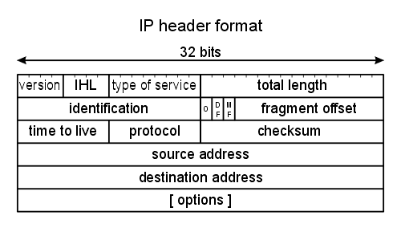
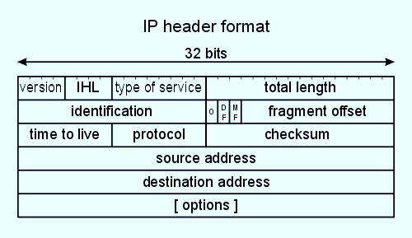





Possible Attacks on the IP Layer
DATAGRAM
Eve
Mobile network
Global ISP
Home network
Regional ISP
Alice
Host
Bob
Host
Institutional network

Slide 157
What network-layer security services?
Mobile network
Three scenarios
Router to Router
Router to Host
Host to Router
Global ISP
Home network
Regional ISP
Security services
Confidentiality
Data integrity
Authentication
Against replay attacks
Institutional network
"blanket coverage"
Notes:
“blanket coverage” 全保

Slide 158
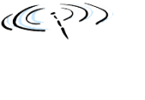


An institute connected by Internet
laptop
w/ IPsec
Unsecure!
public
Internet
salesperson
in hotel
Secure!
Secure!
router w/
IPv4 and IPsec
router w/
IPv4 and IPsec
IP
header
payload
IP
header
payload
branch office
headquarters

Slide 159
Motivation for VPNs
institutions often want private networks for security.
    costly: separate routers, links, DNS infrastructure.
Virtual private networks (VPN): institution's inter-office traffic is sent over public Internet instead
  encrypted before entering public Internet
  logically separate from other traffic

Slide 160
Basic idea of VPN
public
Internet
laptop
w/ IPsec
IP
header
IPsec
header
Secure
payload
salesperson
in hotel
IP
header
IPsec
header
Secure
payload
IP
header
IPsec
header
Secure
payload
router w/
IPv4 and IPsec
router w/
IPv4 and IPsec
Secure!
IP
header
payload
IP
header
payload
branch office
headquarters

Slide 161
IPsec services
IPSec security services
  Data integrity
  Origin authentication
  Confidentiality
  Replay attack prevention
two protocols providing different service models:
  AH
  ESP

Slide 162
Two IPsec protocols
Authentication Header (AH) protocol
  provides source authentication & data integrity but not confidentiality
Encapsulation Security Protocol (ESP)
  provides source authentication, data integrity, and confidentiality
  more widely used than AH

Slide 163
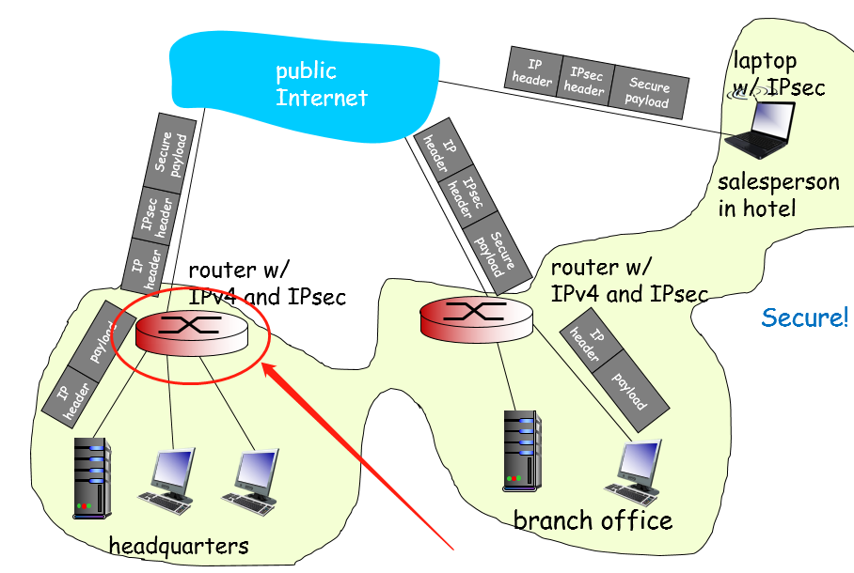
IPSec: What a network entity does?
Basic idea
For each pair of IPSec network entities, a logical connection (i.e., states) is established!
Each connection has two unidirectional security associations (SAs)
A SA on a network entity is simply a set of states!

Slide 164
Security associations (SAs)
before sending data, "security association (SA)" established from sending to receiving entity
  SAs are simplex: for only one direction
Sending, receiving entities maintain state information about SA
  recall: TCP endpoints also maintain state info
  IP is connectionless; IPsec is connection-oriented!

Slide 165
Example SA from R1 to R2
headquarters
Internet
branch office
200.168.1.100
193.68.2.23
R1
security association
R2
172.16.1/24
172.16.2/24
R1 stores for SA (from R1 to R2):
32-bit SA identifier: Security Parameter Index (SPI)
origin SA interface (200.168.1.100)
destination SA interface (193.68.2.23)
type of encryption used (e.g., 3DES with CBC)
encryption key
type of integrity check used (e.g., HMAC with MD5)
authentication key

Slide 166
Concept: Security Assoc. Database (SAD)
endpoint holds SA state in security association database (SAD), where it can locate them during processing.
when sending IPsec datagram, R1 accesses SAD to determine how to process datagram.
when IPsec datagram arrives to R2, R2 examines SPI in IPsec datagram, indexes SAD with SPI, and processes datagram accordingly.

Slide 167
IPsec datagram
focus for now on tunnel mode with ESP
"enchilada" authenticated
encrypted
new IP
header
ESP
hdr
original
IP hdr
Original IP
datagram payload
ESP
trl
ESP
auth
SPI
Seq
#
padding
pad
length
next
header

Slide 168
What happens?
headquarters
Internet
branch office
200.168.1.100
193.68.2.23
R1
security association
R2
172.16.1/24
172.16.2/24
"enchilada" authenticated
encrypted
new IP
header
ESP
hdr
original
IP hdr
Original IP
datagram payload
ESP
trl
ESP
auth
SPI
Seq
#
padding
pad
length
next
header
Notes:
New IP header 不是原有datagram的IP header. 是SA的两个端点。

Slide 169
R1: convert original dgram to IPsec dgram
appends to back of original datagram (which includes original header fields!) an "ESP trailer" field.
encrypts result using algorithm & key specified by SA.
appends to front of this encrypted quantity the "ESP header, creating "enchilada".
creates authentication MAC over the whole enchilada, using algorithm and key specified in SA;
appends MAC to back of enchilada, forming payload;
creates brand new IP header (the two ends of SA), with all the classic IPv4 header fields, which it appends before payload

Slide 170
Inside the enchilada:
"enchilada" authenticated
encrypted
new IP
header
ESP
hdr
original
IP hdr
Original IP
datagram payload
ESP
trl
ESP
auth
SPI
Seq
#
padding
pad
length
next
header
ESP trailer: Padding for block ciphers
ESP header:
  SPI, so receiving entity knows what to do
  Sequence number, to thwart replay attacks
MAC in ESP auth field is created with shared secret key
Notes:
Enchilada：墨西哥卷

Slide 171
IPsec sequence numbers: Details
for new SA, sender initializes seq. # to 0
each time datagram is sent on SA:
  sender increments seq # counter
  places value in seq # field
goal:
  prevent attacker from sniffing and replaying a packet
  receipt of duplicate, authenticated IP packets may disrupt service
method:
  destination checks for duplicates
  doesn't keep track of all received packets; instead uses a window
Notes:
SSL against replay: nonces!
Ipsec: seq #.

Slide 172
A question remains
headquarters
Internet
branch office
200.168.1.100
193.68.2.23
R1
security association
R2
172.16.1/24
172.16.2/24
When R2 receives a datagram from 172.16.1.8, how does it know how to handle it (as normal or IPSec)?
Check security policy database (SPD)

Slide 173
Security Policy Database (SPD)
policy: For a given datagram, sending entity needs to know if it should use IPsec
needs also to know which SA to use
  may use: source and destination IP address; protocol number
info in SPD indicates "what" to do with arriving datagram
info in SAD indicates "how" to do it

Slide 174
Security Analysis: Trudy attacks
Suppose Trudy sits somewhere between R1 and R2. She doesn't know the keys.
will Trudy be able to see original contents of datagram? How about source, dest IP address, transport protocol, application port?
change data bits without detection?
masquerade as R1 using R1's IP address?
replay a datagram?

Slide 175
Manual configuration of SAs impractical!
previous examples: manual establishment of IPsec SAs in IPsec endpoints:
    Example SA
      SPI: 12345
      Source IP: 200.168.1.100
      Dest IP: 193.68.2.23
      Protocol: ESP
      Encryption algorithm: 3DES-cbc
      HMAC algorithm: MD5
      Encryption key: 0x7aeaca…
      HMAC key:0xc0291f…
manual keying is impractical for VPN with 100s of endpoints
instead use IPsec IKE (Internet Key Exchange)

Slide 176
IKE: PSK and PKI
authentication (prove who you are) with either
  pre-shared secret (PSK) or
  with PKI (pubic/private keys and certificates).
PSK: both sides start with secret
  run IKE to authenticate each other and to generate IPsec SAs (one in each direction), including encryption, authentication keys
PKI: both sides start with public/private key pair, certificate
  run IKE to authenticate each other, obtain IPsec SAs (one in each direction).
  similar with handshake in SSL.

Slide 177
IKE phases
IKE has two phases
  phase 1: establish bi-directional IKE SA
    note: IKE SA different from IPsec SA
    aka ISAKMP security association
  phase 2: ISAKMP is used to securely negotiate IPsec pair of SAs
phase 1 has two modes: aggressive mode and main mode
  aggressive mode uses fewer messages
  main mode provides identity protection and is more flexible

Slide 178
Chapter 8 roadmap
8.1 What is network security?
8.2 Principles of cryptography
8.3 Message integrity, authentication
8.4 Securing e-mail
8.5 Securing TCP connections: SSL
8.6 Network layer security: IPsec & VPN
8.7 Securing wireless LANs
8.8 Operational security: firewalls and IDS

Slide 179
Security is very important in WLAN!
Radio signals (carrying data frames) go everywhere and can be easily intercepted by potentially bad guys.

Slide 180



Possible Attacks on WLANs
frames
Radio links
Bob
Mobile Host
Alice
Access Point
Eve

Slide 181
Let’s start with a poor design for WLAN confidentiality

Slide 182
WEP design goals
Key 1101
Alice
Key 1101
Access Point
Bob
Key 1101
symmetric key cryptography
  confidentiality
  end-host authentication
  data integrity
The AP and hosts share a secret key (via a out-of-band channel)

Slide 183

WEP authentication
authentication request
nonce (128 bytes)
nonce encrypted with shared key
success if decrypted value equals nonce
Notes:
not all APs do it, even if WEP is being used
AP indicates if authentication is necessary in beacon frame
done before association

Slide 184
Symmetric stream ciphers
40 bits
24 bits
Key+IV_{packet}
keystream
generator
keystream_{packet}
Always the same
A new IV for a frame
WEP uses RC4
WEP approach:
initialize keystream with shared key (always the same) + new IV for each frame

Slide 185
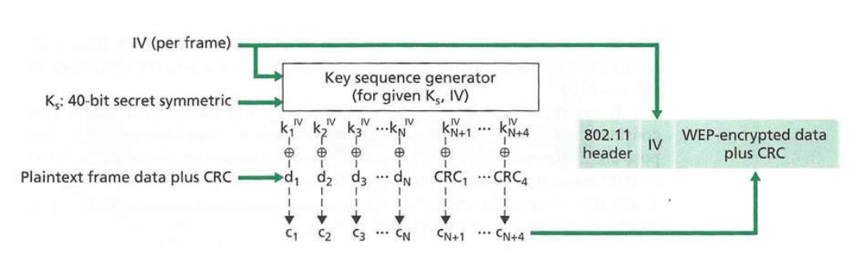
WEP encryption
24 bits
combine each byte of keystream with byte of plaintext to get ciphertext:
m(i) = ith unit of message
ks(i) = ith unit of keystream
c(i) = ith unit of ciphertext
Encrypt: c(i) = ks(i) ⊕ m(i) (⊕ = exclusive or)
Decrypt: m(i) = ks(i) ⊕ c(i)
IV sent in clear texts

Slide 186
Security hole
security hole:
24-bit IV, one IV per frame, -> IV's eventually reused
IV transmitted in plaintext -> IV reuse detected
There are only 2²⁴ different stream cipher keys in total.
(because 40-bit key does not change)
A stream cipher key is reused after only 12000 frames with very high probability.
(average a few seconds in 11Mbps WLAN)

Slide 187
Breaking 802.11 WEP encryption
Key 1101
Alice
Key 1101
causes Alice to encrypt known plaintext (e.g., FTP file request)
Access Point
Trudy (does not have key 1101)
Trudy causes Alice to encrypt known plaintext d₁ d₂ d₃ d₄ …
Trudy sees: c_{i} = d_{i} XOR k_{i}^{IV}
Trudy knows c_{i}, d_{i}, so can compute k_{i}^{IV}
Trudy knows encrypting key sequence k₁^{IV} k₂^{IV} k₃^{IV} …
Next time IV is used, Trudy can decrypt! (although key is not cracked)

Slide 188
802.11i: improved security
numerous (stronger) forms of encryption possible, alters keys for each successive packet
Personal mode
  Shared key is used
  Longer IV (48 bits) and master key (128 bits)
Enterprise mode
  provides key distribution
  uses authentication server separate from access point, leading to easier management

Slide 189
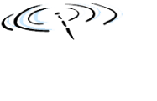
802.11i Enterprise Mode: four phases of operation
AP: access point
STA:
client station
AS:
Authentication
server
wired
network
1 Discovery of
security capabilities
2
STA and AS mutually authenticate, together
generate Master Key (MK). AP serves as "pass through"
With public key,
Similar to SSL
3
STA derives
Pairwise Master
Key (PMK)
AS derives
same PMK,
sends to AP
3
4
STA, AP use PMK to derive
Temporal Key (TK) used for message
encryption, integrity

Slide 190
Chapter 8 roadmap
8.1 What is network security?
8.2 Principles of cryptography
8.3 Message integrity, authentication
8.4 Securing e-mail
8.5 Securing TCP connections: SSL
8.6 Network layer security: IPsec & VPN
8.7 Securing wireless LANs
8.8 Operational security: firewalls and IDS

Slide 191


Firewalls
A firewall isolates organization's internal net from larger Internet, allowing some packets to pass, blocking others
administered
network
public
Internet
trusted "good guys"
untrusted "bad guys"
firewall

Slide 192
Firewalls: why
prevent denial of service attacks:
  SYN flooding: attacker establishes many bogus TCP connections, no resources left for "real" connections
prevent illegal modification/access of internal data
  e.g., attacker replaces CIA's homepage with something else
allow only authorized access to inside network
  set of authenticated users/hosts
three types of firewalls:
  stateless packet filters
  stateful packet filters
  application gateways

Slide 193
Stateless packet filtering
Should arriving packet be allowed in? Departing packet let out?
internal network connected to Internet via router firewall
router filters packet-by-packet, decision to forward/drop packet based on:
  source IP address, destination IP address
  TCP/UDP source and destination port numbers
  ICMP message type
  TCP SYN and ACK bits

Slide 194
Stateless packet filtering: example
example 1: block incoming and outgoing datagrams with IP protocol field = 17 and with either source or dest port = 23
  result: all incoming, outgoing UDP flows and telnet connections are blocked
example 2: block inbound TCP segments with ACK=0.
  result: prevents external clients from making TCP connections with internal clients, but allows internal clients to connect to outside.

Slide 195
Stateless packet filtering: examples
Policy | Firewall Setting
No outside Web access. | Drop all outgoing packets to any IP address, port 80
No incoming TCP connections, except those for institution's public Web server only. | Drop all incoming TCP SYN packets to any IP except 130.207.244.203, port 80
Prevent Web-radios from eating up the available bandwidth. | Drop all incoming UDP packets - except DNS and router broadcasts.
Prevent your network from being used for a smurf DoS attack. | Drop all ICMP packets going to a "broadcast" address (e.g. 130.207.255.255).
Prevent your network from being tracerouted | Drop all outgoing ICMP TTL expired traffic

Slide 196
Access Control Lists
ACL: table of rules, applied top to bottom to incoming packets: (action, condition) pairs: looks like OpenFlow forwarding (Ch. 4)!
action | source address | dest address | protocol | source port | dest port | flag bit
allow | 222.22/16 | outside of 222.22/16 | TCP | > 1023 | 80 | any
allow | outside of 222.22/16 | 222.22/16 | TCP | 80 | > 1023 | ACK
allow | 222.22/16 | outside of 222.22/16 | UDP | > 1023 | 53 | ---
allow | outside of 222.22/16 | 222.22/16 | UDP | 53 | > 1023 | ----
deny | all | all | all | all | all | all

Slide 197
Stateful packet filtering
stateless packet filter: heavy handed tool
  admits packets that "make no sense," e.g., dest port = 80, ACK bit set, even though no TCP connection established:
action | source address | dest address | protocol | source port | dest port | flag bit
allow | outside of 222.22/16 | 222.22/16 | TCP | 80 | > 1023 | ACK
stateful packet filter: track status of every TCP connection
  track connection setup (SYN), teardown (FIN): determine whether incoming, outgoing packets "makes sense"
  timeout inactive connections at firewall: no longer admit packets

Slide 198
Stateful packet filtering
ACL augmented to indicate need to check connection state table before admitting packet
action | source address | dest address | proto | source port | dest port | flag bit | check conxion
allow | 222.22/16 | outside of 222.22/16 | TCP | > 1023 | 80 | any
allow | outside of 222.22/16 | 222.22/16 | TCP | 80 | > 1023 | ACK | x
allow | 222.22/16 | outside of 222.22/16 | UDP | > 1023 | 53 | ---
allow | outside of 222.22/16 | 222.22/16 | UDP | 53 | > 1023 | ---- | x
deny | all | all | all | all | all | all

Slide 199
Application gateways
filter packets on application data as well as on IP/TCP/UDP fields.
example: allow select internal users to telnet outside
host-to-gateway
telnet session
application
gateway
router and filter
gateway-to-remote
host telnet session
1. require all telnet users to telnet through gateway.
2. for authorized users, gateway sets up telnet connection to dest host. Gateway relays data between 2 connections
3. router filter blocks all telnet connections not originating from gateway.

Slide 200
Limitations of firewalls, gateways
IP spoofing: router can't know if data "really" comes from claimed source
if multiple app's. need special treatment, each has own app. gateway
client software must know how to contact gateway.
  e.g., must set IP address of proxy in Web browser
filters often use all or nothing policy for UDP
tradeoff: degree of communication with outside world, level of security
many highly protected sites still suffer from attacks

Slide 201
Intrusion detection systems
packet filtering:
  operates on TCP/IP headers only
  no correlation check among sessions
IDS: intrusion detection system
  deep packet inspection: look at packet contents (e.g., check character strings in packet against database of known virus, attack strings)
  examine correlation among multiple packets
    port scanning
    network mapping
    DoS attack

Slide 202
Intrusion detection systems
multiple IDSs: different types of checking at different locations
firewall
internal
network
Internet
IDS
sensors
Web
server
DNS
server
FTP
server
demilitarized
zone

Slide 203
Network Security (summary)
basic techniques
  cryptography (symmetric and public)
  message integrity
  end-point authentication
used in many different security scenarios
  secure email
  secure transport (SSL)
  IP sec
  802.11
operational security: firewalls and IDS

