Slide 1
Lab01:Introduction to Mininet and Performance Measurement
计算机网络实践课
Notes:
此页可以删除

Slide 2
Outline
Mininet介绍
Mininet基本操作
基于Python Sockets的编程Iperfer实现
基于mininet的Performance Measurement

Slide 3
Outline
Mininet介绍
Mininet基本操作
基于Python Sockets的编程Iperfer实现
基于mininet的Performance Measurement

Slide 4
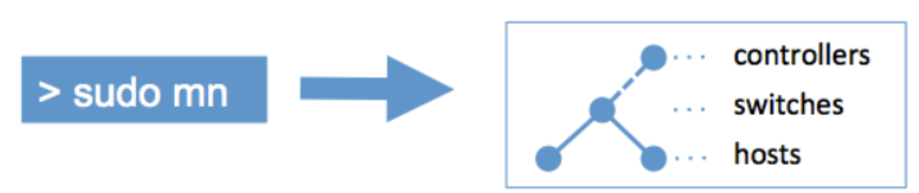
Mininet介绍
Mininet is a network emulator, or perhaps more precisely a network emulation orchestration system.
轻量级的网络仿真（network emulation）平台，主要用于在单台计算机上创建、测试和研究软件定义网络（SDN）。可以创建一个包含主机，交换机，控制器和链路的虚拟网络。
Mininet creates a realistic virtual network, running real kernel, switch and application code, on a single machine (VM, cloud or native), in seconds, with a single command:
Mininet: http://mininet.org
Mininet on github: https://github.com/mininet

Slide 5
Mininet介绍
A Mininet host behaves just like a real machine; you can run arbitrary programs (including anything that is installed on the underlying Linux system.) .
The programs you run can send packets through what seems like a real Ethernet interface, with a given link speed and delay.
Packets get processed by what looks like a real Ethernet switch, router, or middlebox, with a given amount of queueing.
When two programs, like an iperf client and server, communicate through Mininet, the measured performance should match that of two (slower) native machines.

Slide 6
Mininet基本特性
Mininet作为一个轻量级软定义网络研发和测试平台，其主要特性包括：
1. 支持OpenFlow、OpenvSwitch等软件定义网络部件；
2. 支持复杂拓扑、自定义拓扑；
3. 提供python API；
4. 很好的硬件移植性 (Linux兼容), 结果有更好的说服力；
5. 高扩展性，支持超过4096台主机的网络结构。

Slide 7
Outline
Mininet介绍
Mininet基本操作
基于Python Sockets的编程Iperfer实现
基于mininet的Performance Measurement

Slide 8
Mininet环境安装
1. 准备 linux 环境
  - 交大云平台(https://home.jcloud.sjtu.edu.cn/)提供了已经配置好的mininet镜像，包括后续作业用到的其他包，使用该环境可以避免后续的环境配置。
  - 主要内容：
    - 如何创建云主机？
    - 如何登陆云主机？ssh方式、控制台方式
  - 参考链接：canvas->页面->General Instructions for Mininet-based Program...
2. 上传作业
  - 云平台的主机只有合适的环境，还没有作业内容...
  - scp
  - vscode 拖动...

Slide 9
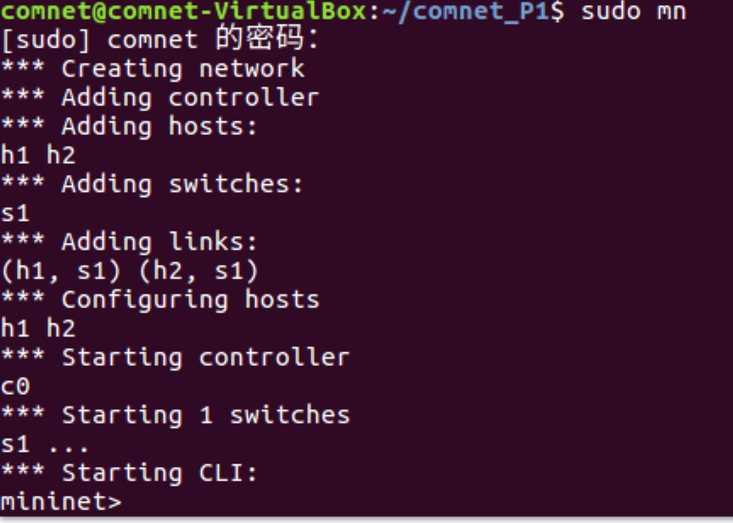
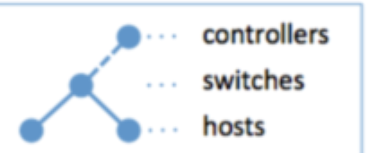
Mininet基本操作
1. Mininet StartUp
sudo mn （--topo=minimal）
exit： 退出
sudo mn -c：清除残留内容
参考： https://mininet.org/walkthrough/

Slide 10
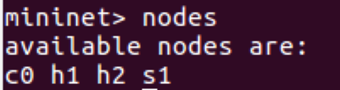
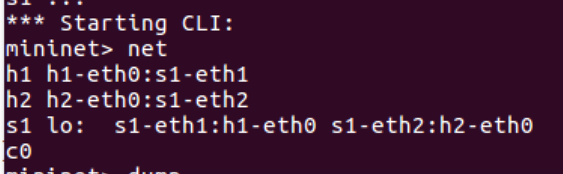
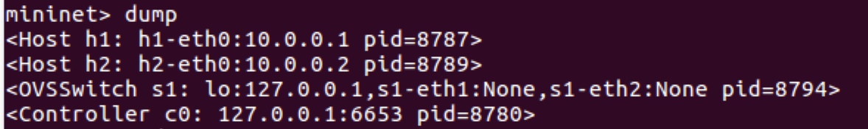
Mininet基本操作
2. Interact with Hosts and Switches
进入CLI 界面，通过命令与mininet进行交互
help 查看全部可使用命令
nodes ：列出所有实体节点
net : 列出链接
dump: 列出节点的详细信息

Slide 11
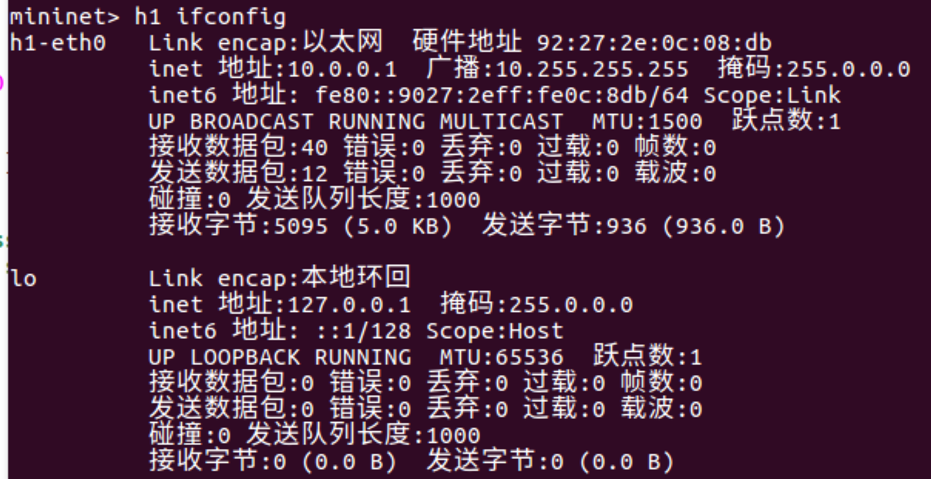
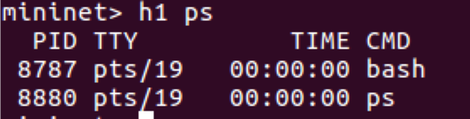
Mininet基本操作
2. Interact with Hosts and Switches
[node] instruction 与linux相似的指令
  node ifconfig -a : 查看指定节点的网络配置
node ps : 查看指定节点的网络进程

Slide 12
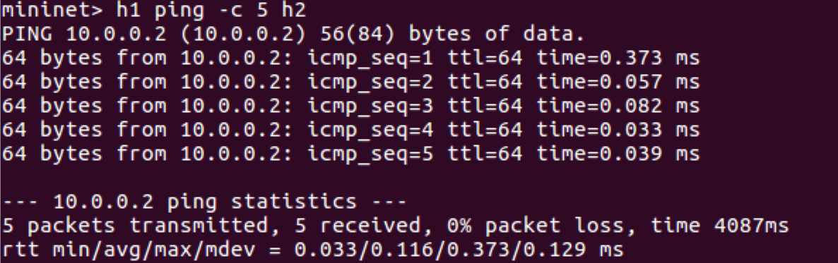
Mininet基本操作
2. Interact with Hosts and Switches
node_1 ping [-c ] node_2 : 测试host之间的连通
pingall ： 全部节点互相ping

Slide 13
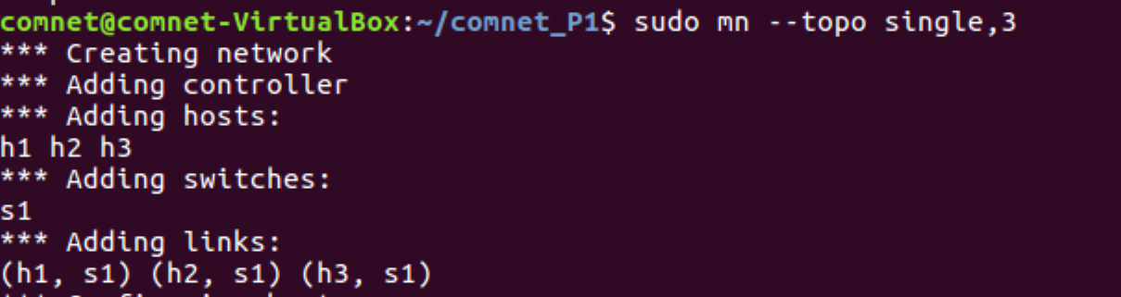
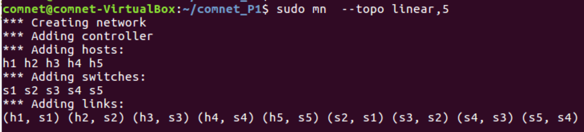
Mininet基本操作
3. 网络拓扑结构修改及自定义
sudo mn --topo : 使用--topo 参数进行修改
例： sudo mn --topo single,3 (三个host)
sudo mn --topo linear, 5

Slide 14
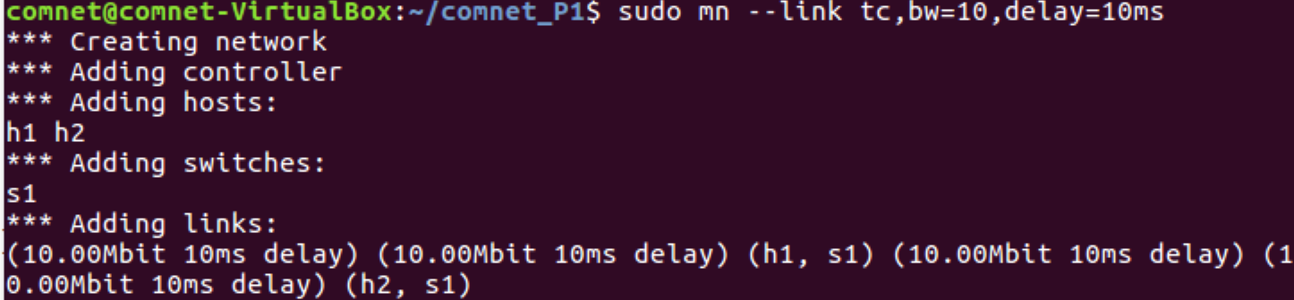
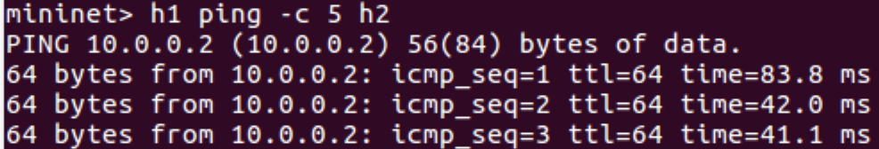
Mininet基本操作
3. 网络拓扑结构修改及自定义
sudo mn --link : 使用--link 参数进行链路上参数修改
例： sudo mn --link tc,bw=10,delay=10ms (带宽为10Mbps, 时延为10ms)
可以看到ping的时延变为40ms

Slide 15
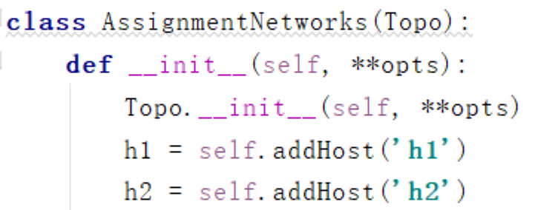


Mininet基本操作
3. 网络拓扑结构修改及自定义
使用python API进行网络结构及参数的自定义
  后续作业给出了网络的拓扑结构，可以通过阅读python代码了解详情

Slide 16
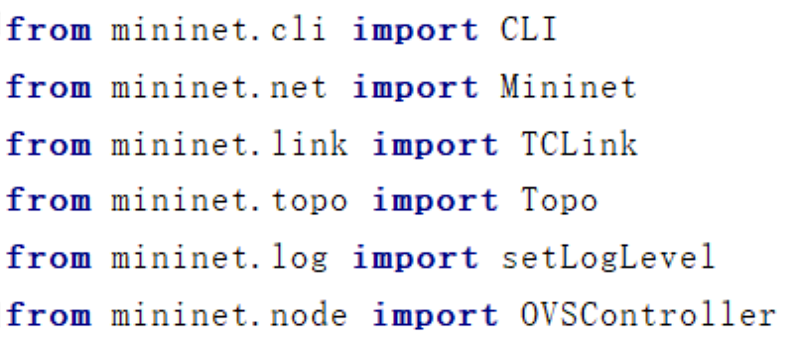
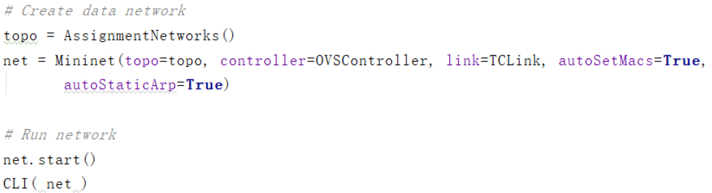
Mininet基本操作
3. 网络拓扑结构修改及自定义
使用python API进行网络结构及参数的自定义

Slide 17
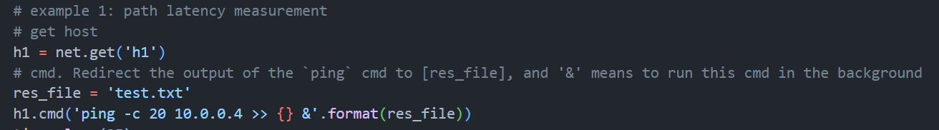
Mininet基本操作
3. 网络拓扑结构修改及自定义
使用python API控制网络中的host

Slide 18
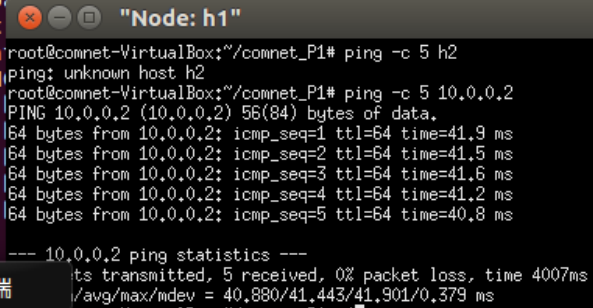
Mininet基本操作
4. 补充
xterm node； 为指定节点开启一个xterm窗口，方便单独对该节点进行指令； - 如果通过ssh连接云平台主机，需要保证安装X11（windows）
  - 如果通过控制台登陆云平台主机，xterm可以直接生效
- 示例：
xterm h1;
ping -c 5 h2;

Slide 19
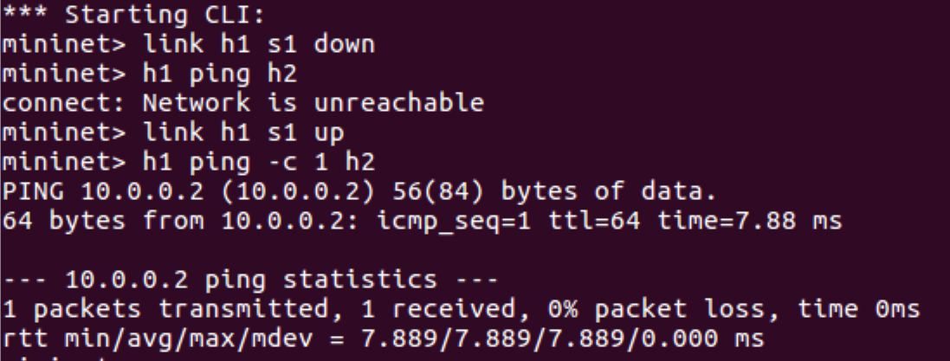
Mininet基本操作
4. 补充
link h1 h2 dowm/up : 手动对链路进行断开和连接，方便测试

Slide 20
Outline
Mininet介绍
Mininet基本操作
基于Python Sockets的编程Iperfer实现
基于mininet的Performance Measurement

Slide 21
P1-实验内容
1. 基于python sockets实现一个Iperfer，作为网络带宽测试工具
2. 利用Iperfer以及ping, 分别对mininet网络中各链路的带宽和时延进行性能测量。

Slide 22
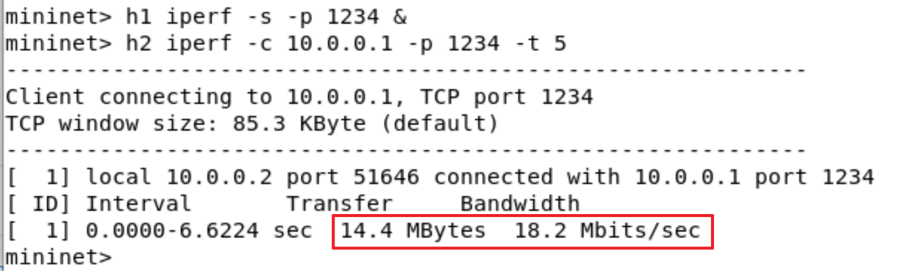
Iperf-1
Iperf is a common tool used to measure network bandwidth
Use iferf:
  Server: iferf -s -p [port]
  Client: iperf -c [server_ip] -p [port] -t [time]
For example (run in Miminet CLI):
  h1 iperf -s -p 1234 >> output.txt &
  h4 iperf -c 10.0.0.1 -p 1234 -t 5
Result:

Slide 23
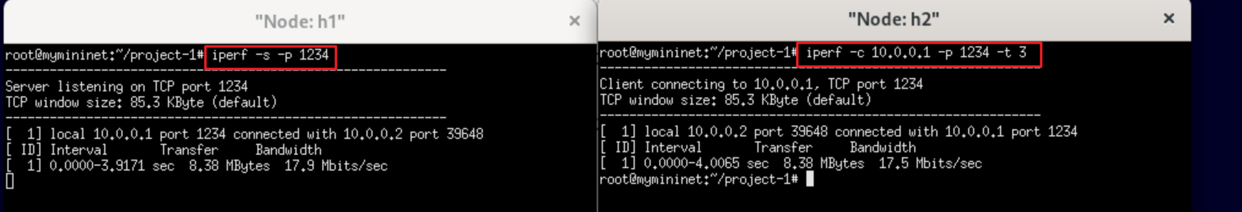
Iperf-2
Use iferf:
  Server: iferf -s -p [port]
  Client: iperf -c [server_ip] -p [port] -t [time]
For example (run after xterm):
  [In h1] iperf -s -p 1234
  [In h2] iperf -c 10.0.0.1 -p 1234 -t 5
Result:

Slide 24
Iperfer
You will write your own version of iperf to measure network bandwidth. Your tool, called Iperfer, will send and receive TCP packets between a pair of hosts using sockets.
实现目标：
Client：send TCP packets to a specific host for a specified time window, track how much data was sent during that time frame
Sever：receive TCP packets and track how much data was received during the lifetime of a connection

Slide 25
Iperfer_Client
Client：
python3 Iperfer.py -c -h <server hostname> -p <server port> -t <time>
Example: python3 Iperfer.py -c -h localhost -p 12345 -t 10
When running as a client, Iperfer must establish a TCP connection with the server and send data as quickly as possible for time seconds. Data should be sent in chunks of 1000 bytes and the data should be all zeros. Keep a running total of the number of bytes sent.

Slide 26
Iperfer_Server
Server：
python3 Iperfer.py -s -p <listen port>
Example: python3 Iperfer.py -s -p 12345
When running as a server, Iperfer must listen for TCP connections from a client and receive data as quickly as possible until the client closes the connection. Data should be read in chunks of 1000 bytes. Keep a running total of the number of bytes received.

Slide 27
Python sockets
对于一个功能齐全的Socket，都要包含以下基本结构，其工作过程包含以下几个基本的步骤：
1、创建Socket；
2、对Socket进行读/写操作；
3、关闭Socket
参考：https://realpython.com/python-sockets/

Slide 28
Python sockets
Client:
创建socket： client_socket = socket.socket(socket.AF_INET, socket.SOCK_STREAM)
client_socket.connect((host, port))
发送数据： client_socket.sendall(b'0' * 1000)
关闭Socket：client_socket.close()

Slide 29
Python sockets
Server:
创建socket： server_socket = socket.socket(socket.AF_INET, socket.SOCK_STREAM)
server_socket.bind(('0.0.0.0', port))
监听并连接： server_socket.listen(1)
conn, addr = server_socket.accept()
读操作： data = conn.recv(1000);
关闭Socket： client_socket.close()

Slide 30
Iperfer
1. coding
基于提供的Iperfer-temp.python 文件, 对client类和server 类的tcp_server和tcp_client函数进行补充.
2. run
python3 Iperfer.py -c -h localhost -p 12345 -t 10
python3 Iperfer.py -s -p 12345

Slide 31
Outline
Mininet介绍
Mininet基本操作
基于Java Sockets的编程Iperfer实现
基于mininet的Performance Measurement

Slide 32
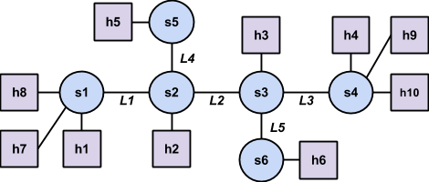
自定义mininet拓扑结构
sudo python3 progAssign1_topo.py
The hosts are assigned IP addresses 10.0.0.1 through 10.0.0.10;

Slide 33
Measurement
Question 1：测量L1-L5的RTT和bandwidth，并记录
1）run ping with 20 packets and store results in latency_L#.txt
2）run Iperfer for 20 seconds and store results in throughput_L#.txt

Slide 34
Measurement
Question 2：测量h1和h4通信的RTT和bandwidth，并记录
1）Put your prediction in your answers.txt file.
2）run ping with 20 packets and store results in latency_Q2.txt
3）run Iperfer for 20 seconds and store results in throughput_Q2.txt

Slide 35
Measurement
Question 3：多路复用，多个hosts同时在s1和s4之间通信，测量两对、三对同时通信时的RTT和bandwidth
1）Put your prediction in your answers.txt file.
2）Put the average RTT and measured throughput for each pair in your answers.txt

Slide 36
Measurement
Question 4：延迟的影响，对（h1，h4）（h5，h6）两对节点，同时运行，测量RTT和bandwidth
1）Put your prediction in your answers.txt file.
2）latency_h1-h4.txt, latency_h5-h6.txt,
throughput_h1-h4.txt, and throughput h5-h6.txt.
Put the average RTT and measured throughput in your answers.txt

Slide 37
Thank you!
Thanks！
Ask the TA when you have questions.

